Slide 1
Digital Printmaking intensive

Slide 2
Photoshop basics
How to cut around an image
Developing compositional skills
How to make an etching using filters
How to make a stamp using filters
How to make a reduction woodcut using filters
Looking at digital printmaking as a “drawing technique”
Looking at digital printmaking as a “printmaking technique”
Make a sequence in the style of a Digital Artist model/s

Slide 3
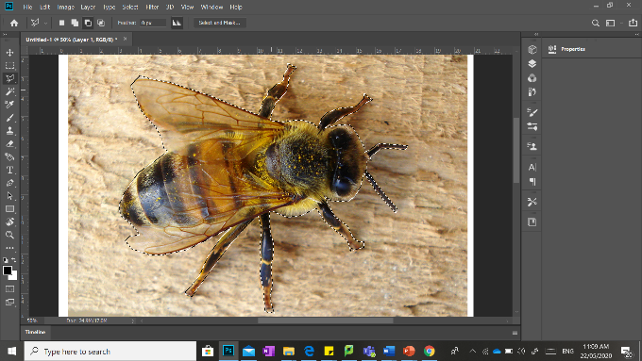

Slide 4
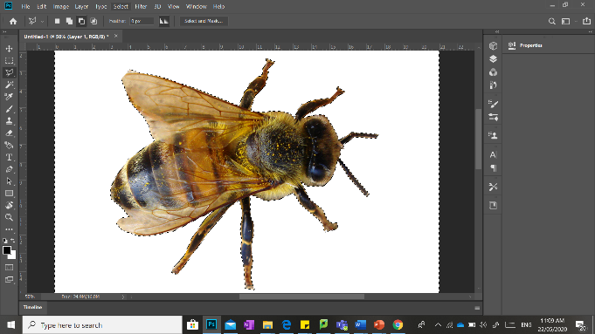

Slide 5
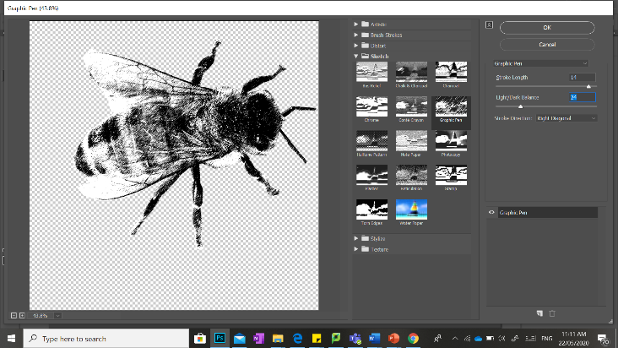

Slide 6
make a woodcut design: Filter, sketch, Stamp
make a multi-colour woodcut design using: filter gallery, artistic, cutout, adjust number of colours
make an image for Screen printing using: Filter gallery, Sketch, halftone pattern

Slide 7
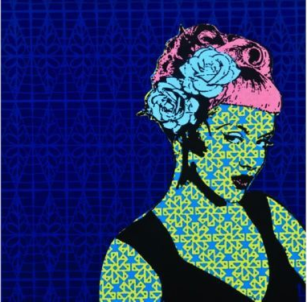
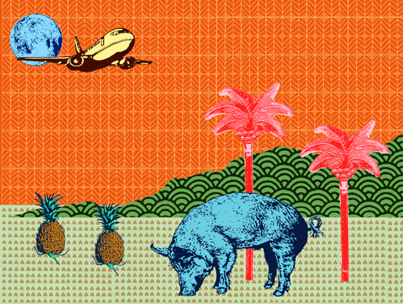
Samuel Tupou

Slide 8
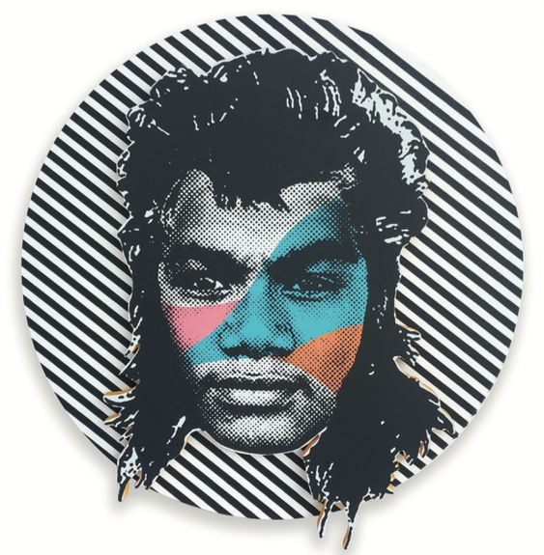
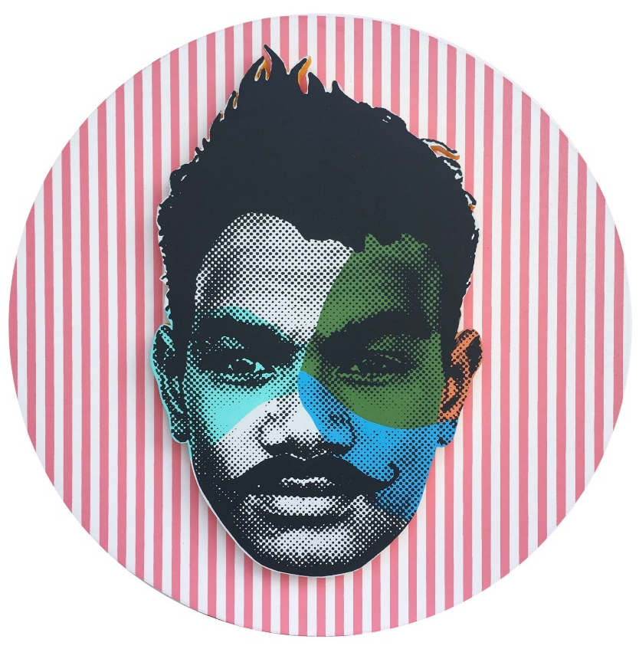

Slide 9
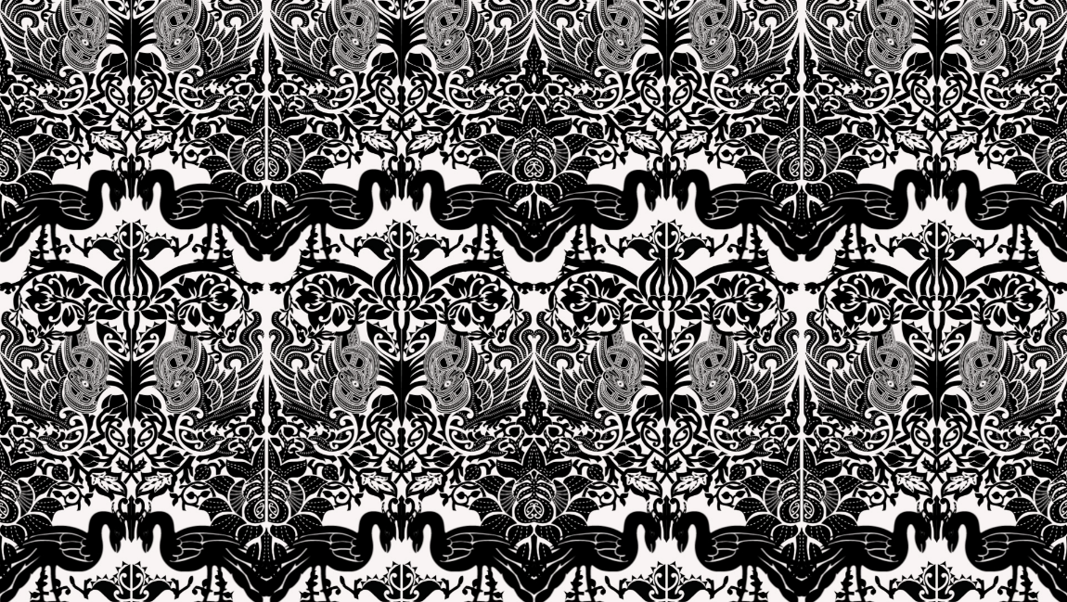
Cecelia Kumeroa

Slide 10
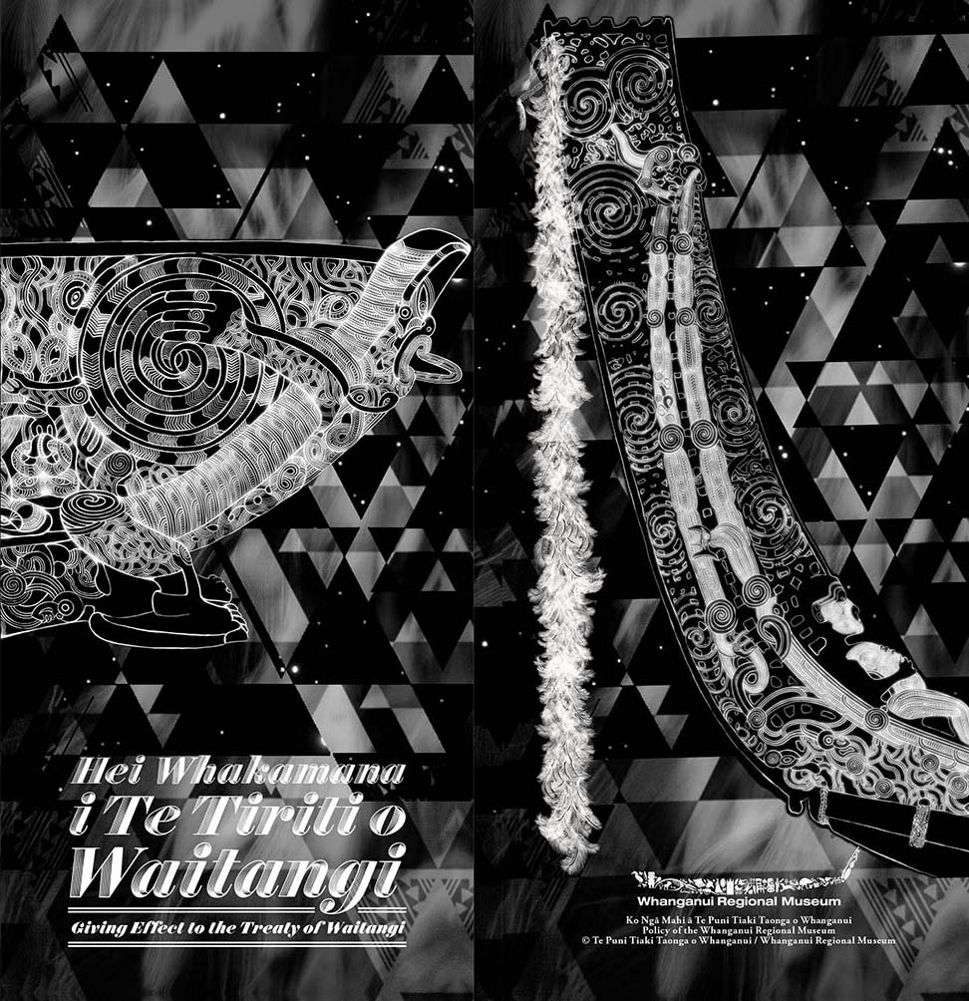

Slide 11
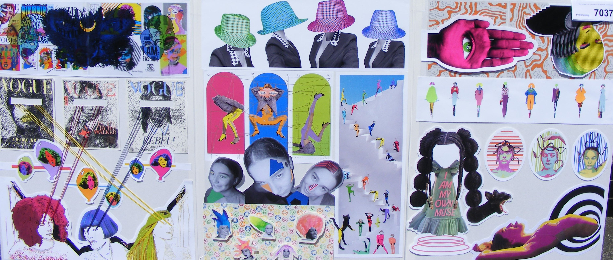
Dani Wright E

Slide 12
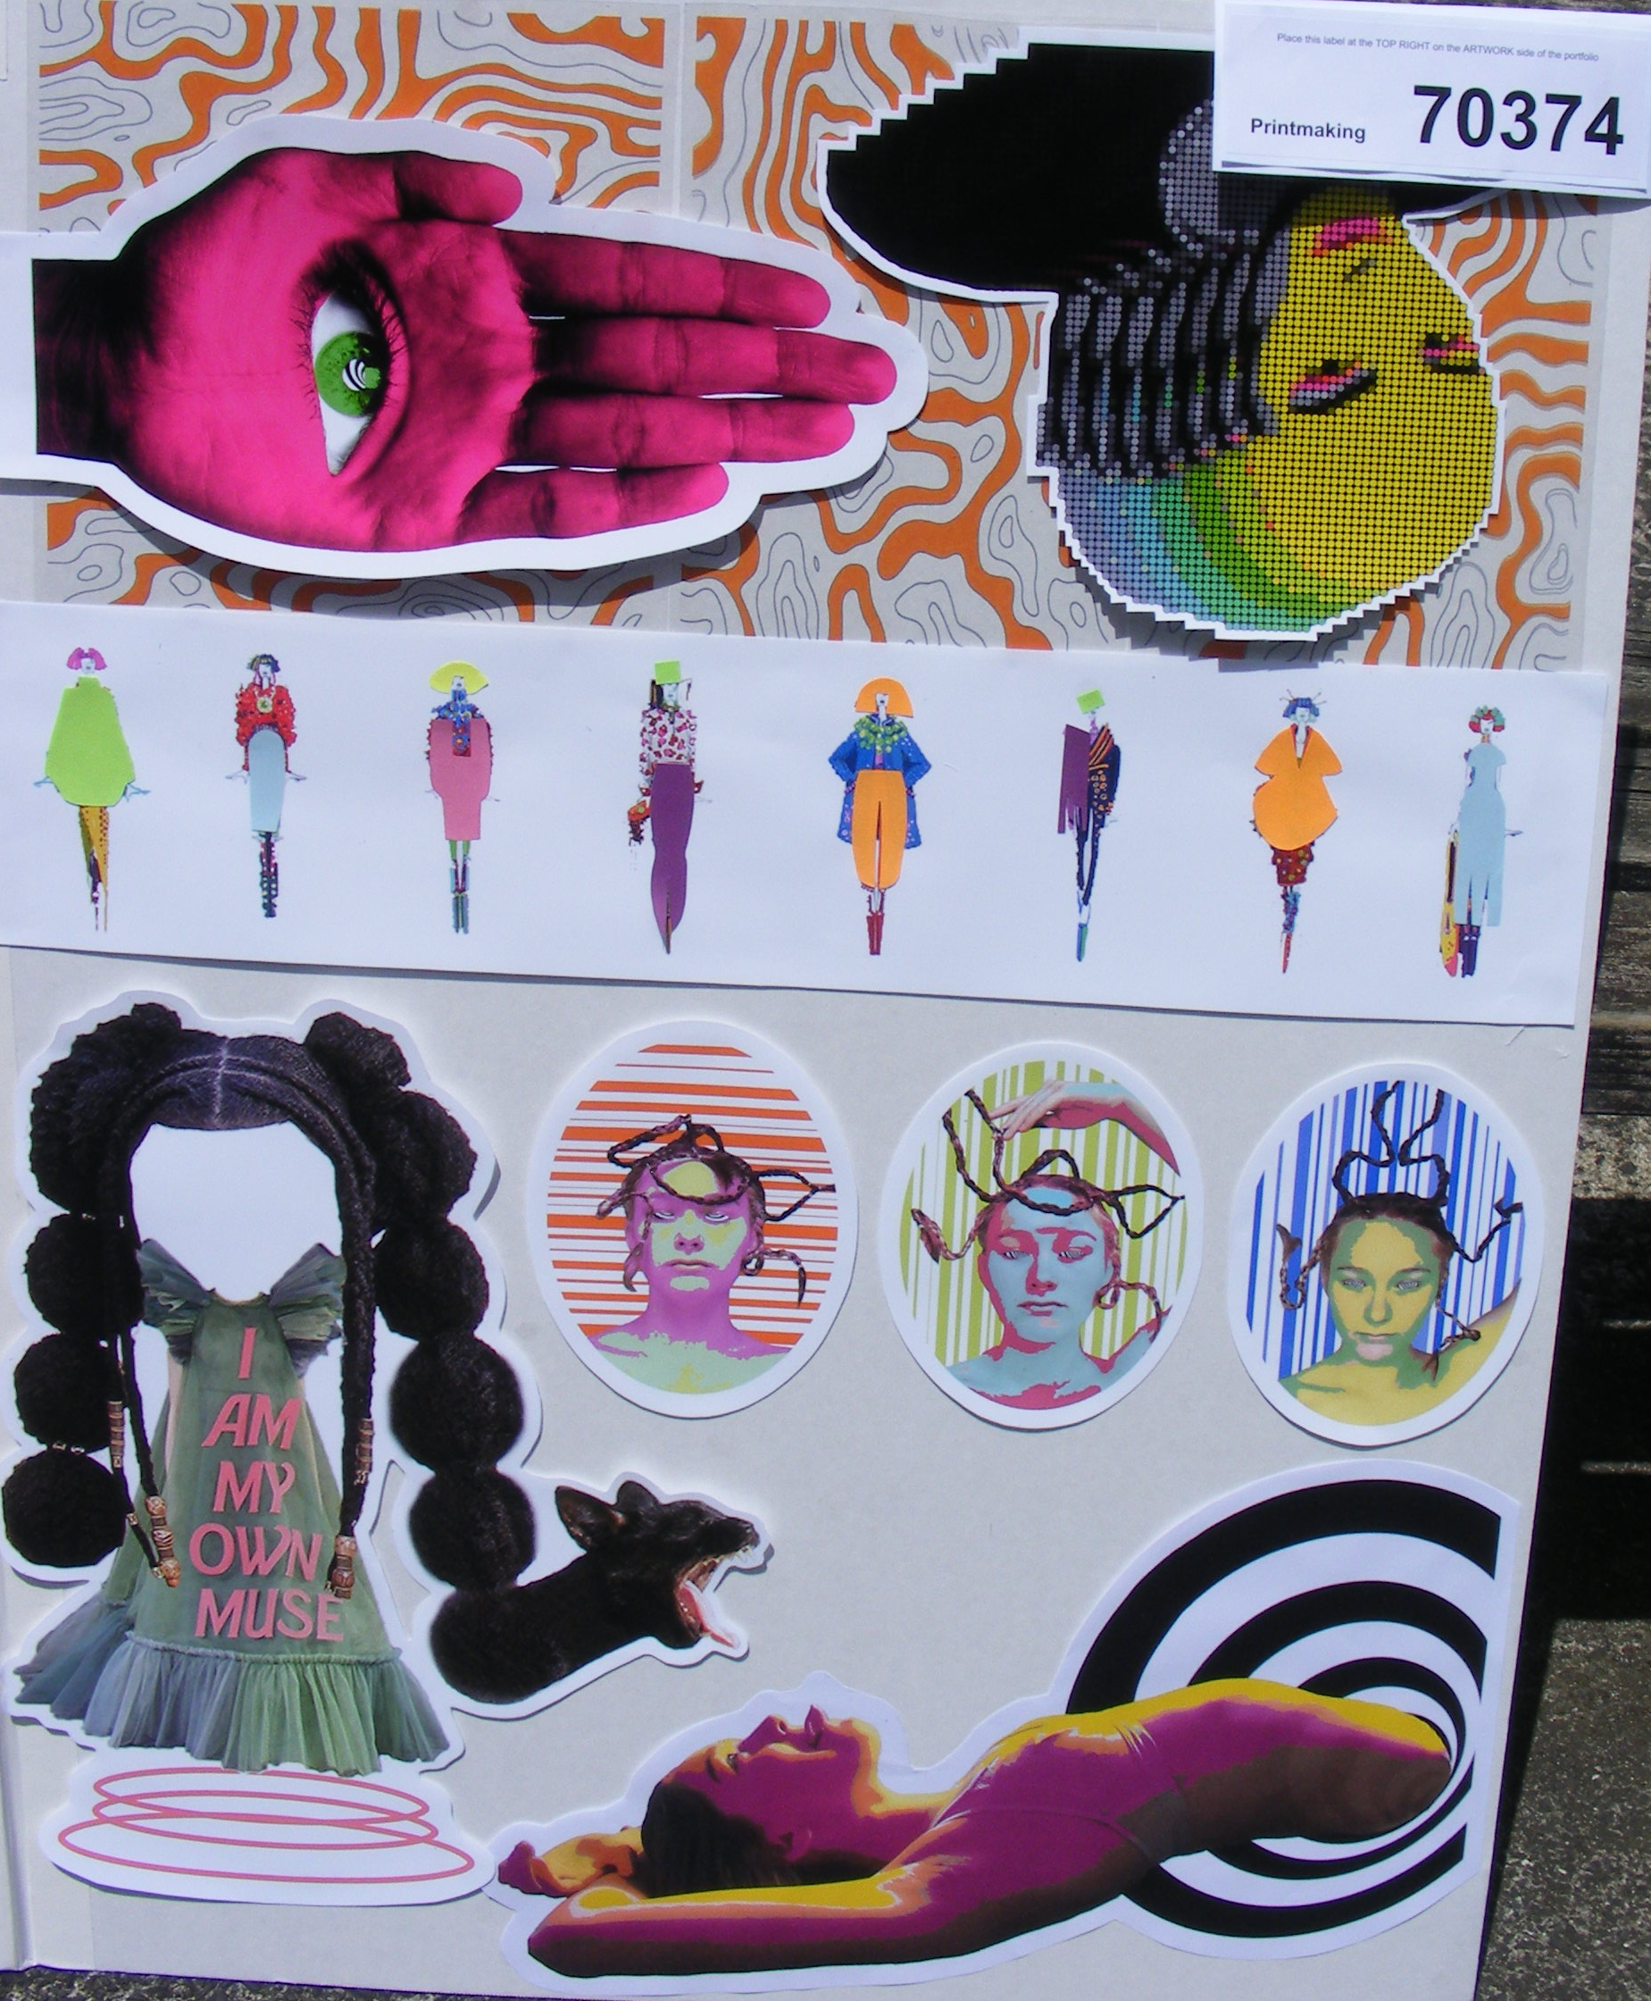

Slide 13
Amber Knight E

Slide 15
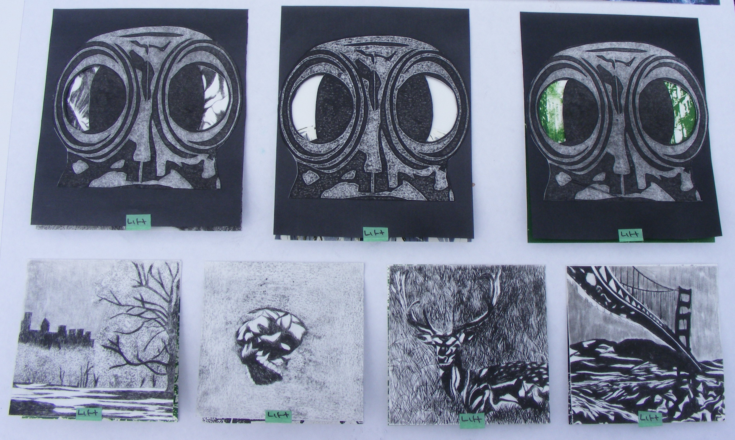

Slide 17
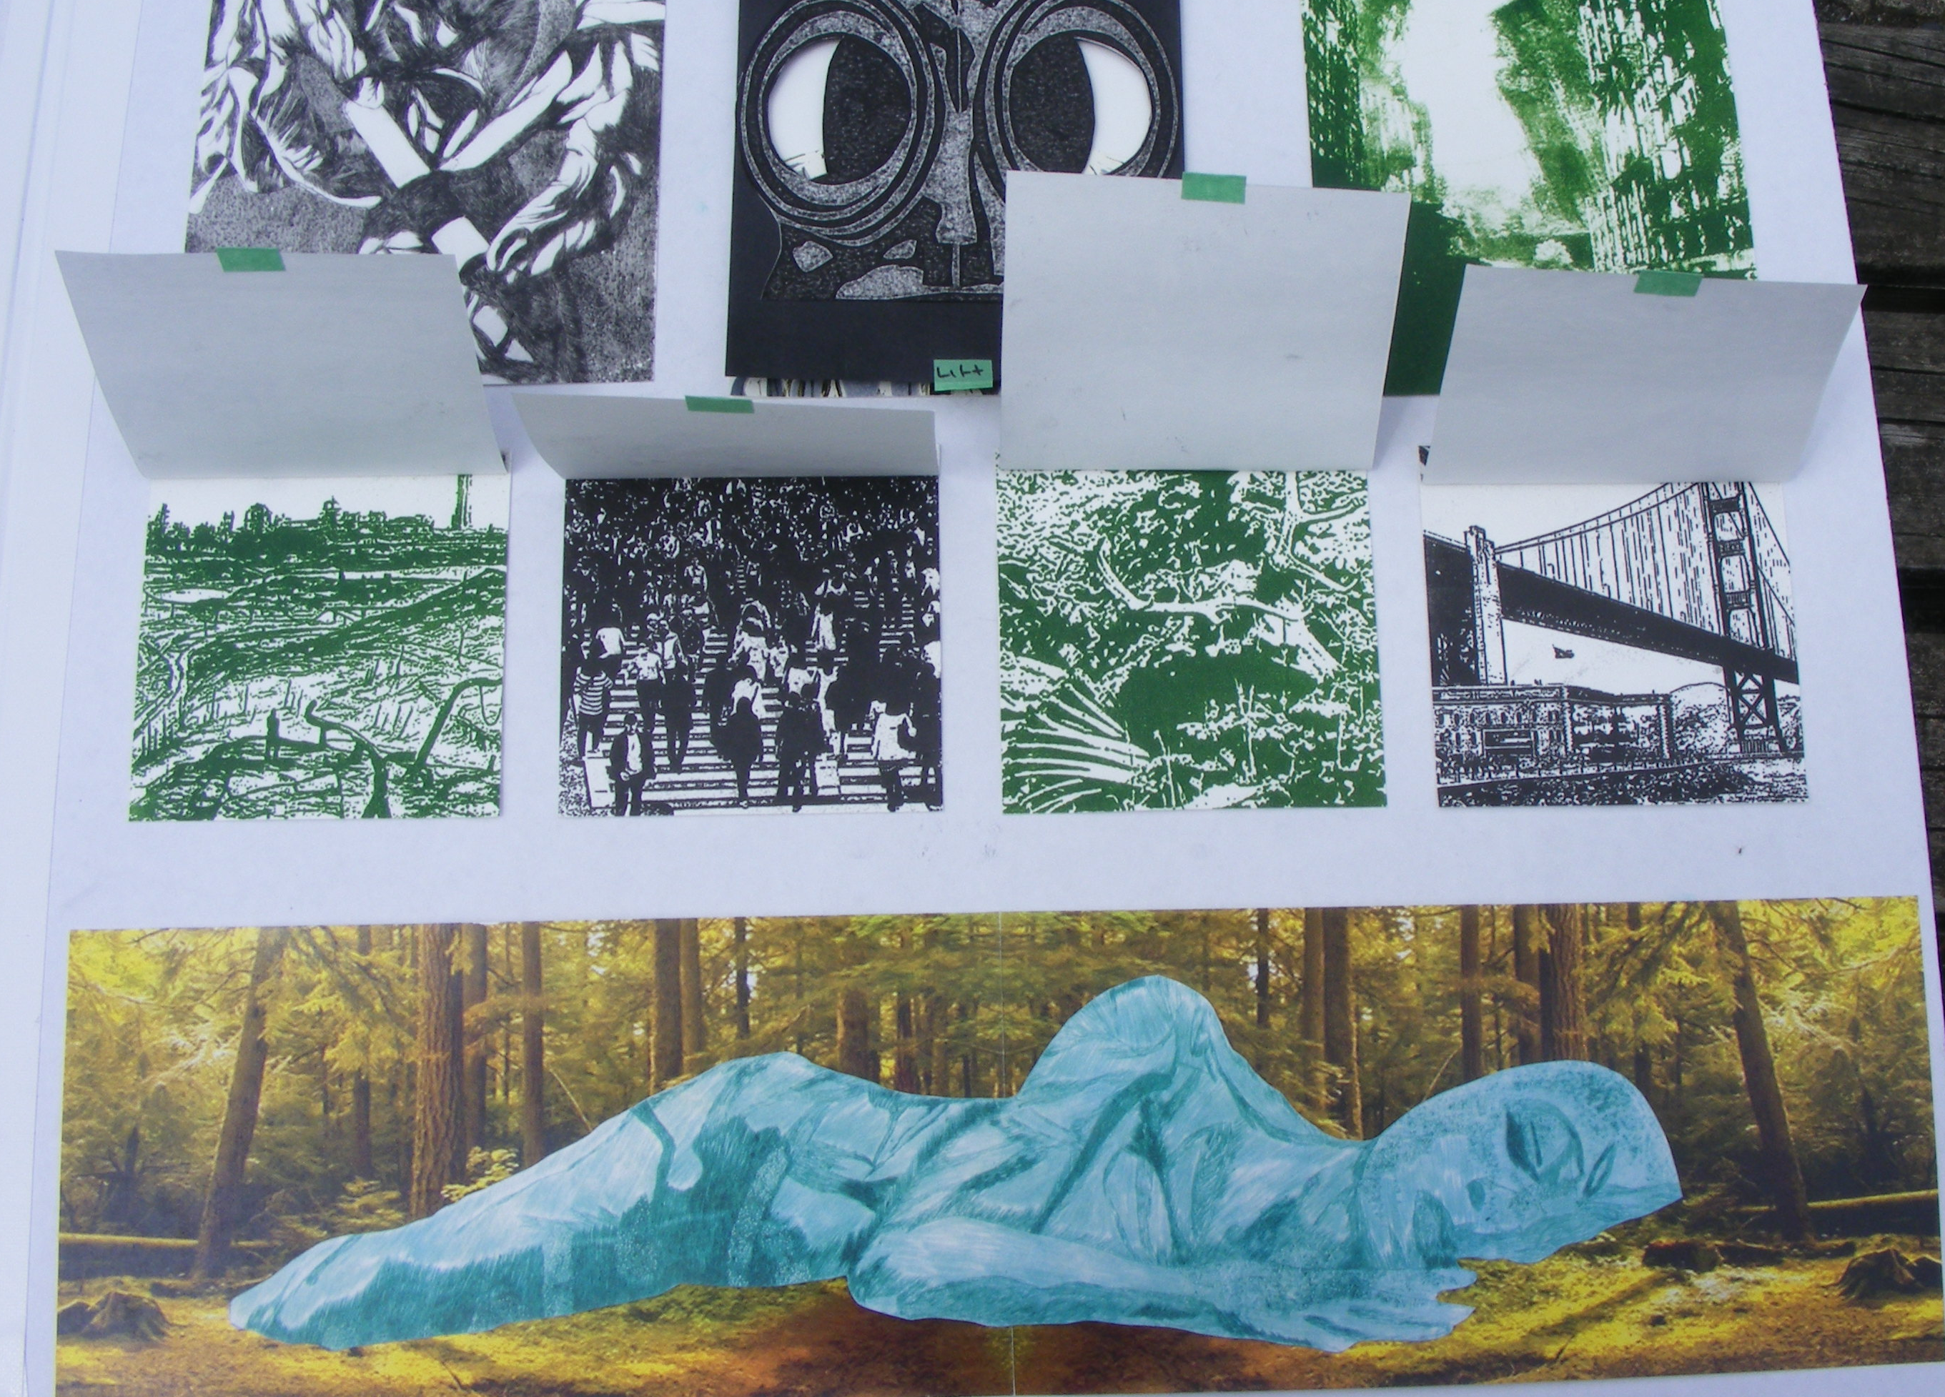

Slide 18
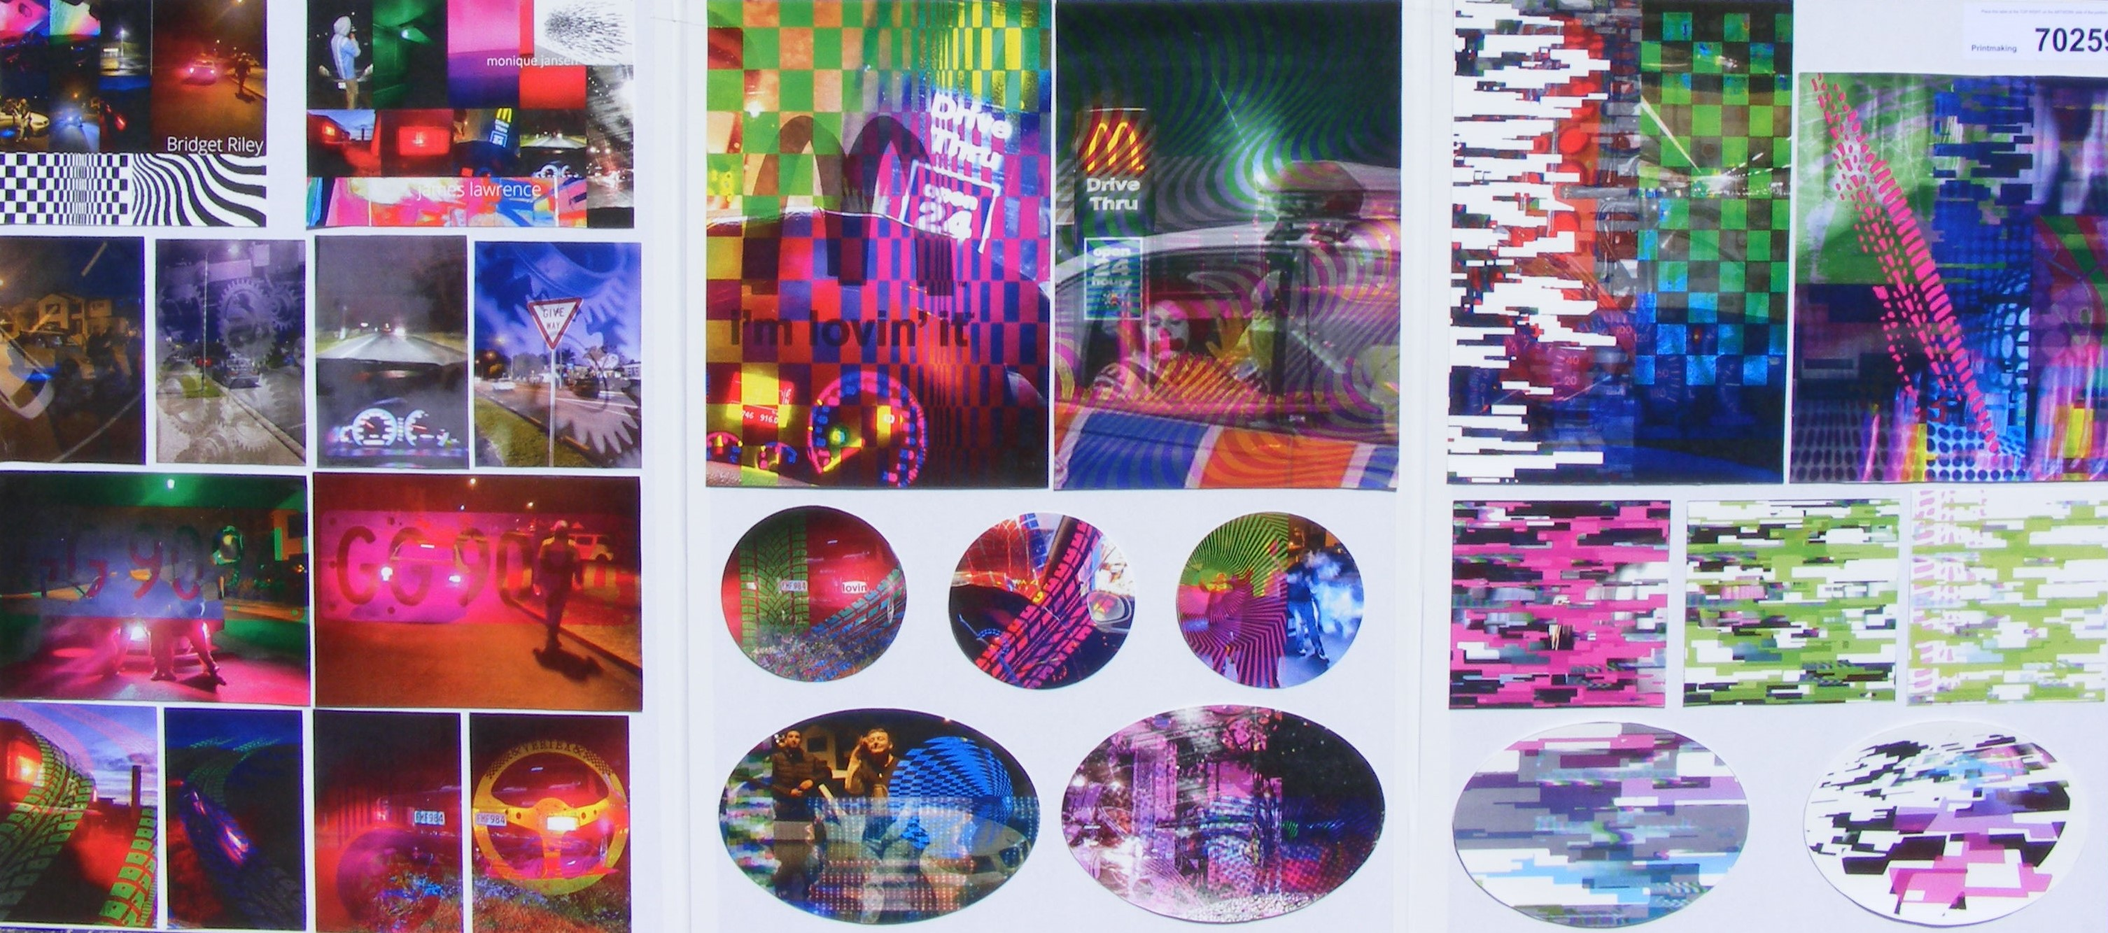
Shamant Kumar M

Slide 19
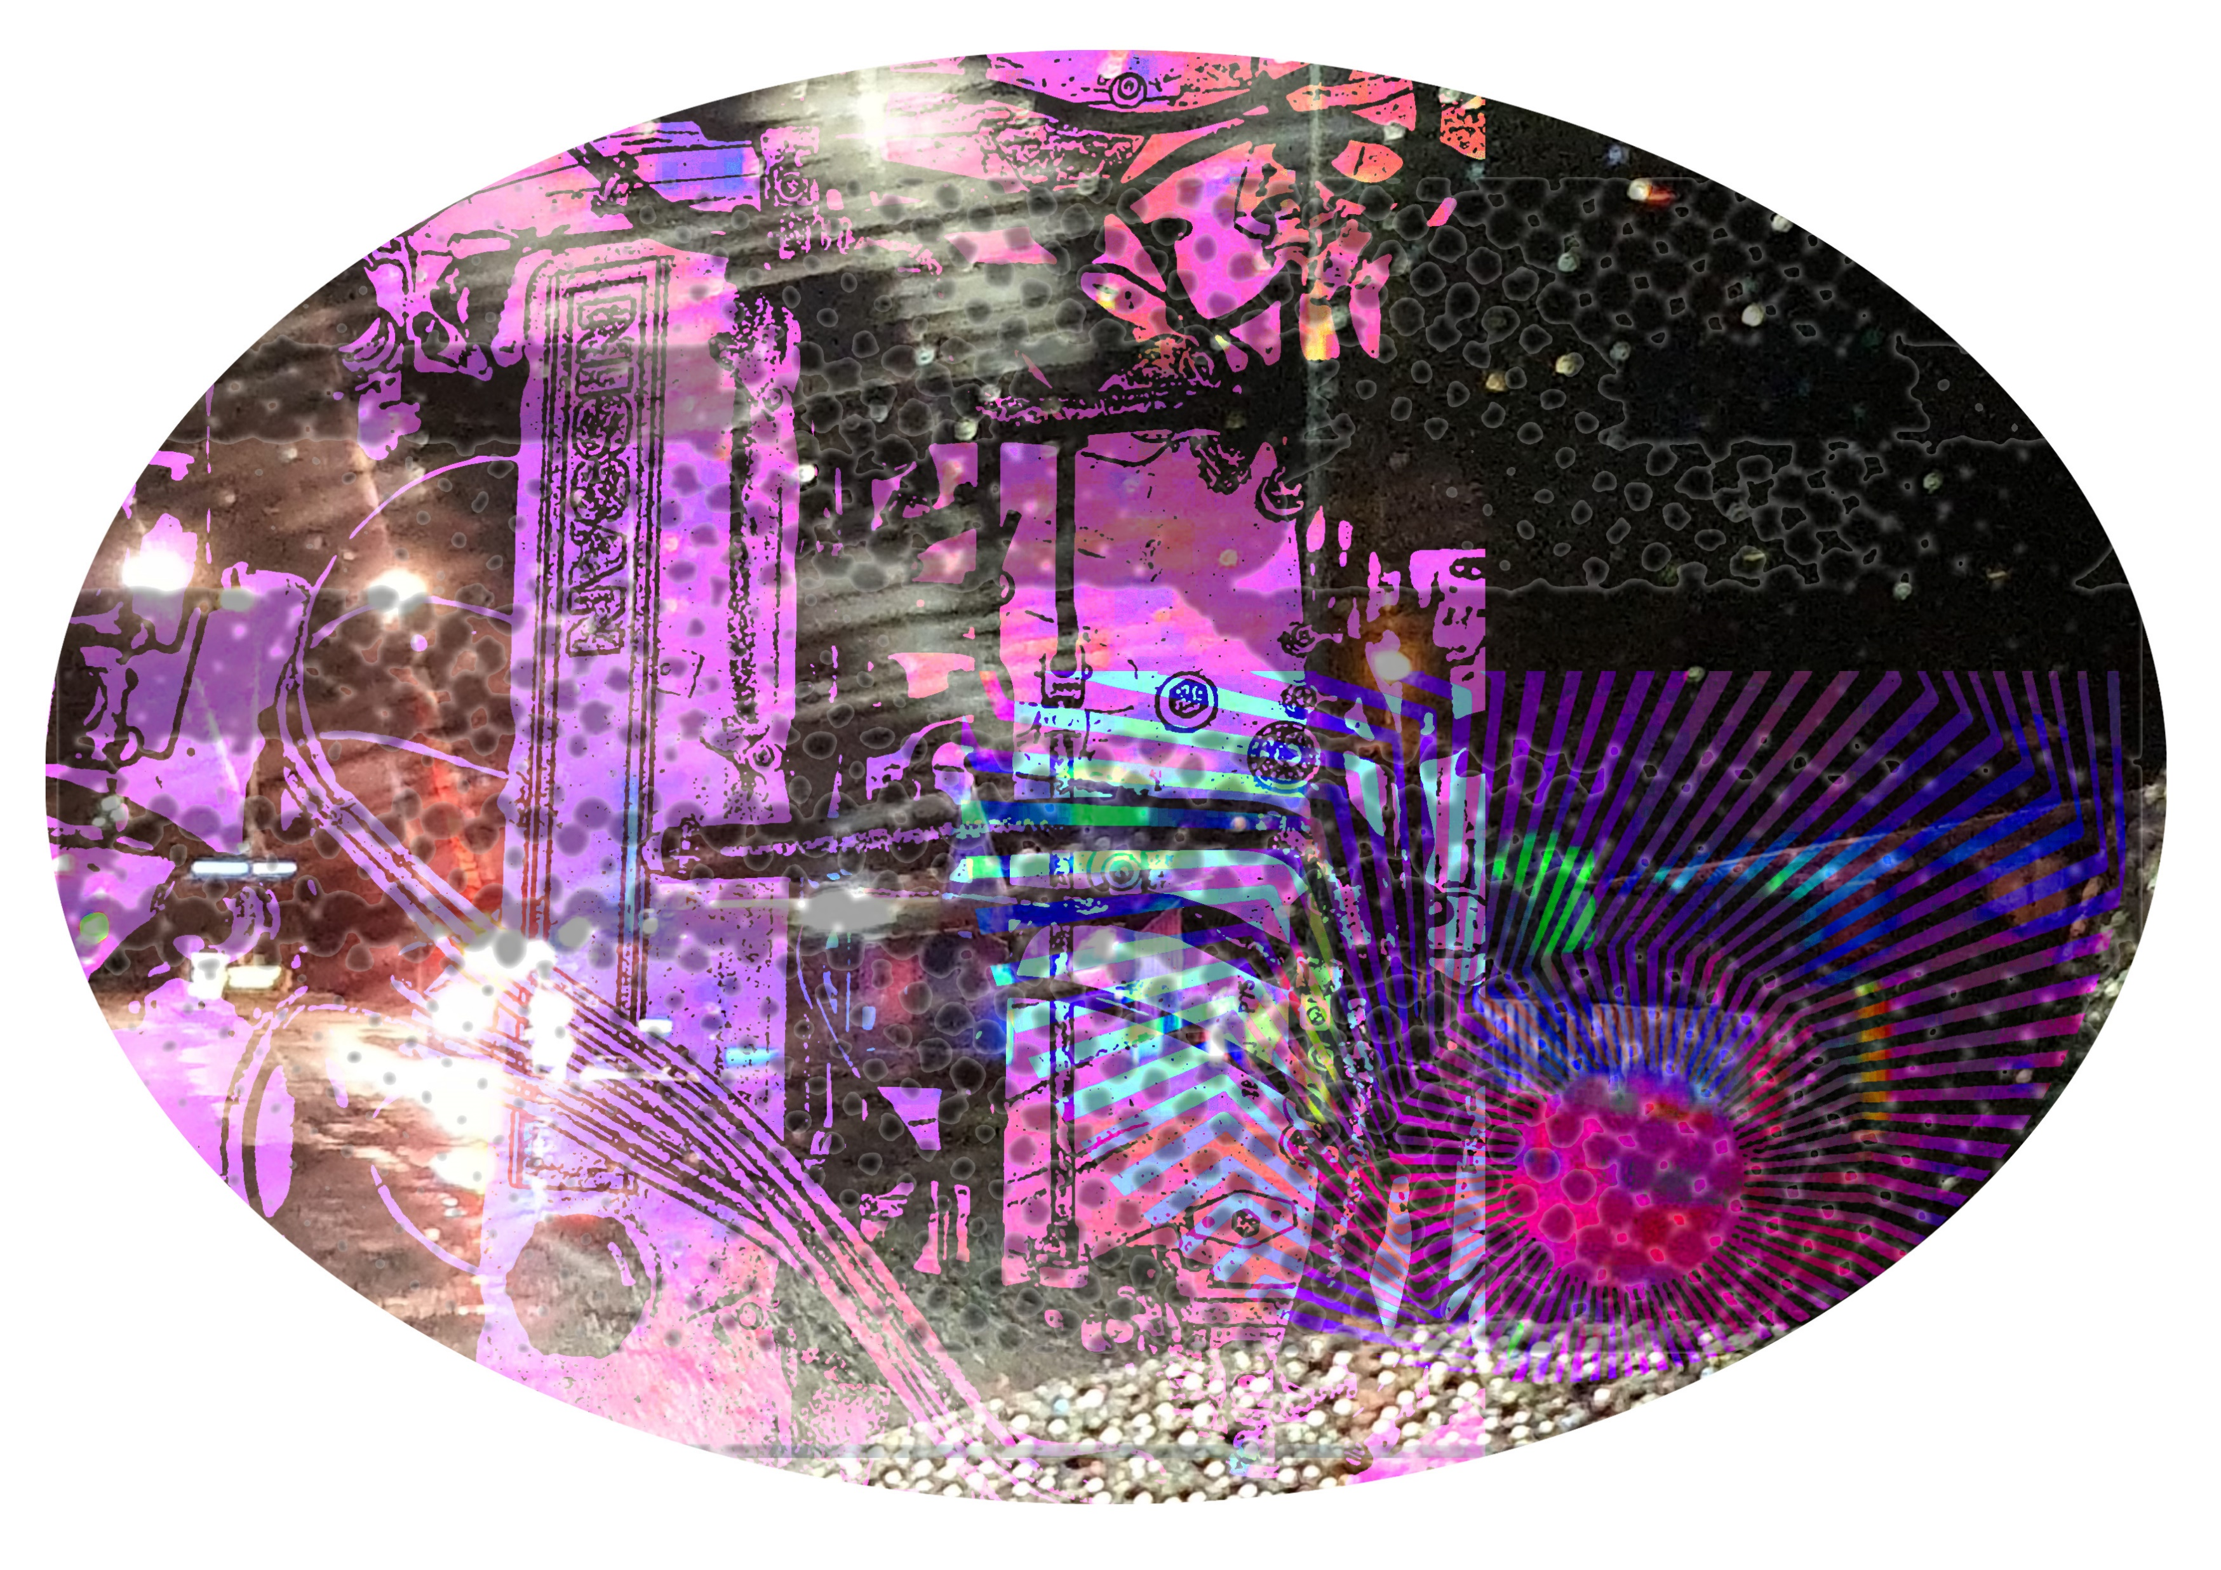

Slide 20
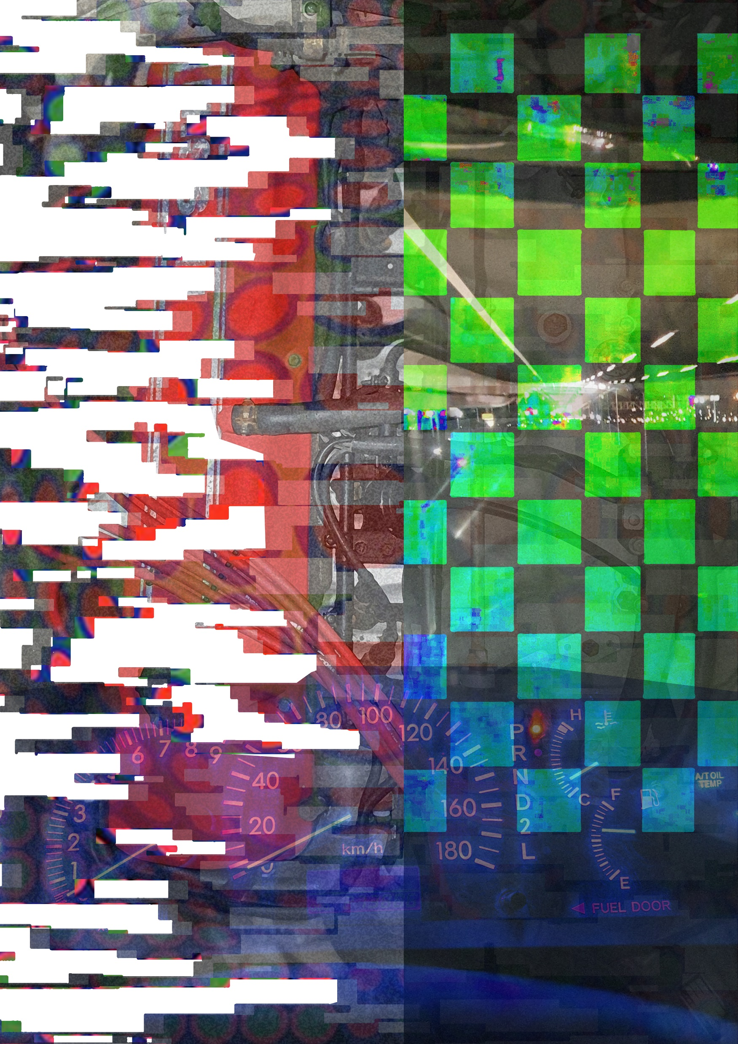

Slide 21
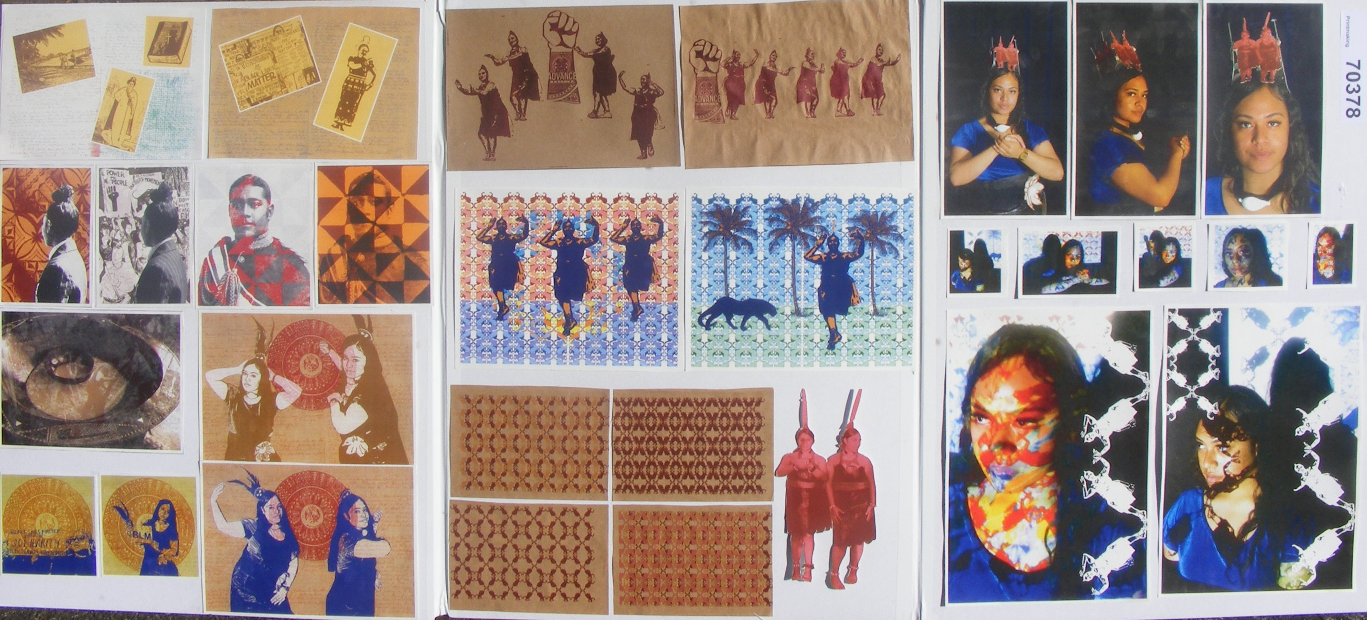
Tonga Fakava M

Slide 24
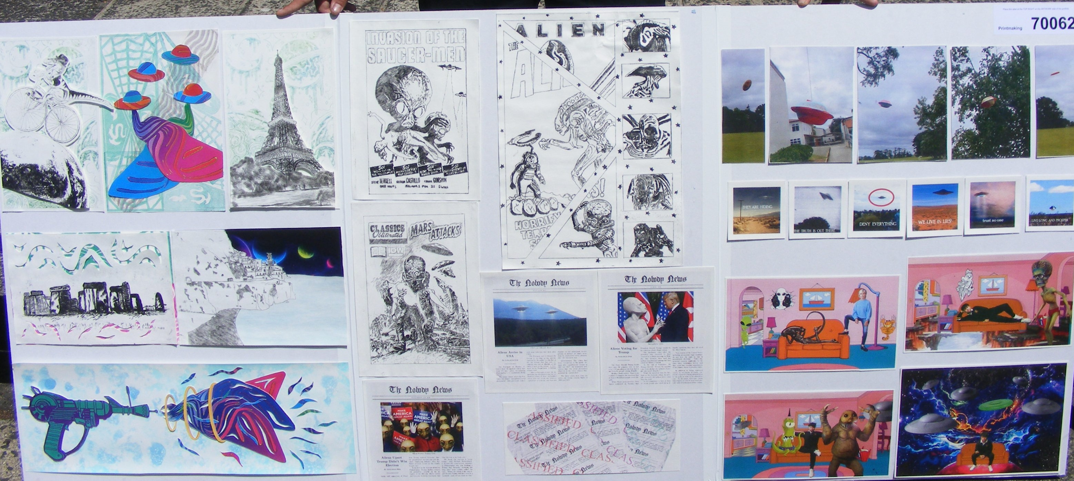
Malachi Poa E

