Slide 1
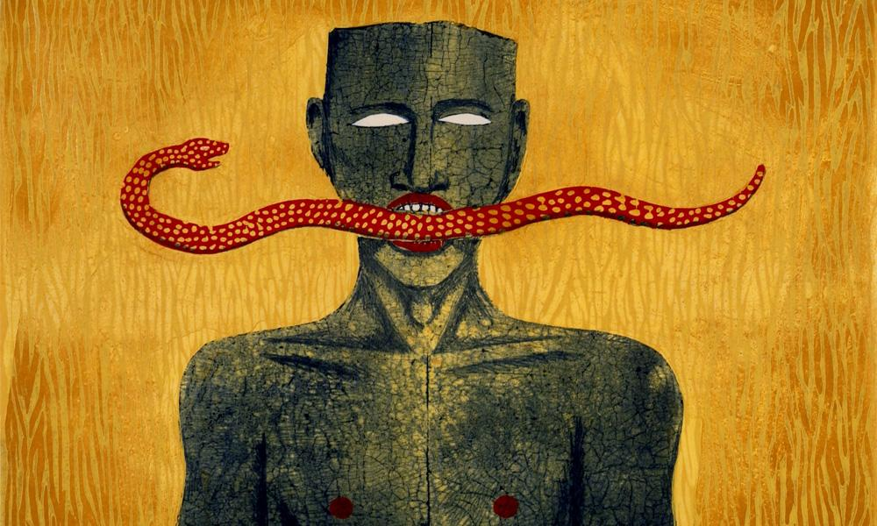
KICK START
Printmaking Artist Models
from small to large
from several to one
By Carole Shepherd (with additions from Esther Hansen)

Slide 2
scale
Tyanna J Blue, Visiting hours, 2012, Print installation

Slide 3
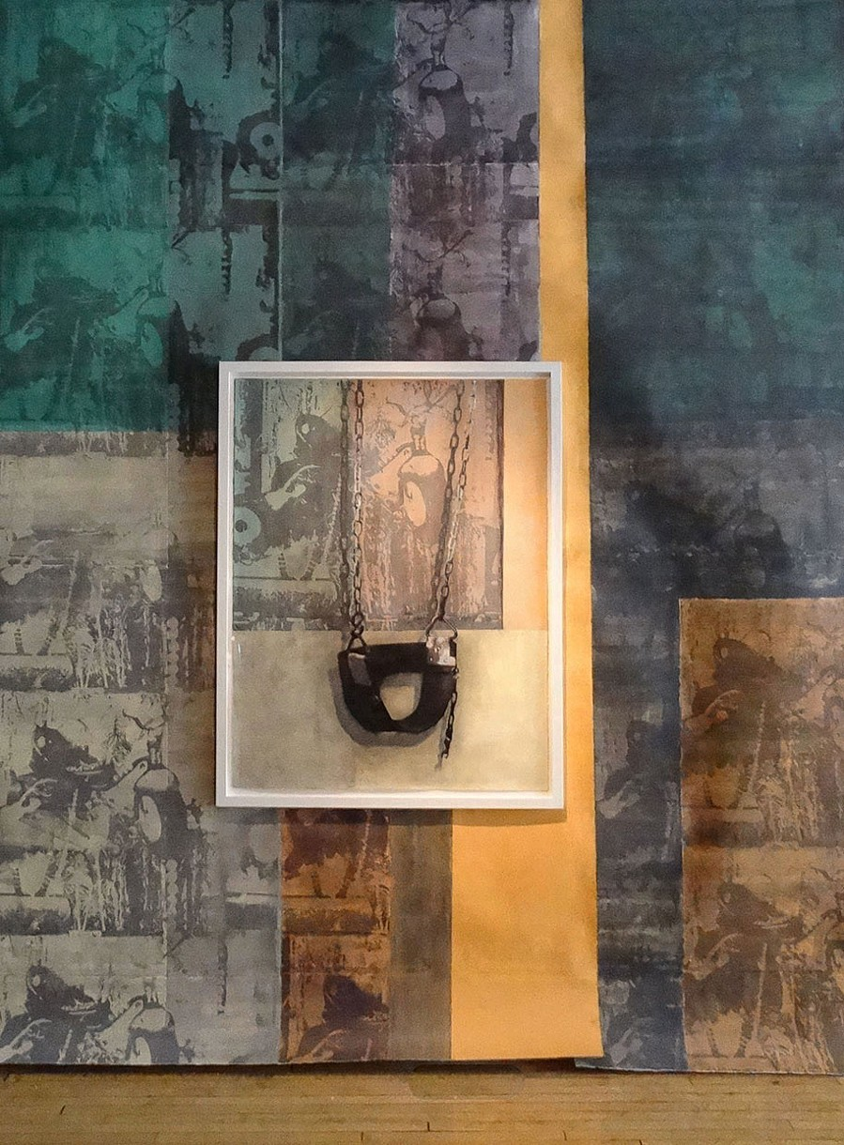
Tyanna J Blue, Playing favourites, 2014, Print installation

Slide 5
Natalia Leginowicz, Wesley College, Large print collaborative project

Slide 6
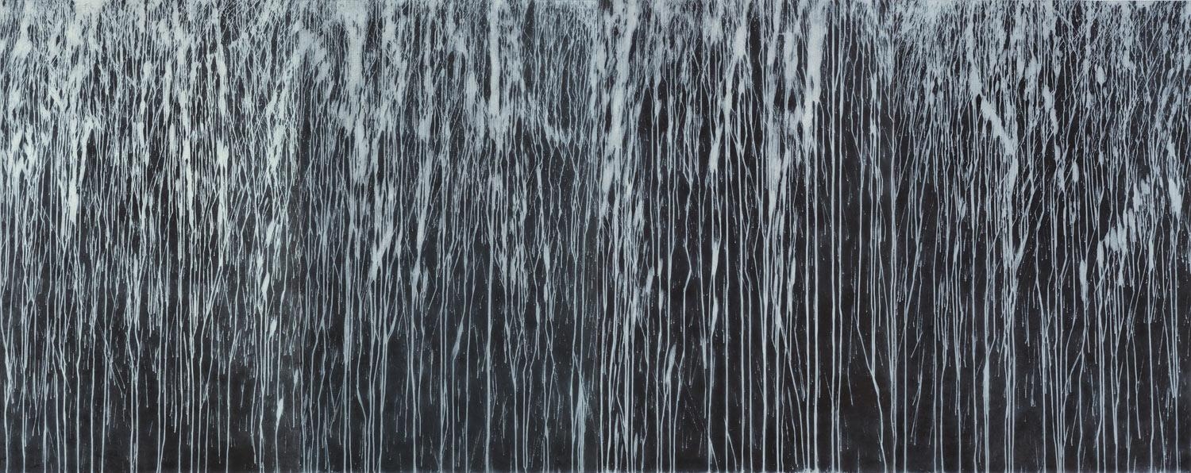

Slide 7
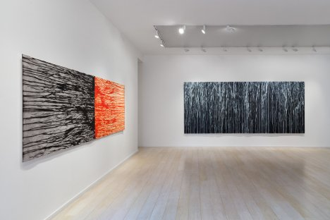
Richard Long, 2015, monumental carborundum relief prints

Slide 8
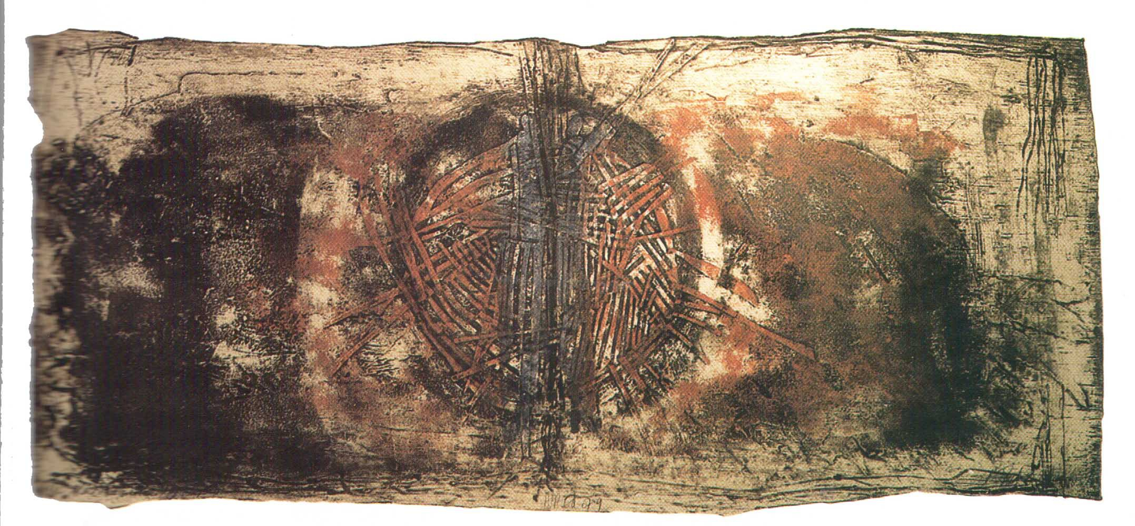
Cheryl Daley-Champagnie , From The Dwellers series, 1996; mixed media on handmade paper; private collection. Photograph by Petrine Archer-Straw

Slide 9
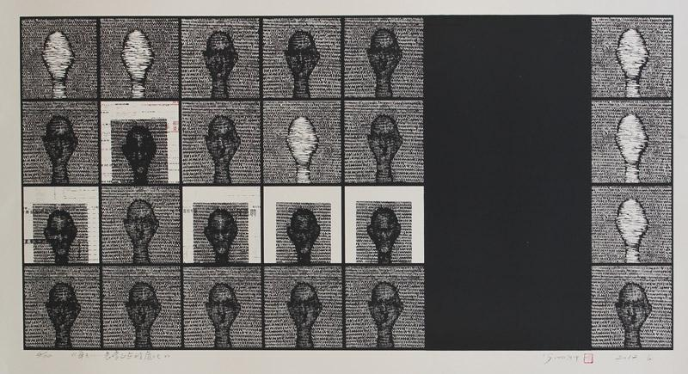
Everyday Portrait
Luo Xiangke 羅湘科
Screenprint from Woodcut
535mm x 1060mm

Slide 10
Angela Cavalieri

Slide 11
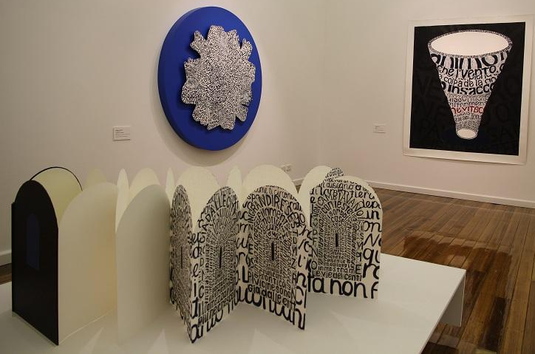
Angela Cavalieri

Slide 12
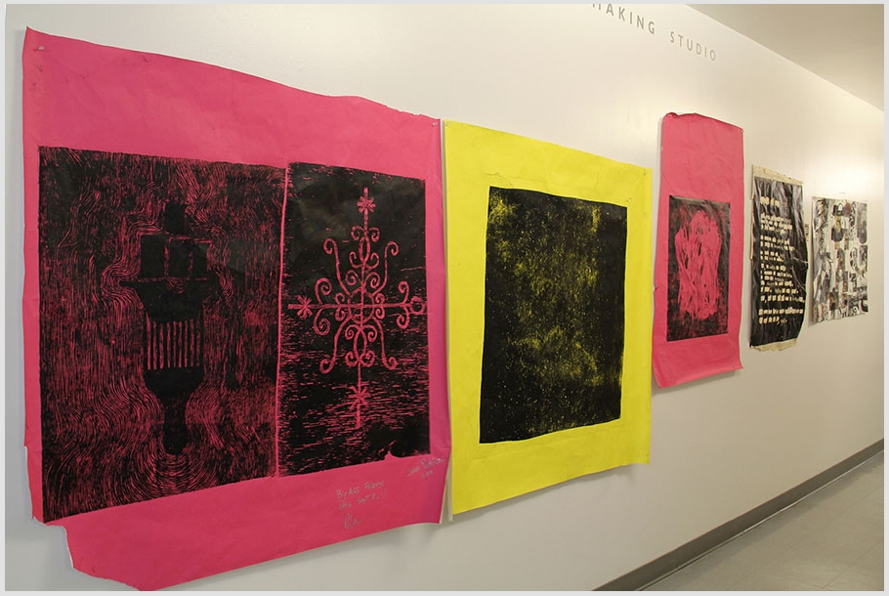
Otis College of Art and Design - steamroller printmaking event

Slide 13
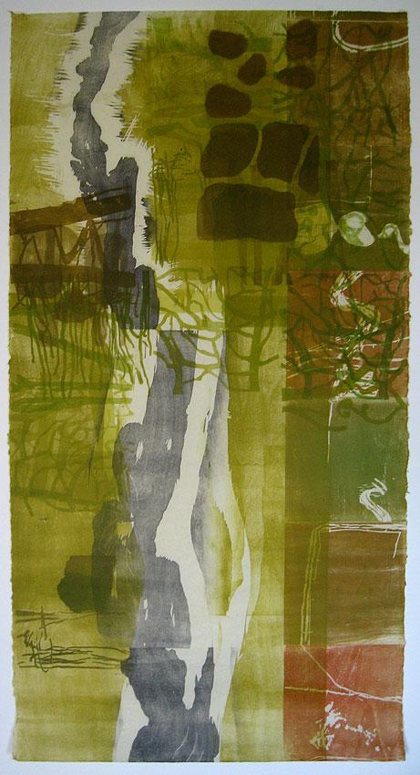
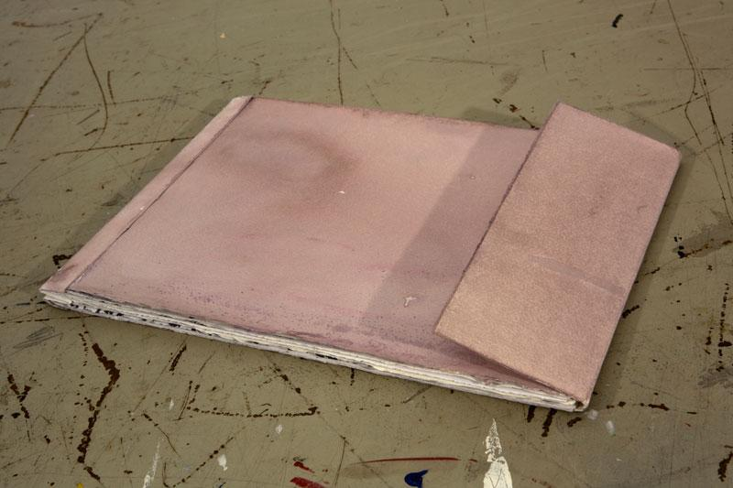
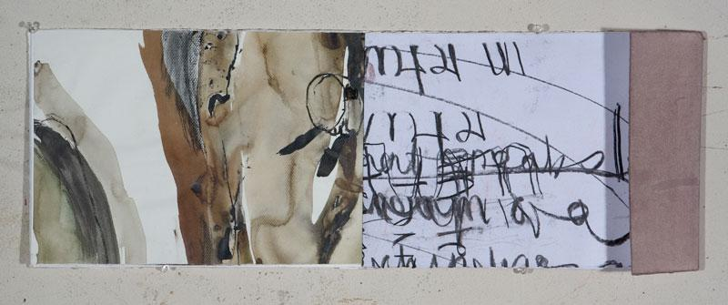
Gary Shinfield

Slide 14
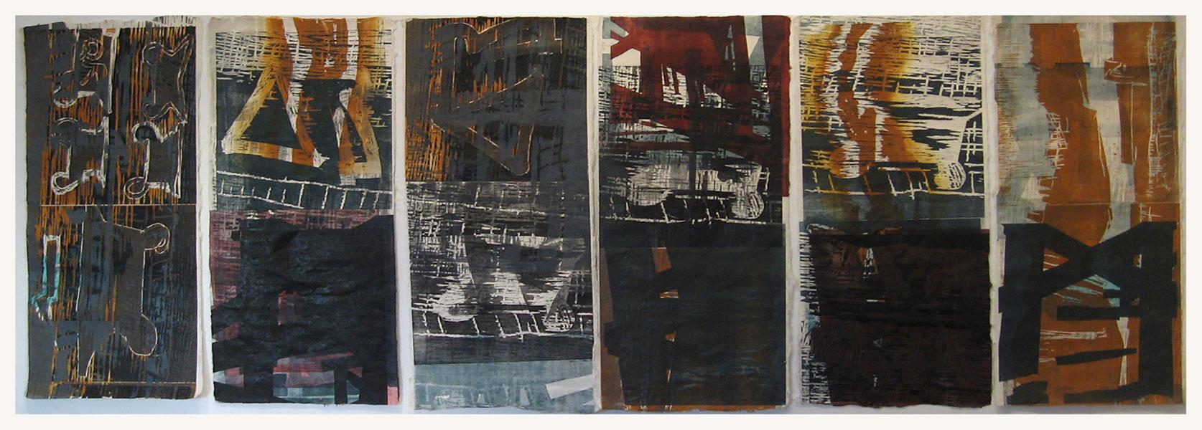

Slide 15
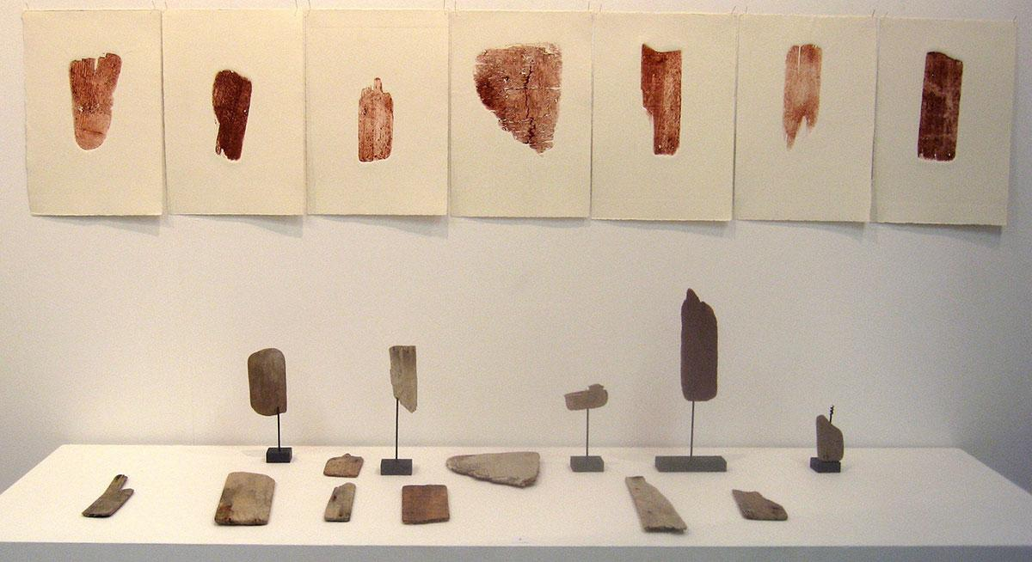
Gary Shinfield, Shards, 2013
5 Australian and 5 New Zealand artists challenging traditional printmaking structures North Art Gallery, Auckland New Zealand

Slide 16
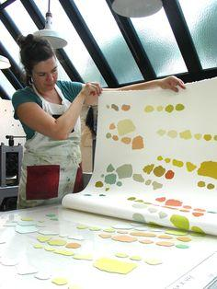

Slide 17
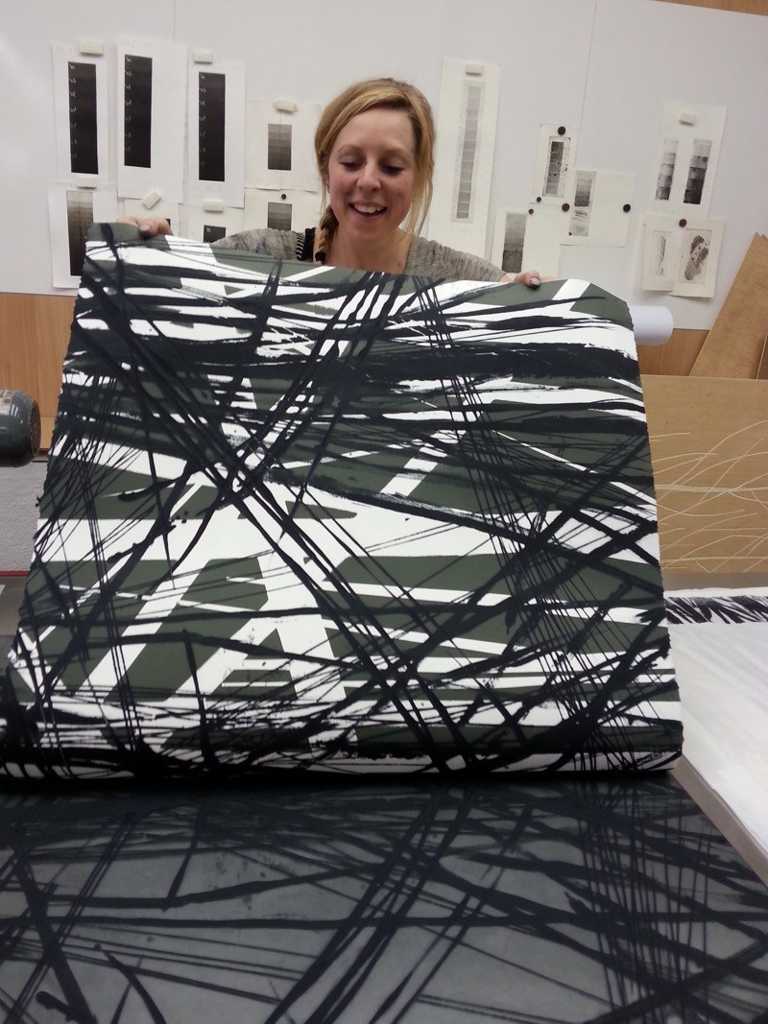
Holly Drewett

Slide 18
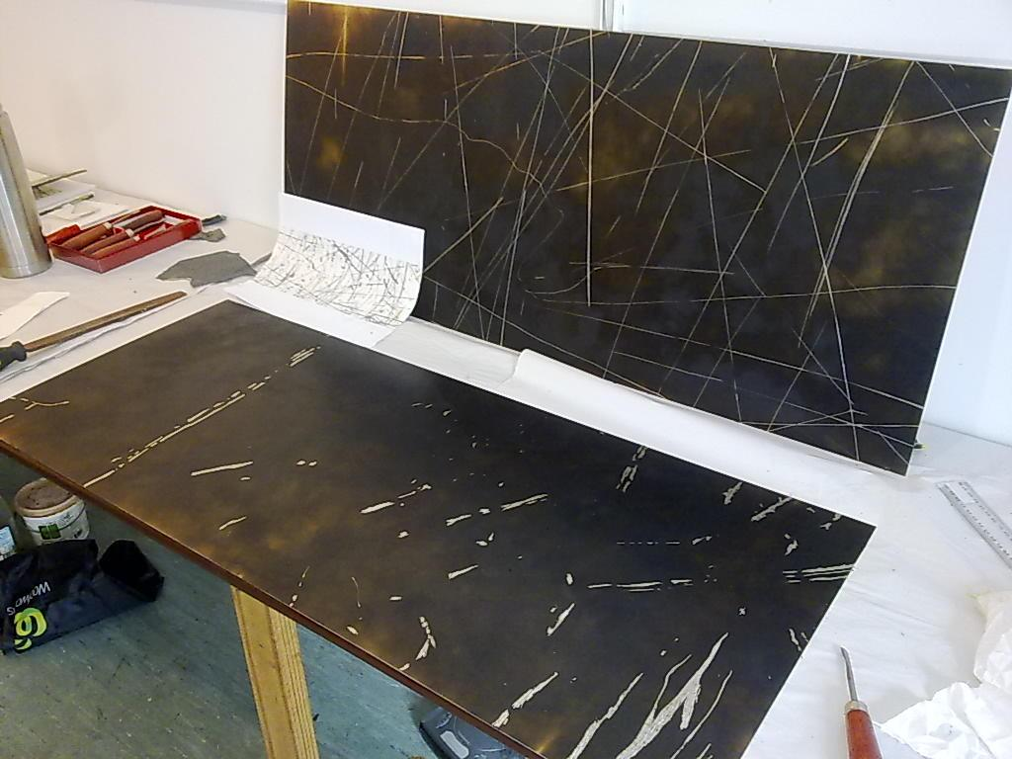

Slide 19
the multiple
Eric Robinson, Solo Installation at Northwestern College
February 21, 2015

Slide 20
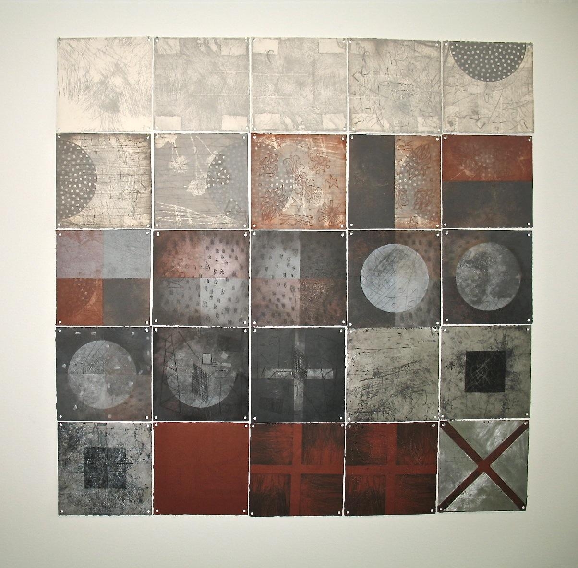
LYNN TAYLOR

Slide 21
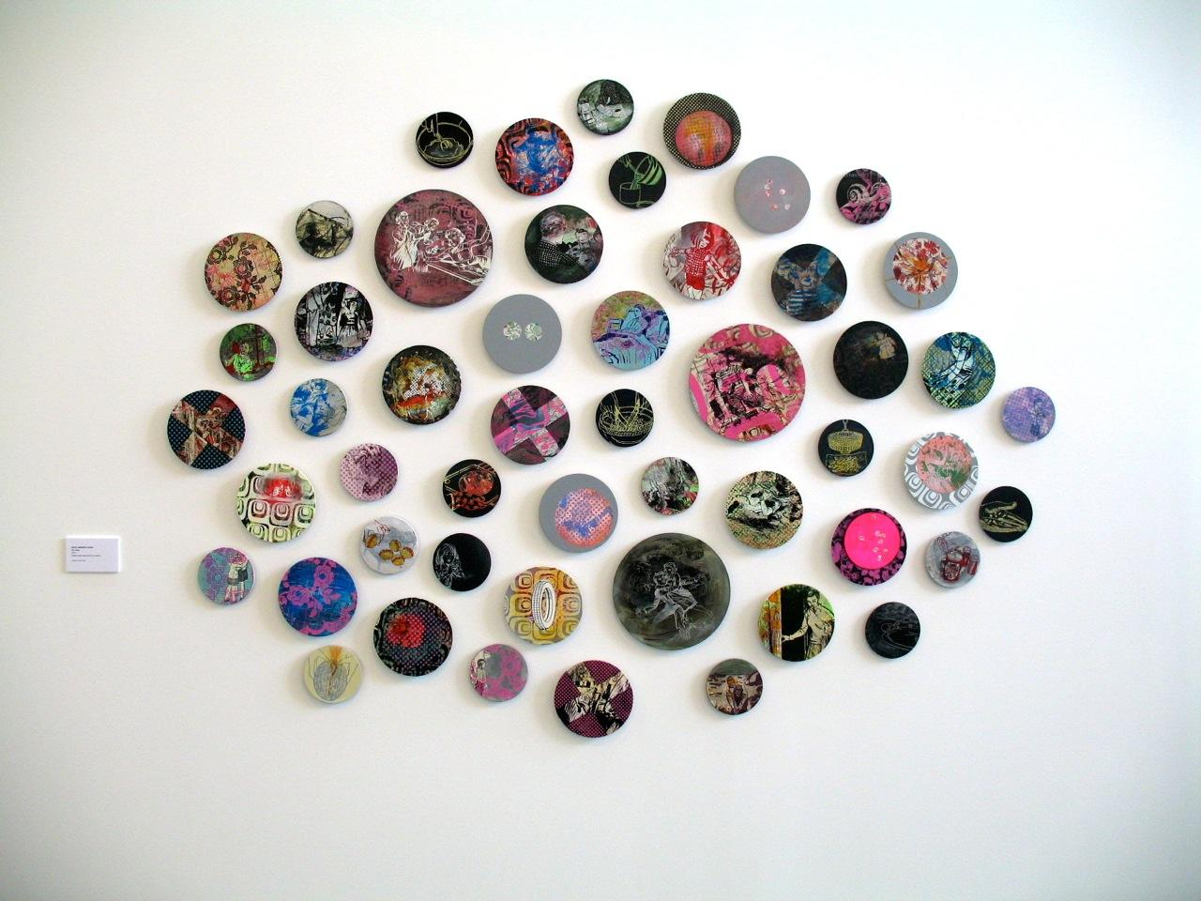
NICOL SANDERS

Slide 22
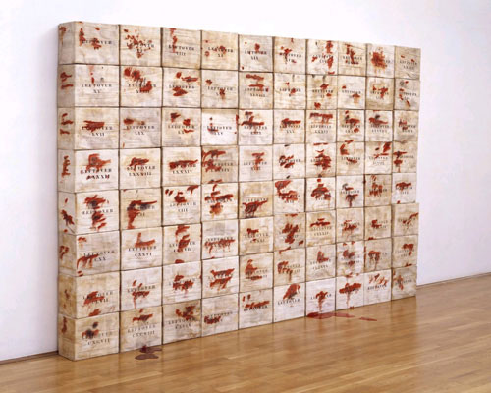

Slide 23
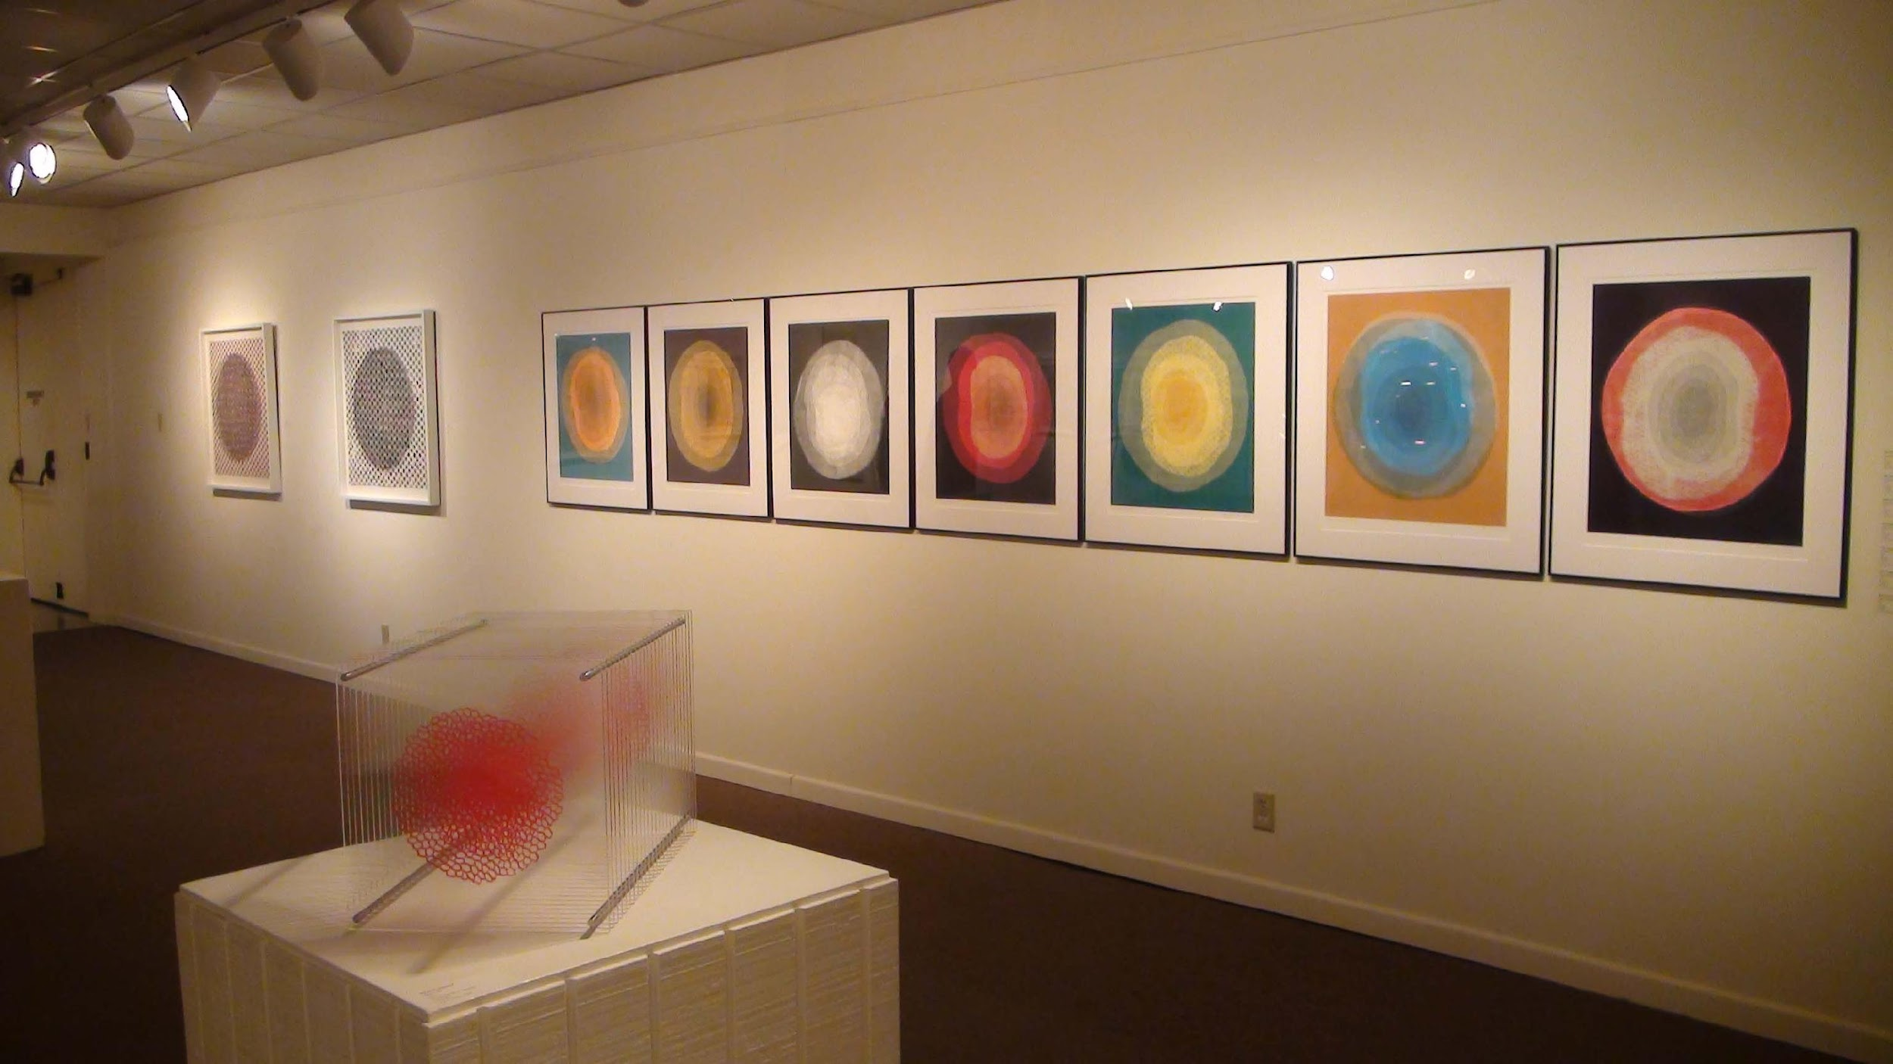

Slide 24
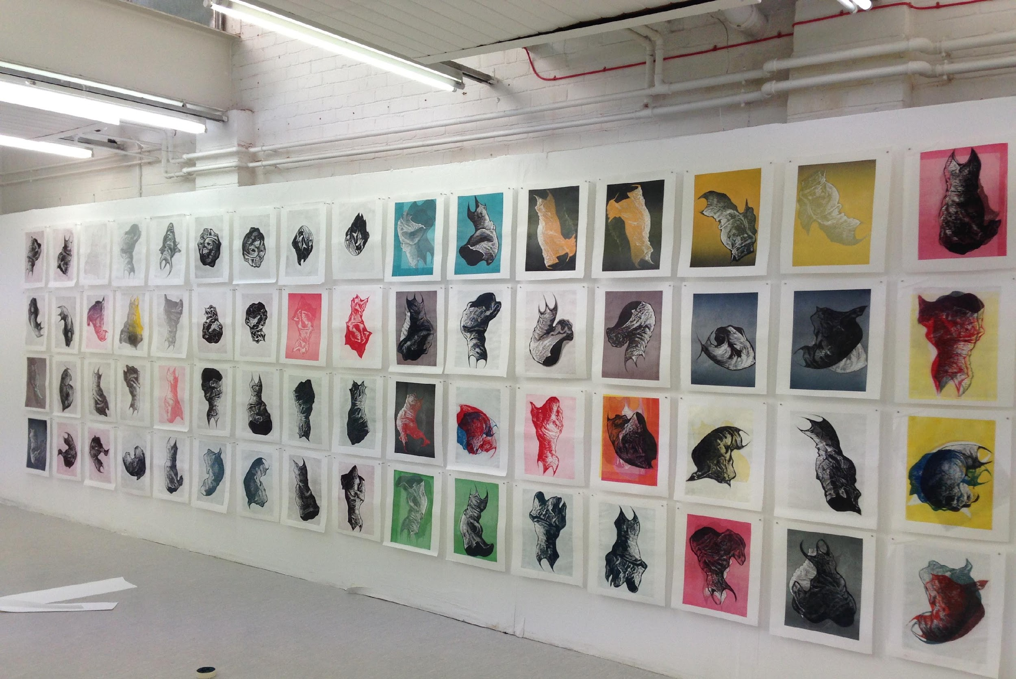
Wuon-Gean, 64 dancing dress prints, 2013, Scotland, IMPACT

Slide 25
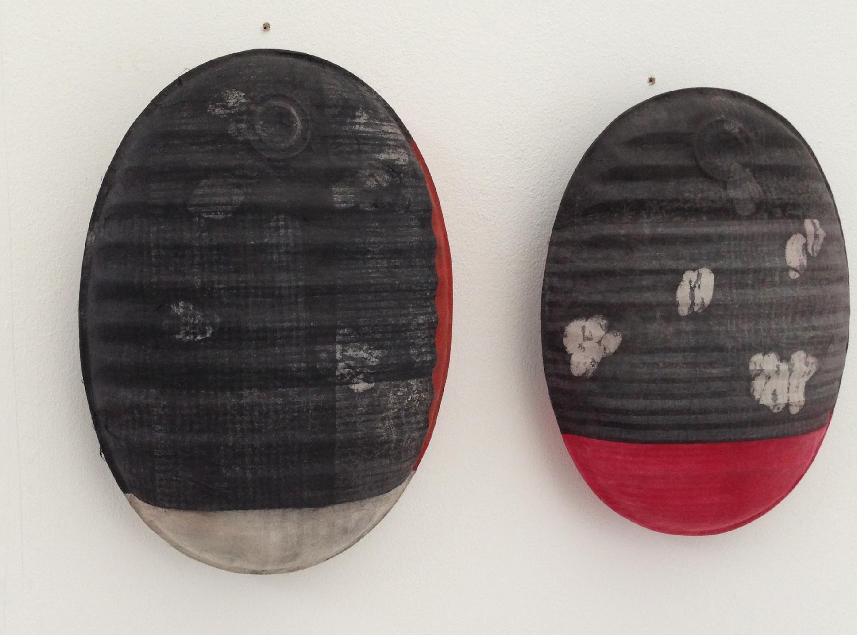
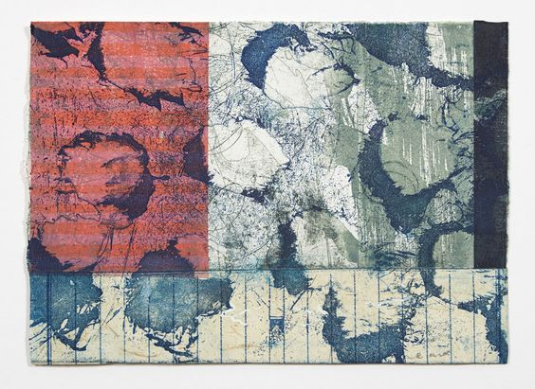
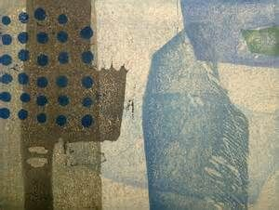
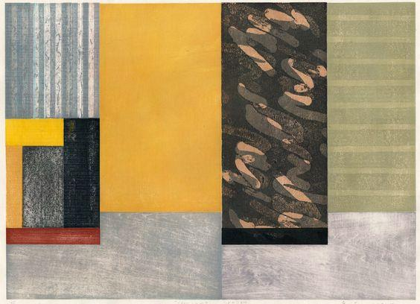
Paul Furneaux

Slide 26
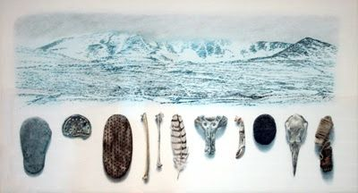
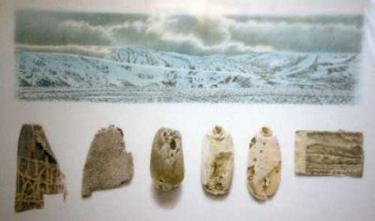
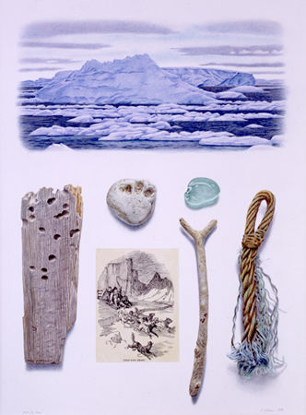
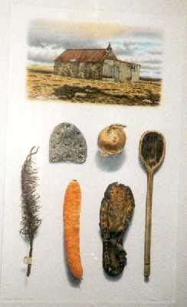
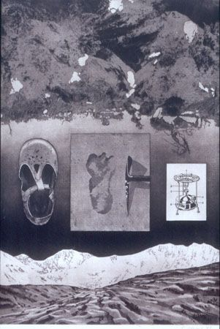
Reinhard Behrens

Slide 27
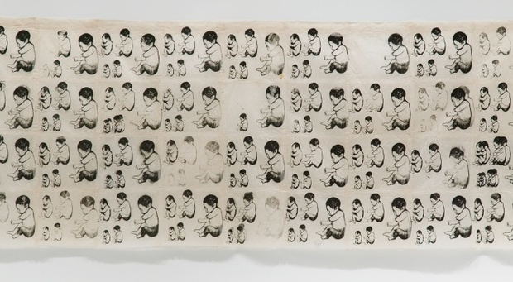
Kiki Smith

Slide 28
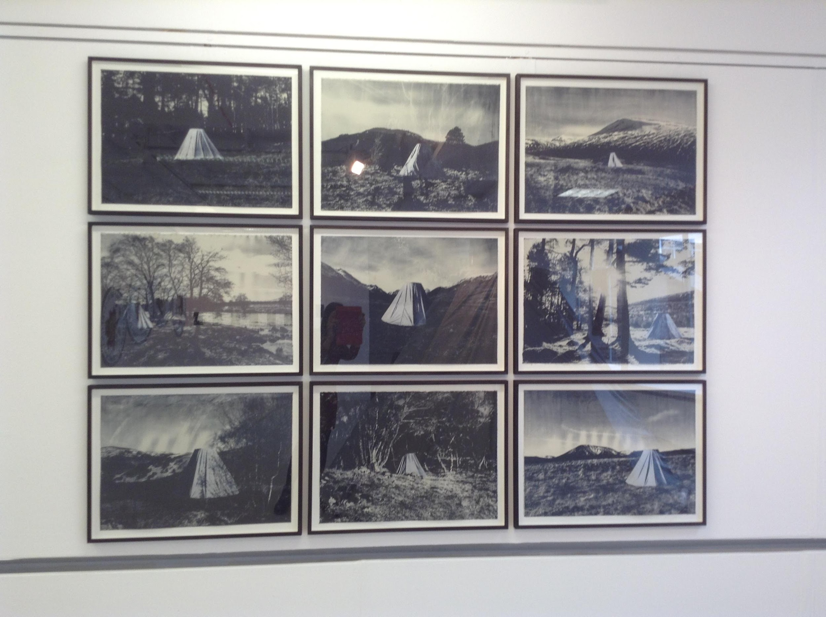

Slide 29
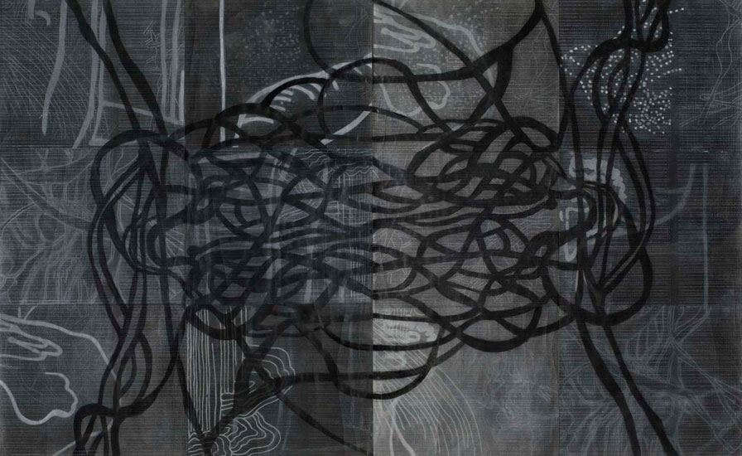
SARAH AMOS

Slide 30
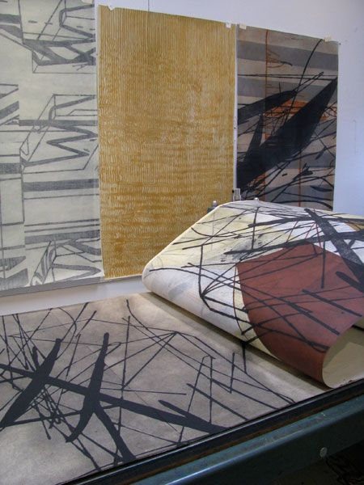

Slide 31
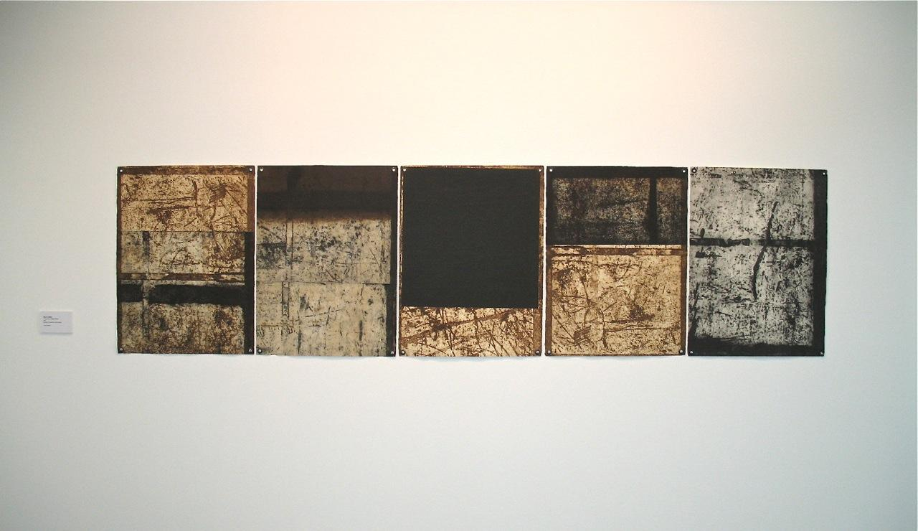
PHILLIP CARBON

Slide 32
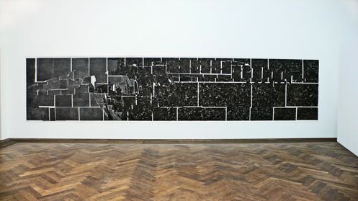

Slide 33
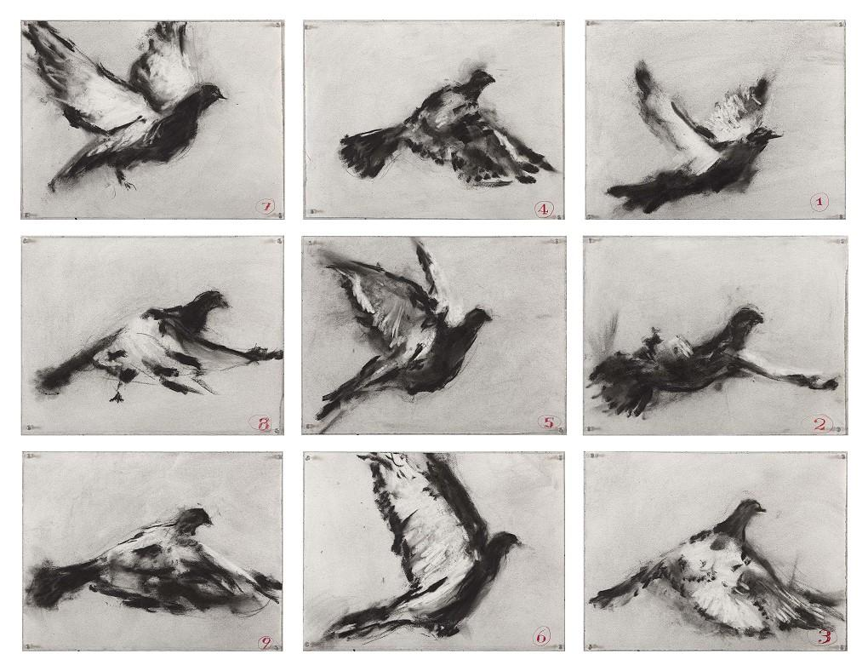

Slide 34
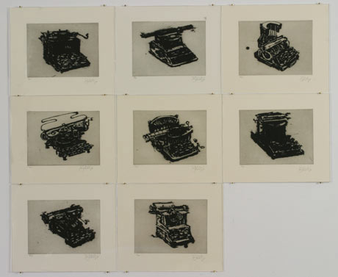

Slide 35
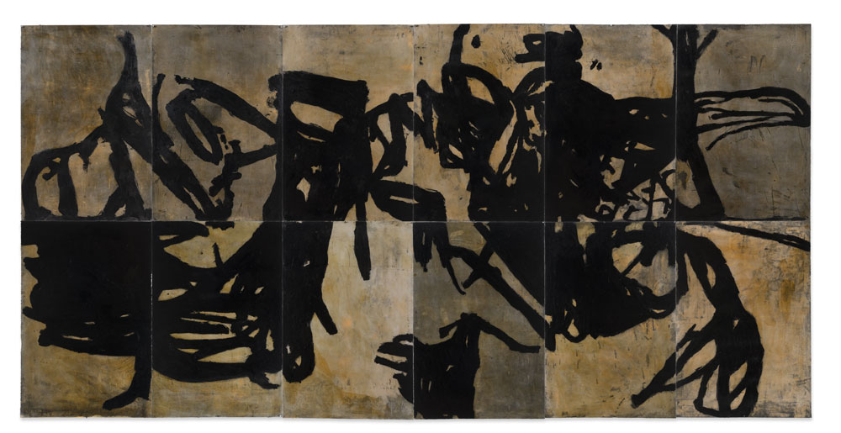
MIKE PARR

Slide 36
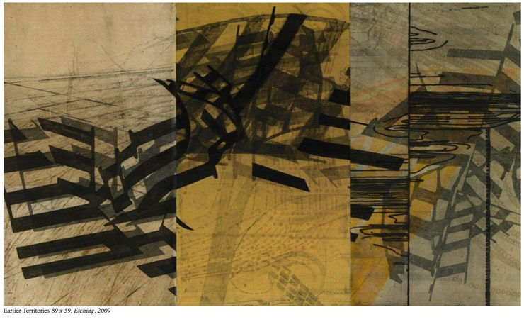

Slide 37
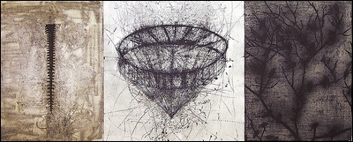
Charles Cohen

Slide 38
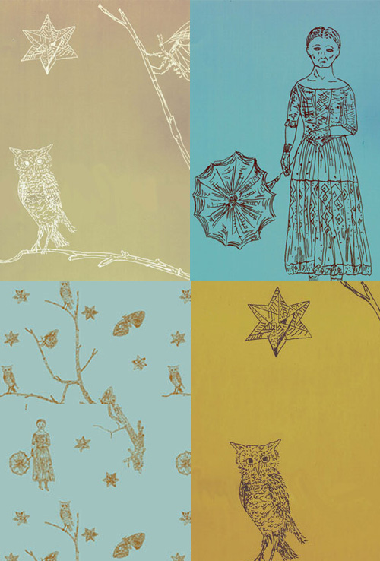

Slide 39
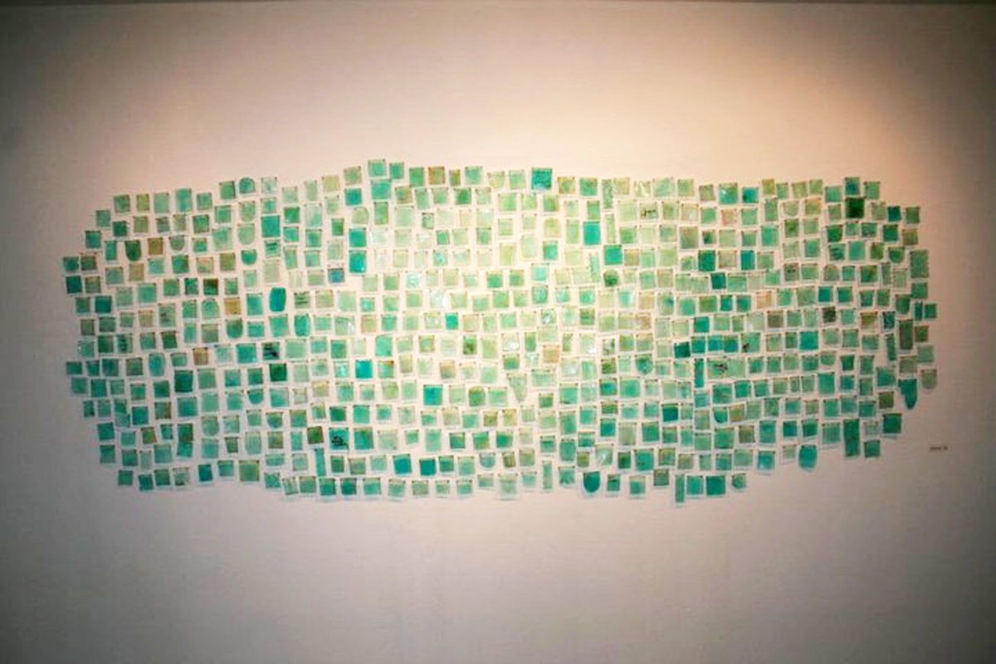
Brandie Grogan , End Of Days (detail)
2014, Mixed Media, Silkscreen, Thread, Etching, Pins, 6' x 3'

Slide 40
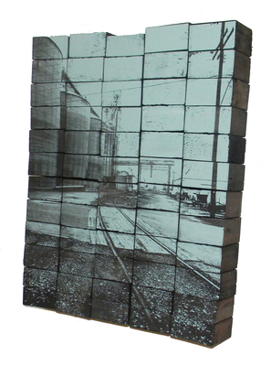
Brandie Grogan, What Is The Meaning Of All This, Silkscreen on reclaimed redwood, Original Dimensions:
22.5" x 18" x 3"

Slide 41
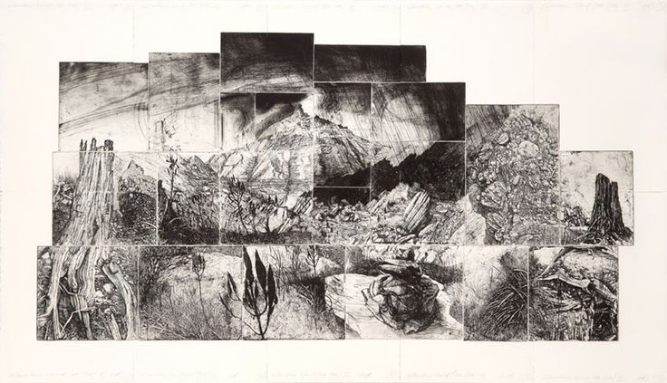
RAY ARNOLD

Slide 42
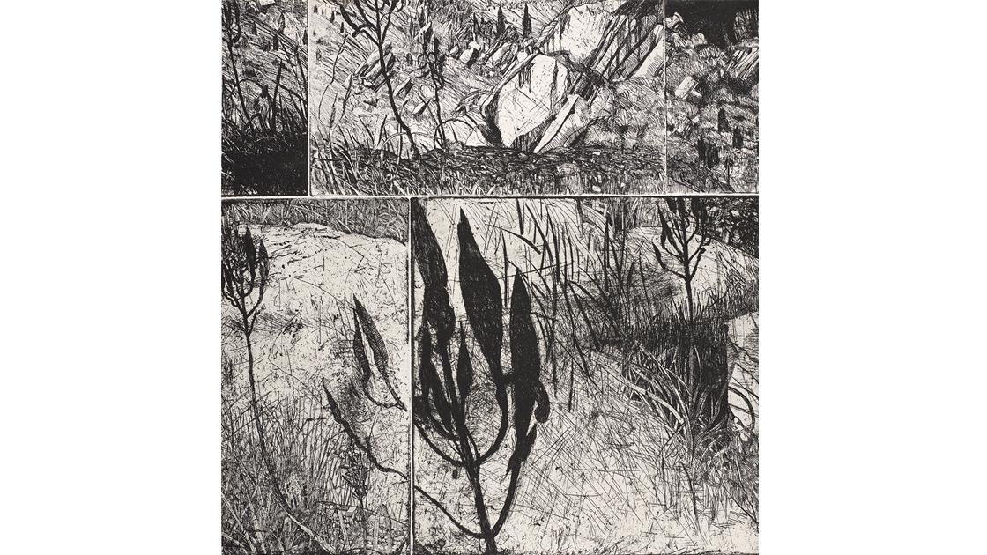

Slide 43
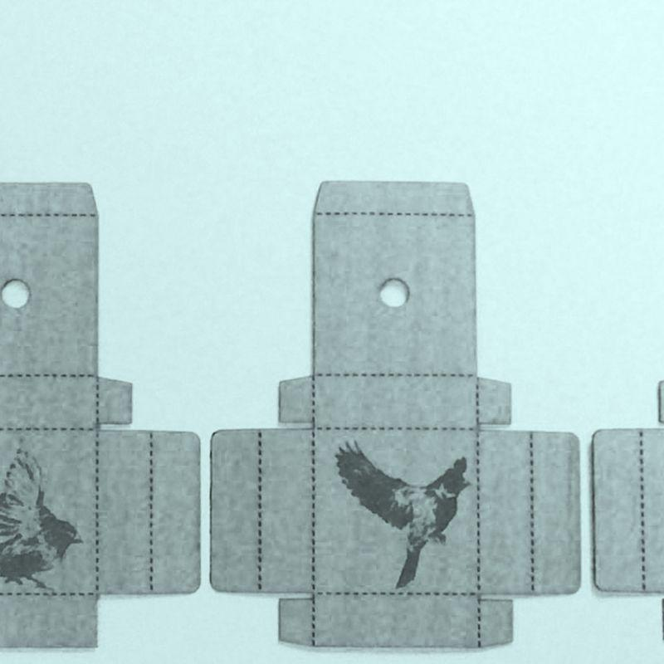
modular

Slide 44
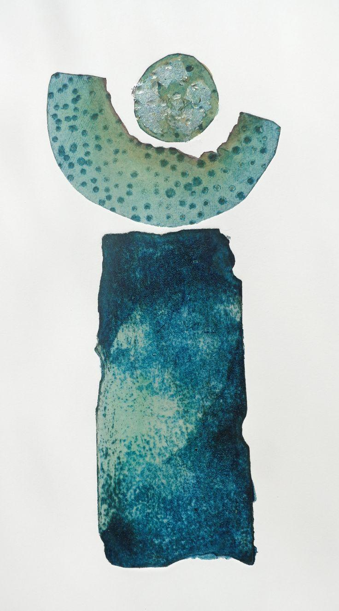
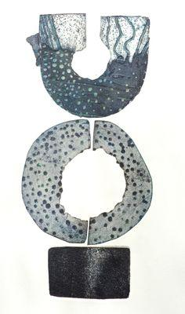
Clare Maria Wood

Slide 45
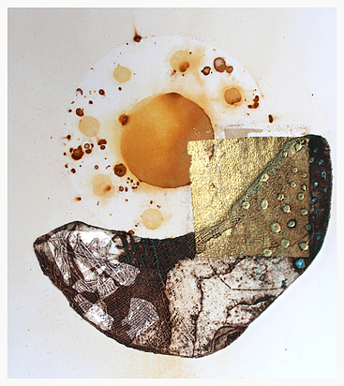
Clare Maria Wood, Submerged, 2 plate collograph, 30 x 30cm
Clare Maria Wood, Arc XVI, collograph, silver and gold leaf, rust transfer

Slide 46
Sally James

Slide 49
IMMANTS TILLERS

Slide 52
diaspora

Slide 57
folded paper/map

Slide 59
JOHN WOLSELEY

Slide 60
Pat Vivod, Portrait of the Farmer as a Young Man c2002 is part of a series of one of a kind intaglio etchings. This one was printed with 5 separate copper plates and a monotype.

Slide 61
more is more

Slide 66
Teresa Cole

Slide 69
strata
Ruth Solomons

Slide 74
Shawn Bitters, Yes, Yes, Yes, Now, Now, Now, Screen Print on Hand Made Paper, Variable, 2013

Slide 76
collage
ROBERT KUSHNER

Slide 80
Mehwish Iqbal

Slide 81
Paula Zinsmeister

Slide 82
Crystal Wagner

Slide 83
JUDY PFAFF

Slide 84
Chris Kenny

Slide 85
Sarah Gillett

Slide 86
the modular component

Slide 87
Dianne Fogwell

Slide 88
NANCY SPERO

Slide 89
the conceptual / THE MODERNIST

Slide 91
Jane Bustin

Slide 92
Jane Bustin

Slide 97
the digital

Slide 99
STEVE LOVETT

Slide 100
NEIL EMMERSON

Slide 101
the scroll

Slide 103
ALEXIS NEAL

Slide 104
Woodblock on acetate by Tova (Cassie) Rein BFA '09

Slide 105
Friedhard Kiekeben, Project David, seven steel etchings with plates; etched in nitric acid, 1988

Slide 106
the cut out

Slide 107
collaborative drawing

Slide 112
DIGITAL

Slide 119
http://www.gutenberg.org/files/26496/26496-h/26496-h.htm
Rembrandt's Etching Technique: An Example Author: Peter Morse Release Date: August 31, 2008 [EBook #26496]
http://www.nontoxicprint.com/content.htm
Nontoxicprint - Nontoxic Printmaking, Safe Painting & Printed Art

Slide 120
Indrani Gall, Eclipse II, color Intaglio Type print

Slide 121
Elizabeth Dove hybrid print

Slide 122
Liz Chalfin, what's next?, photopolymer intaglio and ink drawing, 2008

Slide 123
Matt Forrest

Slide 124
Joe Lindsey, silkscreen and digital print, 2007, Columbia College Chicago Academic Print Studio

