Slide 1
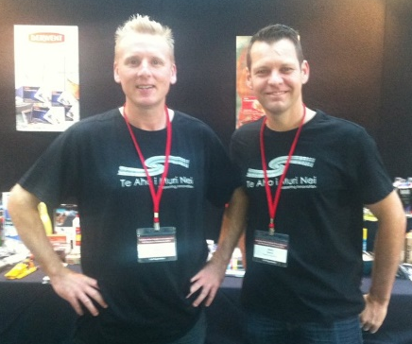
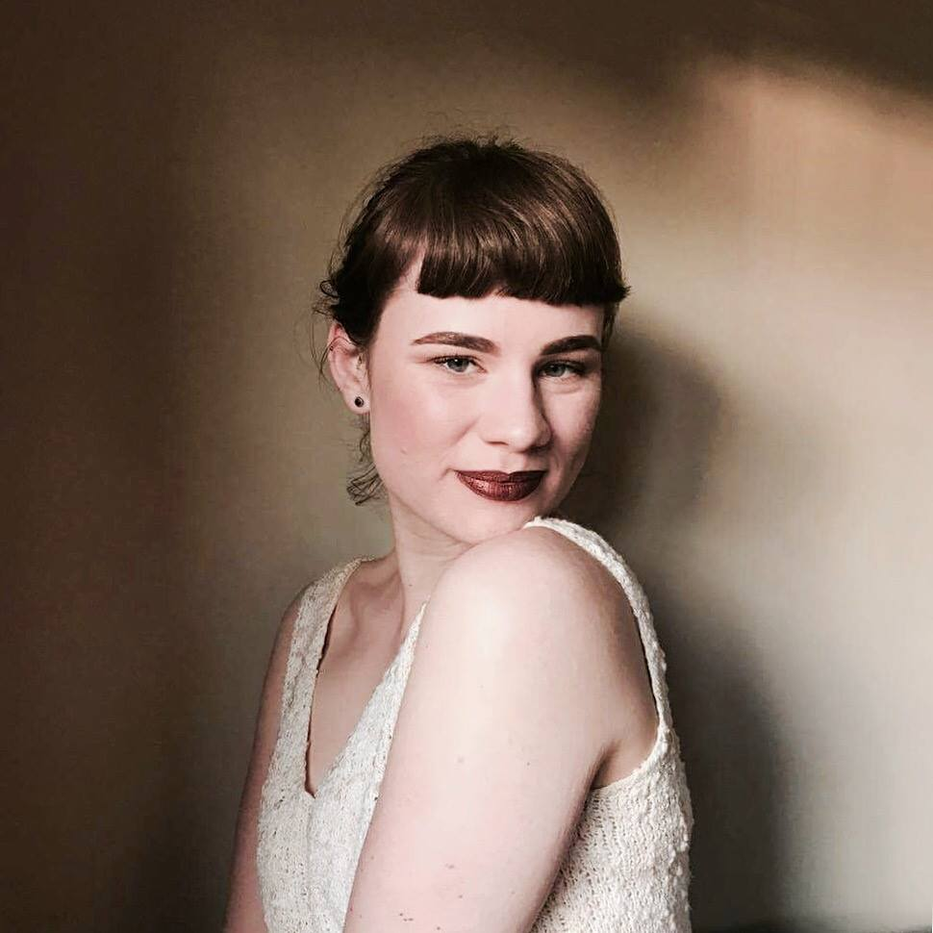
Lo-Fi Print Processes December 2020 PART 1
Covid-proof your print courses with Lo-Fi processes Esther Hansen
he@pukekohehigh.school.nz
Special thanks to HOF/HOD Art Vicky Moore-Allen, and the art crew
Renee Neville, Martin Bennett, Jay Pressnell, Kylie Waitai, Jessica Bluck,
Morgan Hogg, Jennifer Stewart and Stuart McEwing

Slide 2
SCAFFOLDING OF PRINT at PHS by year level Year 9
Woodcut or collagraph or reduction woodcut
Year 10
dry point etching, reduction woodcut, linear mono printing, collagraph – 3 processes
Year 11
Dry point etching, woodcut on folio
Year 12
Woodcut, cyanotype, digital printing, chine colle, mono printing, dry point etching, screen printing, eco printing, collagraph, photocopy prints, pronto plate
Year 13
Woodcut, cyanotype, photograms, digital printing, chine colle, mono printing, dry point etching, screen printing, eco printing, collagraph, mezzotint, salt etching, soft ground and hard ground etching, pronto plate, 3D printing, laser cut prints, embossing ………

Slide 3
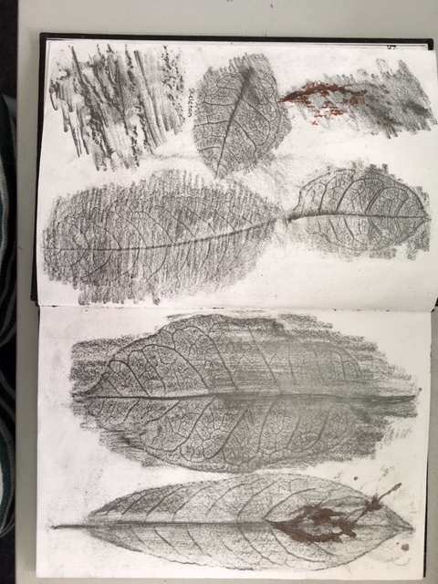
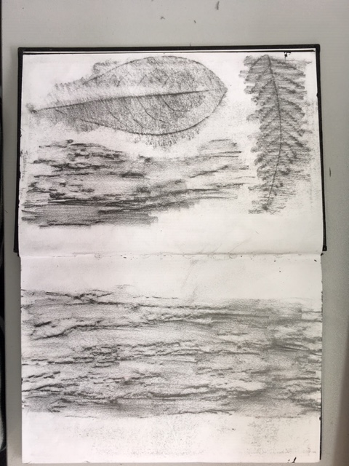
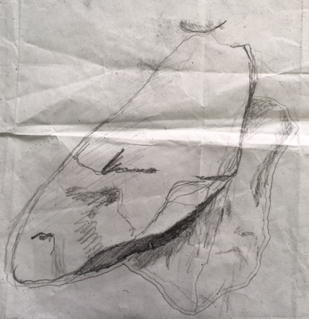
Experimental drawings - Frottage
PHS Student Aleisha Neary 2018

Slide 4
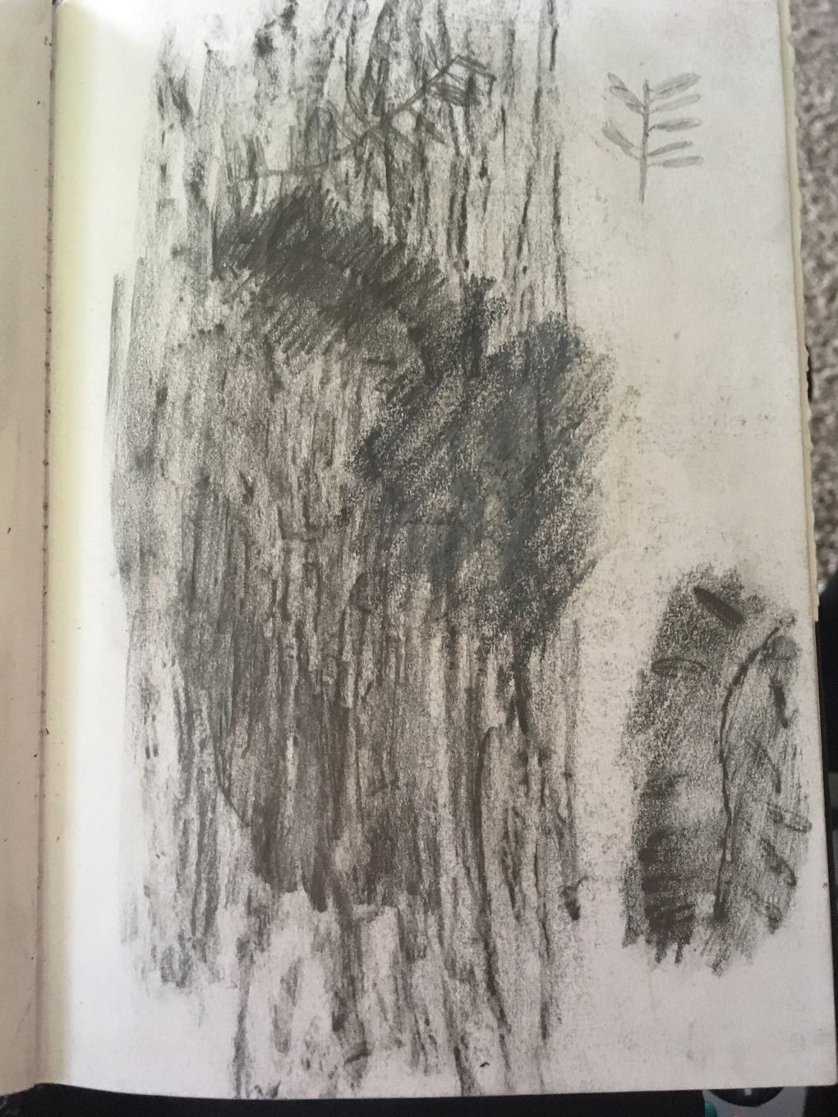
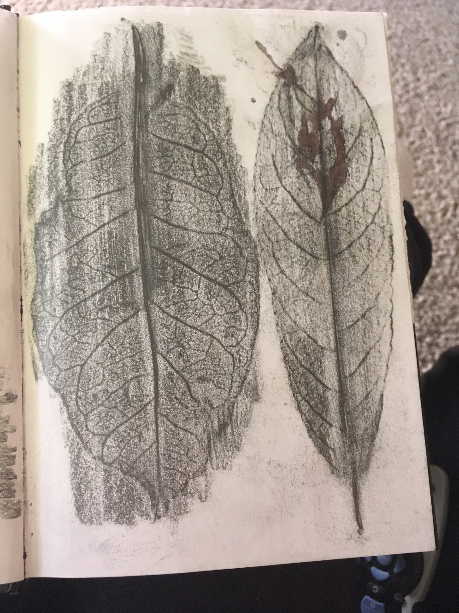
Experimental drawings
PHS Student Aleisha Neary 2018

Slide 5
Drawing sequence PHS Student Aleisha Neary 2018
Native plants- pressed onto paper-natural colours-pressed into nature
Tree trunk pencil rubbing on Totara Tree –pressed/rubbed against nature
Realistic South Island Robin pencil drawing

Slide 6
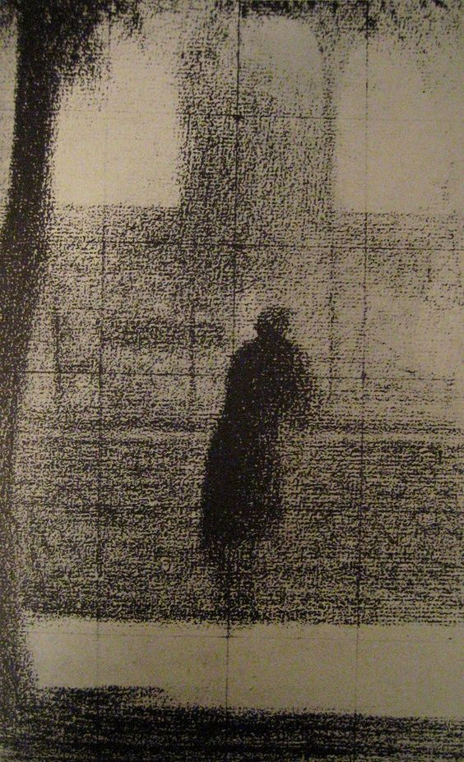
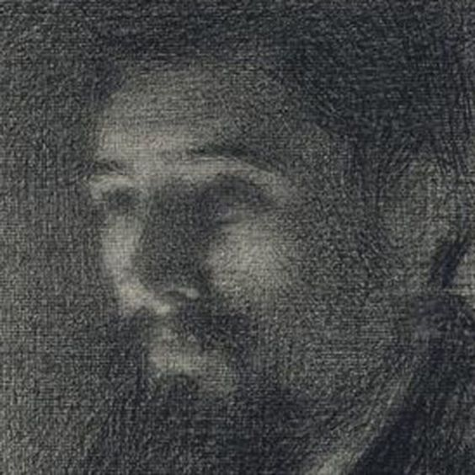
Seurat Drawings in tone

Slide 7
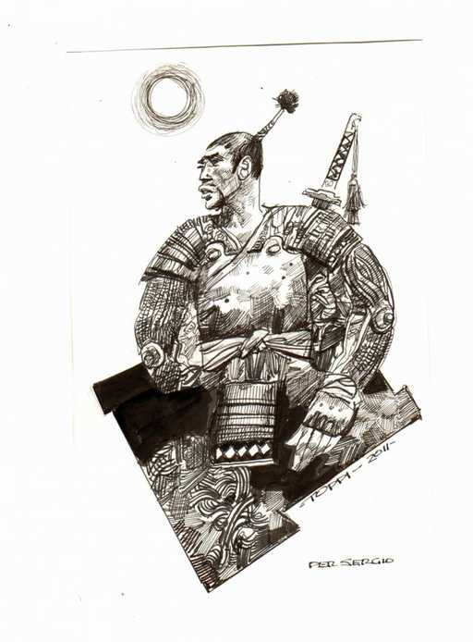
Sergio Toppi

Slide 8
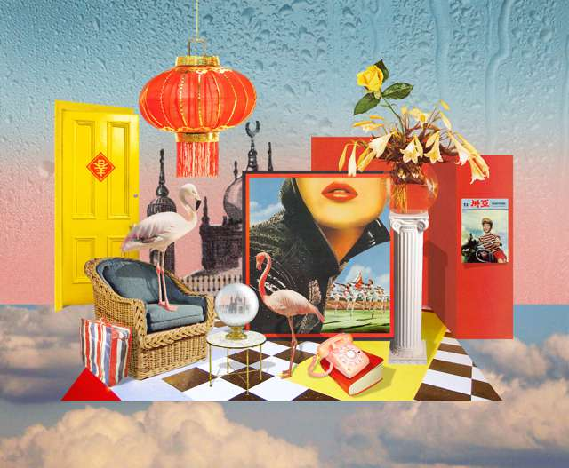
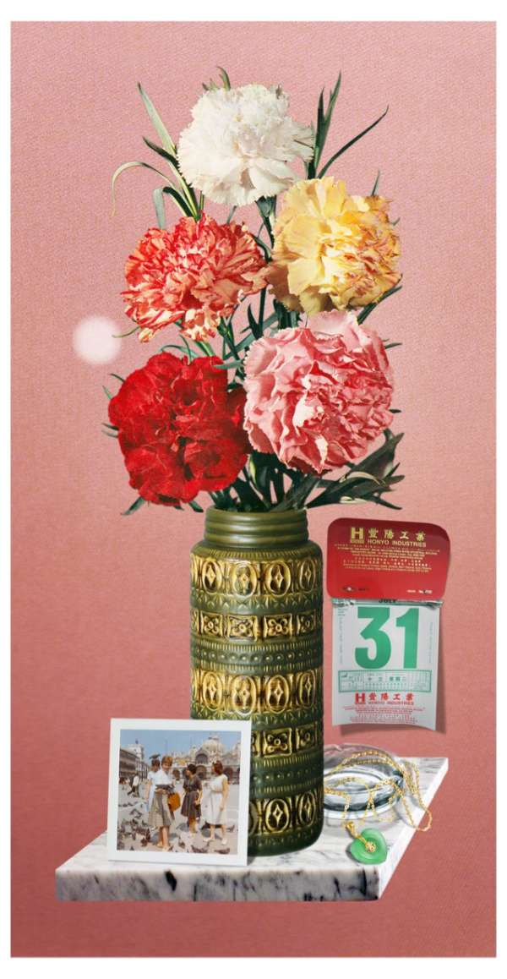
Kerry Ann Lee

Slide 9
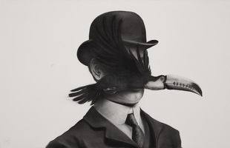
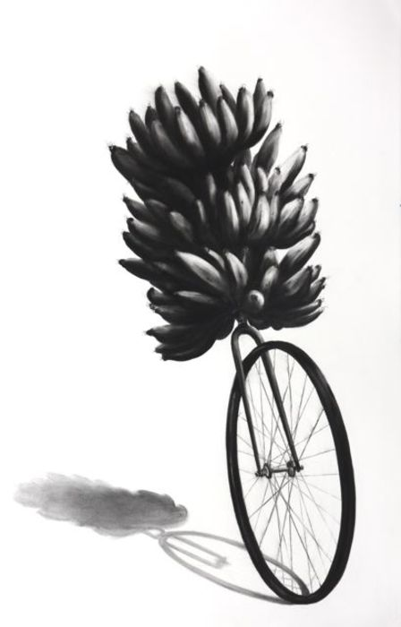
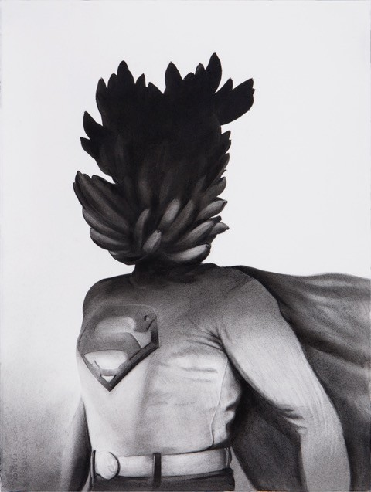
Gonzalo Fuenmayor

Slide 10
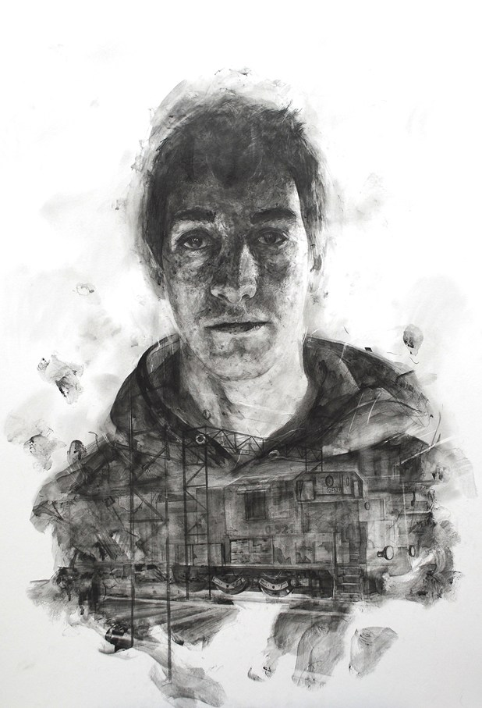
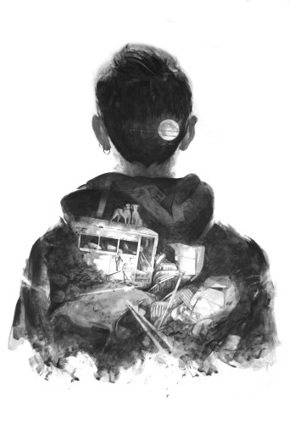
Thomas Cian

Slide 11
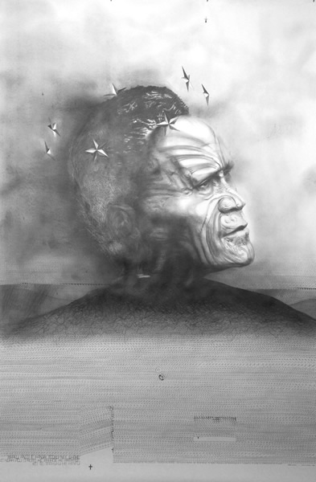
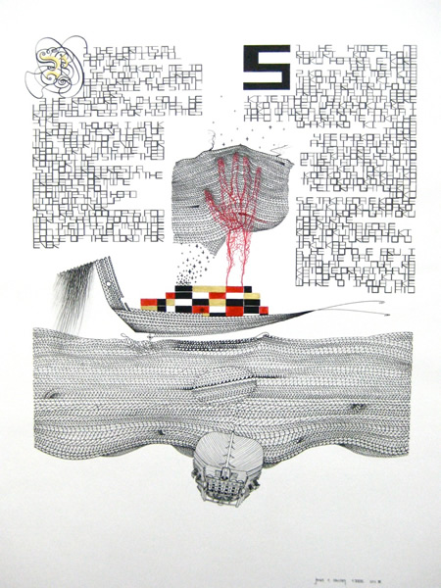
James Ormsby (NZ)

Slide 12
Jane Crisp (NZ)

Slide 13
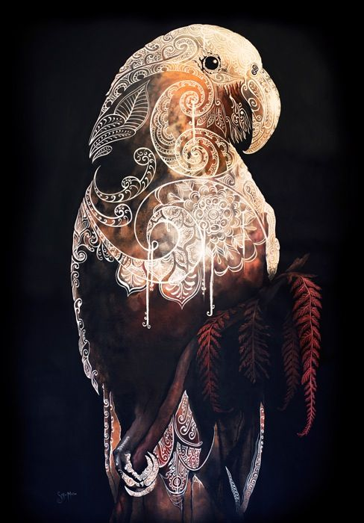
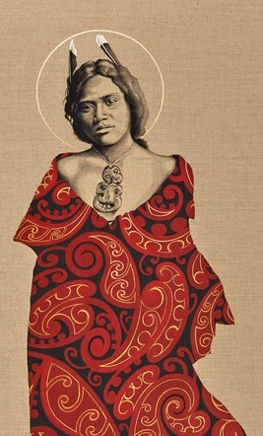
Sofia Minson (NZ)

Slide 14
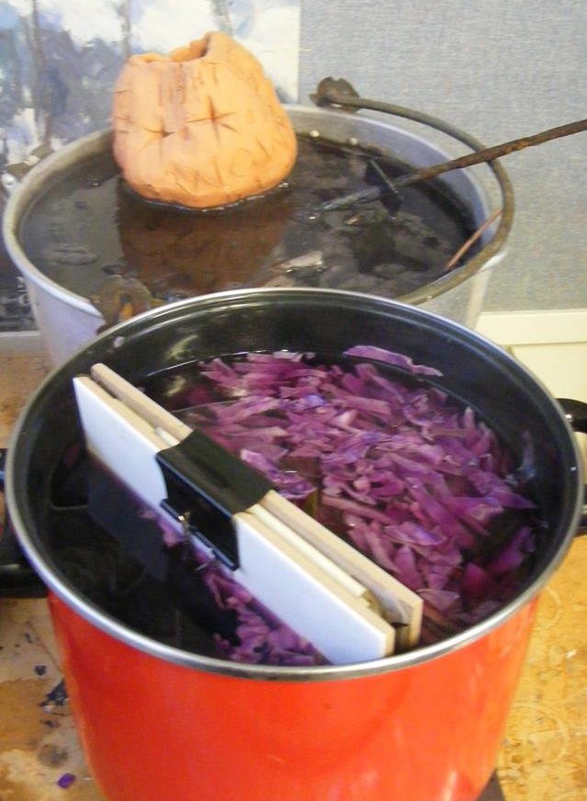
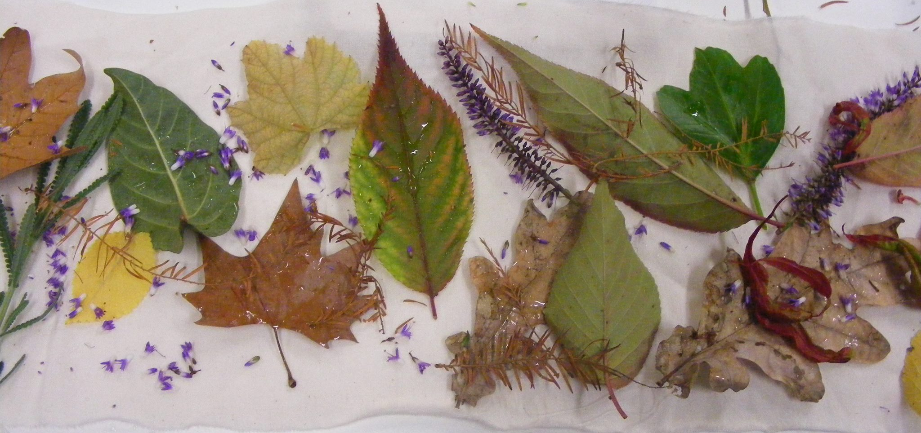
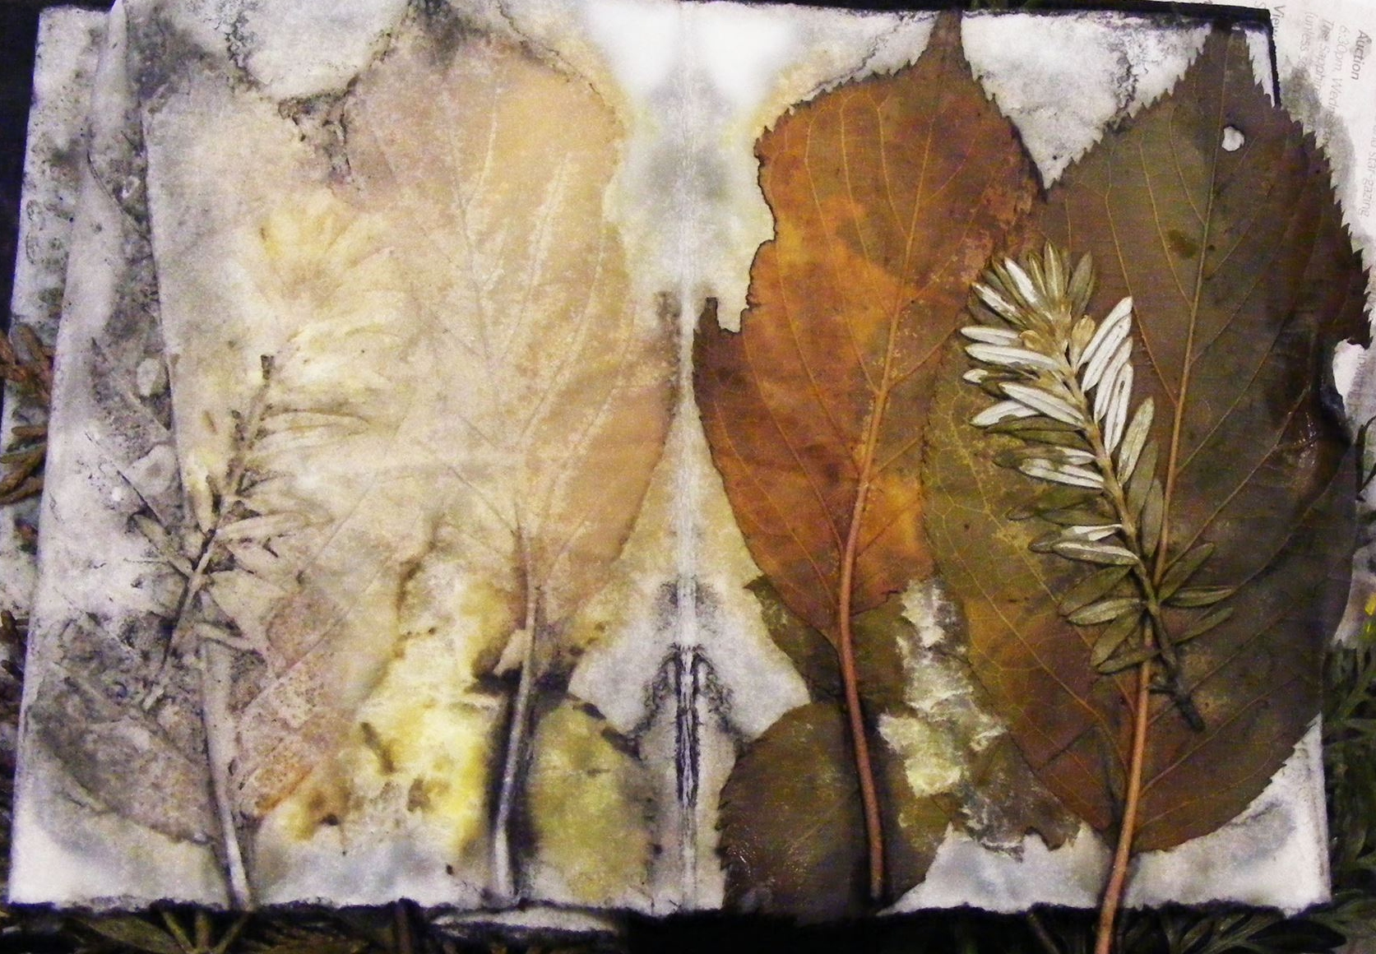
Eco printing

Slide 15
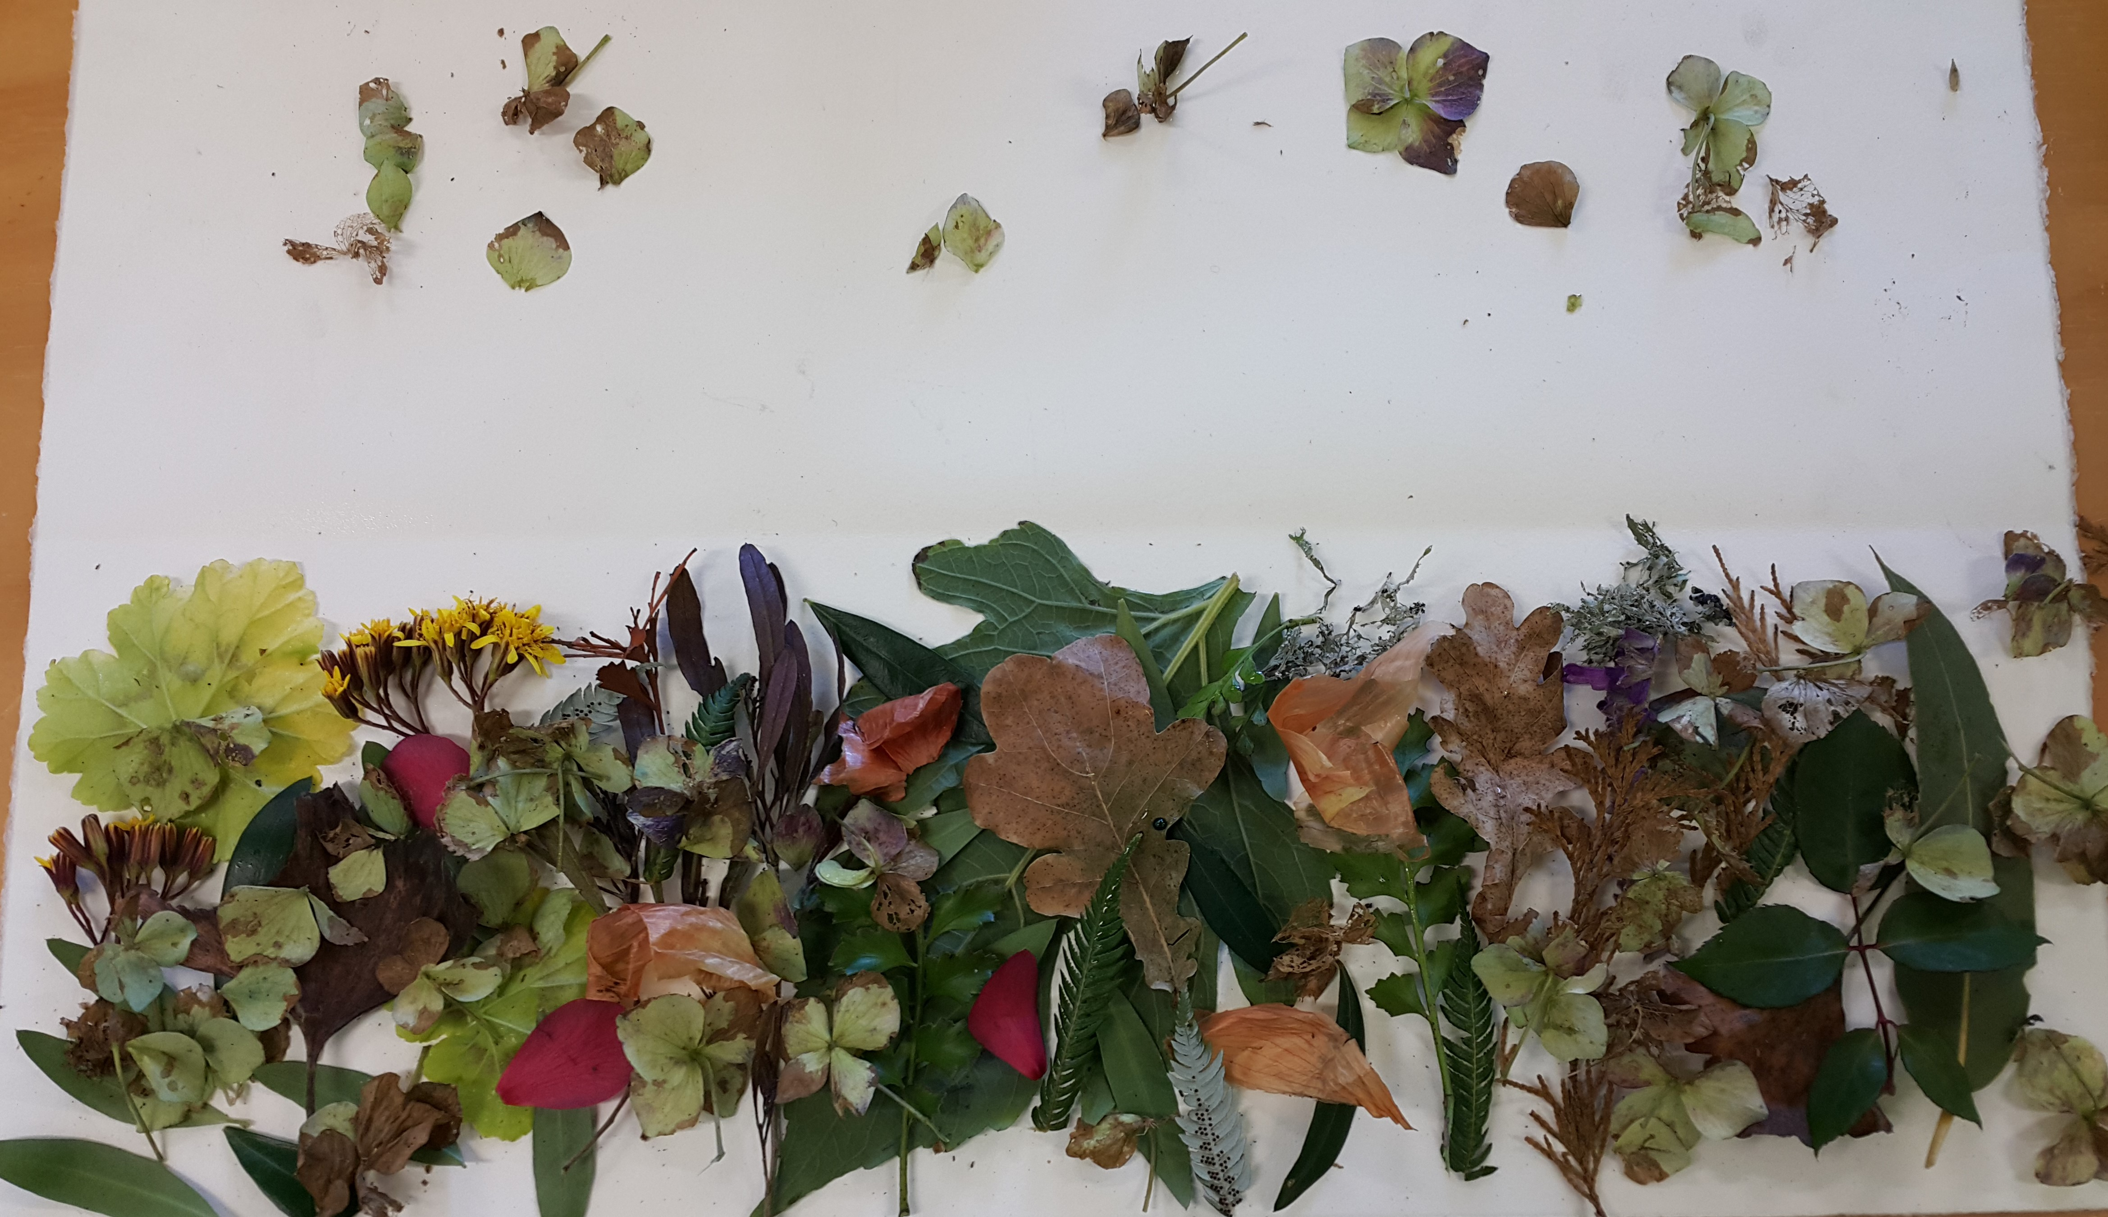
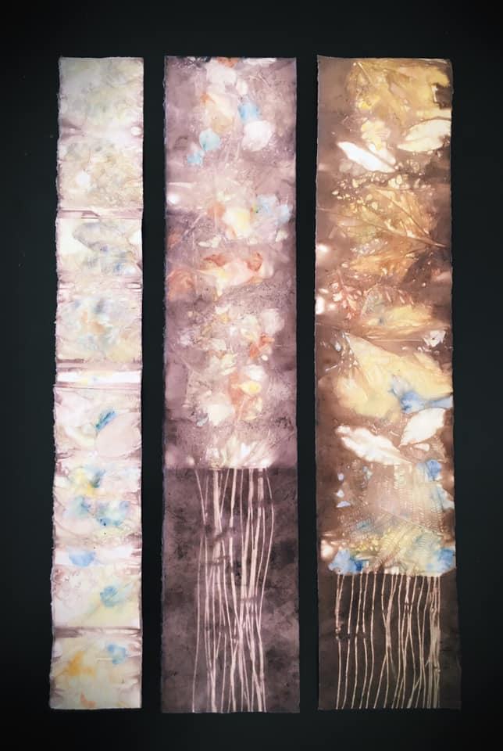
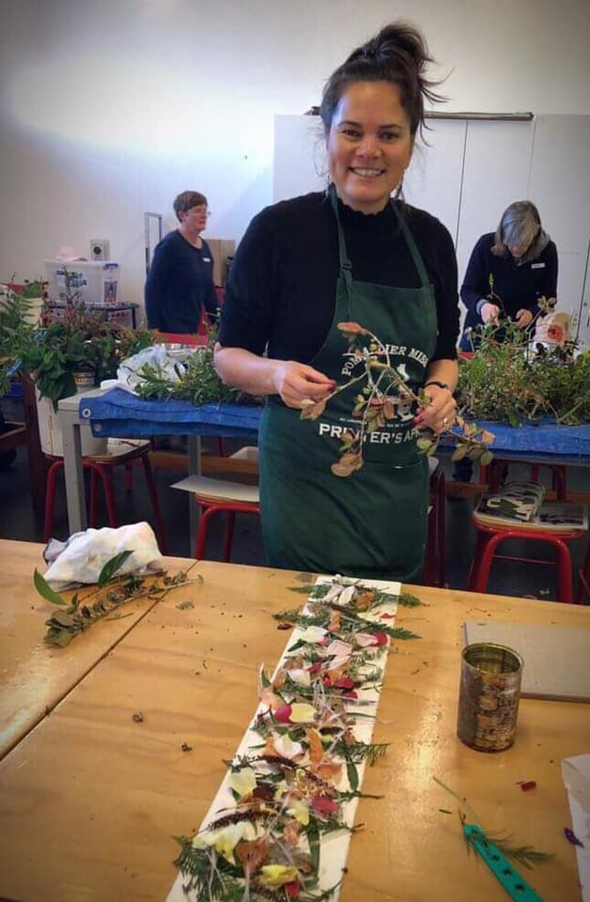
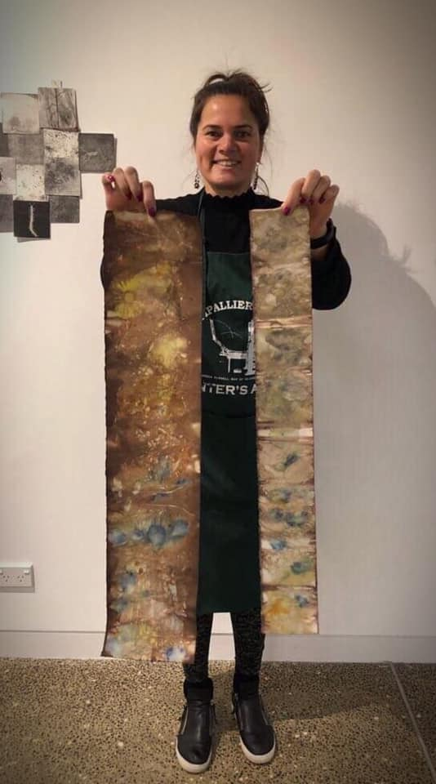
Erinna Law-Szalay

Slide 16
Eco-printing on paper tutorial: how to eco-print with a rusty can
https://www.youtube.com/watch?v=Gyc3stbuSlI
Eco-printing on paper tutorial
https://www.youtube.com/watch?v=h2GCTfySJtA
Eco Printing
Https://www.youtube.com/watch?v=gNmt5_PlTSc
Eco Printing on Watercolour Paper
https://www.youtube.com/watch?v=DyXnnnh0SuU
Any collected leaves or plant material you might like to try (eucalyptus, silver dollar, olive, rose leaf, tanikaha (celery pine), rimu, onion skins, lichen, oak leaves, etc). Petals from flowers may add colour into the background of your leaf prints (Iris, dark pansy etc). Lightly press or put between pages of a book for travelling. Best picked on the day.
(you will pool these to share in the group)
2 x 20cm approx. lengths of copper pipe and/or iron pipe and/or wood dowel and/ or PVC pipe to wrap paper around
8 large bulldog clips or similar
4 x A5 plywood piece or flat ceramic tiles to for the outer flat bundles for contact printing
String, scissors, ruler
Disposable gloves
Craft knife
smallish bits of rusty steel, washers, bolts, old hinges or any interesting steel shapes
An Old large pot/ spare hot plate
Rust water
2 or 3 pots with various coloured baths for eco dying effects, tongs, weights
One sheet of 300gsm or close - 100% cotton rag paper or equivalent, un-sized will be provided – you will be able to purchase more if you use this up.
Recipe
In a large Pot WATER APPOX. 20 LITRES, +1 CUP WHITE VINEGAR + 1 litre of Iron Water + 2 TABLESPOONS CHESTNUT TANNIN POWDER (brown tones) (or red cabbage (purple tones) or turmeric (yellow tones))
= ROLLING SIMMER 1 ½ HOURS

Slide 17
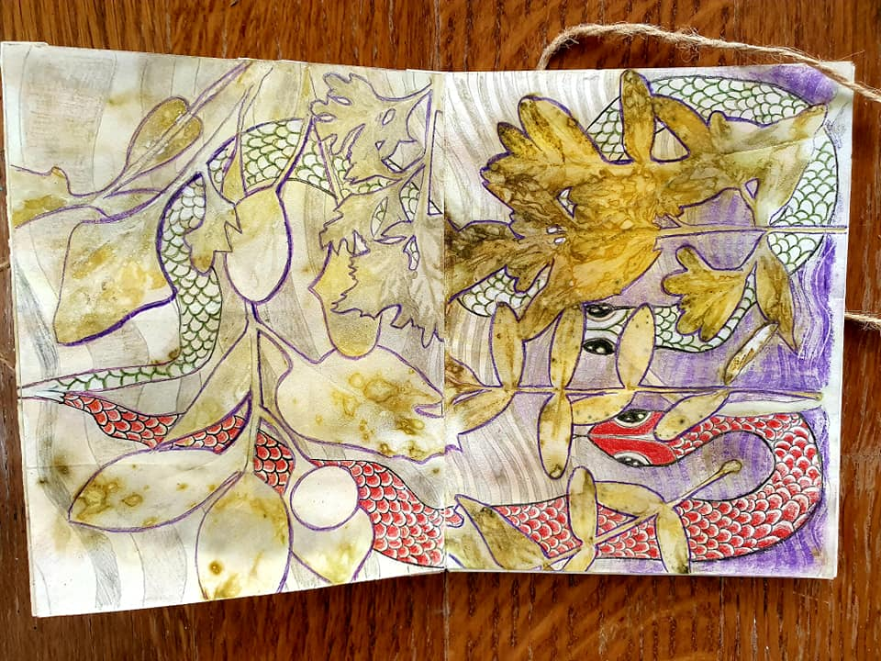
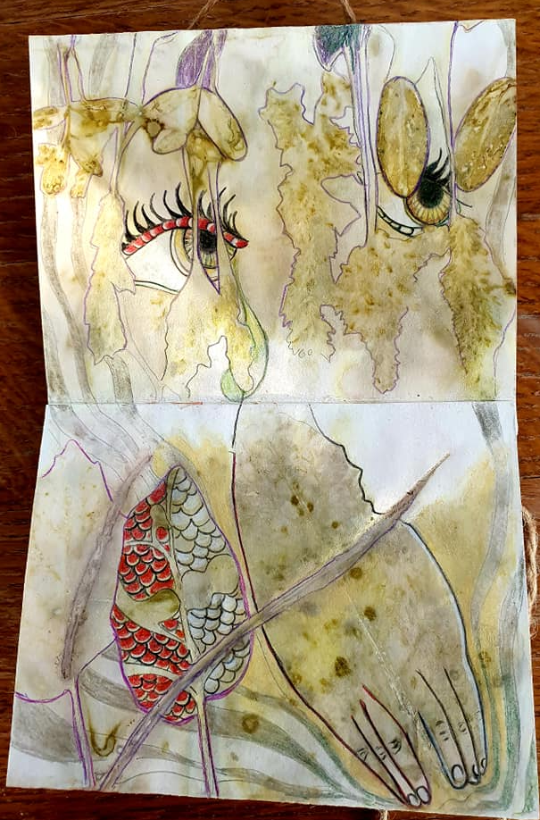
Elke Campforts drawing into eco prints

Slide 18
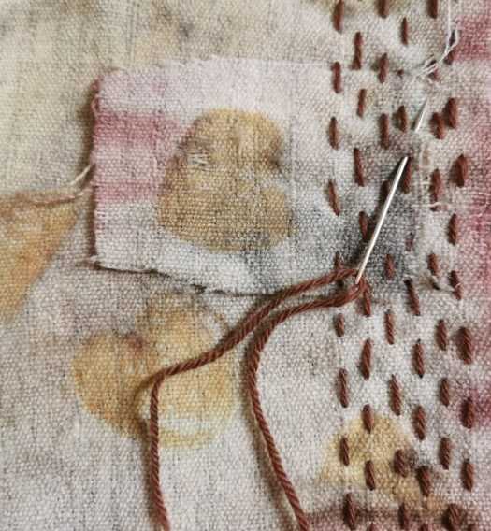
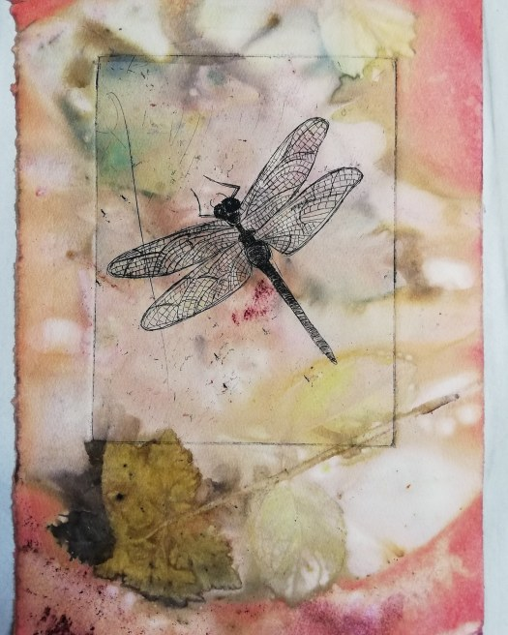
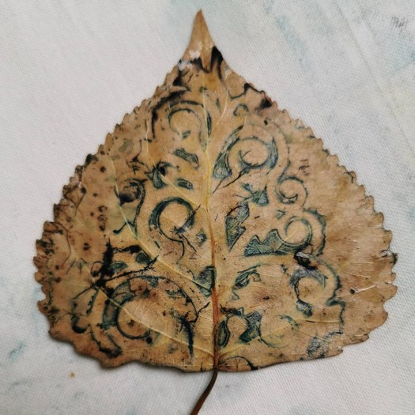
Dragonfly, Samantha Boulanger, Etching on Eco-printed Paper 2019
http://samanthaboulanger.com/blog/

Slide 19
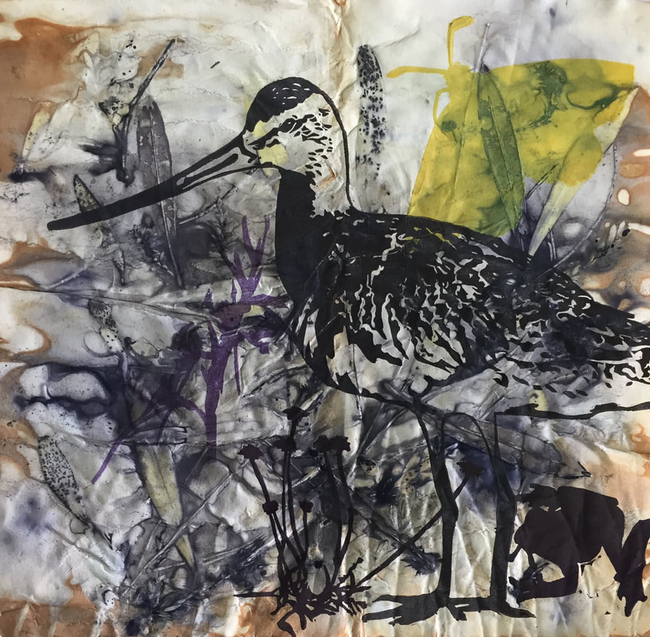
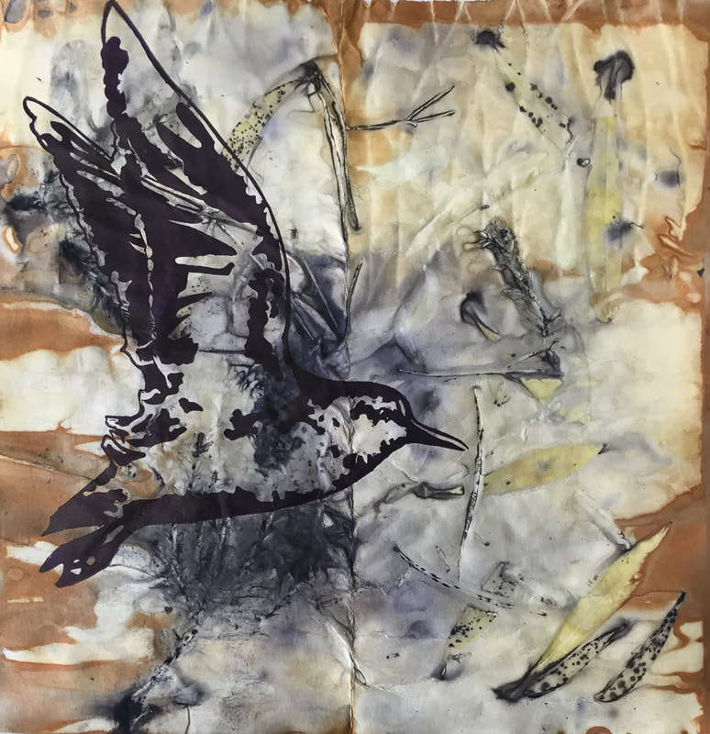
Kate Gorringe-Smith
The Godwit, the Grass Frog and the Golden Sun Moth, Linocut on eco-print, Altona foreshore, Melbourne's west
Altona Stint, Linocut on eco-print, Altona foreshore, Melbourne's west

Slide 20
Aleisha Neary 2018 eco print and dry-point print

Slide 21
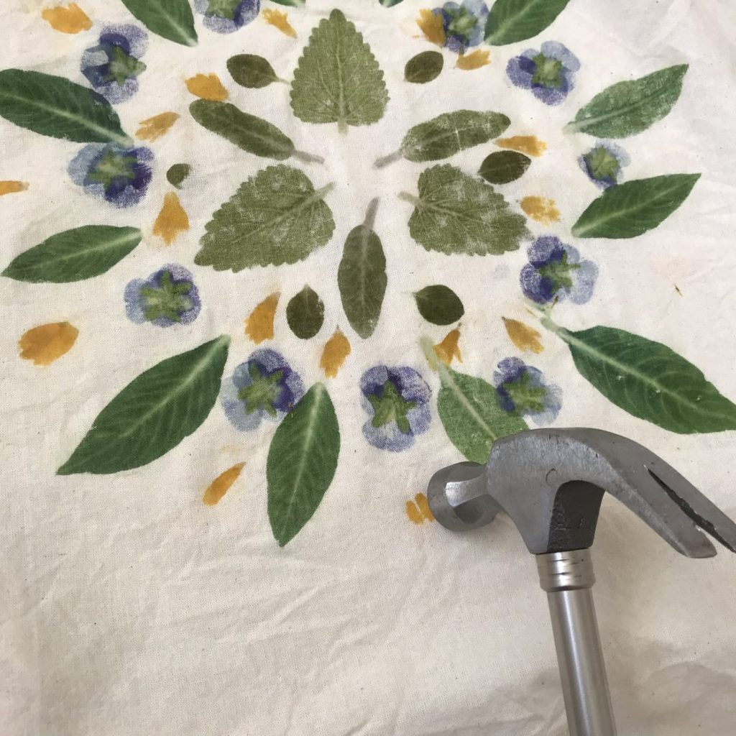
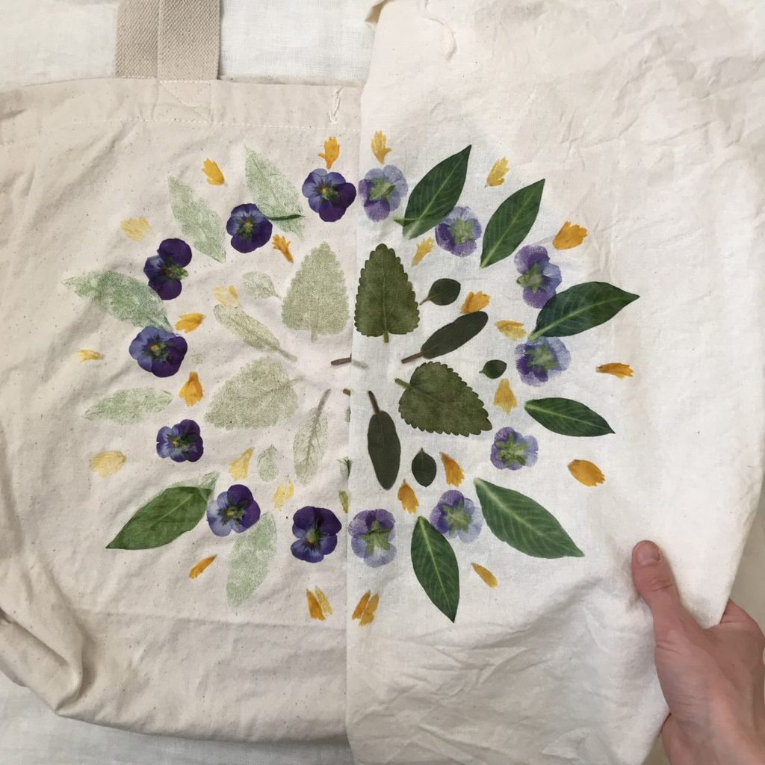
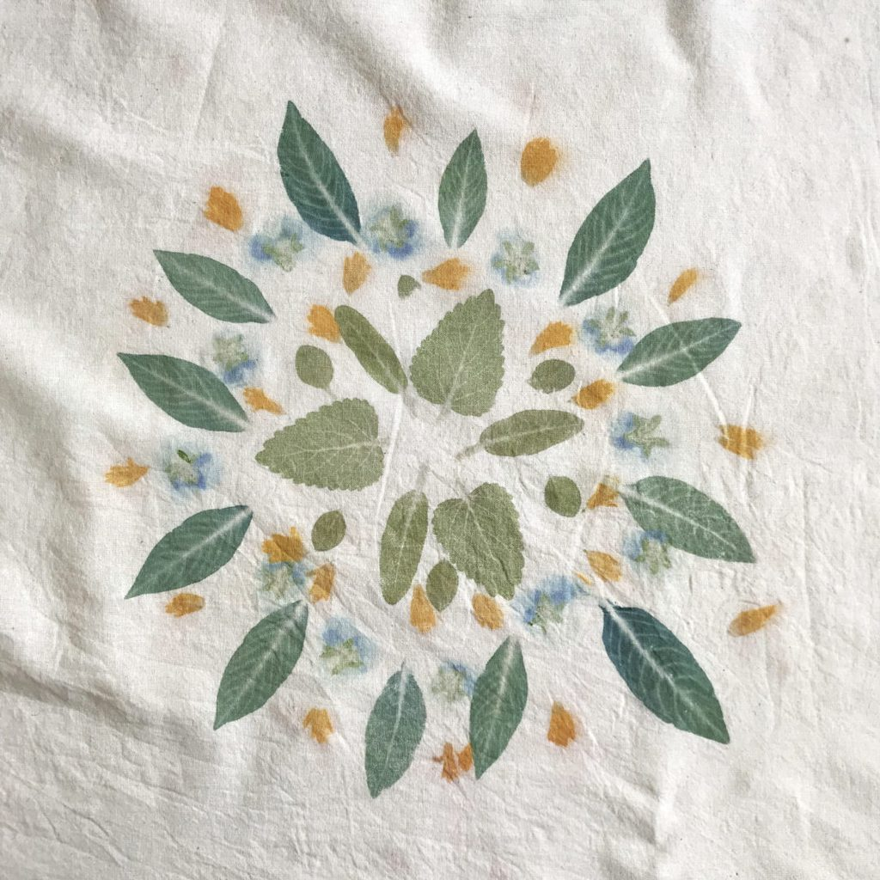
flower hammering/pounding technique https://rebeccadesnos.com/blogs/journal/a-botanical-mandala-on-fabric
I prewashed the fabric (I used a cotton bag and extra piece of fabric on top. You choose what you want to use)
I pretreated the fabric in soya milk (or alum - your choice). Make a very diluted bucket of soya milk and soak the cloth in there for 12 hours, then squeeze out as much liquid as possible and hang to dry. Then do two more dips in the same bucket of milk and dry in between. Wait a few days before hammering plants into the fabric. This will give the milk time to cure and bond with the fibres.
Making the mandala
You can create incredible results with just a small handful of plants.
Here I collected violas, dyer's knotweed (Persicaria tinctoria/Japanese indigo), lemonbalm, coreopsis, sage and oregano. You can try any plant as long as it's not poisonous.
two pieces of fabric
soya milk* or other way to pretreat/mordant fabric (you choose)
plants (check that none are poisonous)
hammer
smooth hard surface (I used a wooden chopping board)
iron
*soya milk is a binder, not a mordant, but still helps plant dyes attach to the fibres. Technically soya milk is a binder, and the chemistry involved is different to traditional mordants like alum. The end result is similar - you have dyes that last longer on fibres.

Slide 22
Cyanotype
Students need:
Packet of precoated paper from the teacher
OHT negatives or Negative sharpie drawings or cardboard silhouettes
Found objects - flat and 3D
Glass or perspects sheet
Clip board or wooden base and bulldog clips
Home essentials Hydrogen Peroxide 3% solution from chemist ( one cap full in a bucket of water makes the Blue prints more intense
3 buckets – first bucket with running water, peroxide bucket, final wash
Extend with:
Over drawing
Over printing – etchings, mono prints, woodcuts, etc….
Double exposures – move items
Different times of day – shadows created by objects
Stitching
Combining with rust prints
The process uses two chemicals:
Ammonium iron(III) citrate
Potassium ferricyanide
Teacher Prep:
Science department to mix the chemicals solutions
Store in dark
Mix two part solution in equal amounts
Coat paper in safe lighting
Store in black plastic, light proof envelopes
Use within a few days

Slide 23
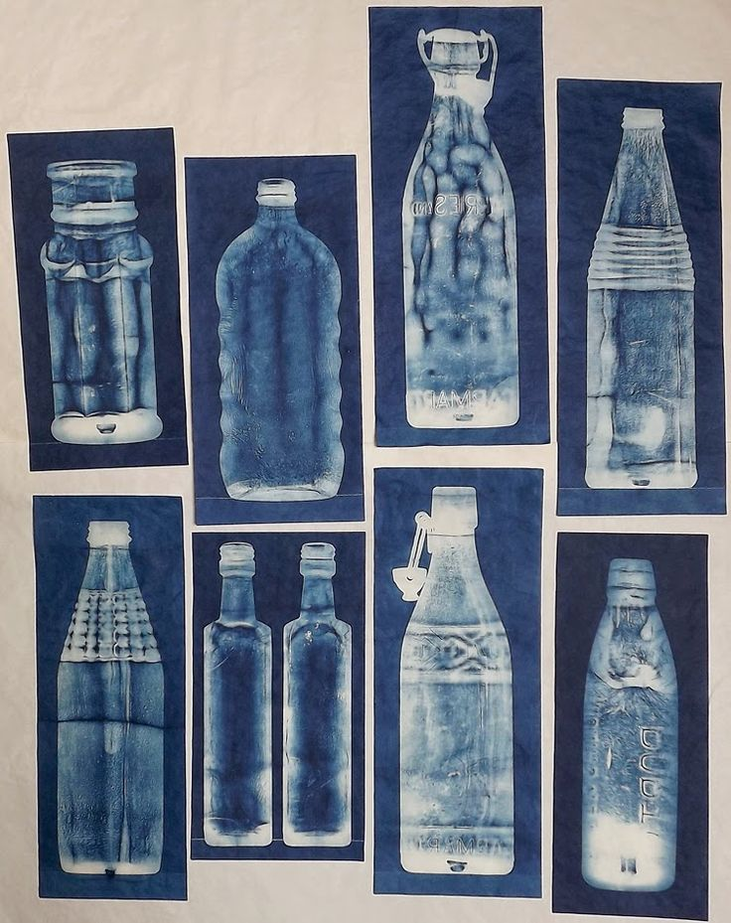
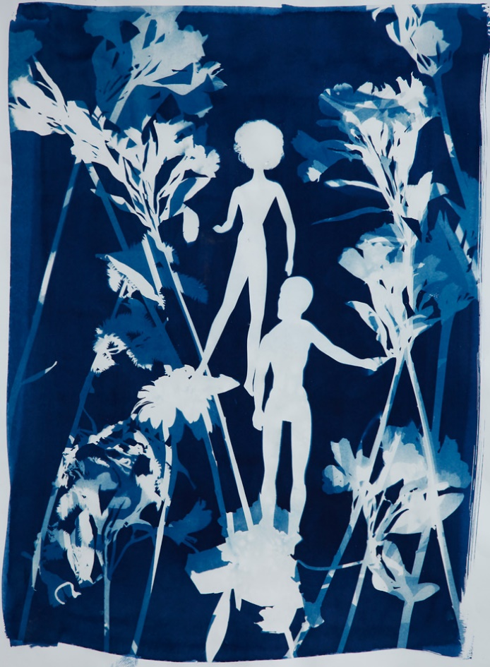
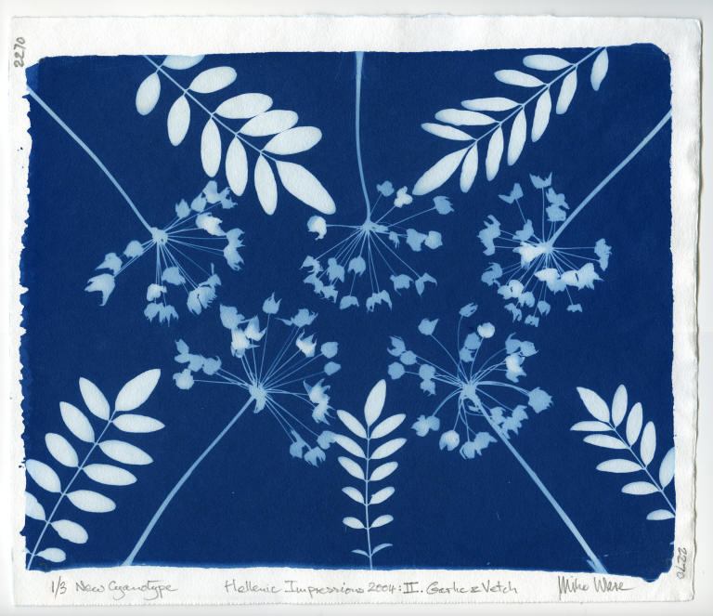
Expose the sensitized paper within a few hours of coating, if possible. It makes no difference whether the paper is heat-dried in warm air for a few minutes, or dried at room temperature for at least half an hour. Its storage life depends on the purity of the paper base, but it will keep longer in a desiccated enclosure. The coated side should remain yellow or yellow-green; if it has turned blue the highlights will be chemically fogged, so it must be rejected, and a better paper found.

Slide 24
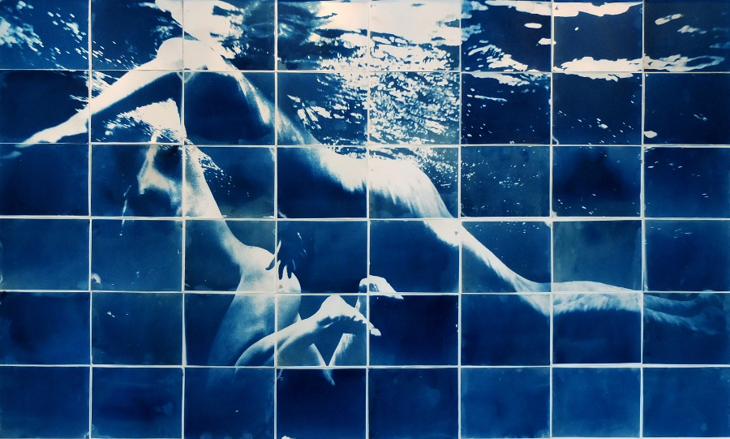
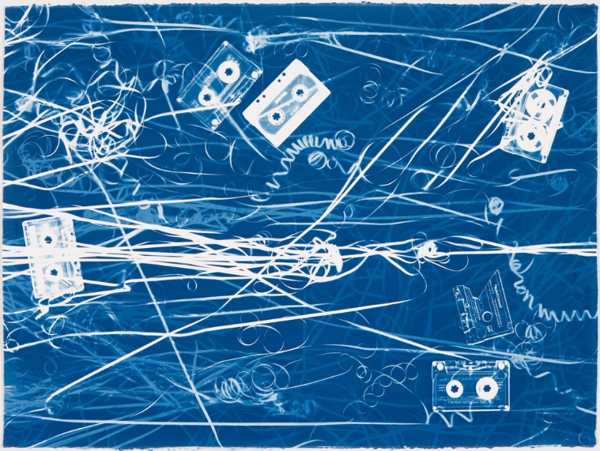
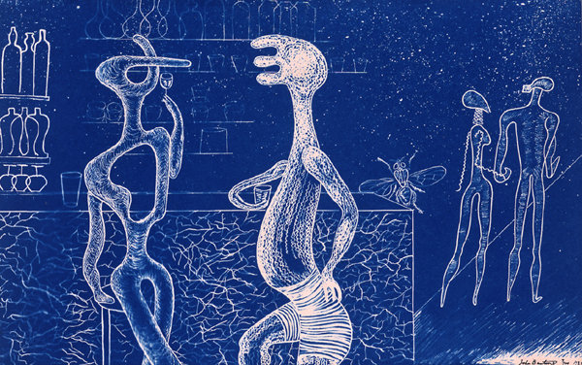
Tasks
Make at least 3 cyanotypes.
You can explore the following ideas:
Double exposure,
layering transparent and solid objects,
create a repeated pattern or mandala of leaves and flower petals
Make a cyanotype frame for another kind of drawing
Make your own negative from your bush photos and draw back into it with sharpie, chinagraph pencil and a craft knife
Make paper masks/ silhouette shapes
Use what you have around you
A record of botanical specimens like Anna Atkins
Create your own silhouette negative in photoshop

Slide 25
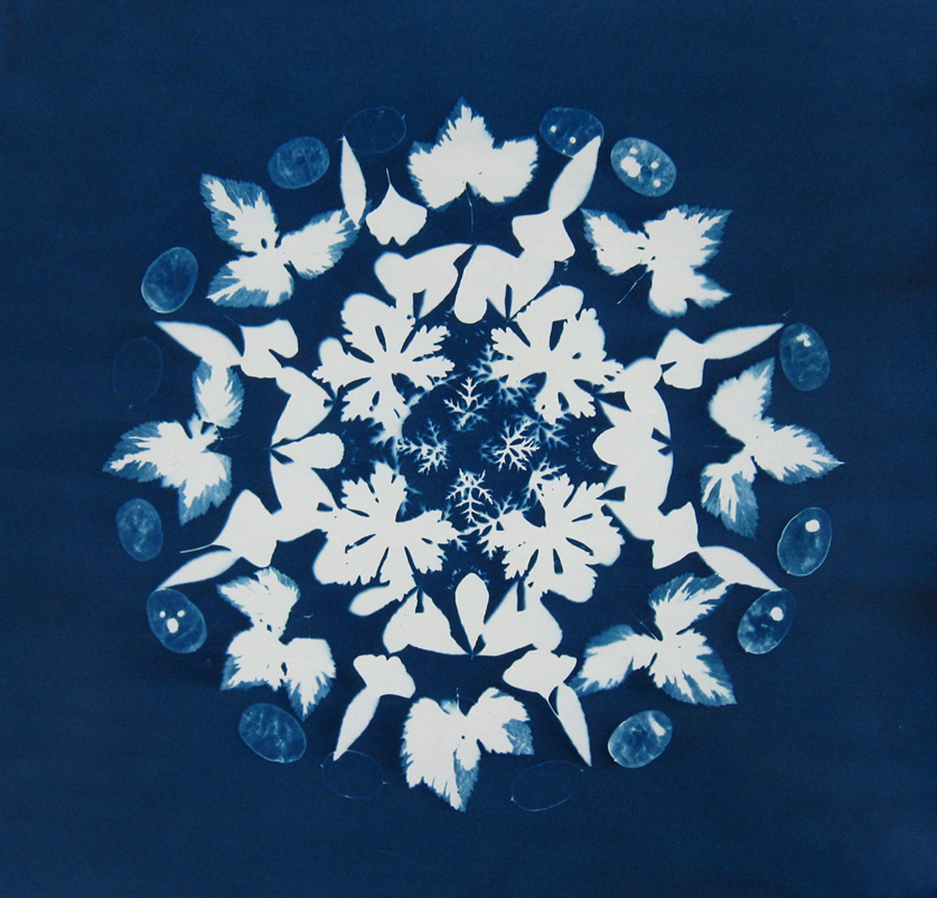
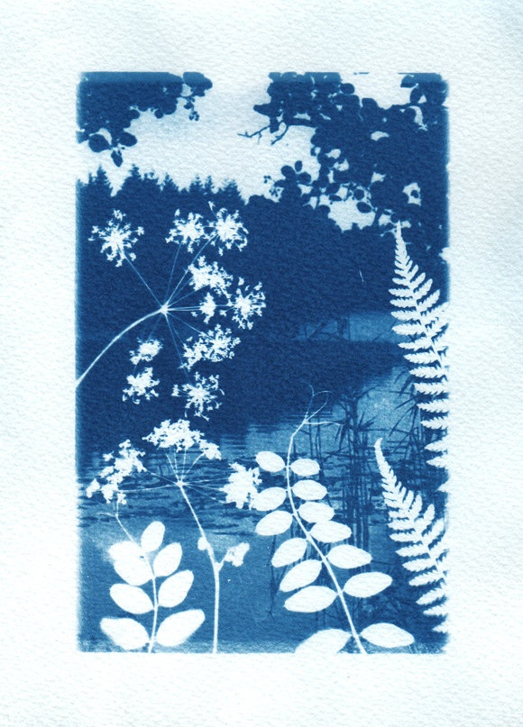
Jody Hanson, 'Cyanotype Mandala', 2015
https://www.dishwishes.ru/ru/content/25-cynotype

Slide 26
Jasmine Horton
Ngati Tuwharetoa, Ngati Rangi, Te Ati Awa ki Taranaki
Born in Palmerston North and raised in and around the Manawatu in Fielding, Taihape and Ohakune until moving to Whakatane in the Eastern Bay of Plenty at 10 years old. Jasmine has called many places in New Zealand her home and now resides with her twelve year old son in Whangarei where she has been for the past 16 years.
Jasmine graduated with a Bachelor of Applied Arts – Visual from NorthTec in 2006 and spent the following six years working in the Graphic Design industry while designing jewellery in her spare time. In 2013 Jasmine became the manager of the community owned fine art print studio Te Kowhai Print Trust. In 2018 Jasmine became the full-time Graphic Designer at Kaipara District Council where she still works today.
Jasmine’s work is very much inﬂuenced by her graphic design and jewellery background and tends to deal with the concepts of home, whakapapa, ukaipo, the whenua and our environment. Of fnding our place in our own world and the spiritual connectedness we can feel with certain landmarks, how they aﬀect our wairua and our cultural identity.

Slide 27
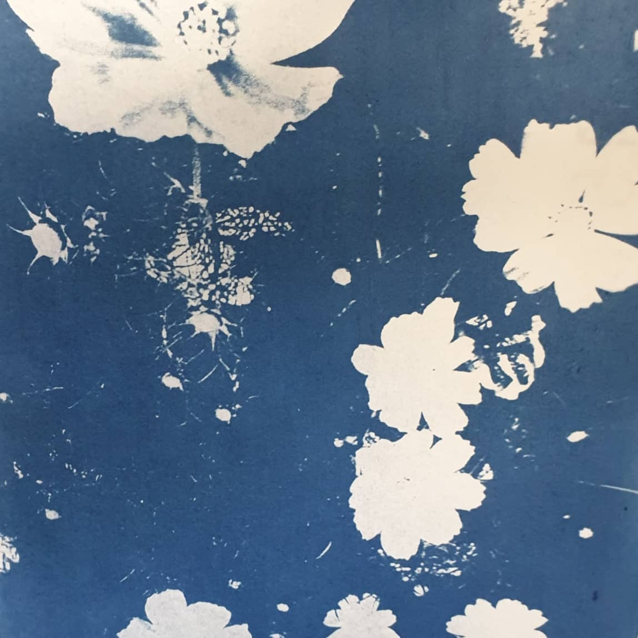
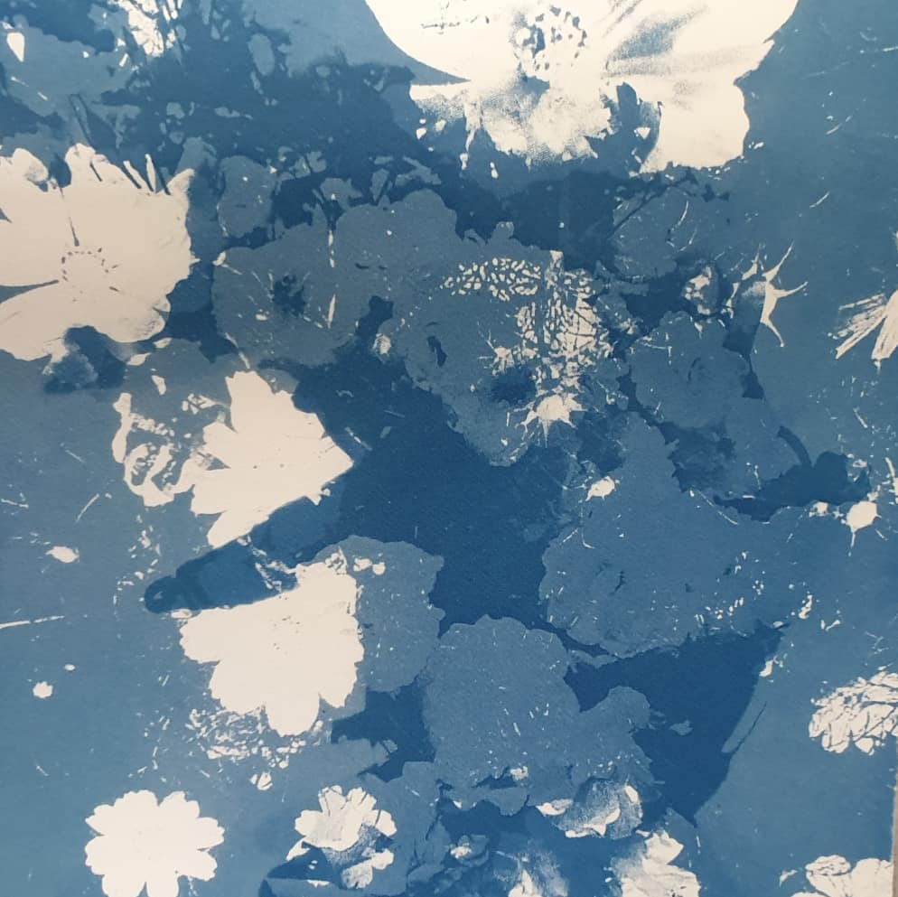
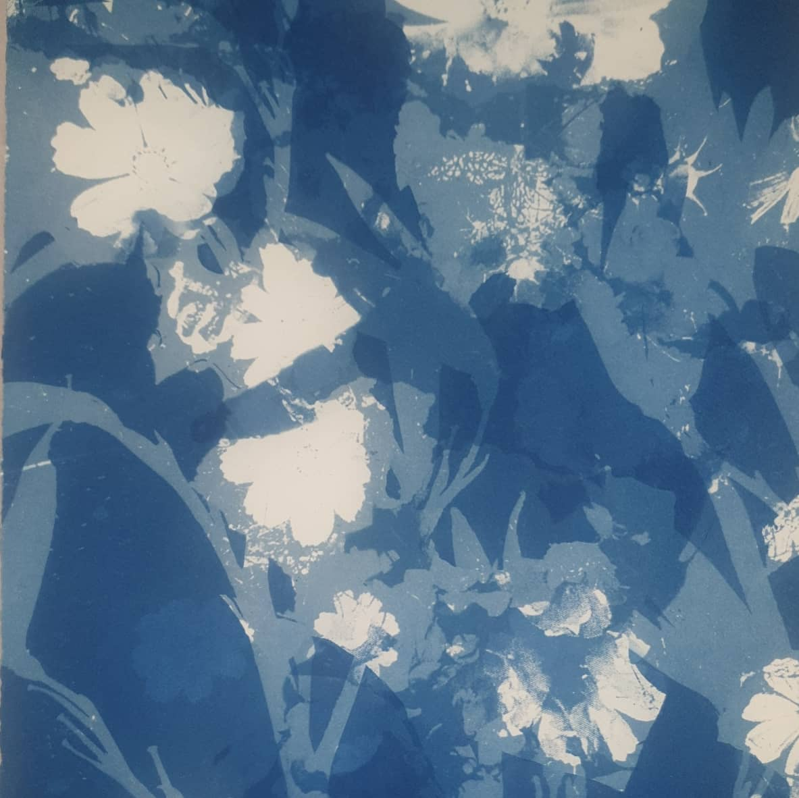
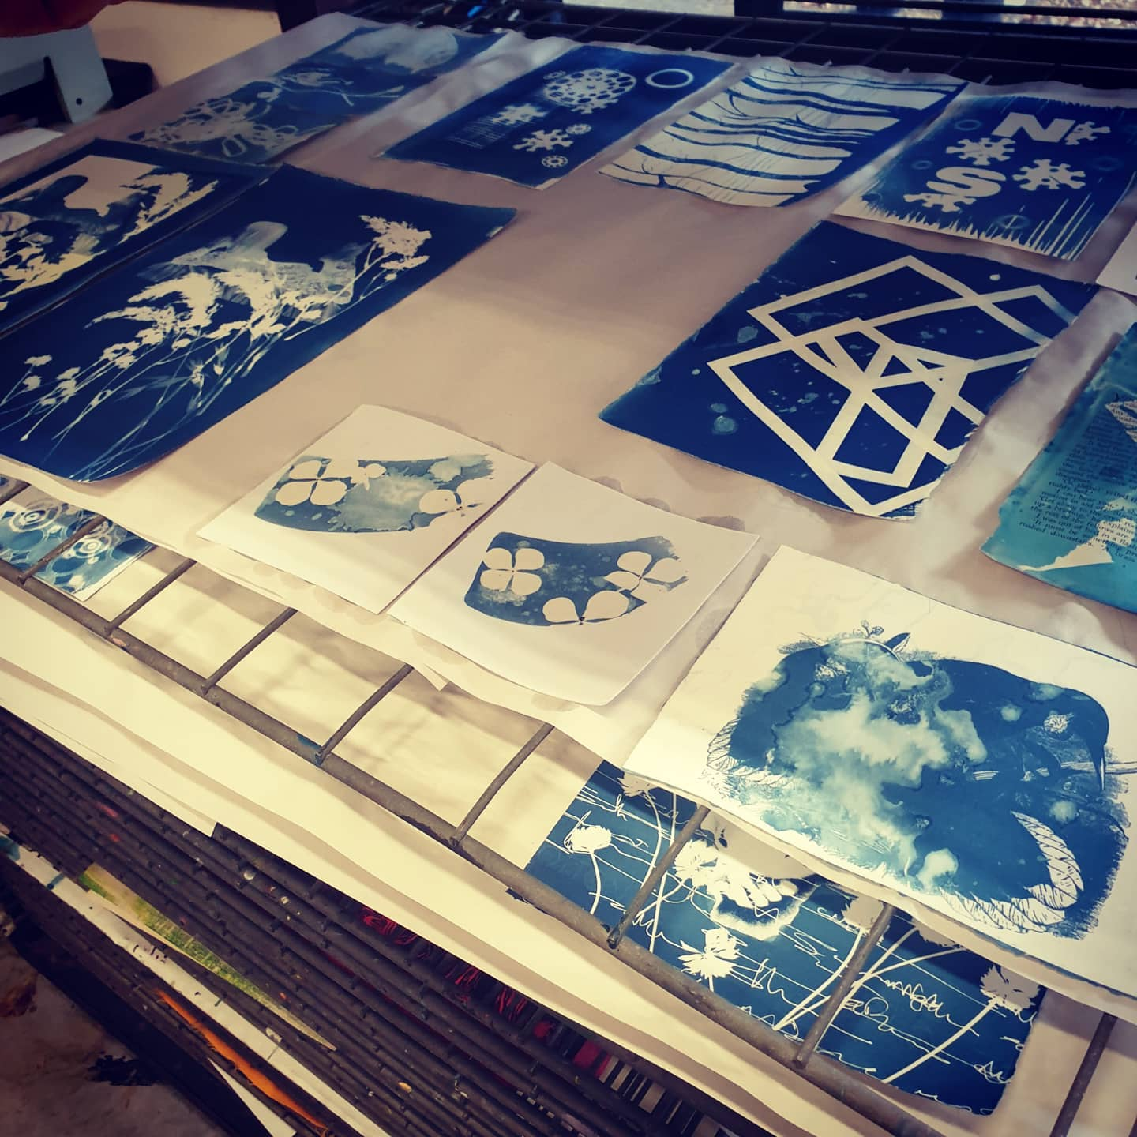
Jasmine Horton

Slide 28
Jasmine Horton

Slide 29
Jasmine Horton
“My cyanotype print created for the Suffragette show at Yvonne Rust Gallery. Marking 125 years since woman won the right to vote in New Zealand. Titled, "A Change of Clothes". An ode to the Suffragette movement and the different waves of feminism we've had since... a middle finger to feminine beauty ideals over the ages.”
https://www.facebook.com/paperlovedesign/photos/my-cyanotype-print-created-for-the-suffragette-show-at-yvonne-rust-gallery-marki/903453456527704/

Slide 30
Jasmine Horton, Cyanotypes with woodcuts

Slide 31
Jasmine Horton,
Multi-toned prints, tea-tone with regular cyanotype layer over the top.

Slide 33
Christie Taylor
Lemons by Anna Atkins

Slide 34
Einat Imber

Slide 35
inkjet prints and cyanotypes
http://stevenwillblog.blogspot.co.uk/

Slide 36
Whispers of the Positive by Wen Redmond - hand pulled print, collaged, and sewn on watercolour paper and cloth, painted with acrylics, layered with digital images, and monoprinted using inkjet prints, cyanotype, silk organza, cheesecloth, watercolour paper, ink drawings and mediums

Slide 37
KristaMcCurdyArt

Slide 38
Melissa Panter, “Death and Sainthood“, cyanotype and mixed media.

Slide 39
Tasha Lewis

Slide 40
Hollis Moore – with mono print and woodcut

Slide 41
Marilee Salvator collaboration with Kristina Arnold
Erupt, etching, screen-printing, cyanotype, sewing, ink, rhinestones, 2017, 27 x 32

Slide 42
MAX STADNIK
Cyanotype and rust print

Slide 43
Jonpaul Smith

Slide 44
Anna Watts photography

Slide 45
Louise Jackson saved to Stitched
Partridge. Cyanotype, gouache, ink, metallic pen, thread, varnish. The start of a Blue Series.

Slide 46
L Jackson, Paint and pen on Cyanotype background with hand embroidery. Buy it at Two & Six, Brixton Village

Slide 47
Collograph printing

Slide 48
Combine etching with collographs

Slide 49
Angela Smets Collographs from Framers Card

Slide 50
Esther Hansen
Relief Printing with Card Packaging https://www.youtube.com/watch?v=VeQK3zsMsHY

Slide 51
Kate Stenger

Slide 52
Nigel Oxley

Slide 53
Teresa rinder
"Blue and orange", Mixed Media, 2020.

Slide 54
Mono Printing

Slide 55
Golden Open acrylic mono printing

Slide 56
Belinda Griffiths
Belinda Griffiths

Slide 57
Lynn Brofsky

Slide 58
Edgar Degas Monoprints

Slide 59
Chelsea Twiss layered mono prints

Slide 60
Chelsea Twiss
Layered mono prints

Slide 61
Sophie Lécuyer

Slide 62
Sophie Lécuyer

Slide 63
Sophie Lécuyer

Slide 64
Sophie Lécuyer

Slide 65
Sophie Lécuyer

Slide 68
Sophie Lécuyer monoprint animation
FLORA
https://vimeo.com/315298912
FLORE, premier court-métrage d’animation de la graveuse nancéienne Sophie Lécuyer
https://www.youtube.com/watch?v=3cpeNGPDrrQ

Slide 69
Jason Greig (NZ printmaker)

Slide 70
Emmi Whitehorse

