Slide 1
Mono printing – Textures, Collographs, Pronto plates and monotypes

Slide 2
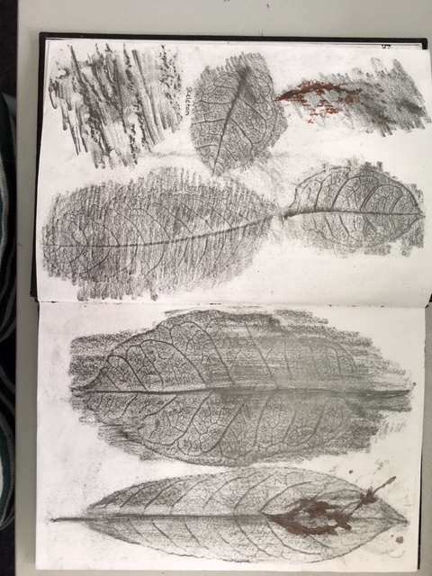
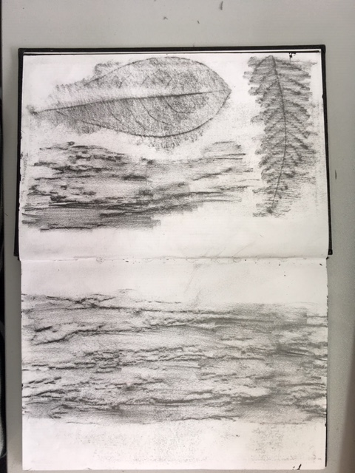
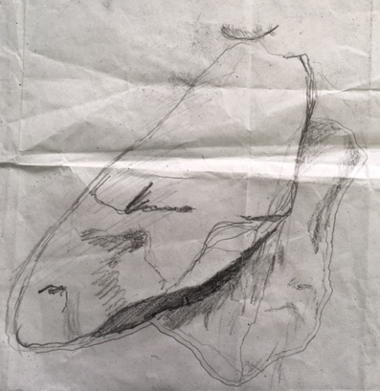
Experimental drawings Frottage
PHS Student Aleisha Neary 2018

Slide 3
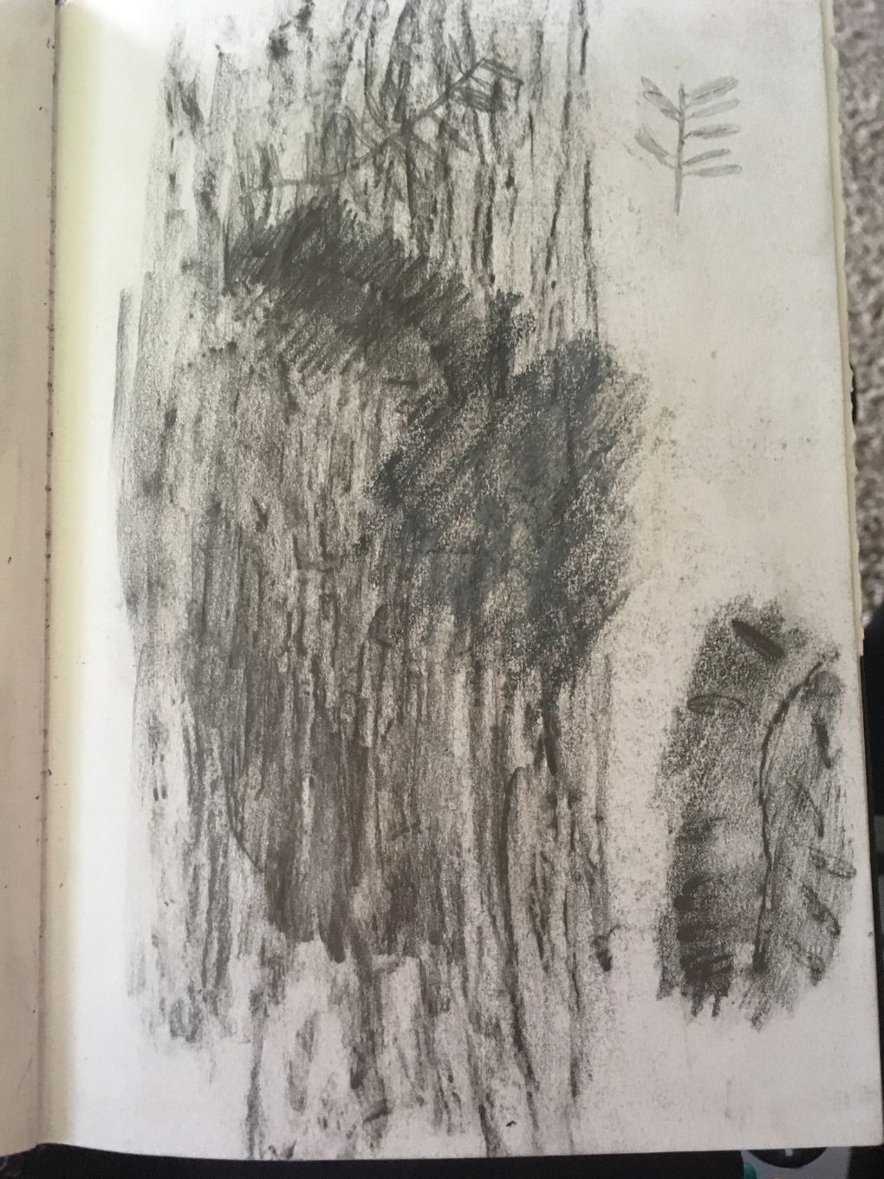
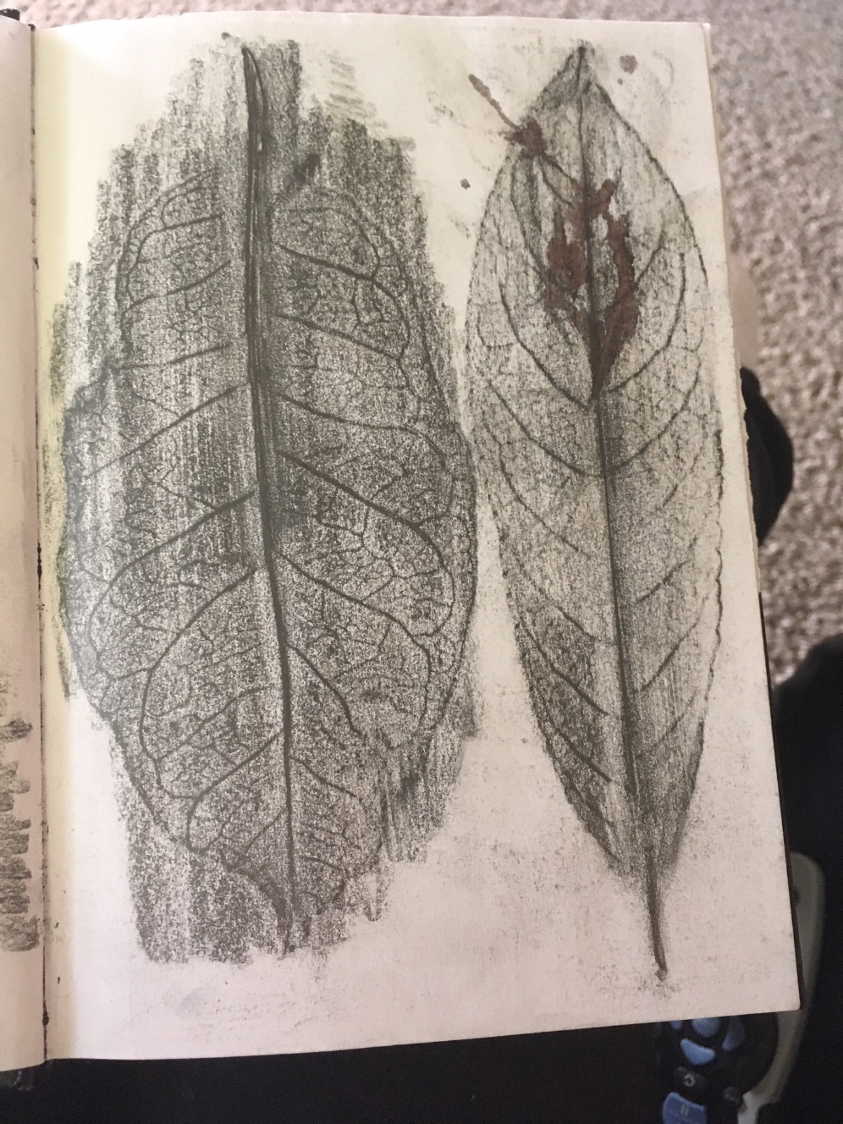
Experimental drawings
PHS Student Aleisha Neary 2018

Slide 4
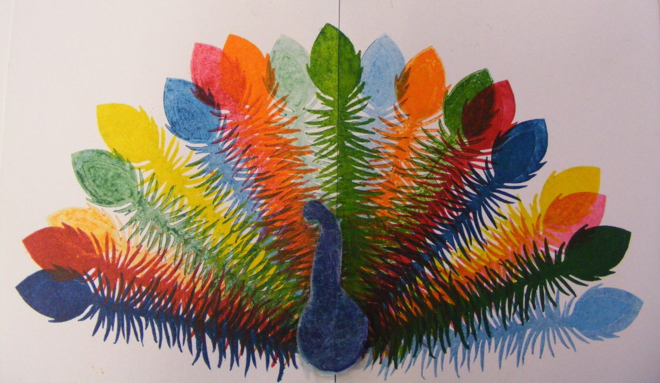
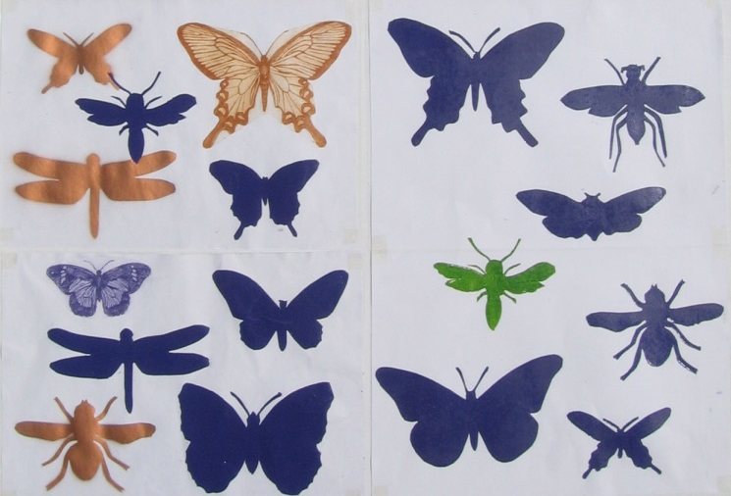
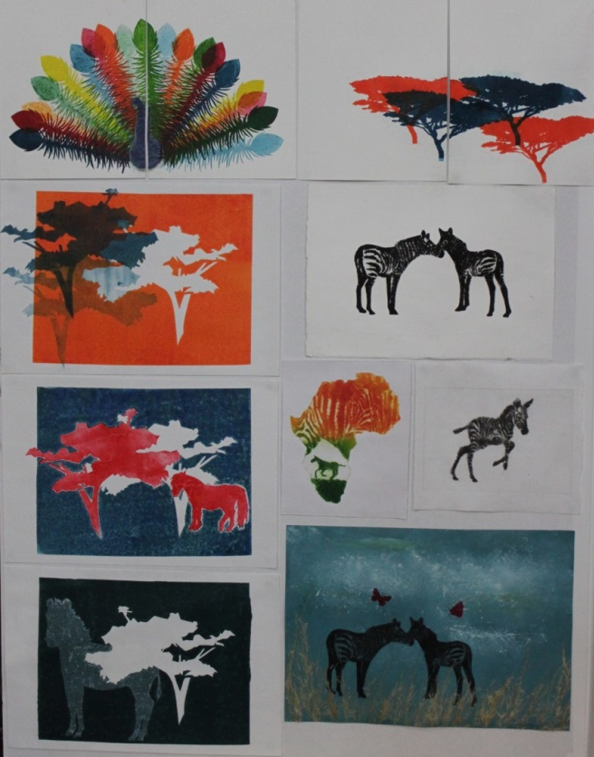
Combine etching with collographs

Slide 5
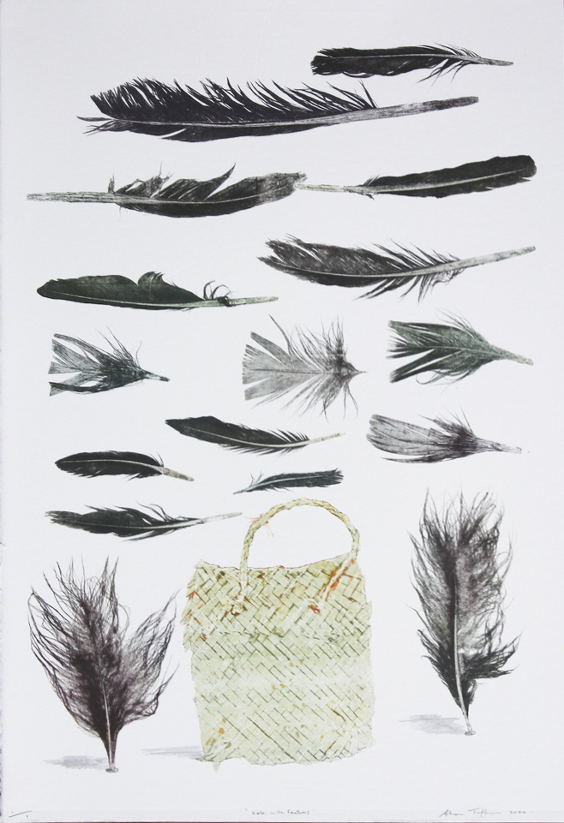
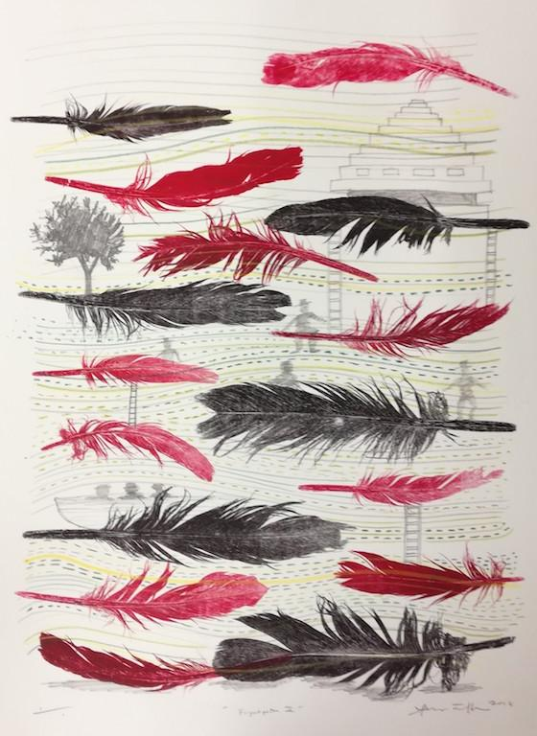
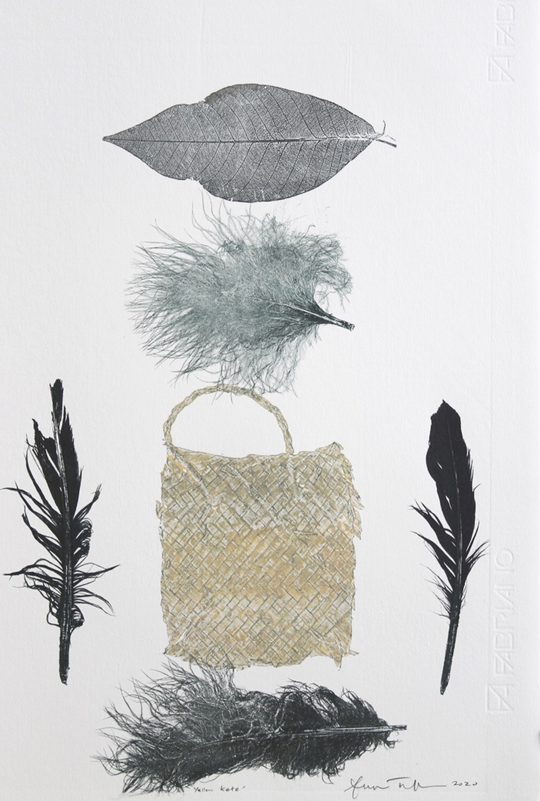
Kete with Feathers II, $495.00
Flightpath 2, $459.00
Yellow Kete, $495.00
Sheyne Tuffery
https://www.sheynetuffery.com/collections/printmaking

Slide 6
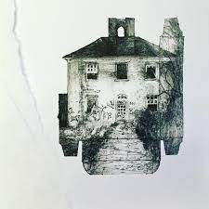
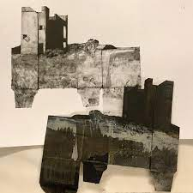
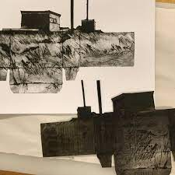
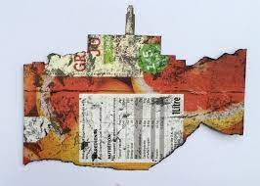
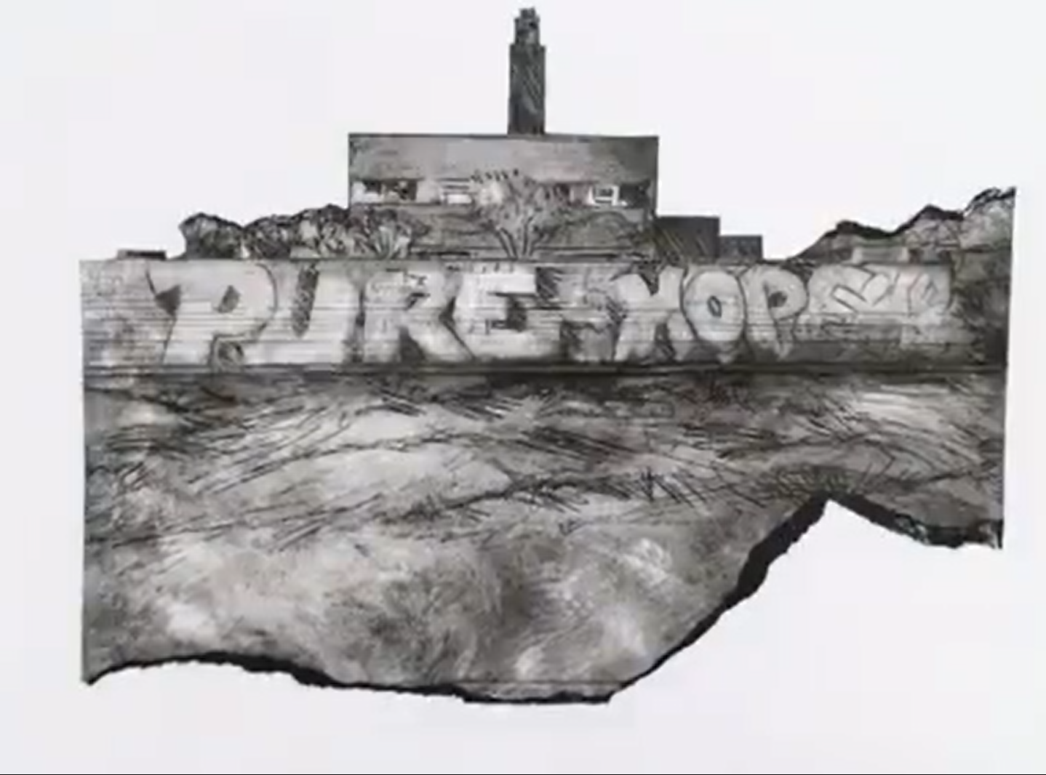
Karen Wicks
https://www.instagram.com/iacartroom/
https://www.facebook.com/ghostbuildings/

Slide 7
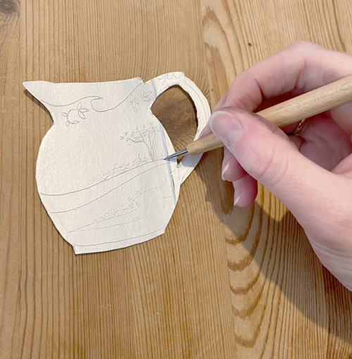
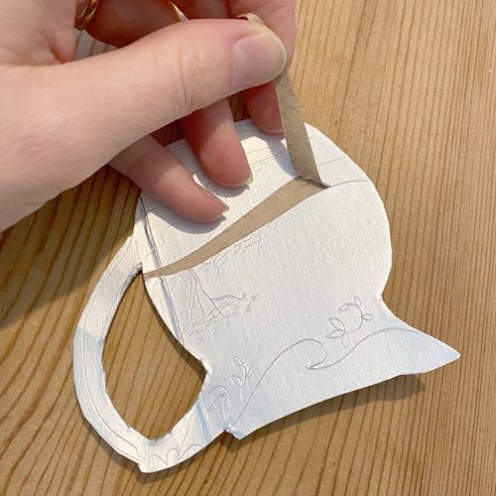
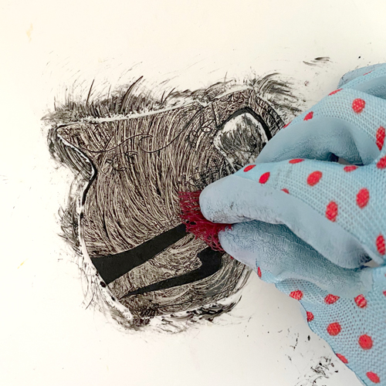
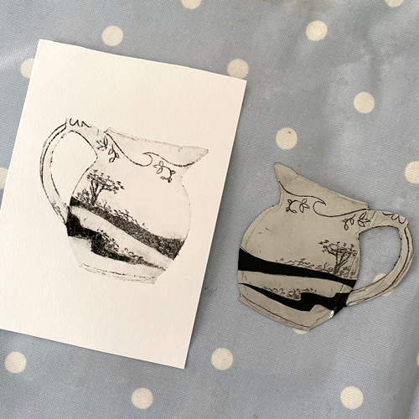
Tetra Pack printing
Lo-fi Printmaking: Drypoint Etching with tetra paks, using a pasta machine
https://www.youtube.com/watch?v=_zMPBgRXaFU\
https://handprinted.co.uk/blogs/blog/tetra-pak-drypoint-and-collagraph-printing

Slide 8
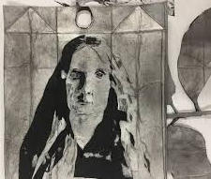
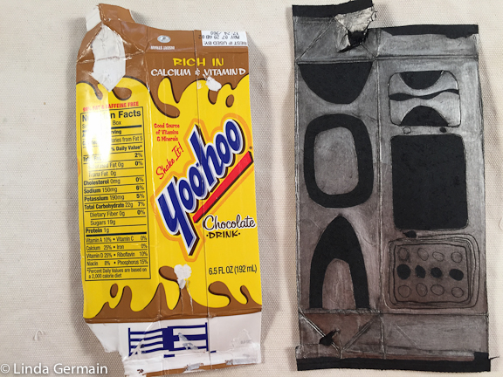
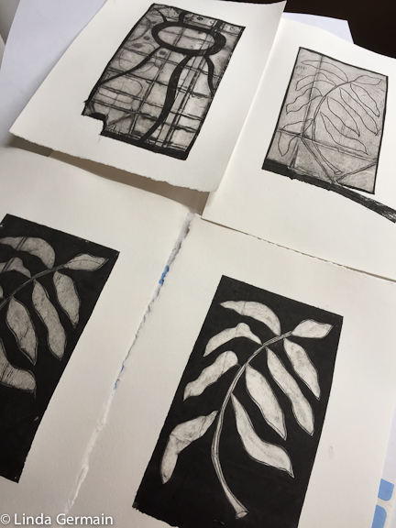
Linda Germain

Slide 9
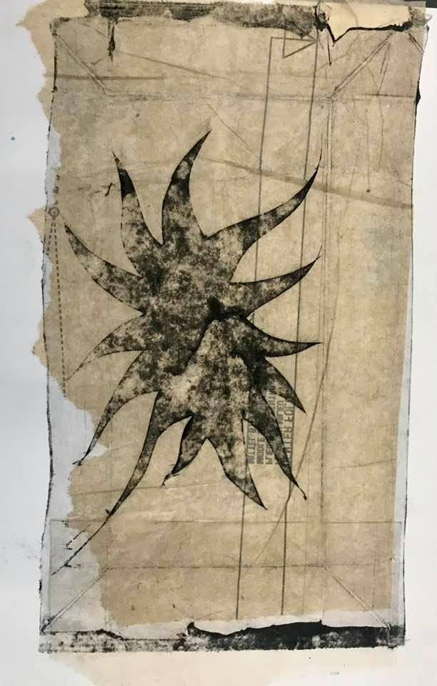
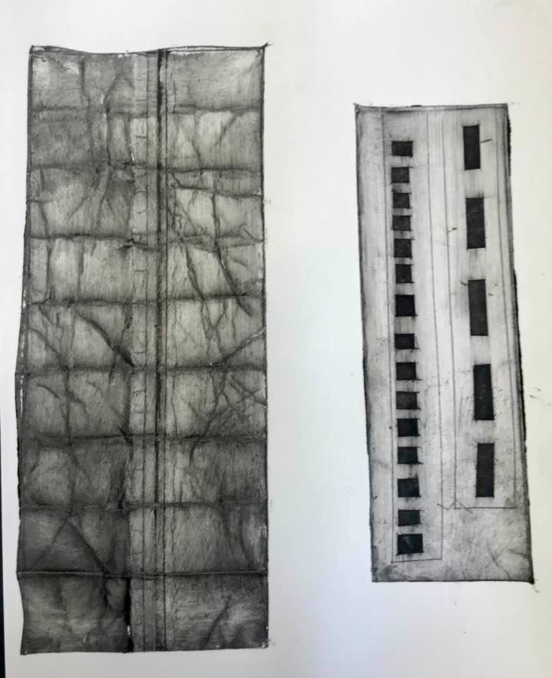
Tetrapak printing workshop with Kathy Boyle

Slide 10
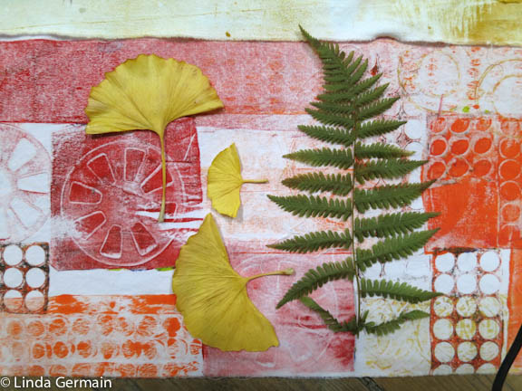
Found Stencils
Stencil Ideas for the Make Stencil Workshop with Linda Germain
https://www.youtube.com/watch?v=OrajhSw5ppw&feature=emb_logo

Slide 11
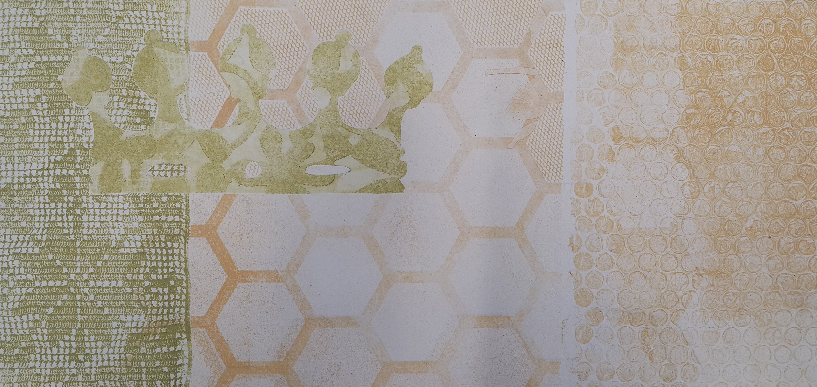
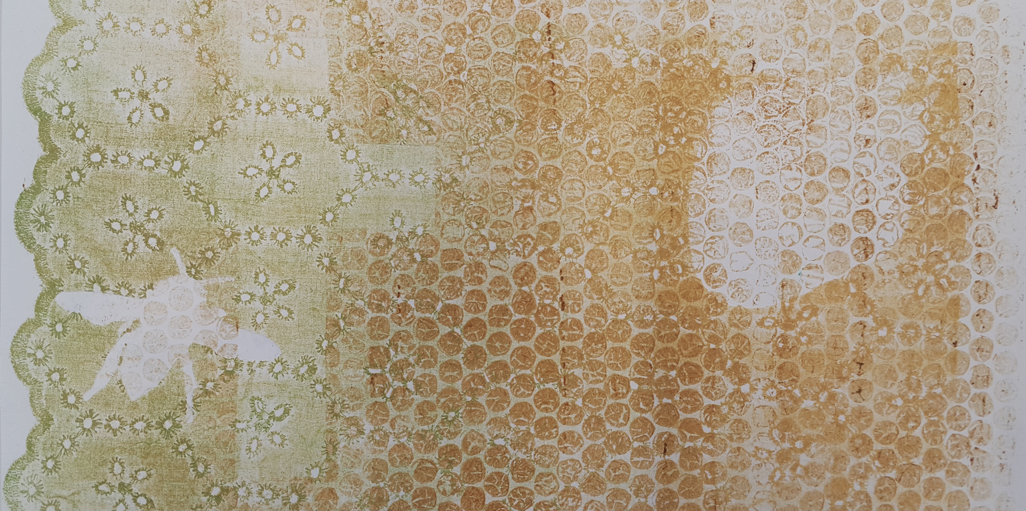
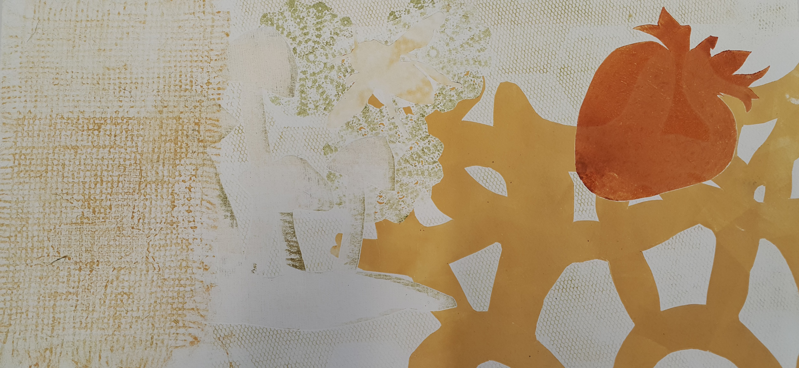
Layered printed texture
Esther Hansen

Slide 12
Jodi Tautari and Esther Hansen collaborative prints

Slide 13
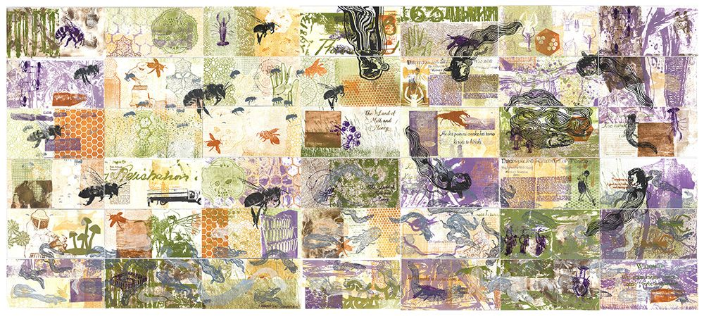
Jodi-Ann Tautari and Esther Hansen "Mohinui Block and the Bee Box Testaments" 2020.

Slide 14
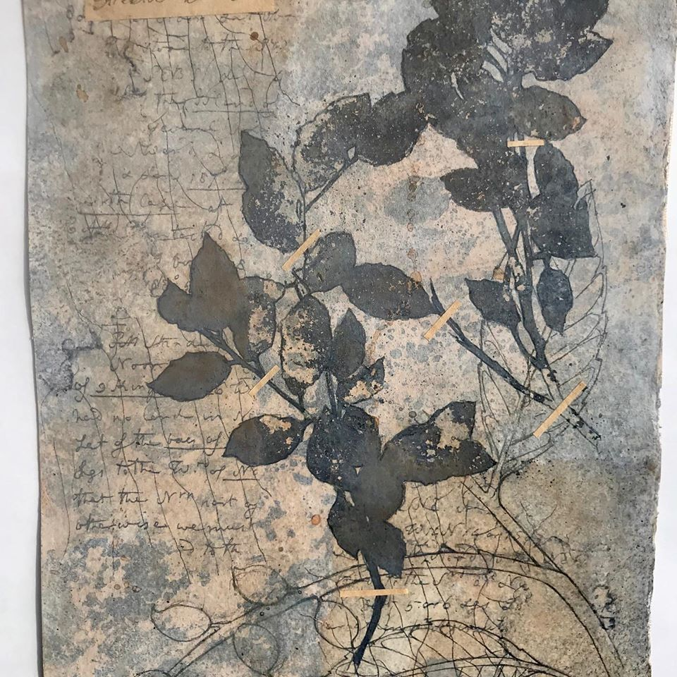
Kathy Boyle art https://www.kathyboyle.nz/books

Slide 15
Irina Gonzales tetra pack collagraph

Slide 16
Marian Haf – collograph plates
https://www.instagram.com/p/CNQNlmRsJX5/
https://www.etsy.com/nz/shop/MarianHaf
https://handprinted.co.uk/blogs/blog/meet-the-maker-marian-haf

Slide 17
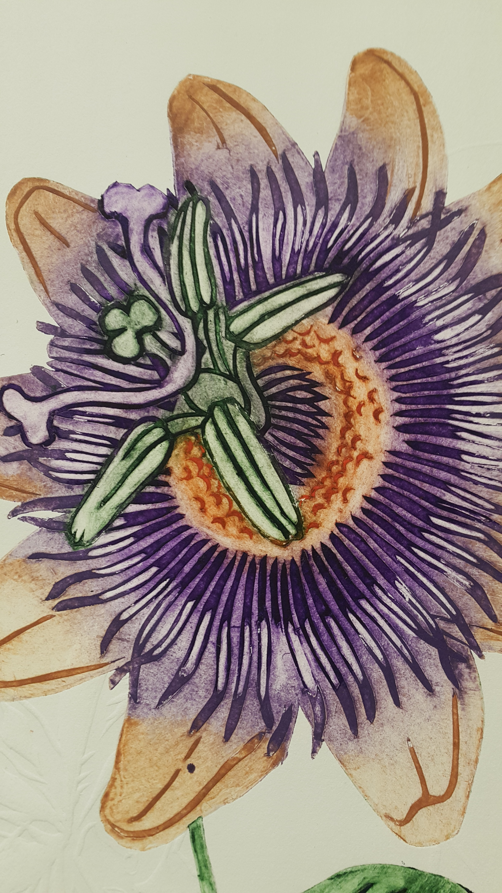
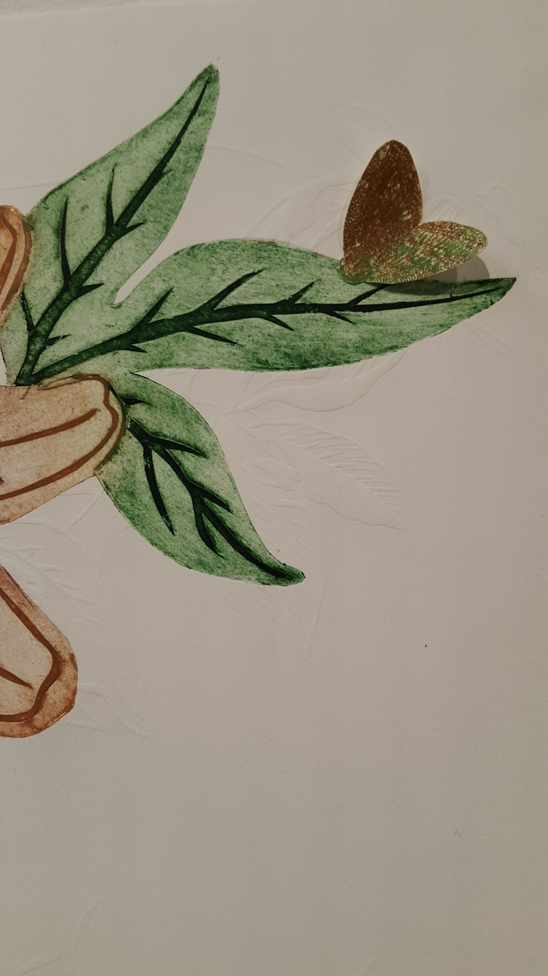
Esther Hansen

Slide 18
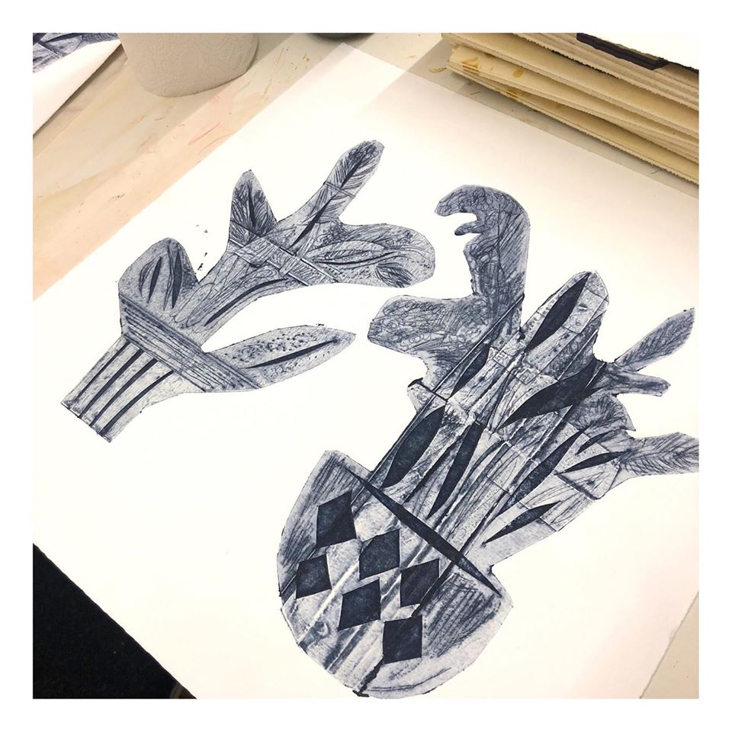
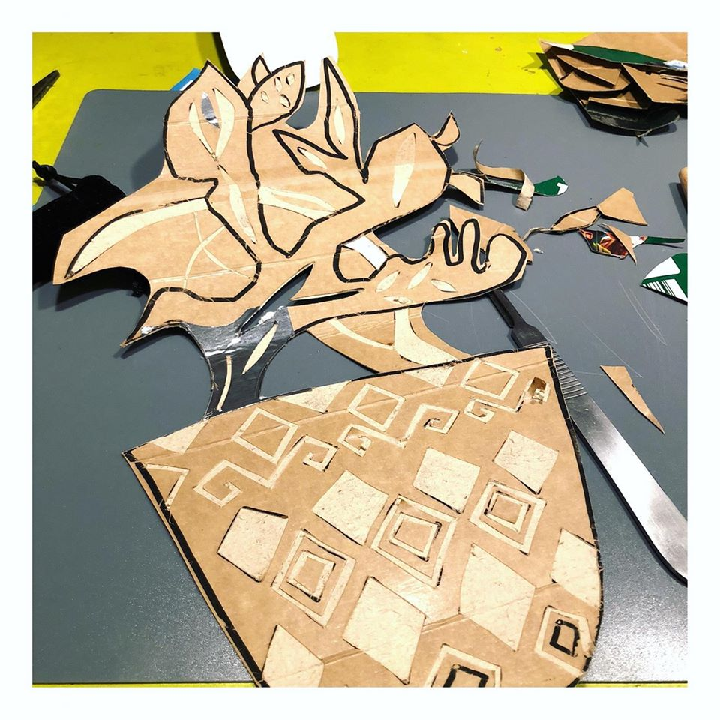
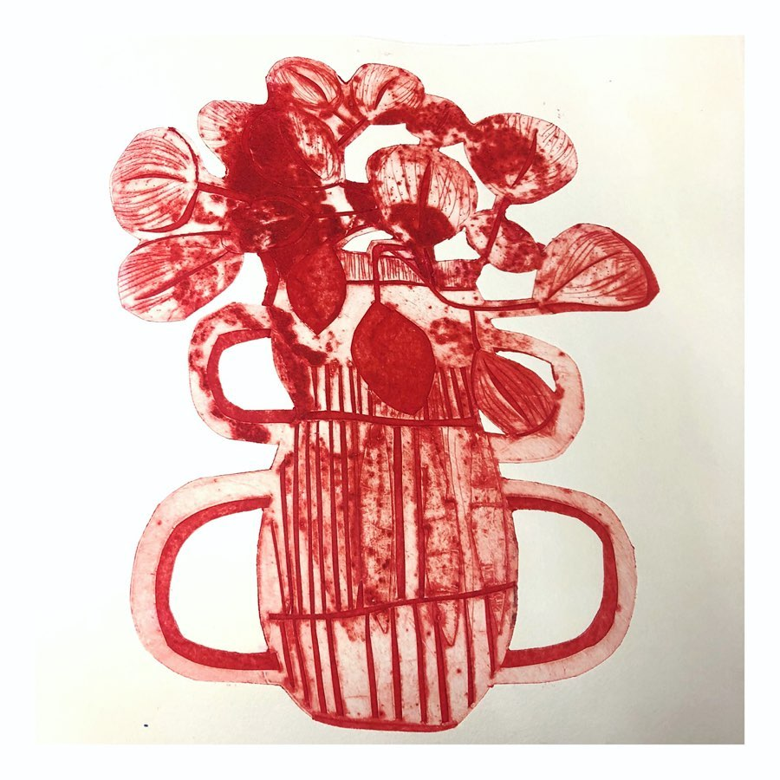
Angela Smets
https://www.picuki.com/profile/angela_smets

Slide 19
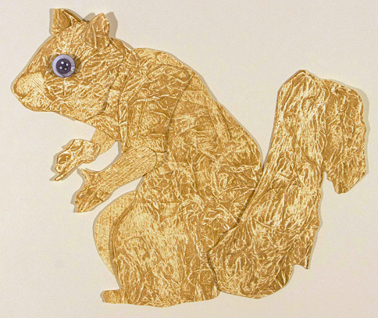
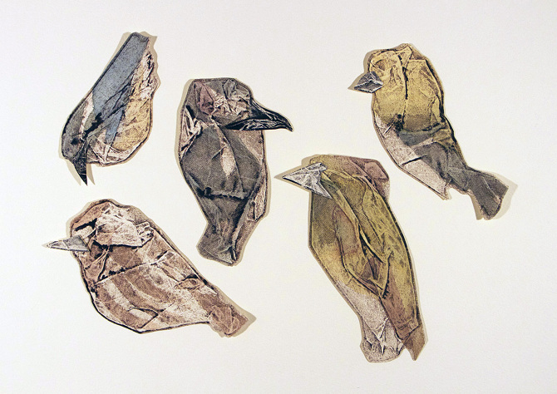
Kate Stenger

Slide 20
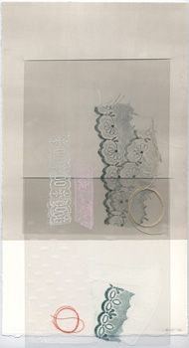
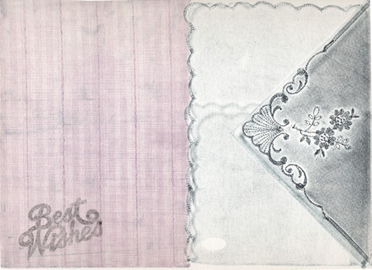
Rebecca Thompson

Slide 21
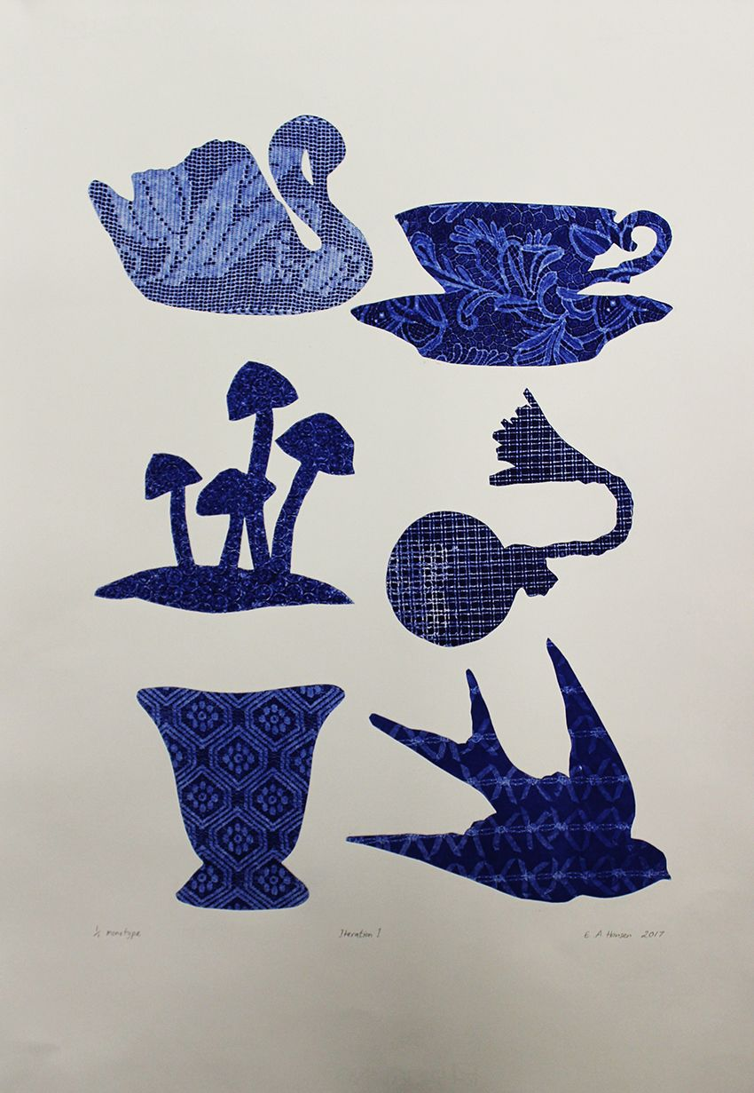
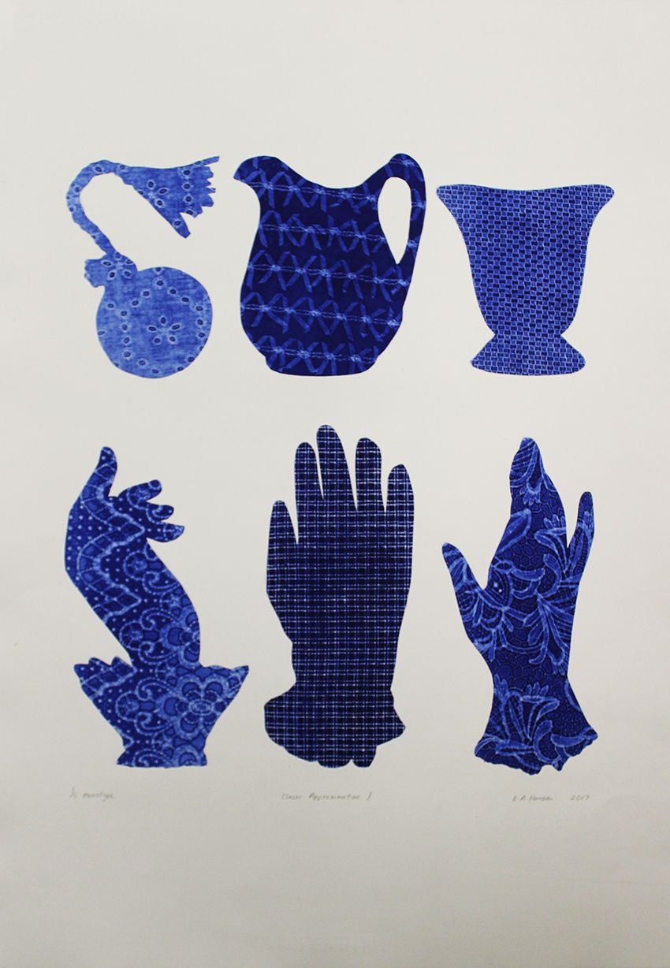
Esther Hansen,
https://www.pinterest.nz/triffidgirl72/esthers-art/

Slide 22
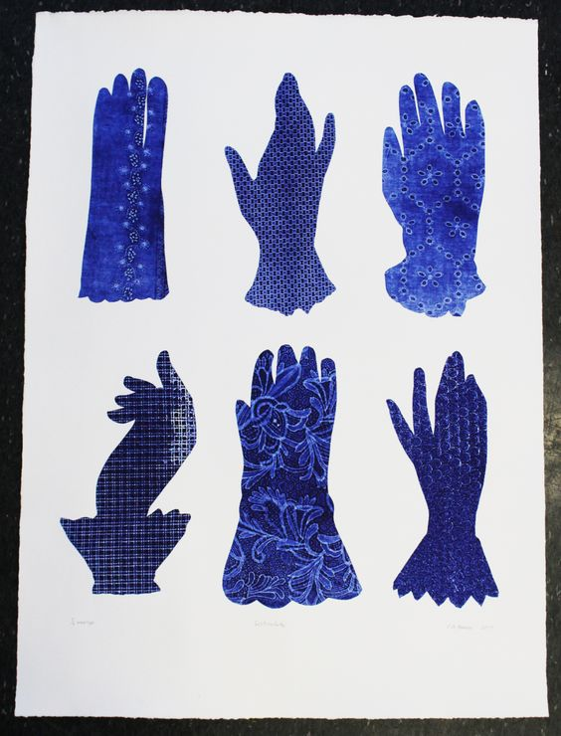
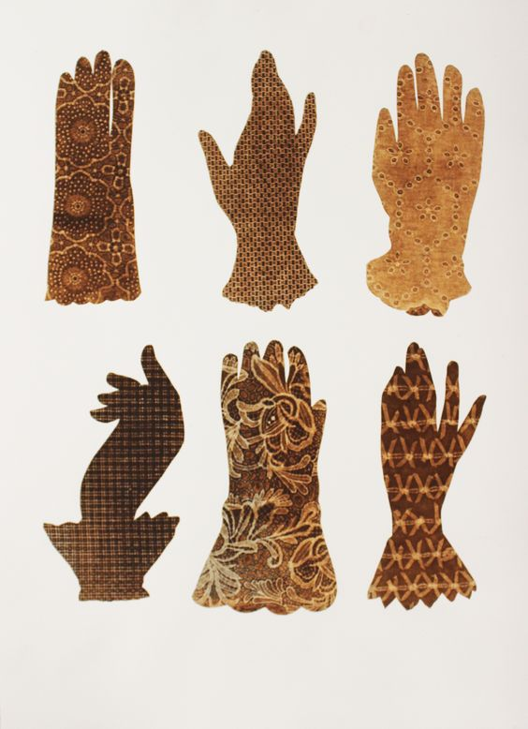
https://www.pinterest.nz/triffidgirl72/esthers-art/

Slide 23
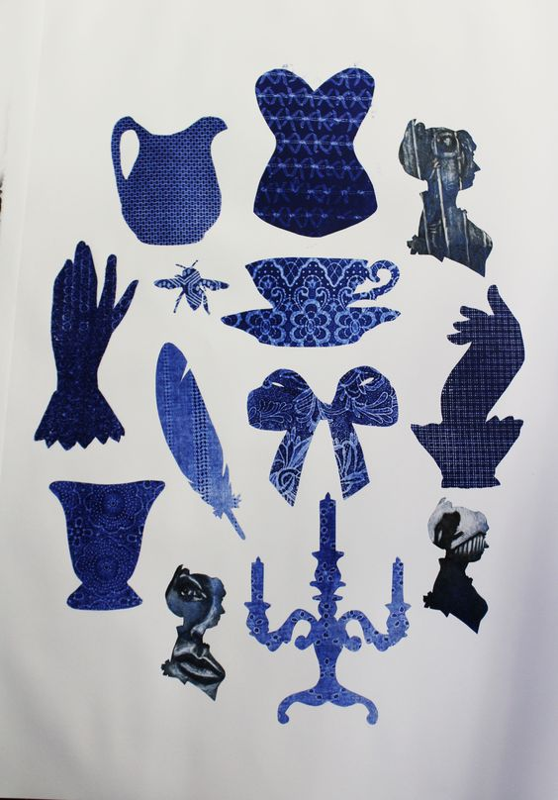
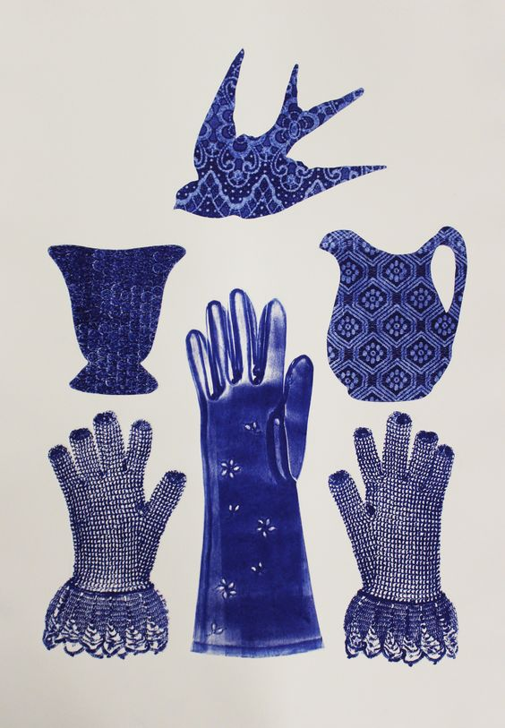
https://www.pinterest.nz/triffidgirl72/esthers-art/

Slide 24
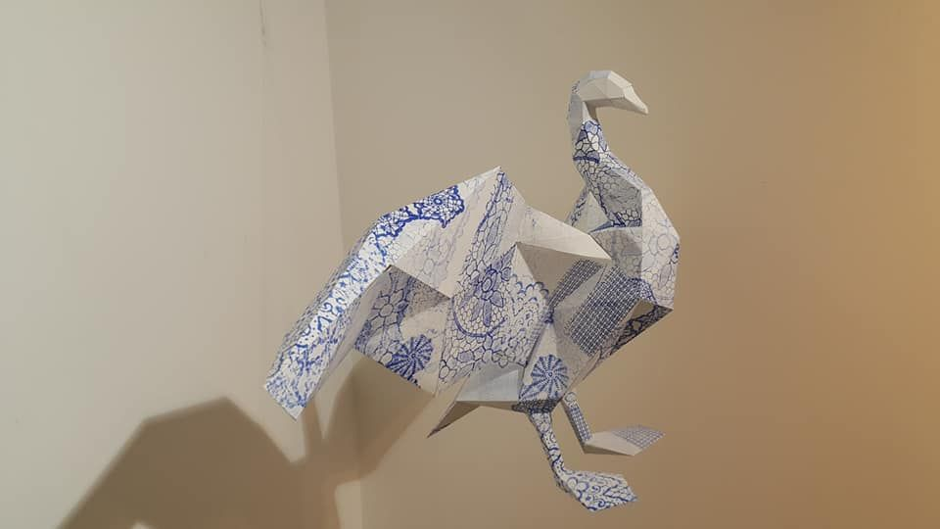
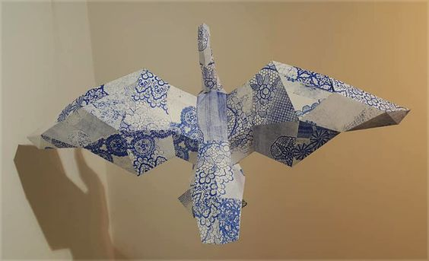
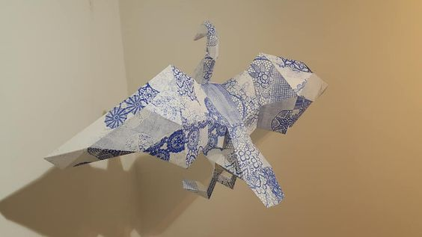
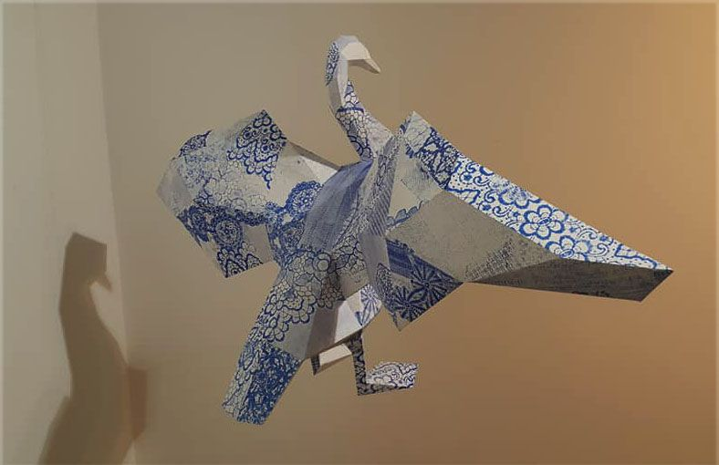
E A Hansen, Cygnini's Song, 2018, mono print on 3D paper swan, low poly origami pattern. lace, doily.

Slide 26
Detail from The Bee Box book project, Esther Hansen, 2019, monoprint, collograph, pronto plate. Printed with the assistance of #FranklinPrintGroup, Meg Wilson, Vicky Moore-Allen and Rebecca Bent. #printmaking #printmakers #PCANZ

Slide 27
Esther Hansen (Pukekohe), Bee Box Book, 2019
Media/Materials used: Oil based monoprint, collograph, laser cut woodcut, pronto plate prints on Fabriano paper, bee hive frames, bee hive box, wood and aluminium supports.
Dimensions: 58 cm x 2.3 metres x 46 cm
Description: 9 used Langstroth beehive frames suspended above a hive box supported by wood and extendable aluminium supports. Prints on Fabriano paper on the front and back side of each hive frame.
Artist's Statement: “The roof, the roof, the roof is on fire” – The Bloodhound Gang “… I want you to act. I want you to act as you would in a crisis. I want you to act as if our house is on fire.” Greta Thunburg The Bee Box Book Project converts a Langstroth hive box into a “book”. Each side expressing an aspect of beekeeping and the artist’s own personal bee mythology. On one side, the factual story of Steve Nimmer, a California beekeeper who tried to rescue, but lost, most of his hives in the 2017 Thomas Wildfires. Global warming is increasing the risk of fires that destroy everything in their path, including whole ecosystems, homes and businesses. They also show the power of man working with nature to rebuild and restore. We are on the brink of ecological disaster. Bees are dying from the impact of human practices. The other pages are more fantastical, from ladies riding bees side-saddle to bees dancing jive. What if a Queen bee really did rule the world? Monoprint, laser-cut woodcuts and pronto lithography have been layered to create images that celebrate a pivotal moment in our species. Our house is on fire, will we just let it burn?
List of collaborators: Esther Hansen concept, design and printing; Rebecca Bent paper cuts, gluing and framing; Meg Wilson expert inking of pronto plates.
Gained Merit award $150

Slide 28
Jodi-Ann Tautari (Hamilton), Mohinui A424, 2019
Media/Materials used: Moulin de gu 230gsm, stone lithography, mono print, collagraph (sand), plexiplate, leather
Dimensions: Closed 760mm x 300mm x 5mm. Open 1500mm x 300mm x 5 mm
Description: For Maori, their historic traditions and connections were passed on through whakairo(carving in wood) and ornamentation on material culture. The connection to Tane(God of the Forrest) and his offspring (paper) are used to explore the difference between maori and pakeha understanding. Maori place a great amount of importance on spoken word (korero) where as for pakeha unless it is written down as in on a contract is not considered as equally valid. Oral histories as opposed to written histories. So oral for maori is greater than written.
Artist's Statement: This book is titled Mohinui 4A2A and is the name of a Maori land block in Waiomio, Northland. The original land deed was given to my mother in-law by a kuia who was born there. The deed which includes the crown stamp, map lines and faded imagery inspired a series of lithographic prints in 1999. The deed hung in my husband’s family homestead (an unlined kauri villa at Waiomio) and was a source of fascination and interest for whanau and manuhiri alike. My mother in-law has been actively involved with Te Tiriti o Waitangi claims since the early 1970s. I have heard many accounts of historical incidents and the social impact of colonization on Maori. Her dedication to exploring the grievances of the Tiriti was one of the reasons the deed was given to her. The book celebrates the phenomenology that only occurs when you are involved in the making, touching and unfolding. It is a sensory response to my unique experience of living close to the whenua on a Maori land block that has such a rich and engaging history.
Heather Bramwell, assisted in some collagraph work and the binding of the book

Slide 30
Jodi-Ann Tautari and Esther Hansen "Mohinui Block and the Bee Box Testaments" 2020. This collaborative project between artists: Jodi-Ann Tautari and Esther Hansen. Shows Tuna (Maori word for Eel) and the Bees are brought together. The wall work is made of monotype, laser cut woodcut, pronto plate prints, (7 rows of 6 works, 42 works in total, each work is 40cm x 20 cm)

Slide 35
Pronto Plate is also known as Polyester Plate Lithography Pronto Plate is a planar printmaking process where ink is applied to an image that has been either hand drawn onto the plate or transferred to the plate via a laser copier. Oil based inks must be used as the process uses the same oil/water resist qualities as traditional lithography. Because there is little to no plate impression created when printing a pronto plate, as it is made of thin flexible plastic, pronto printing can be readily combined with other print processes creating a rich and diverse combination of layers. Also, because the pronto plate is transparent, registration is easy. Pronto plate is an excellent process to use to incorporate more of your drawing skills into your print work.
We will photocopy a prepared drawing or image onto an A4 size pronto plate using a laser printer. We will then ink and print the image learning the tricks and foibles of the process.

