Slide 1
Mono Printing
Linear transfer prints
Monotypes

Slide 2
Linear transfer and mono printing

Slide 3
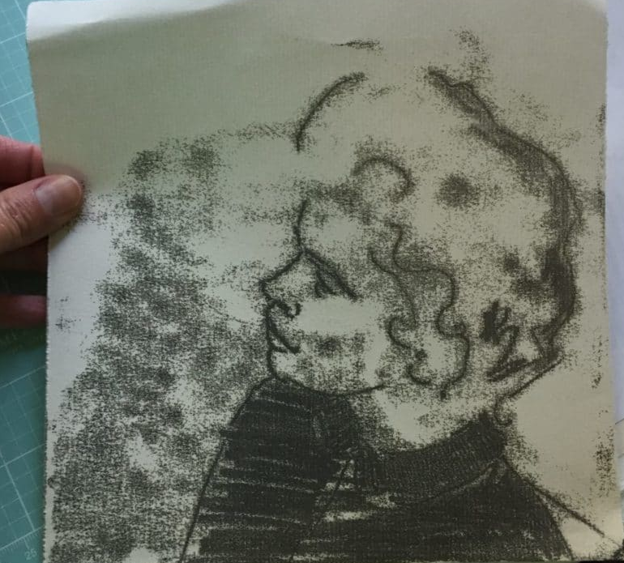
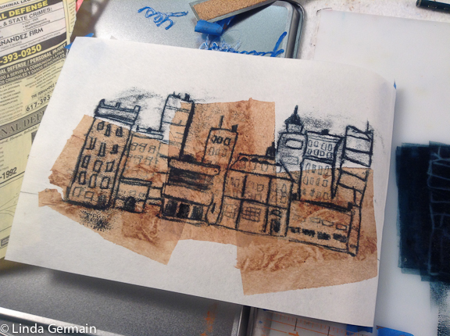
Trace Mono-printing/ Transfer Drawing Monotype
Linda Germain
http://www.lindagermain.com/2017/02/drawings-matrix-printmaking/
Belinda Del Pesco - Inky trace monotype on kozo mulberry paper – simplified mark-making is an “underpainting” staged as a leaping off point towards other media.
https://www.belindadelpesco.com/trace-monotype-5.html/

Slide 4
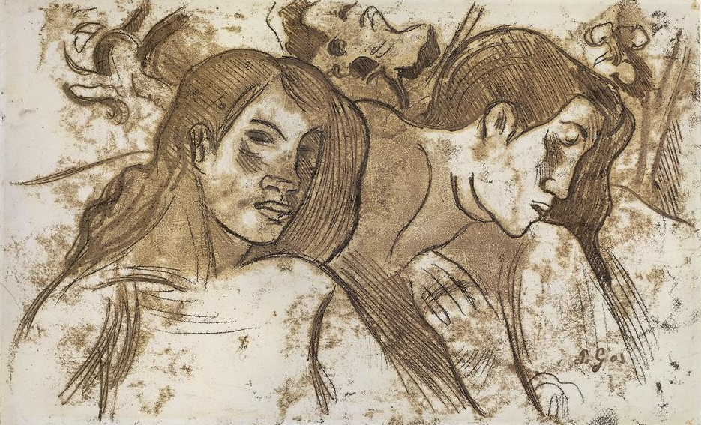
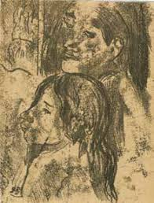
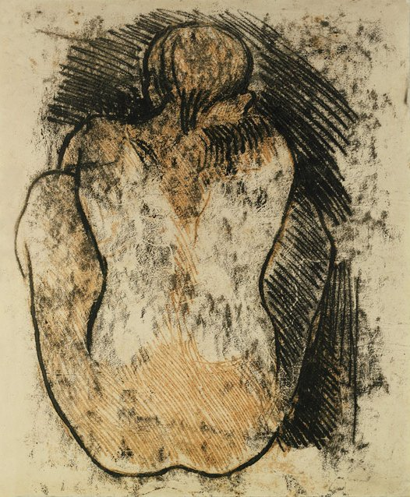
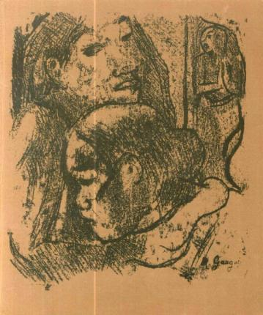
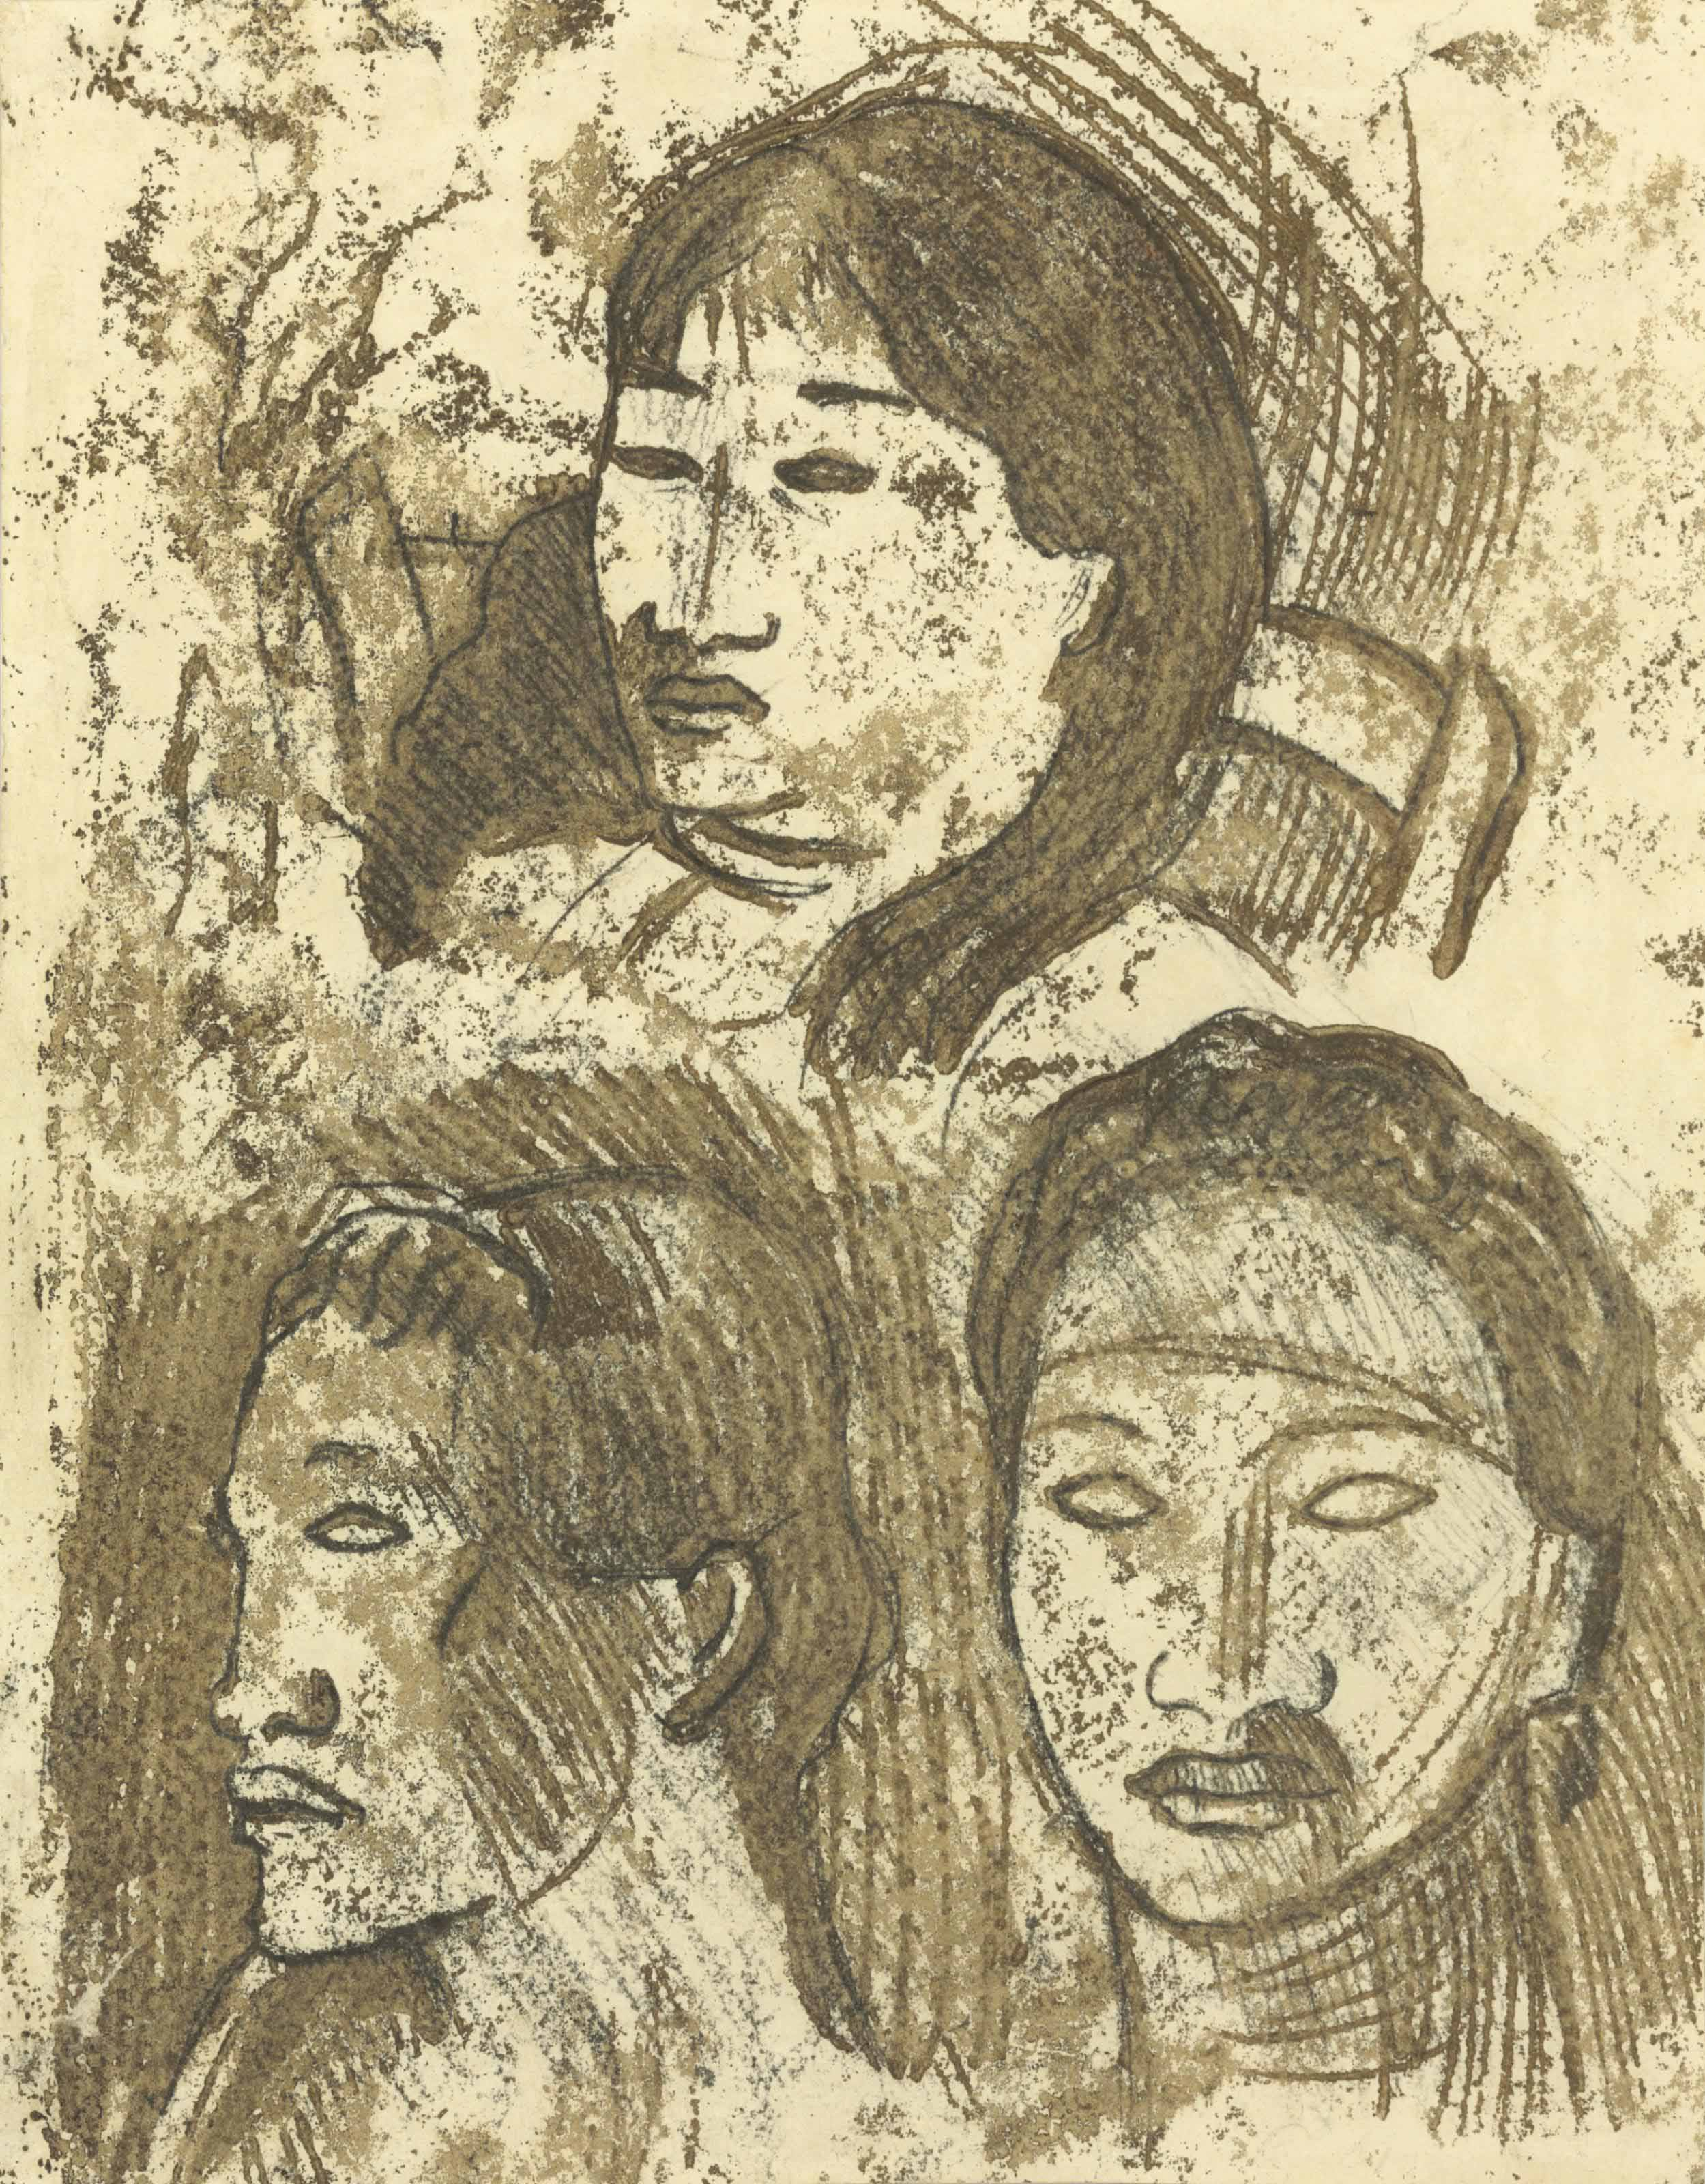
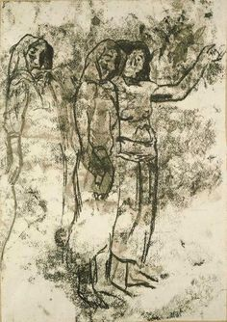
Paul Gauguin
traced monotype, 1899/1900’s
uQE24xvdFUL2Rw at Google Cultural Institute

Slide 5
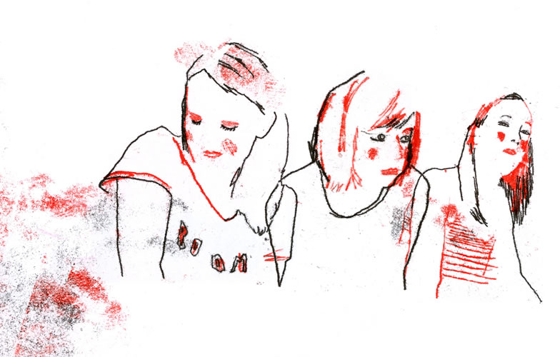
Ceri Amphlett
https://www.we-find-wildness.com/2010/03/ceri-amphlett/

Slide 6
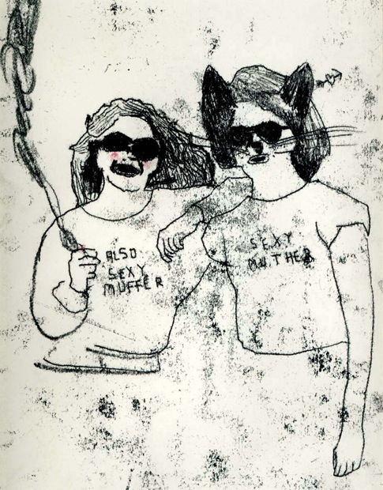
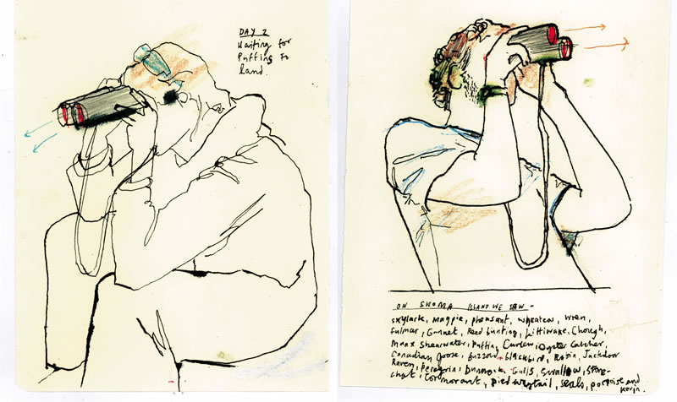
Ceri Amphlett
https://www.we-find-wildness.com/2010/03/ceri-amphlett/

Slide 7
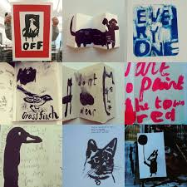
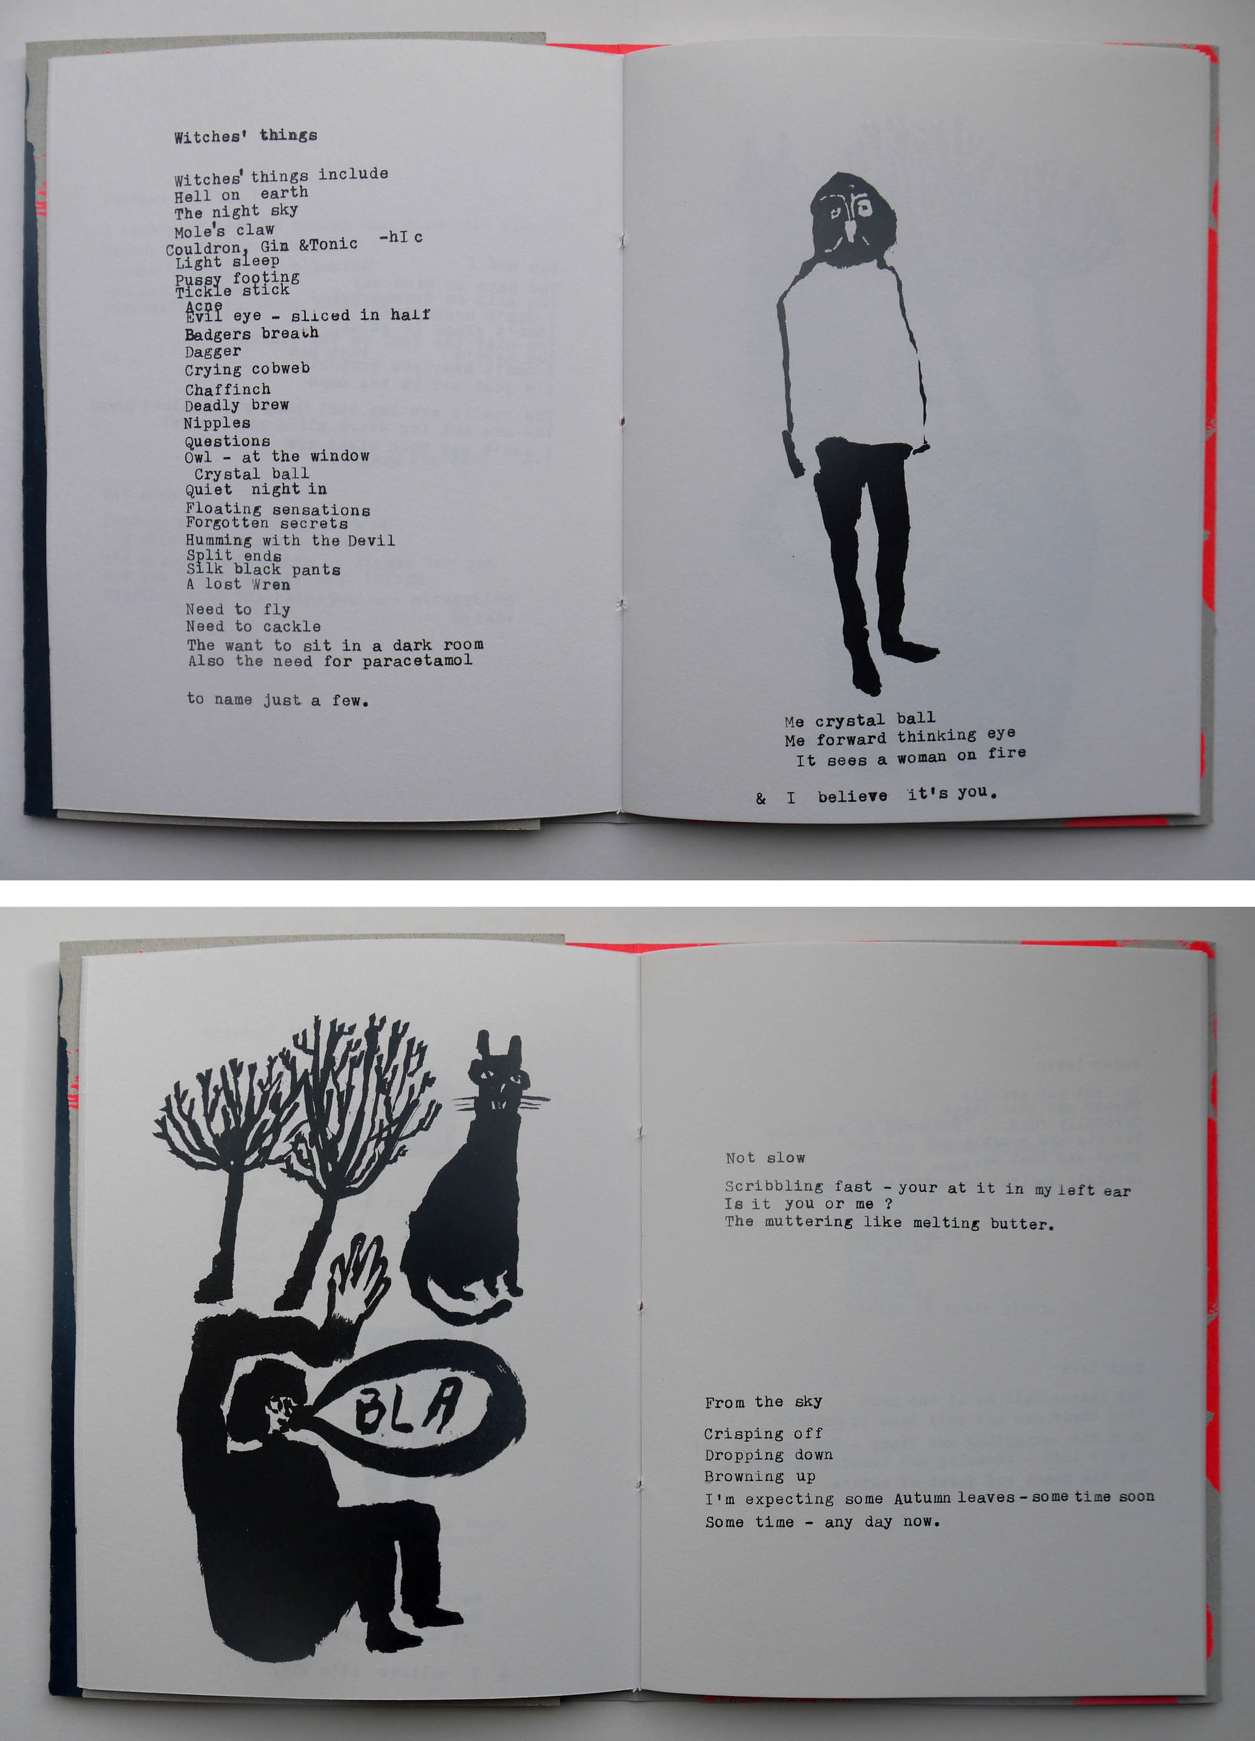
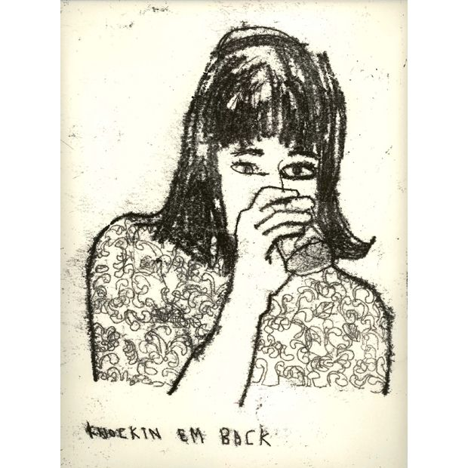
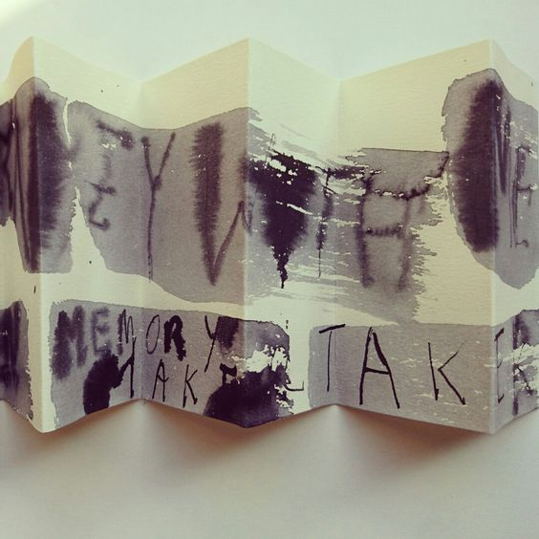
Ceri Amphlett
https://www.we-find-wildness.com/2010/03/ceri-amphlett/

Slide 8
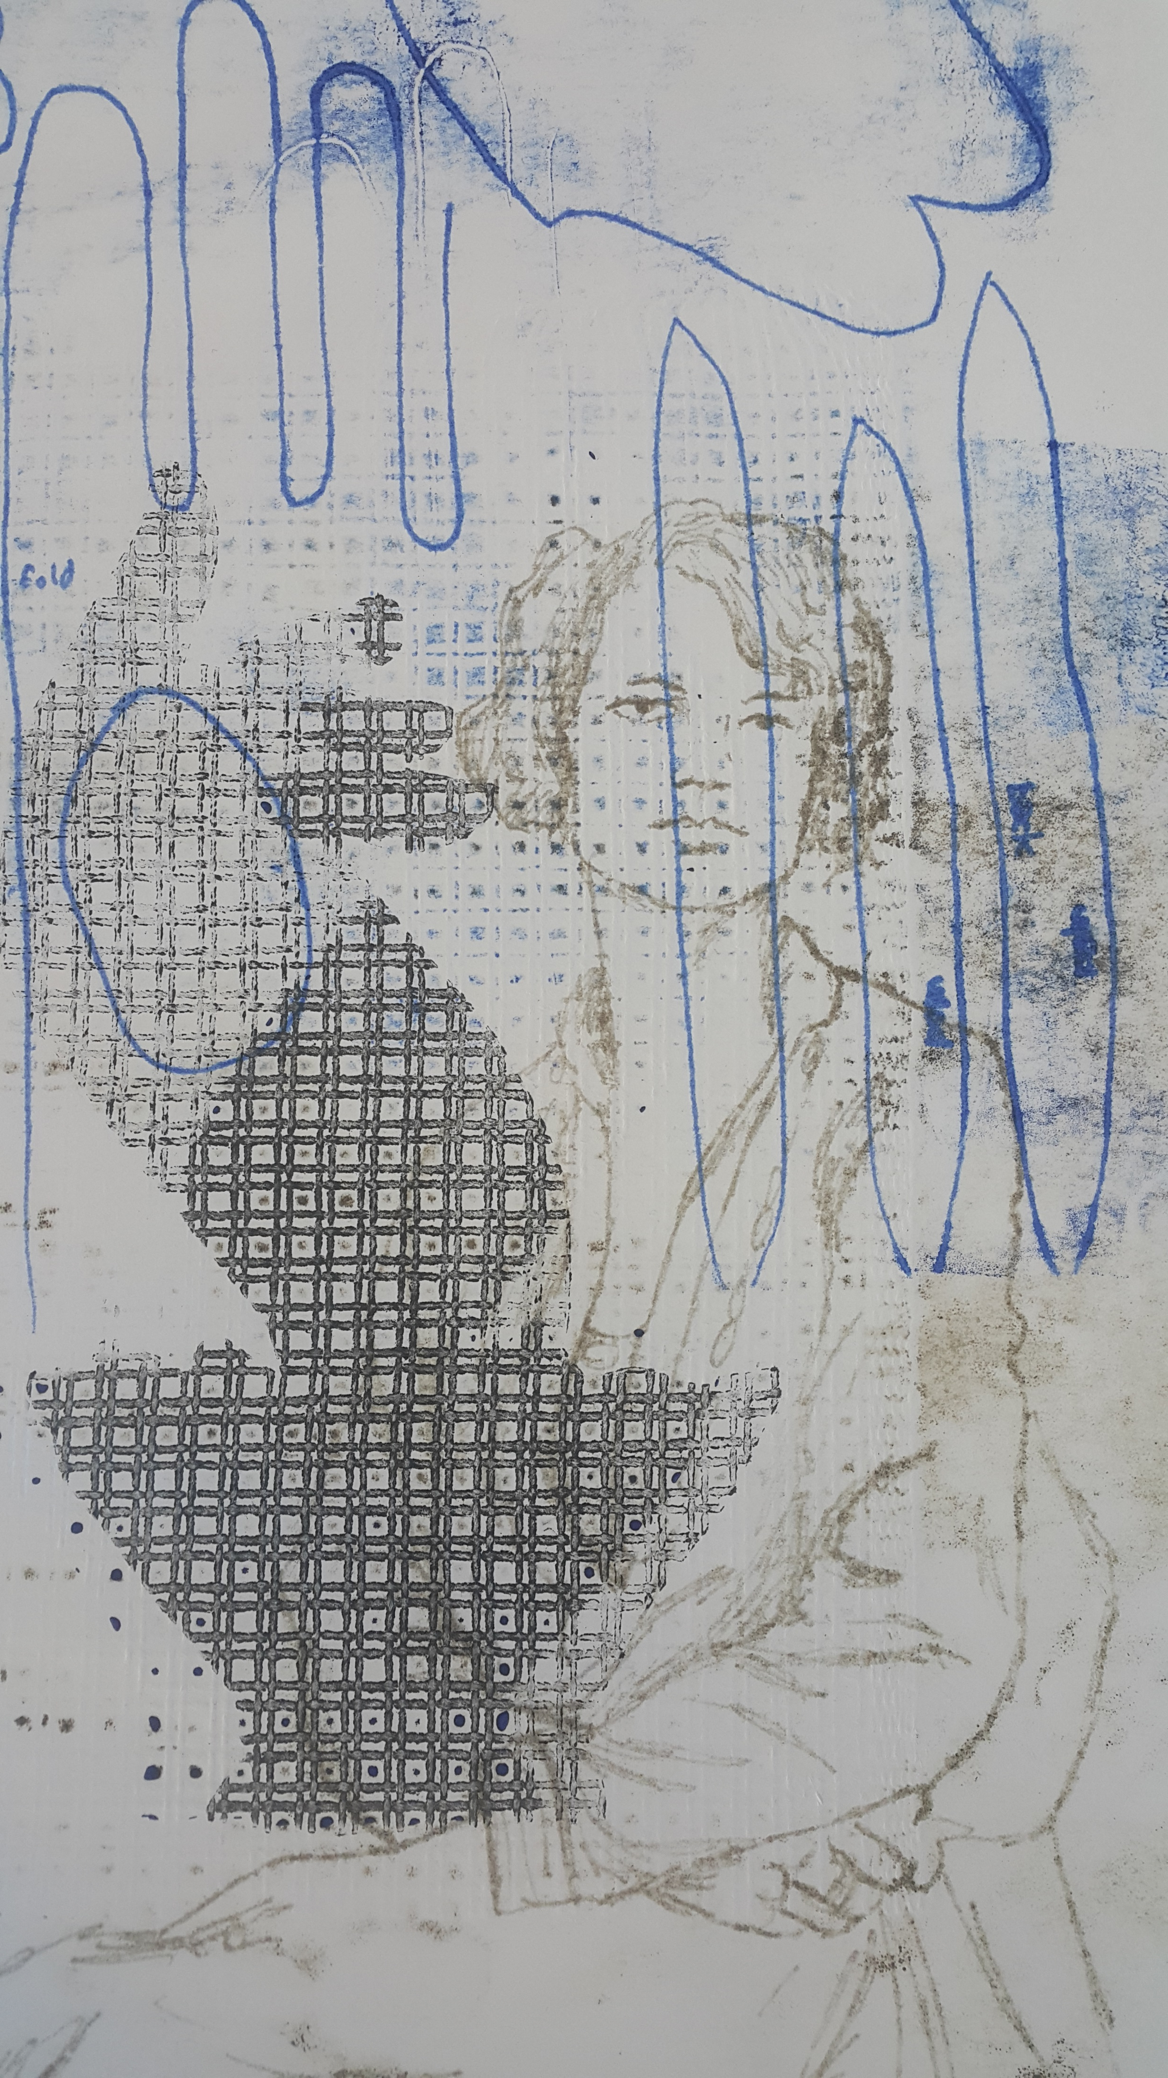
Esther Hansen, Linear mono printing on ghost prints

Slide 9
Layered monotypes

Slide 10
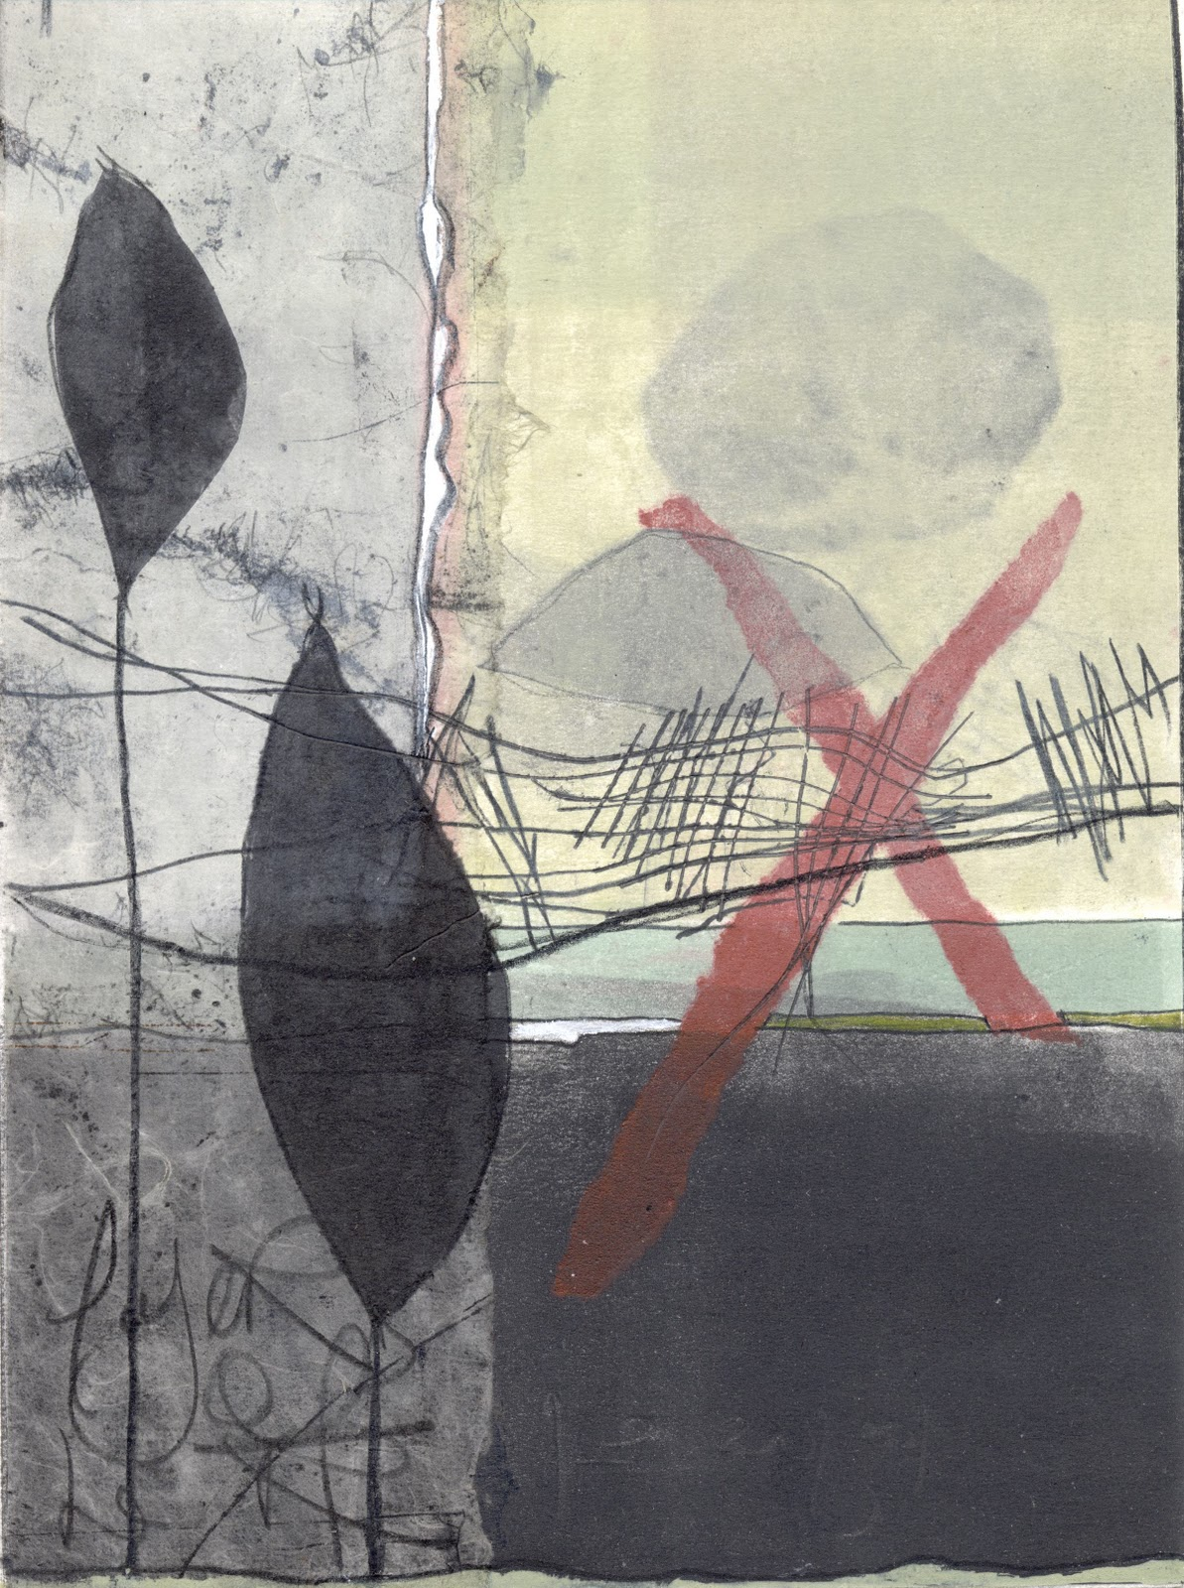
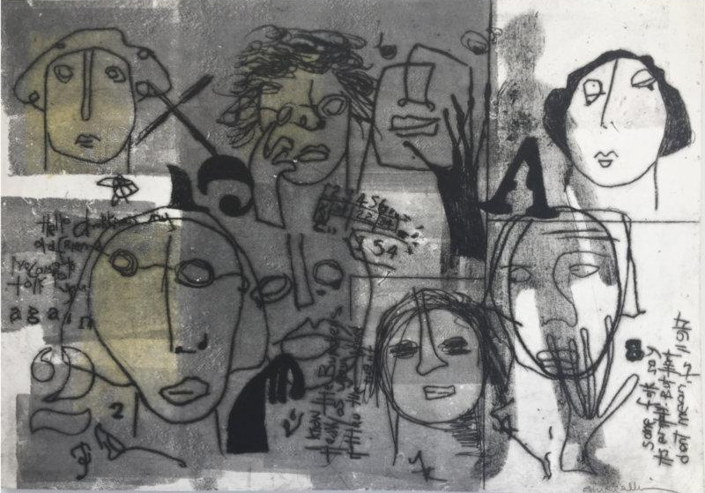
Susan Hurrell-Fieldes
https://www.railwaystreetstudios.co.nz/products/faces
http://www.nzprintmakers.com/2011/12/interview-susan-hurrell-fieldes.html

Slide 11
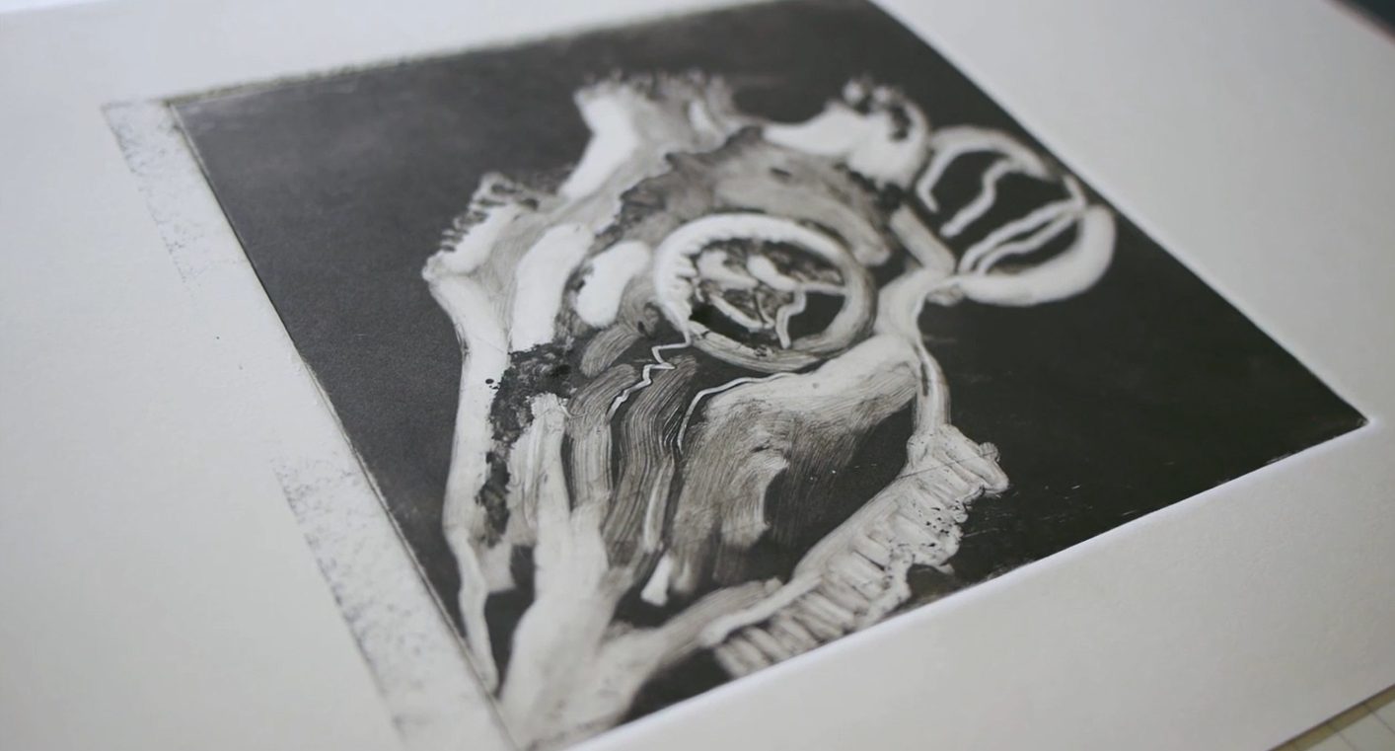
Monoprint with Simon Ripley https://vimeo.com/41523428 Double Elephant Print Workshop

Slide 12
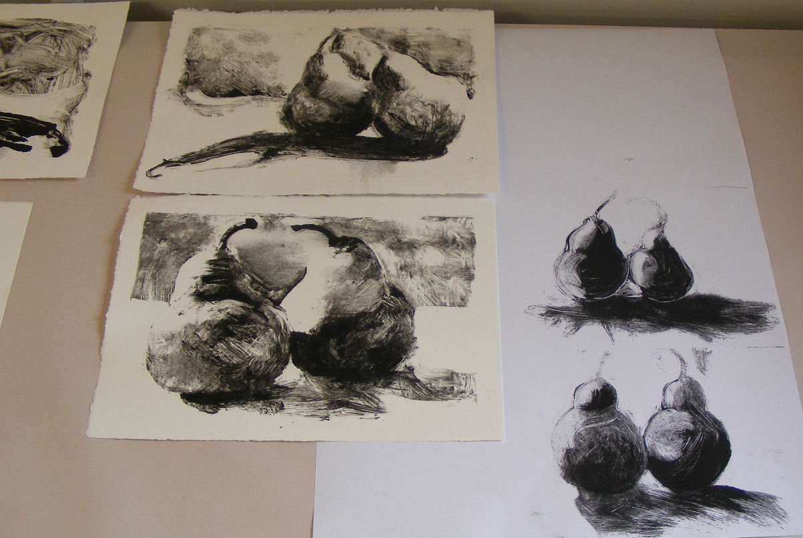
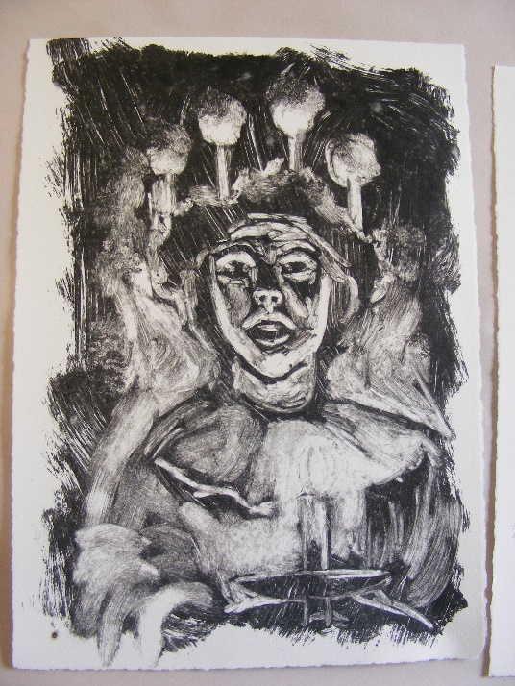
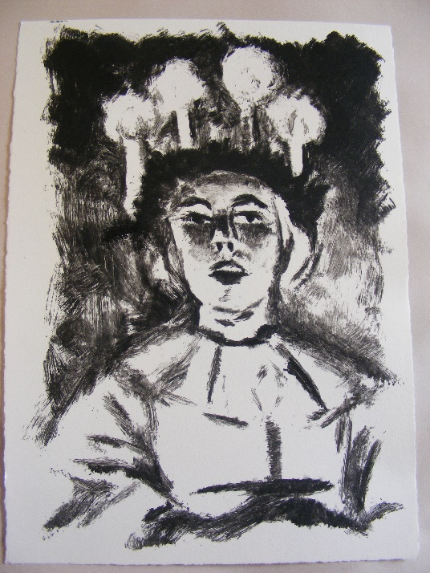
Golden Open acrylic mono printing

Slide 13
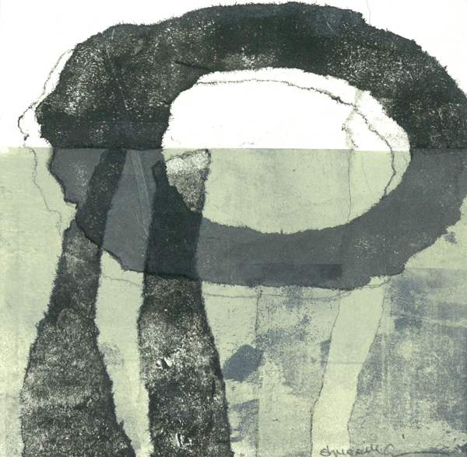
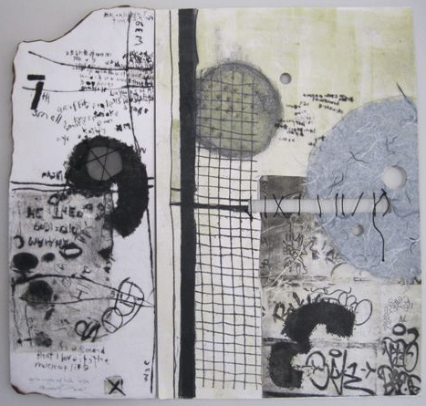
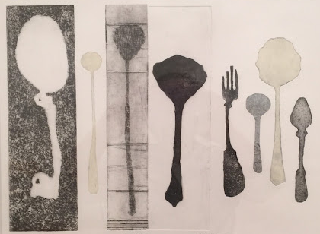
Susan Hurrell-Fieldes
Susan Hurrell Fieldes, 2011, Monotype print "The body of work around this comes from the photographs I took in my last trip to NY in April. The street art fascinates me; the graffiti, the etchings in the footpath, on the roads, the crumbling pedestrian markings, the smells, the noise...mostly, the energy."
http://www.nzprintmakers.com/2011/12/interview-susan-hurrell-fieldes.html
https://www.pinterest.nz/pin/805511083350159767/
https://www.umbrella.org.au/compactprints/portfolio/susan-hurrell-fieldes/
http://www.mcatamneygallery.co.nz/printmaking/susan-hurrell-fieldes/?t=Gallery&n=3263

Slide 14
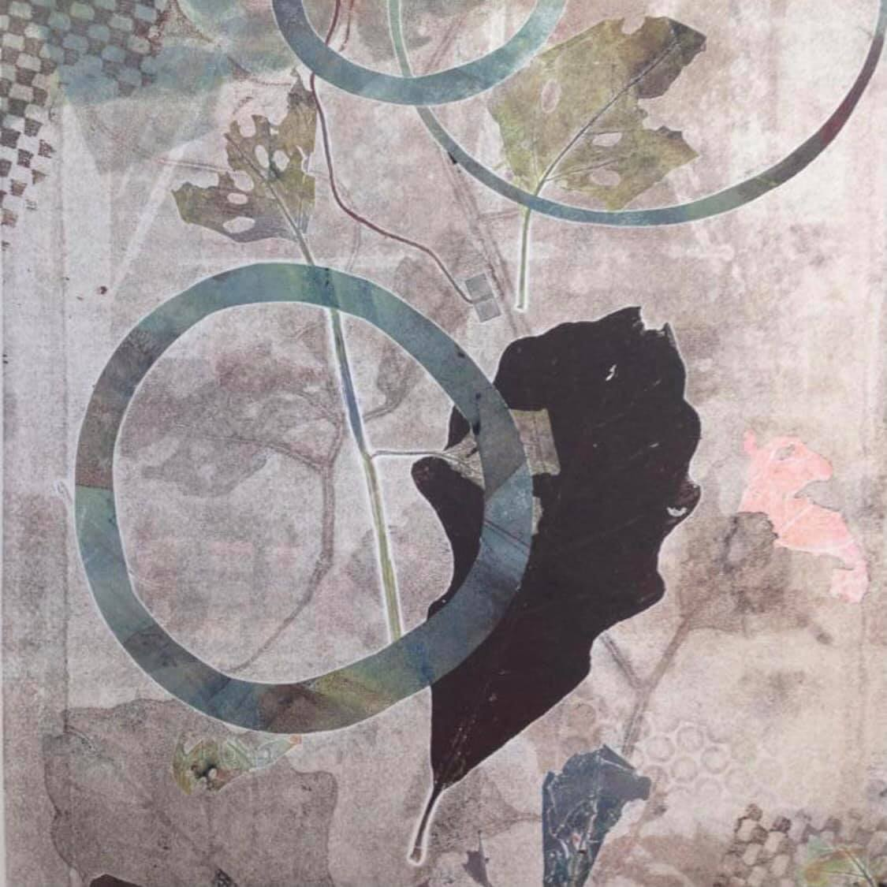
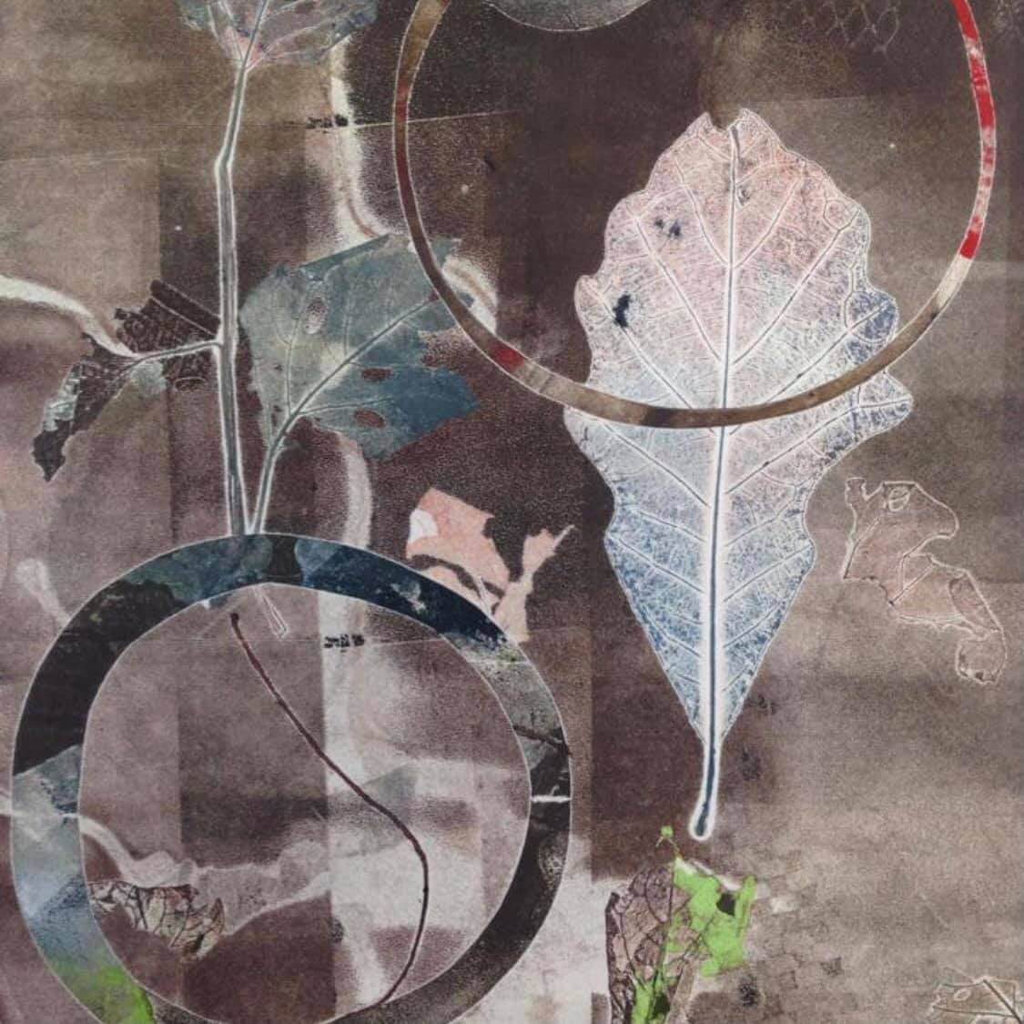
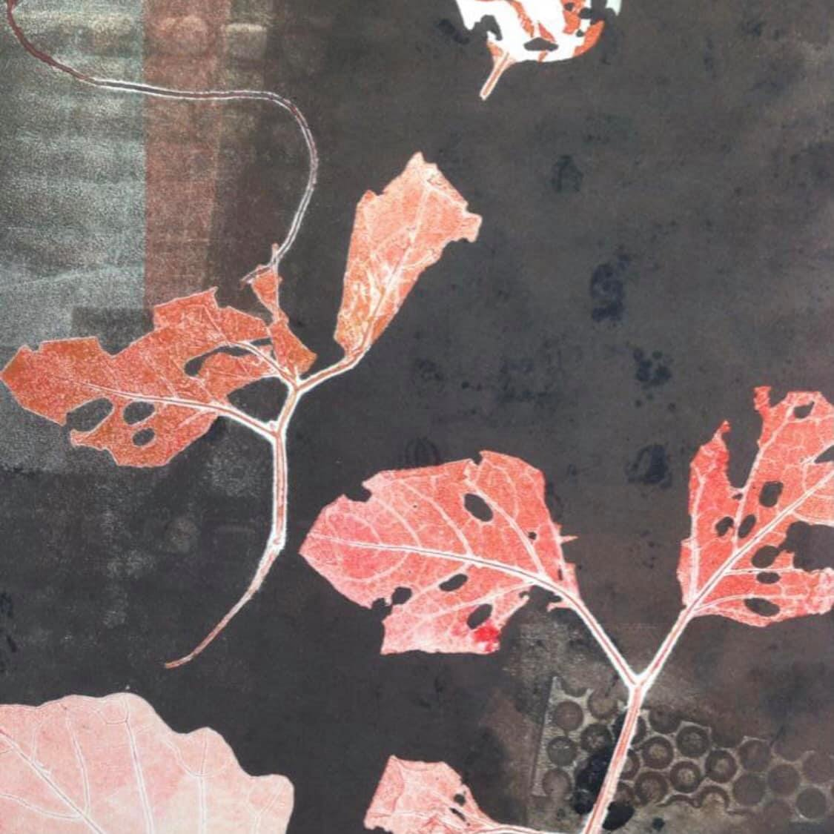
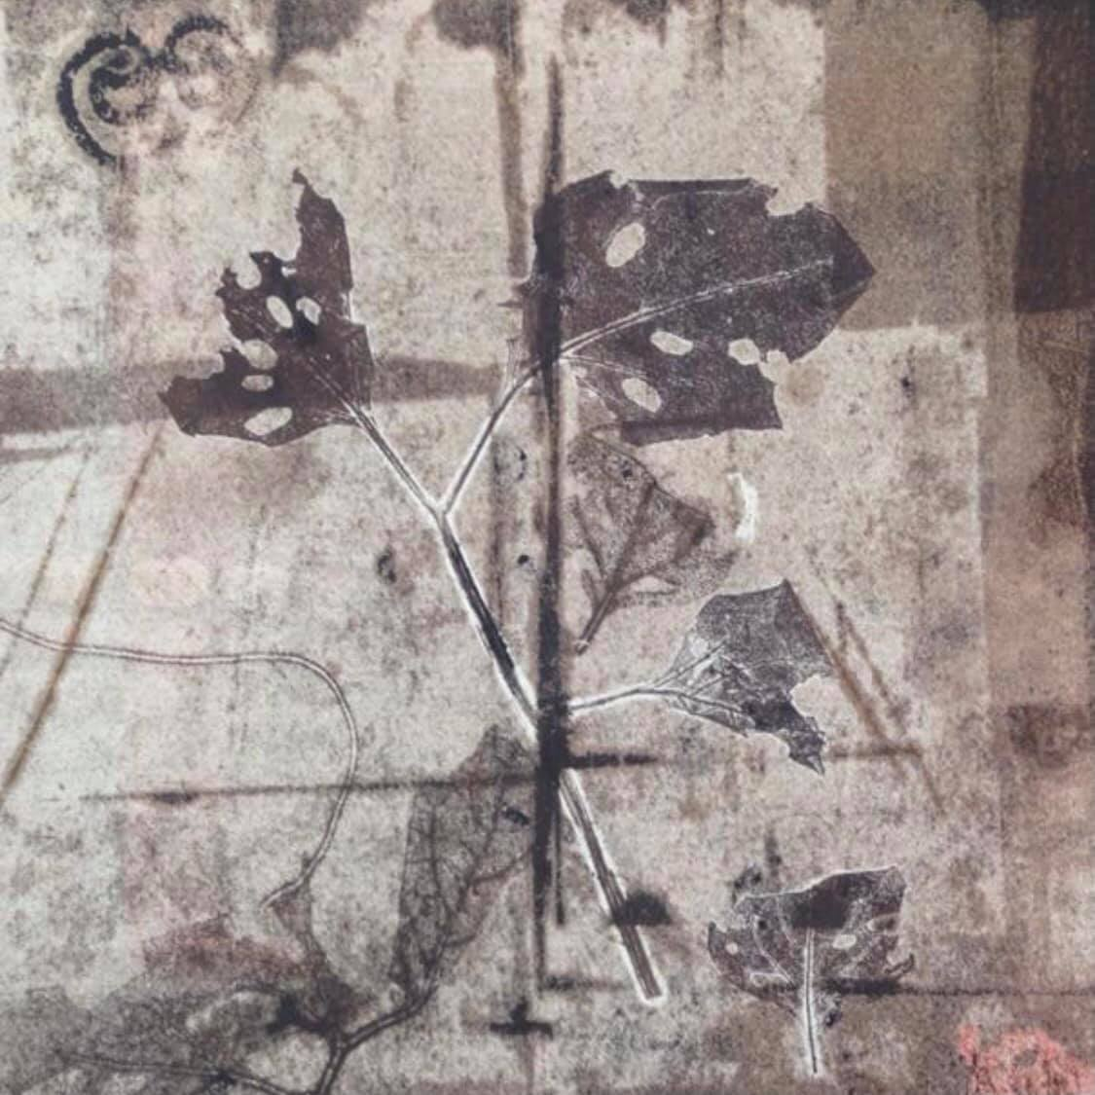
Ruby Silvious
https://www.facebook.com/groups/111525522254814/

Slide 15
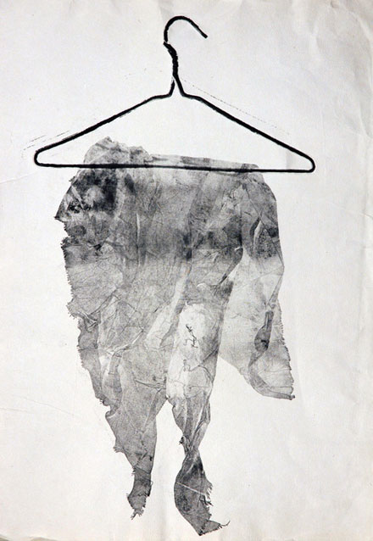
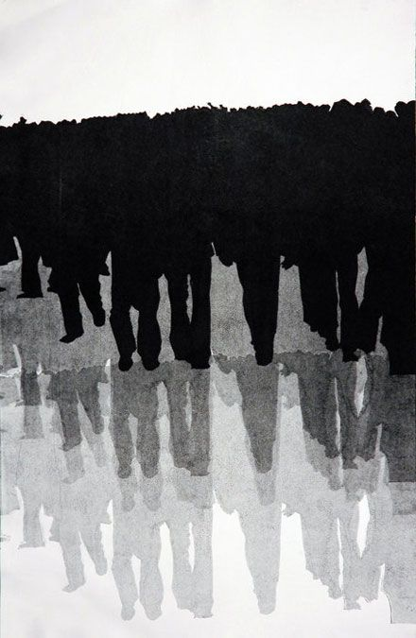
Naz Rahbar
http://www.pikaland.com/2011/08/18/naz-rahbar/

Slide 16
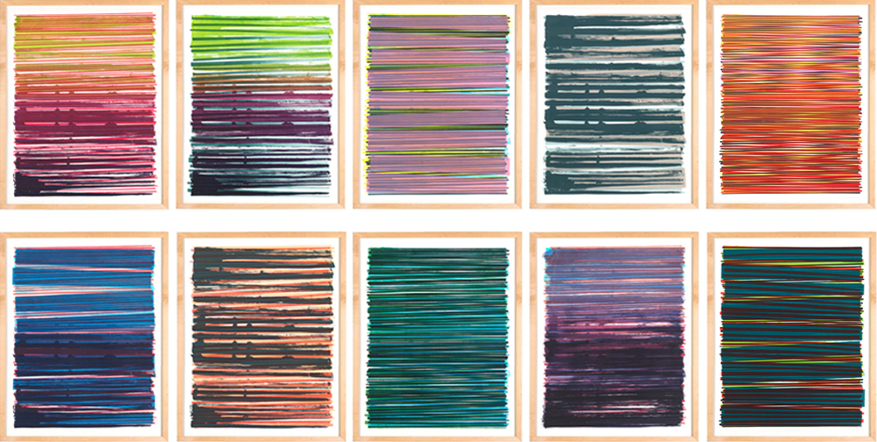
Dana McClure
https://cargocollective.com/danamcclure/Line-Series-Monoprint-No-05

Slide 17
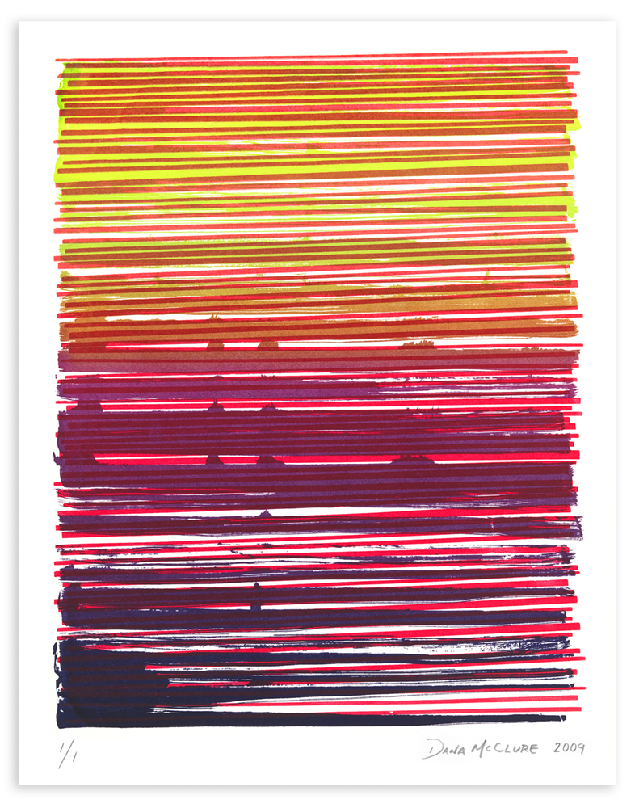
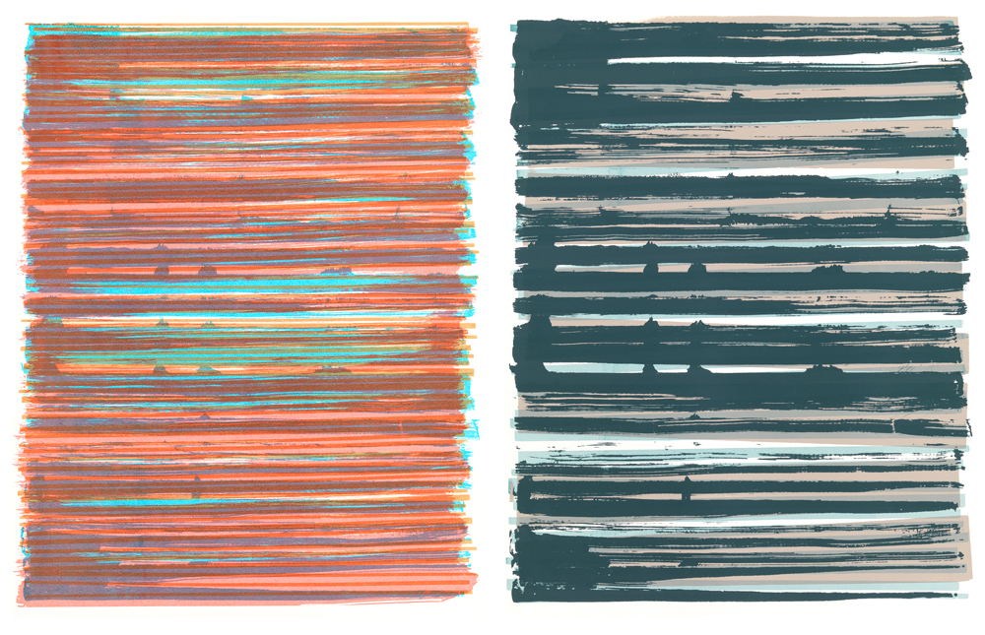
Dana McClure
https://cargocollective.com/danamcclure/Line-Series-Monoprint-No-05

Slide 18
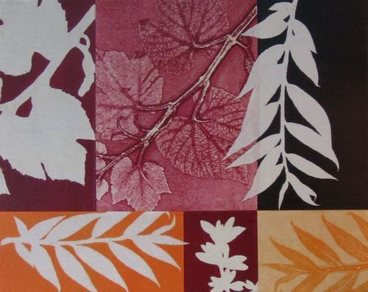
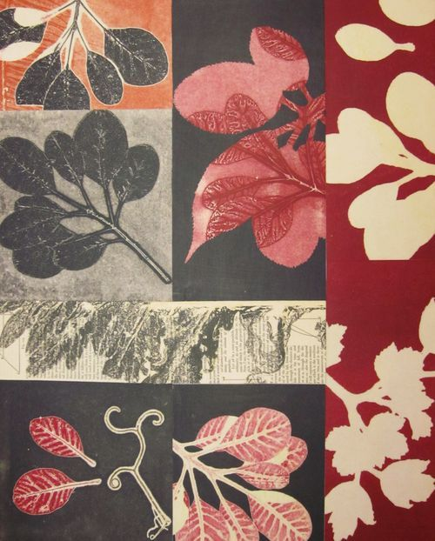
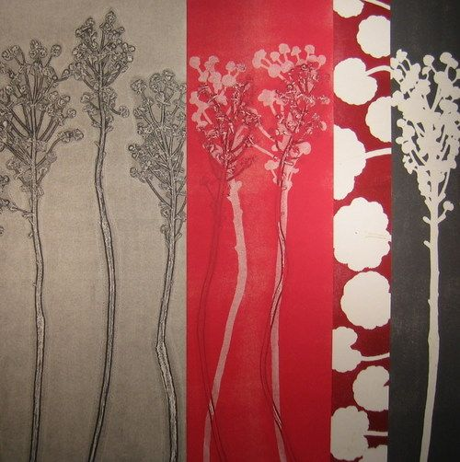
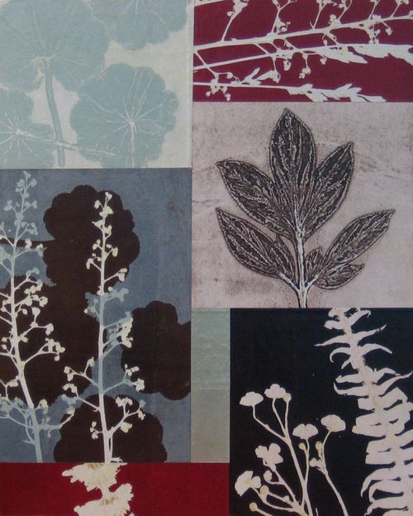
Margaret Briggs
https://briggs.typepad.com/photos/november_11_workshop/img_0451.html
https://briggs.typepad.com/photos/euphorbia/euphorbia_1_36x36.html

Slide 19
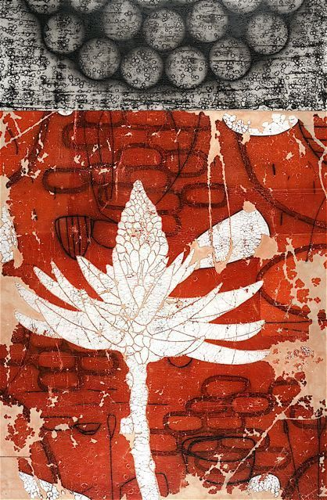
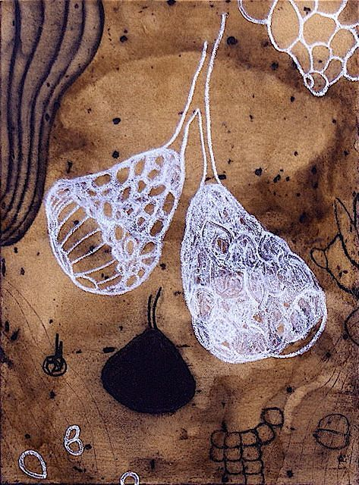
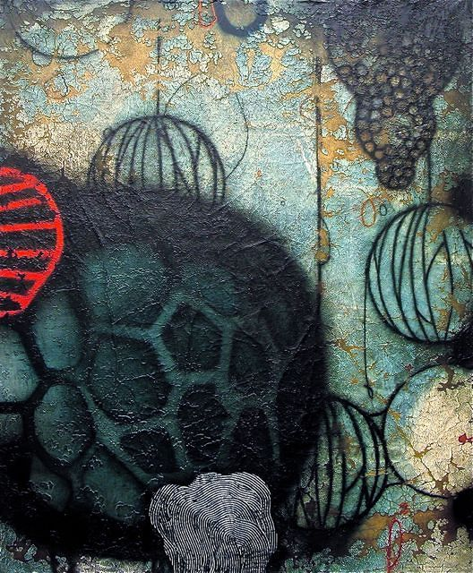
Erik Gonzalez
https://www.pinterest.nz/jkonopka/erik-gonzales/

Slide 20
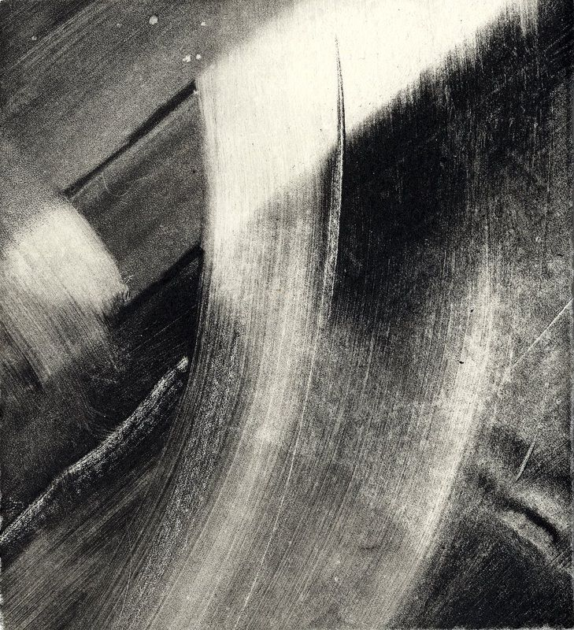
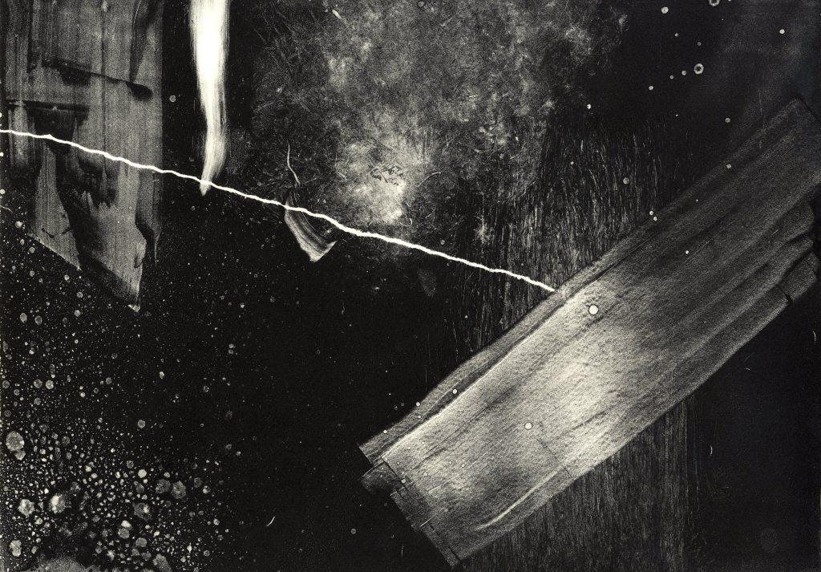
Sophie Victoria Elliott
https://i.pinimg.com/originals/a2/83/27/a28327e1c45cebe7c8ed0eb23ddd8ea6.jpg

Slide 21
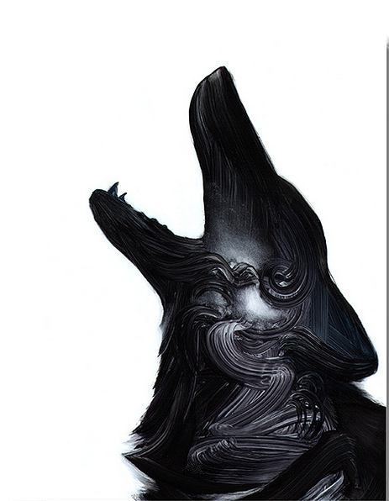
Roll up your collograph with ink. Use cotton buds to wipe away an image or pattern
Print under moderate pressure. Now play with colour and layering and combining with other prints
Adam S Doyle

Slide 22
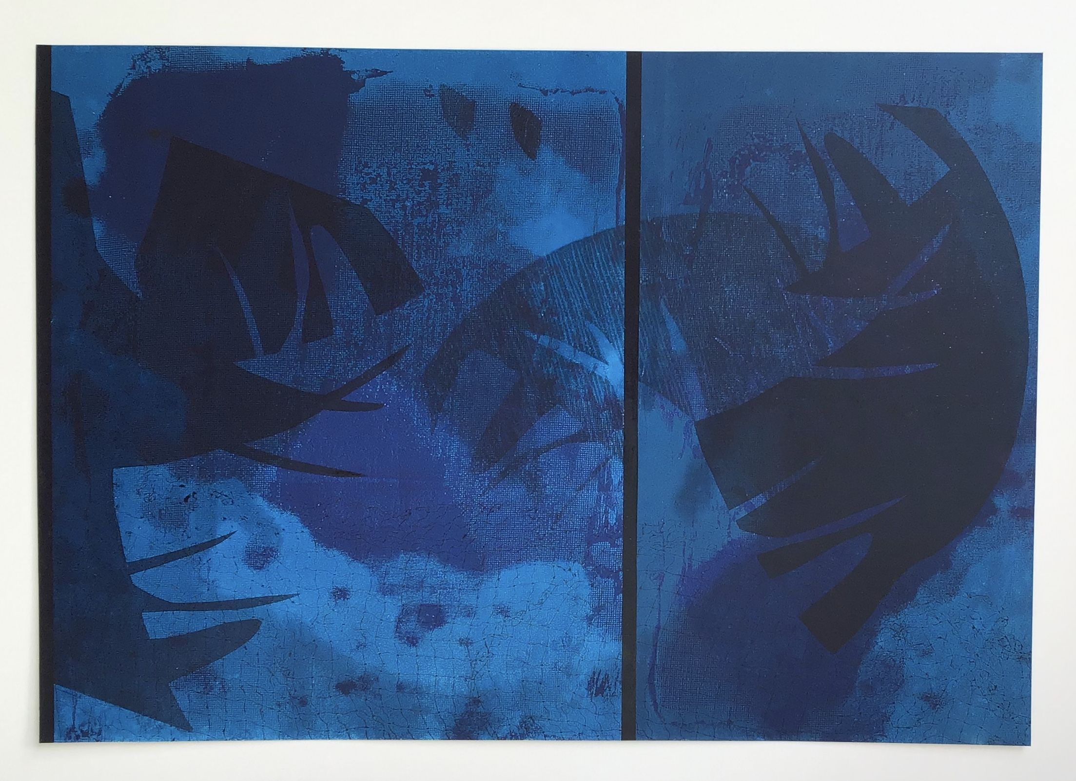
Beth Charles
Sea change Relief/monoprint on paper, 2020 Exhibited Waikato Art Awards, Hamilton, NZ, 2020
http://www.bethcharles.net/

Slide 23
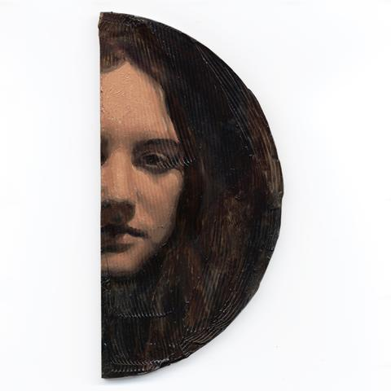
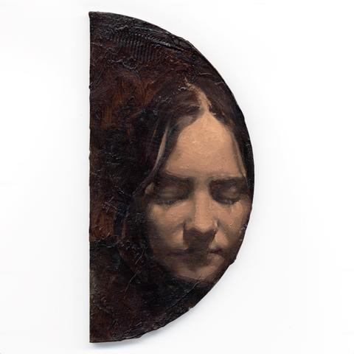
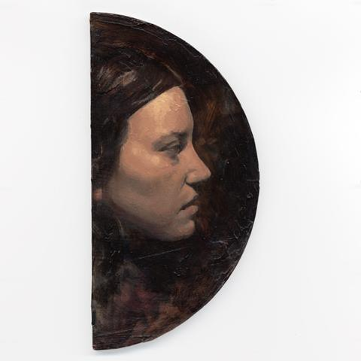
Duncan Pepe Long
https://www.seedgallery.co.nz/collections/duncan-pepe-long-remnants

Slide 24
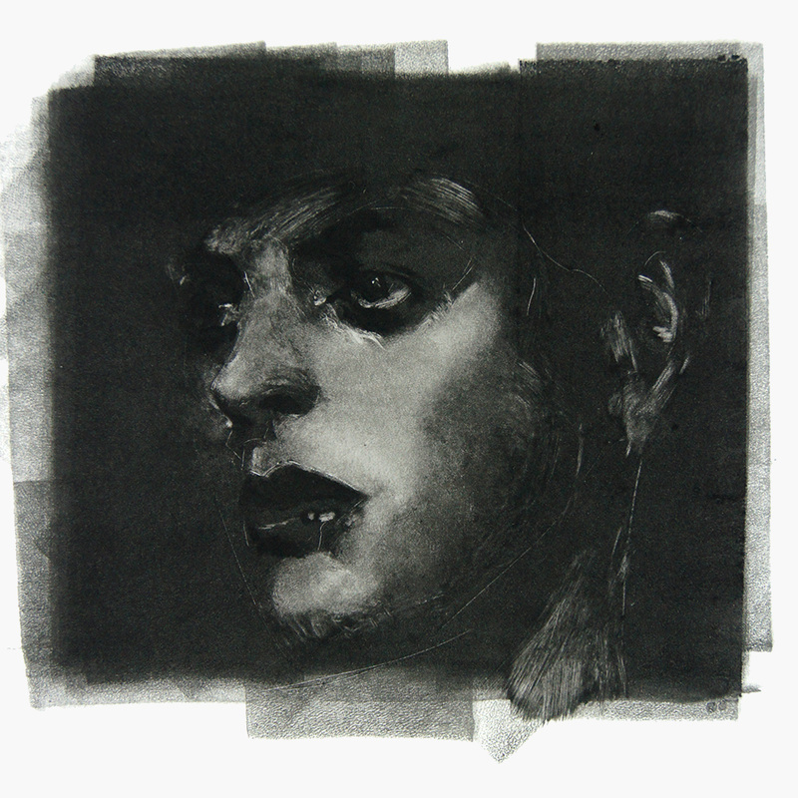
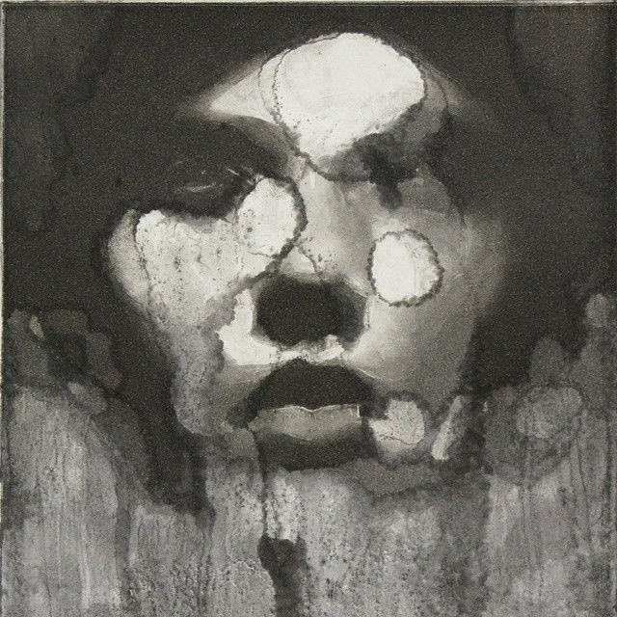
Duncan Pepe Long
https://aucklandprintstudio.tumblr.com/post/103453763901/duncan-pepe-long-blue-moon-2014-2-layer
http://www.nzprintmakers.com/2014/03/monotype-monoprint.html

Slide 25
Belinda Griffith
https://www.foenandergalleries.co.nz/artist/belinda-griffiths/

Slide 26
Belinda Griffith https://belindagriffiths.com/section/453087-Mono-The-Painterly-Print-2017-Franklin-Art-Centre.html

Slide 27
Belinda Griffiths
Belinda Griffiths
https://belindagriffiths.com/section/321355.html

Slide 28
Lynn Brofsky
https://lynnbrofsky.com/

Slide 29
Edgar Degas Monoprints
Edgar Degas (1834–1917) The Tub, ca. 1876–1877 Monotype, 16-1/2 x 21-1/4 inches Bibliothèque de l’Institut national d’histoire de l’art, Paris. Collections Jacques Doucet ©
Edgar Degas’ ‘Three Ballet Dancers’ (c1878-80) © Sterling and Francine Clark Art Institute
Edgar Degas, French, 1834-1917, and Vicomte Lepic, French, 1839-1889 The Ballet Master, c. 1874 monotype heightened with white chalk or wash National Gallery of Art, Washington, Rosenwald Collection 1964.8.1782

Slide 30
Chelsea Twiss layered mono prints

Slide 31
Chelsea Twiss
Layered mono prints

Slide 32
Sophie Lécuyer
http://sophielecuyer.com/impression/

Slide 33
Sophie Lécuyer
http://sophielecuyer.com/impression/

Slide 34
http://sophielecuyer.com/impression/
Sophie Lécuyer

Slide 35
Sophie Lécuyer
http://sophielecuyer.com/impression/

Slide 36
Sophie Lécuyer
http://sophielecuyer.com/impression/

Slide 37
http://sophielecuyer.com/impression/

Slide 38
http://sophielecuyer.com/impression/

Slide 39
Sophie Lécuyer monoprint animation
FLORA
https://vimeo.com/315298912
FLORE, premier court-métrage d’animation de la graveuse nancéienne Sophie Lécuyer
https://www.youtube.com/watch?v=3cpeNGPDrrQ

Slide 40
Jason Greig (NZ)
https://www.pinterest.nz/pin/707909635155691460/
Sunset Superman IV, 2018, Monoprint, 80 x 68 cm 31 1/2 x 26 3/4 inches Courtesy Hamish McKay. https://ocula.com/artists/jason-greig/

Slide 41
Emmi Whitehorse
https://nmwa.org/blog/artist-spotlight/nature-and-continuity-in-prints-by-emmi-whitehorse/

Slide 42
Shirley Stevenson
Look carefully at this artwork
Unpick each layer
How can you make a similar layer?
Using your own imagery and colour rang try to create a richly layered artwork like Shirley Stevenson
https://shirley-stevenson.com/Light-Dark

Slide 43
E Hansen, Joyful Myths, detail, mono-prints and painted signs, 2008, Part of Quartet at the NZ Steel Gallery Franklin.

Slide 45
Thomas Shahan
https://www.etsy.com/listing/78702182/phidippus-audax-jumping-spider-monotype?utm_source=Pinterest&utm_medium=PageTools&utm_campaign=Share&epik=dj0yJnU9cXo1ZjhWUGhrckRlUmUwZXpobC1IM3MzbnIxM1EydlAmcD0wJm49cmVhYlRzbVF2UEZndFVZczI1QkJFdyZ0PUFBQUFBR0J3QUxJ
https://www.flickr.com/photos/panbasket/4386046903

Slide 46
Steven Hughes
Kym Moreland-Garnett - print and ghost print
https://faea.org/FAEAApps/Conference/Handouts/28/MonoprintsGetAllStitchedUpFAEA2018-GoogleDocs.pdf

Slide 47
Laura Berman https://www.laurabermanprojects.com/

Slide 48
Laura Berman
https://www.laurabermanprojects.com/

Slide 49
Stanley Palmer Monoprints
https://www.foenandergalleries.co.nz/artist/stanley-palmer/

Slide 50
Matt Fussell
https://thevirtualinstructor.com/blog/timed-drawing-exercise-monoprint
Andrea Warner
https://www.andiwarner.com/monotypes

Slide 51
Trish Meyer
https://trishmeyer.com/

Slide 52
Christine Herman https://www.christineherman.com/

Slide 53
Christine Herman https://www.christineherman.com/

Slide 54
Christine Herman https://www.christineherman.com/

Slide 55
Christine Herman https://www.christineherman.com/

Slide 56
Mary Sundstrom
https://www.remarqueprintshop.com/store/c28/Mary_Sundstrom.html

Slide 57
Dan Tirels – mono printing with oil stick and plastic bag https://www.youtube.com/watch?v=MbNcysveMWY
Monoprinting with stencils : Abstract figures

