Slide 1
Practical Printmaking Palooza – Print techniques from Junior to Senior – PART 1 ANZAAE 3 hour print workshop Esther Hansen, Kate Rivers, Bridget Burnett and friends
This workshop is aimed at both beginners and more experienced teachers of printmaking. During this fast paced 3-hour practical workshop you will make a quick examples of: eco-printing, linear mono printing, tonal monoprint, collograph, drypoint, chine colle print. Further examples and demonstrations of a range of other techniques may also be shown and explained including pronto plate prints, reduction woodcut and lino cut, cyanotype, etching, mezzotint, silk mezzotint. A slideshow and notes on the processes cover will be available at the end of the workshop

Slide 3
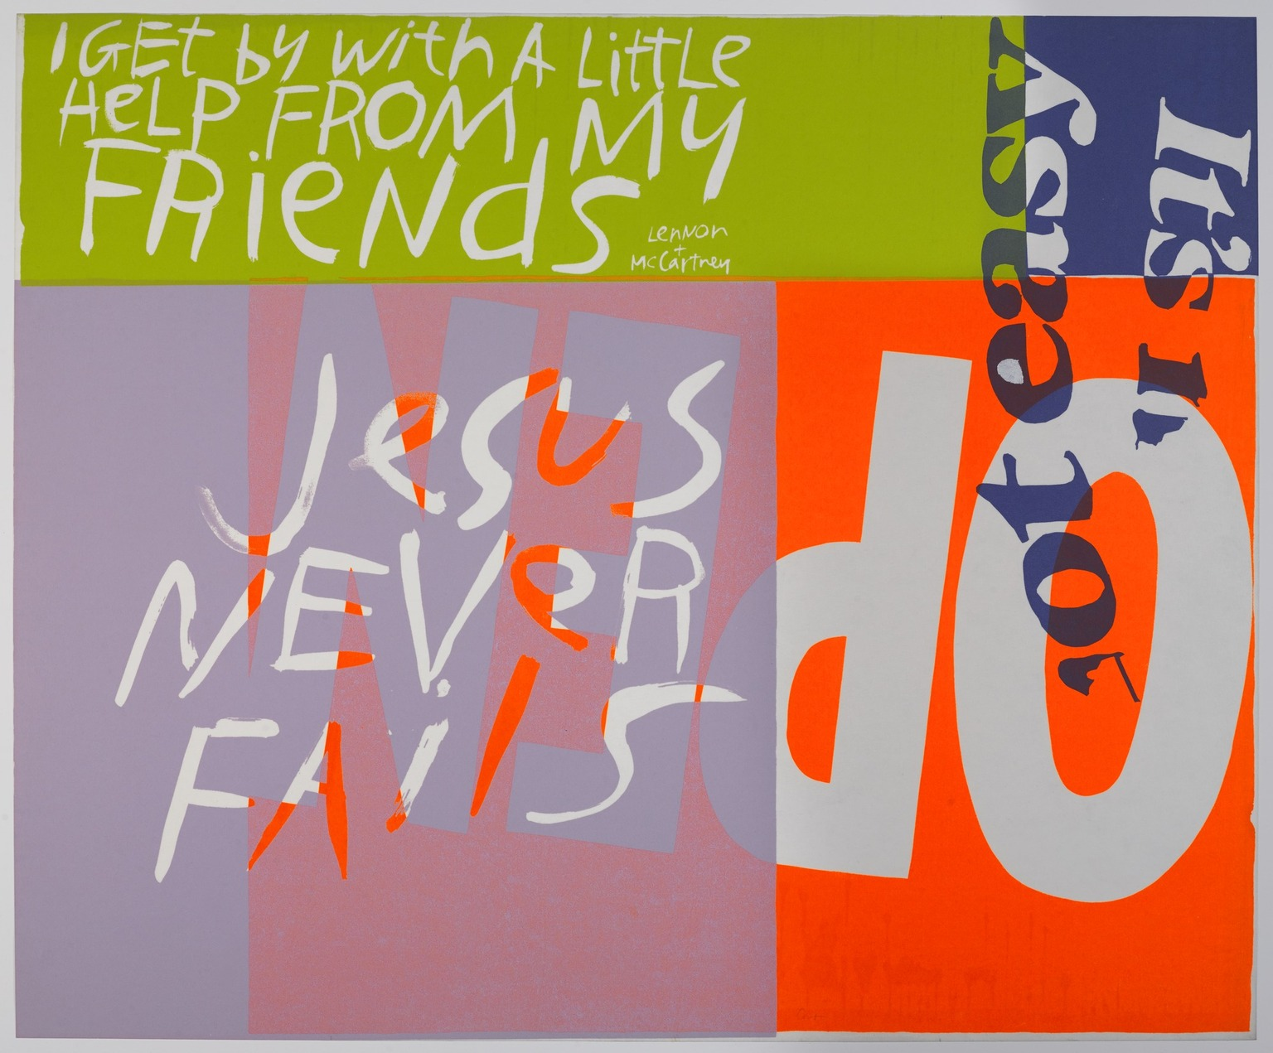
“Creativity belongs to the artist in each of us. To create means to relate. The root meaning of the word art is 'to fit together' and we all do this every day.”
- Sister Corita Kent
Jesus Never Fails, 1967, Sister Corita Kent, Screen print

Slide 4
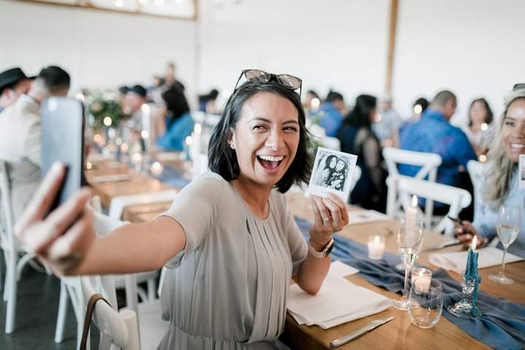
OUR ART DEPARTMENT
Notes:
In 2015 the shape of our Art Department started to change. After being a solid team of a tight five for approx. 8 years, roles shifted so that we became a team comprised of only two full time teachers and the remainder part time.
The last couple of years have been a time of Shape shifting – Jay - deaning, Martin – a stint in LT relief, Peter - significant illness. Now Rachel & Martin part of the COL as across-school leaders., This photo was taken at Gibbs Farm last holidays, and since then Ali gone, Renee joined. Peter leaves us at the end of this year … change as a constant …
As HOD I experienced myself going through a Leadership crisis at the end of term 1 last year. It was the end of an era in our team, and it brought about lots of reflection and deep thinking. To cut a long story short , the changes unfolding became the catalyst for realising that we had completely fulfilled on our previous Department vision, and were in urgent need of a new vision that would take us into the future.

Slide 5
Gutenberg Schrift Sticker By Merkurist.De
https://giphy.com/stickers/merkurist-nachrichten-gutenberg-merkurist-buchdruck-TduUIAsIOkarX0IPjk

Slide 6
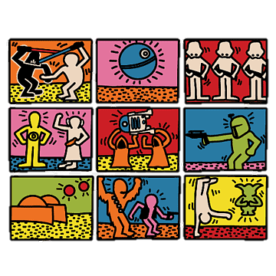
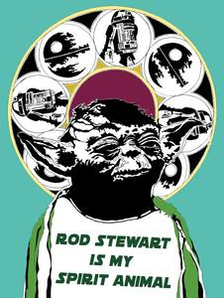
Maggie Covell
https://www.facebook.com/nzartmaggiecovell/photos/a.1451420895085627/2804841013076935
Keith Haring Theduc Collaboration with Krikoui

Slide 7
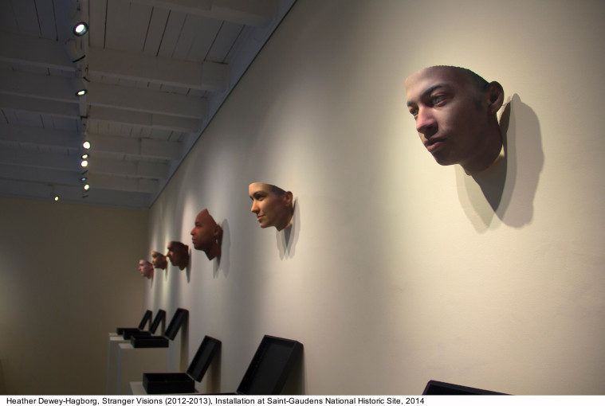
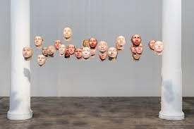
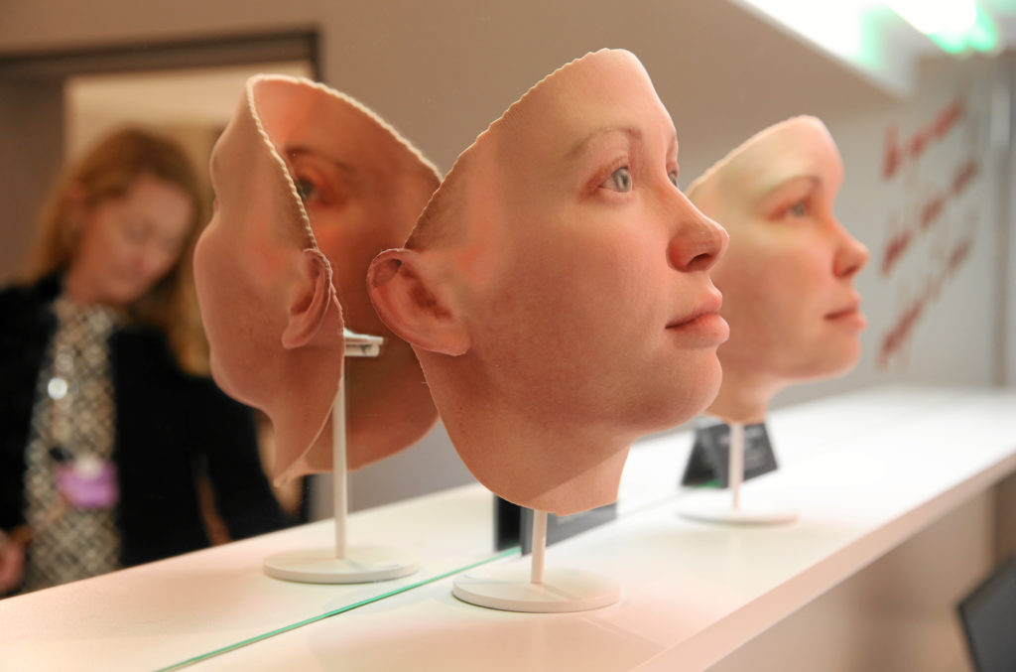
https://deweyhagborg.com/projects/probably-chelsea
Ph.D. student, Heather Dewey Hagborg, has created 3D printed portraits from DNA found on cigarette butts and chewing gum on the streets of New York City. Imagine dropping a cigarette butt, then a couple days later walking into some random Art Gallery and seeing a printing your face on the wall.
https://www.youtube.com/watch?v=oOwcOboKx8E 3 mins
https://www.youtube.com/watch?v=666Kq95xm1o 15 minute
https://vimeo.com/234985530
Heather Dewey-Hagborg, Radical Love, Chelsea Manning (2016). Installation at World Economic Forum in Davos. Courtesy the artists and Fridman Gallery, New York.

Slide 8
Everyone starts with Eco Printing
Then 30 minutes at each station – 8 people at each station rotate after 30 minutes
Silk Mezzotint
Dry point - mark making, plate tone, chine colle
Collograph – plain, textured, wipe away image tetra pac and Pronto plate -
Woodcut textures
Mono printing – linear mono, golden open acrylics, Dan Tirels – mono printing with oil stick and plastic bag

Slide 9
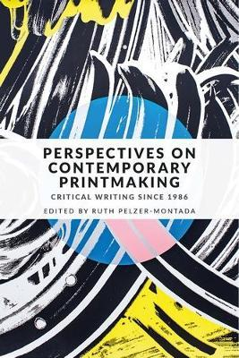
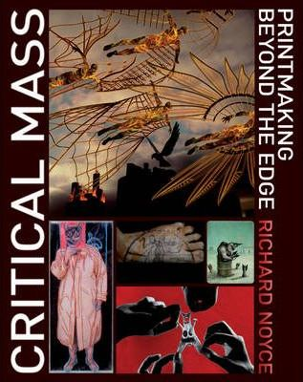
Resources
Perspectives on Contemporary Printmaking : Critical Writing Since 1986 Edited by Ruth Pelzer-Montada
The Printmaking Ideas Book By (author) Frances Stanfield , By (author) Lucy McGeown
Installations and Experimental Printmaking By (author) Alexia Tala
Singular and Serial: Contemporary Monotype and Monoprint By (author) Catherine Kernan , With Laura G. Einstein , With Janice Oresman , Edited by E. Ashley Rooney
Modern Printmaking : A Guide to Traditional and Digital Techniques By (author) Sylvie Covey
Printmaking Off the Beaten Track By (author) Richard Noyce
Critical Mass : Printmaking Beyond the Edge By (author) Richard Noyce
Imprint Magazine OZ
Pressing Matters UK
https://www.printcouncil.nz/
http://tonihartillart.blogspot.com/
https://inaarraoui.com/
https://www.pressingmattersmag.com/
https://www.printcouncil.org.au/imprint-magazine/
https://civa.org/
http://www.cs.org.nz/
https://www.pinterest.nz/triffidgirl72/_saved/
https://www.facebook.com/groups/304856440276248
https://www.facebook.com/125-Celebrate-125-540731813029937
https://abc-nz.org.nz/
http://costumeandtextile.co.nz/
http://www.nzprintmakers.com/
https://austinkleon.com/
https://www.instagram.com/esther.hansen.737/
https://www.instagram.com/vicky.mooreallen/

Slide 10
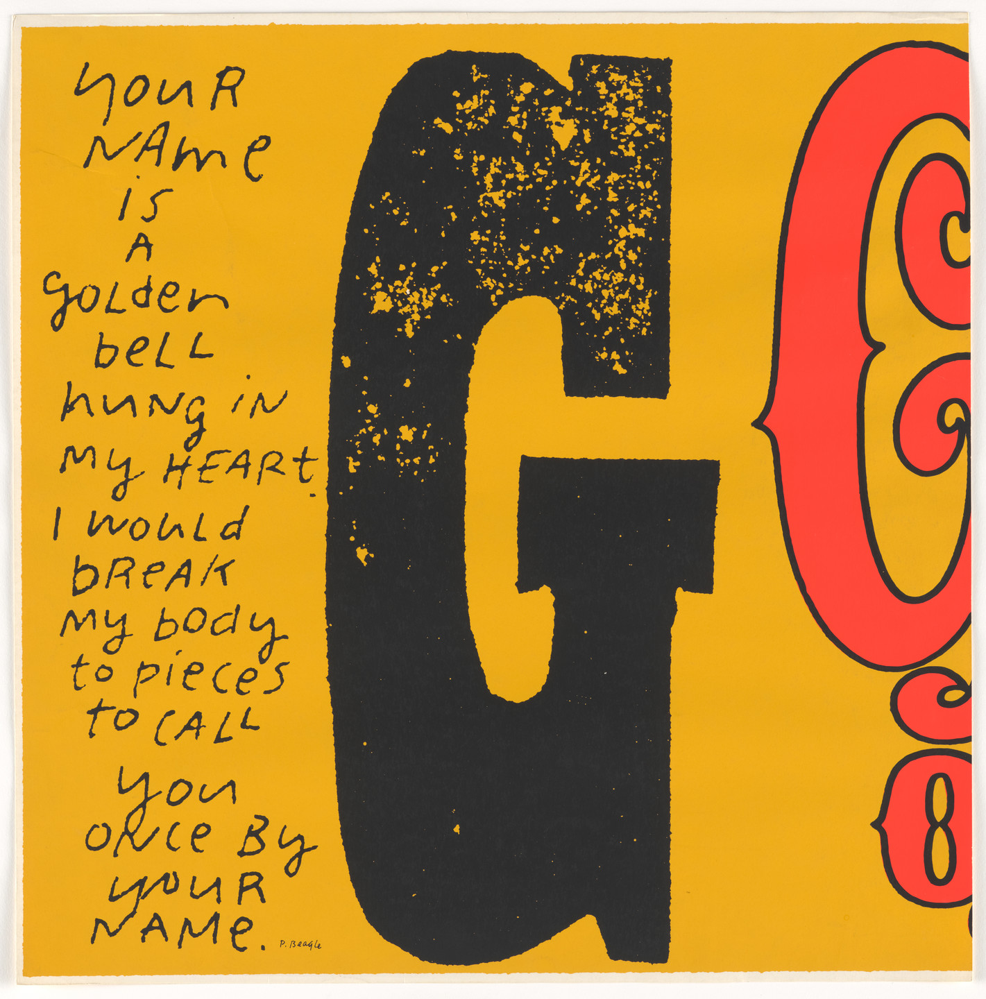
“In this speedy world of ours when facts are multiplying rapidly and giant rearrangements are happening all around us, it seems dangerous to be made nervous by the new - to want what we can never have, to want things not to be rearranged. It would be better to be able to take the leap, which is to be able not only to live with change and newness, but even to help make it.” - Sister Corita Kent
Corita Kent (Sister Mary Corita)
G greatest show of worth from circus alphabet 1968

Slide 11
Esther’s work

Slide 12
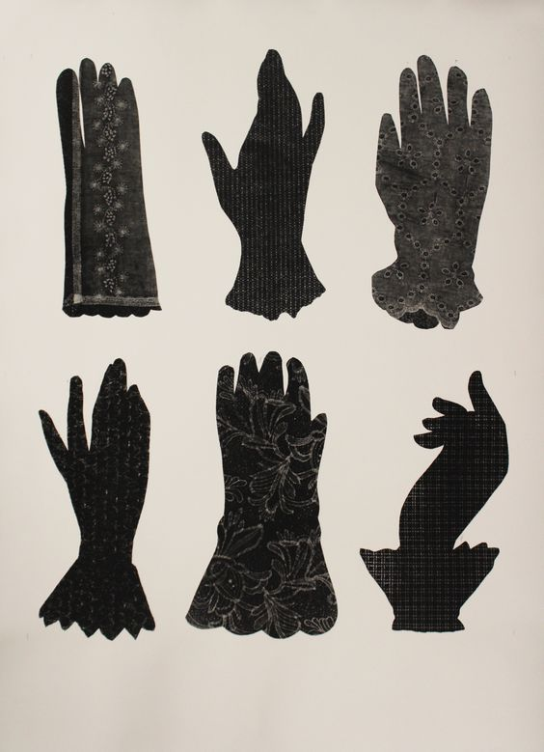
E A Hansen, Gesticulate 3 (black), 2017, lace glove print monotype monoprint

Slide 13
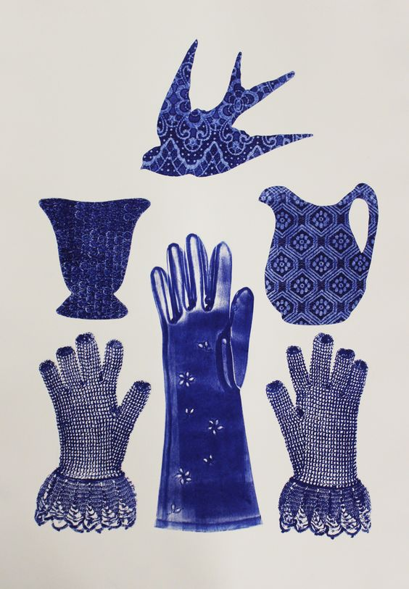
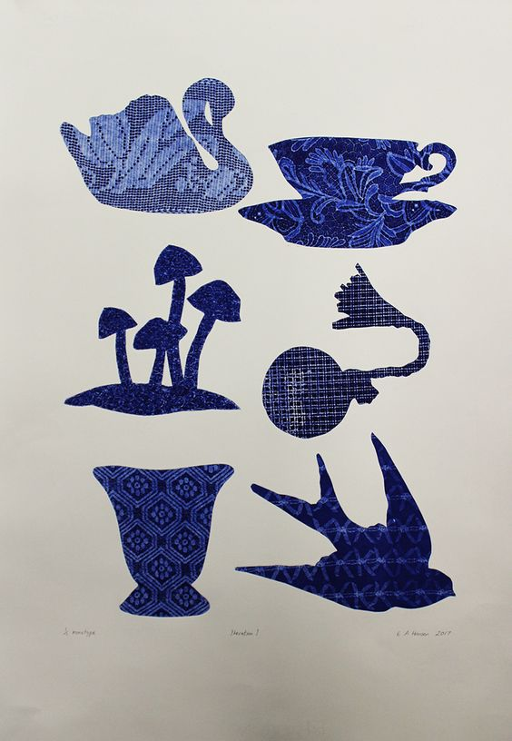
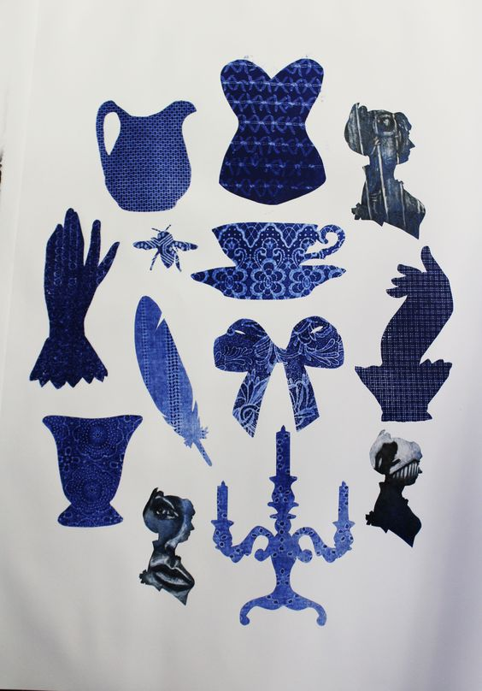
E A Hansen, Iteration I, 2017, monotype mono print
E A Hansen, Trinity I (blue), 2017, mono type
E A Hansen, Consent I, 1/1, monotype print

Slide 14
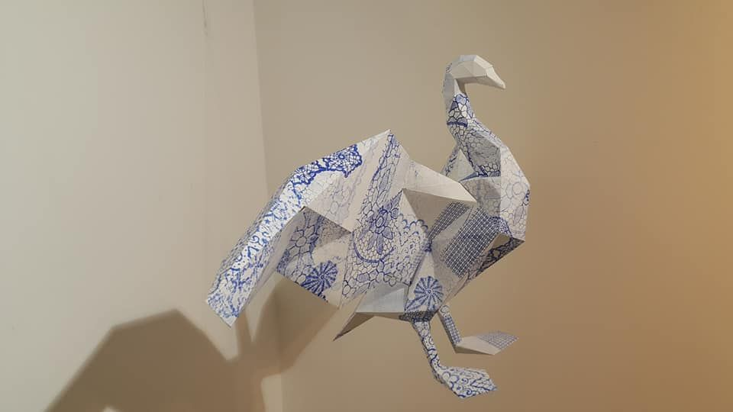
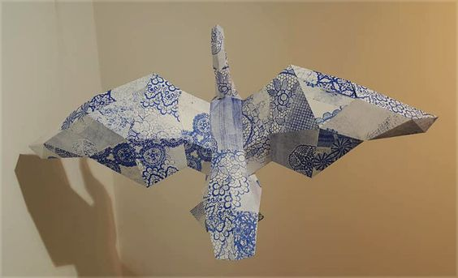
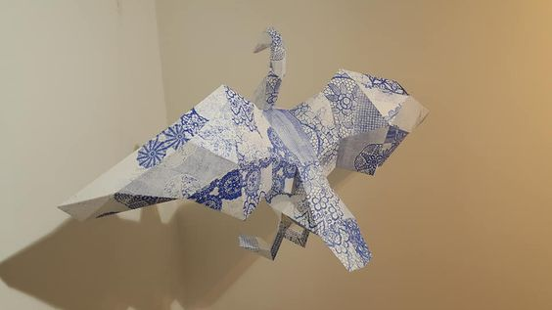
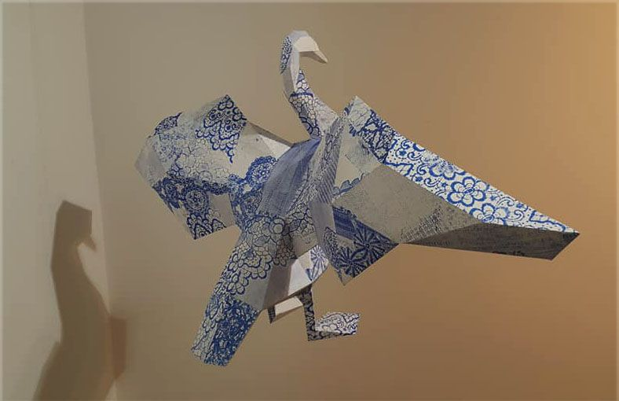
E A Hansen, Cygnini's Song, 2018, mono print on 3D paper swan, low poly origami pattern. lace, doily.

Slide 15
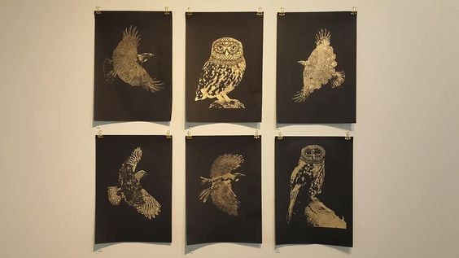
E A Hansen, various gold leaf digital prints, Tui I, Ruru I, Tui II, Kea I, Tui III, Ruru II, 2018, Underlying Networks Exhibition, Franklin Gallery

Slide 16
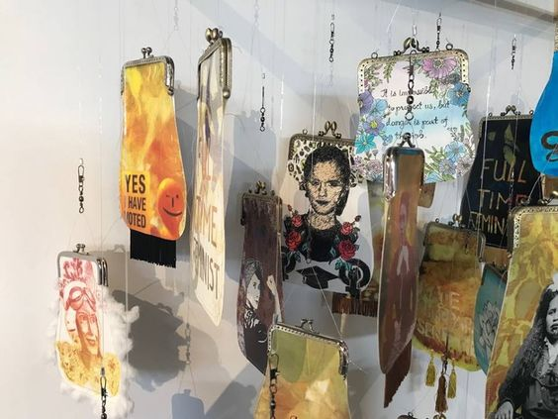
She Speaks 2018
Common Cents (detail), Collaborative print installation, Esther Hansen & Rebecca Bent and students from Pukekohe High school. 2018 on display at the Franklin Gallery Pukekohe till January 2019. From She Speak exhibition.

Slide 17
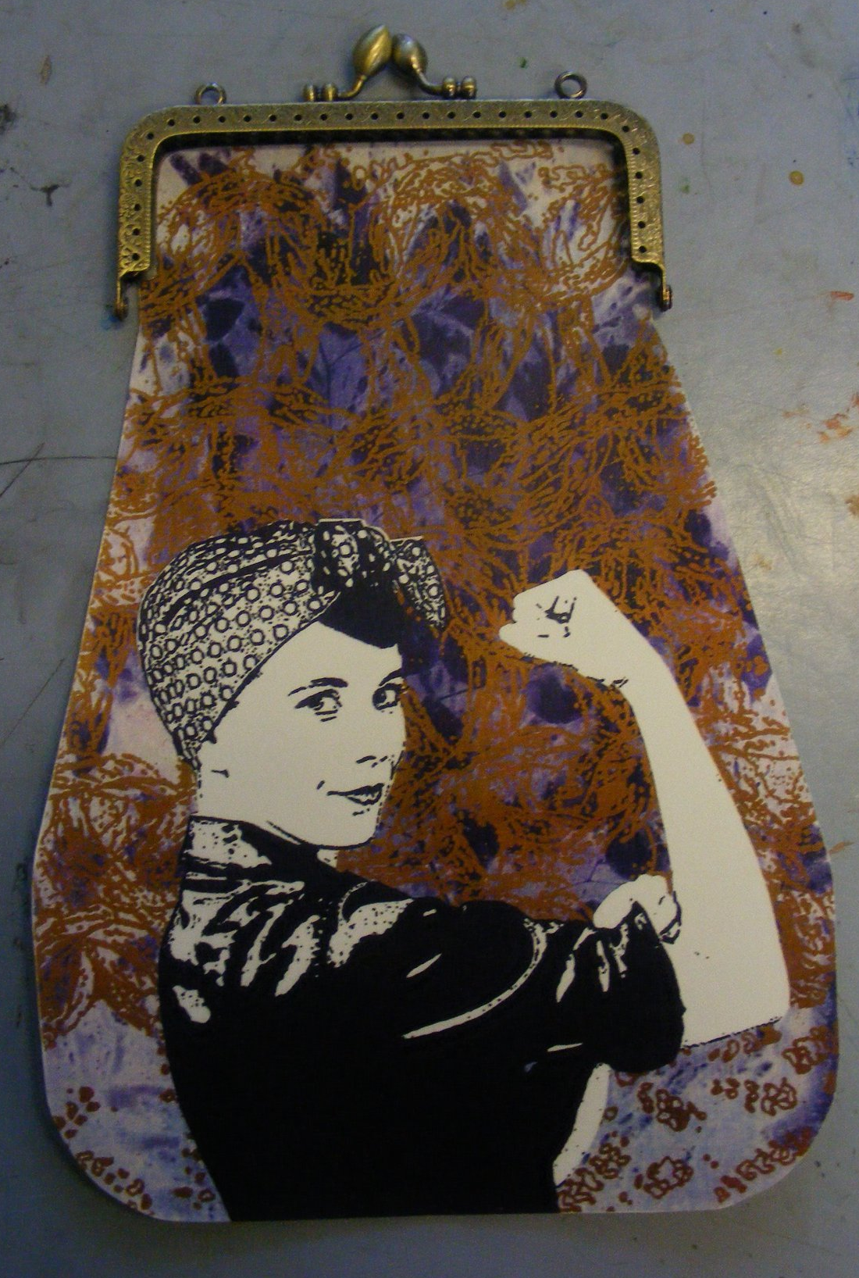
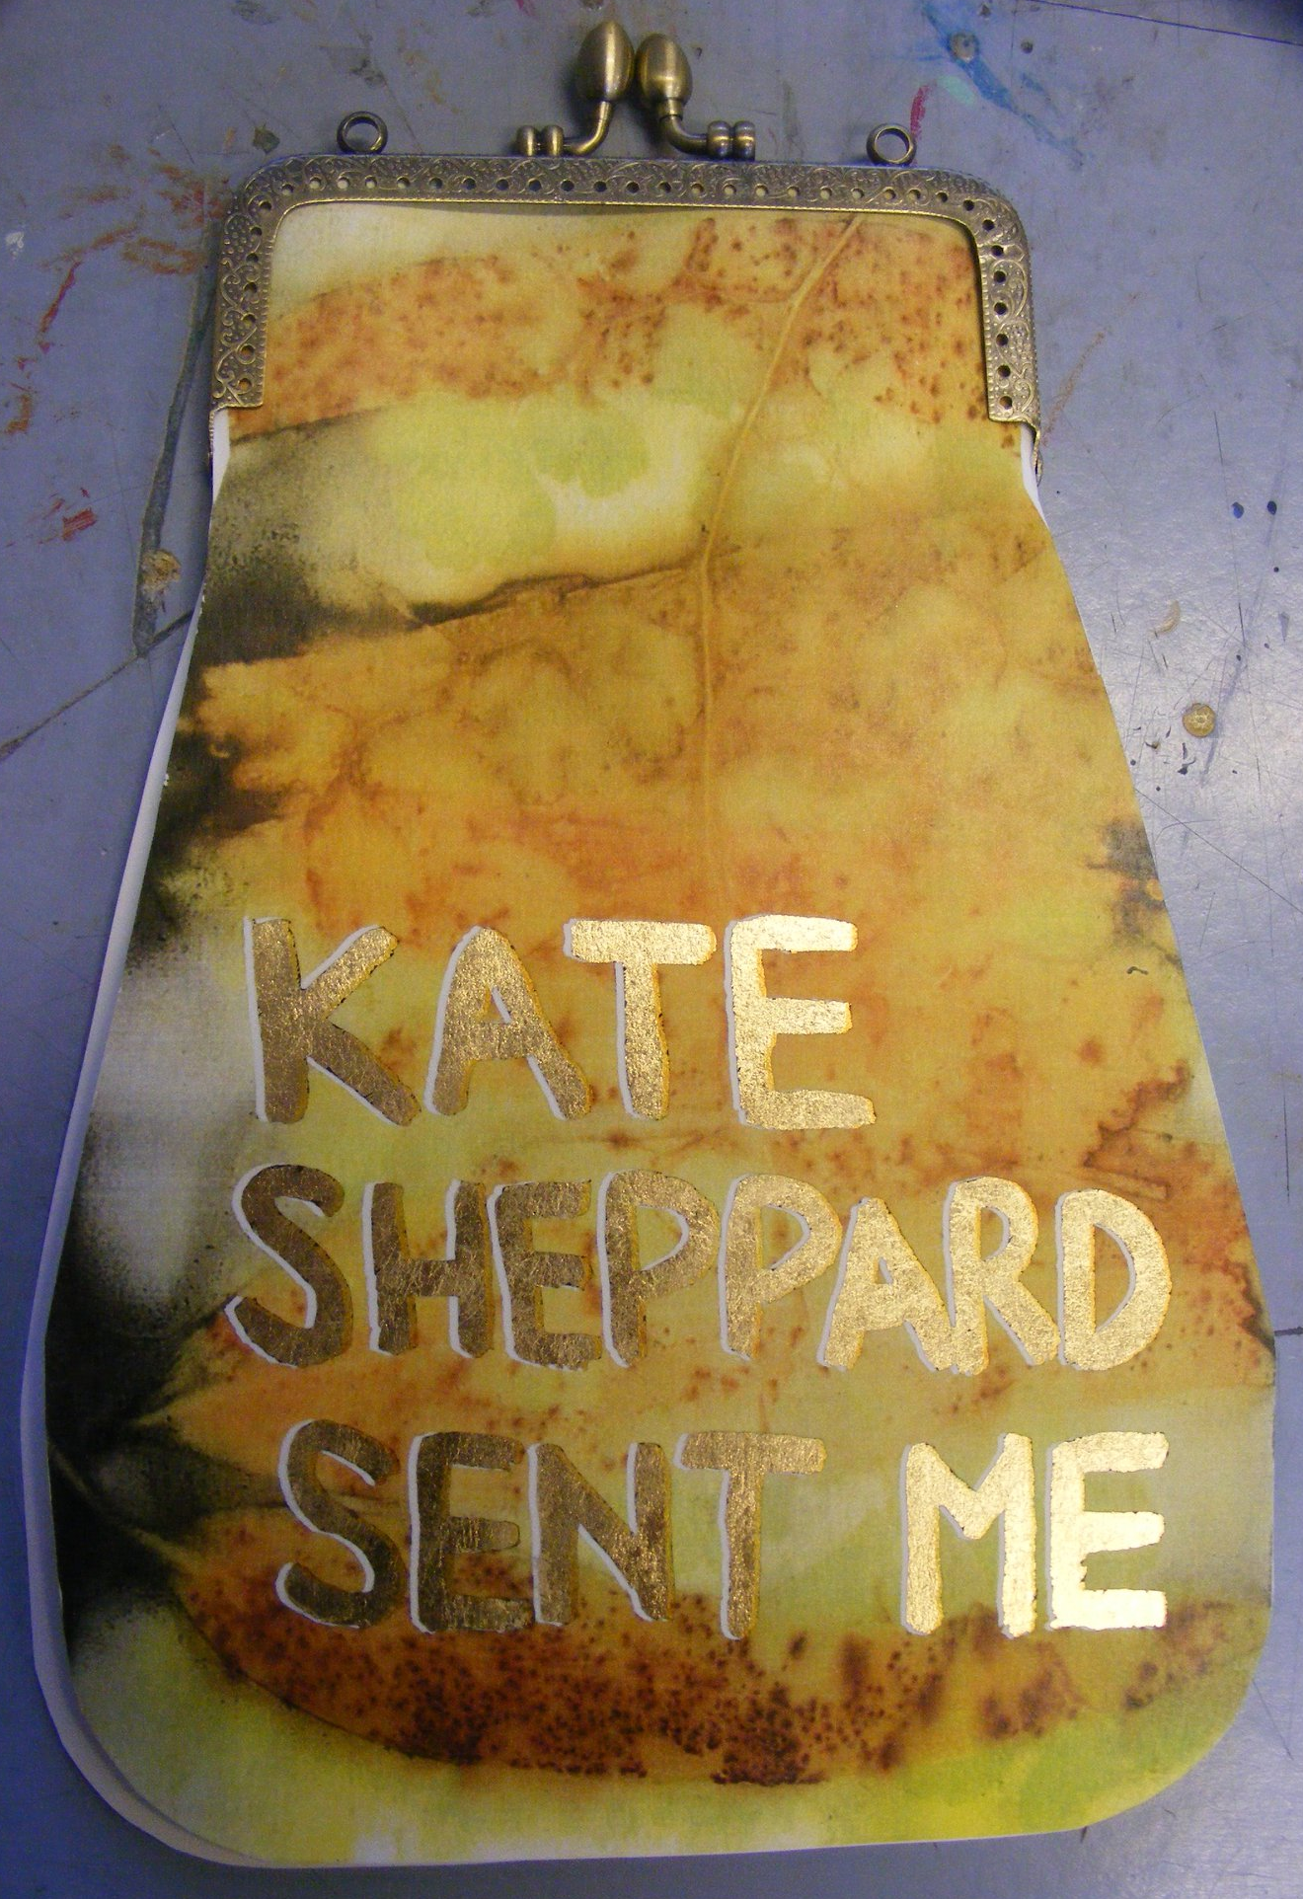
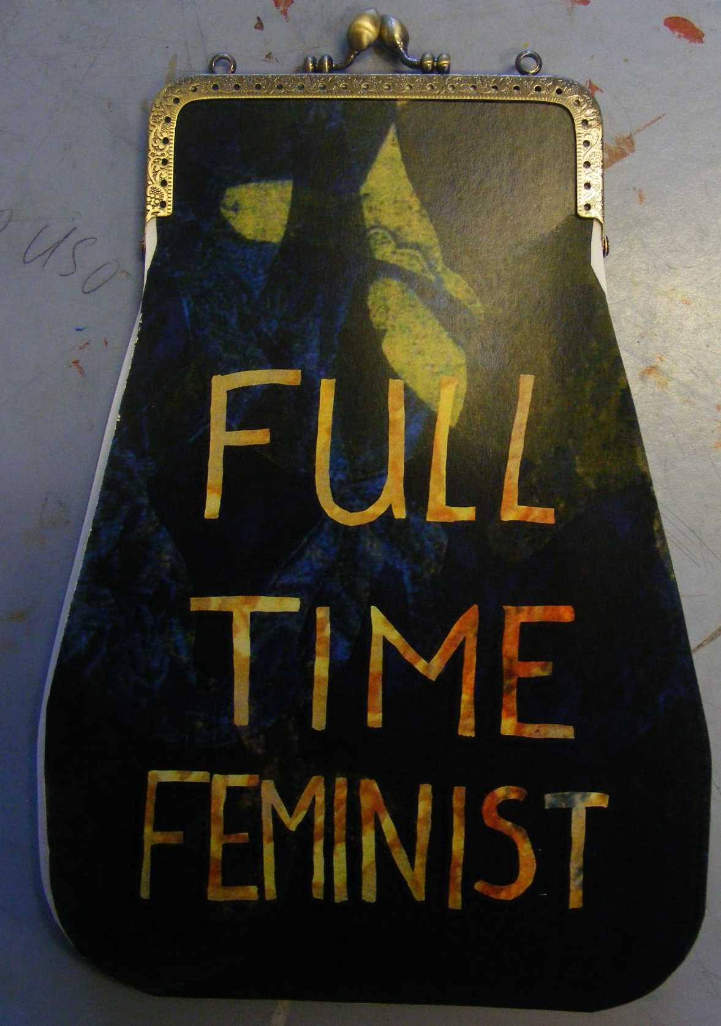
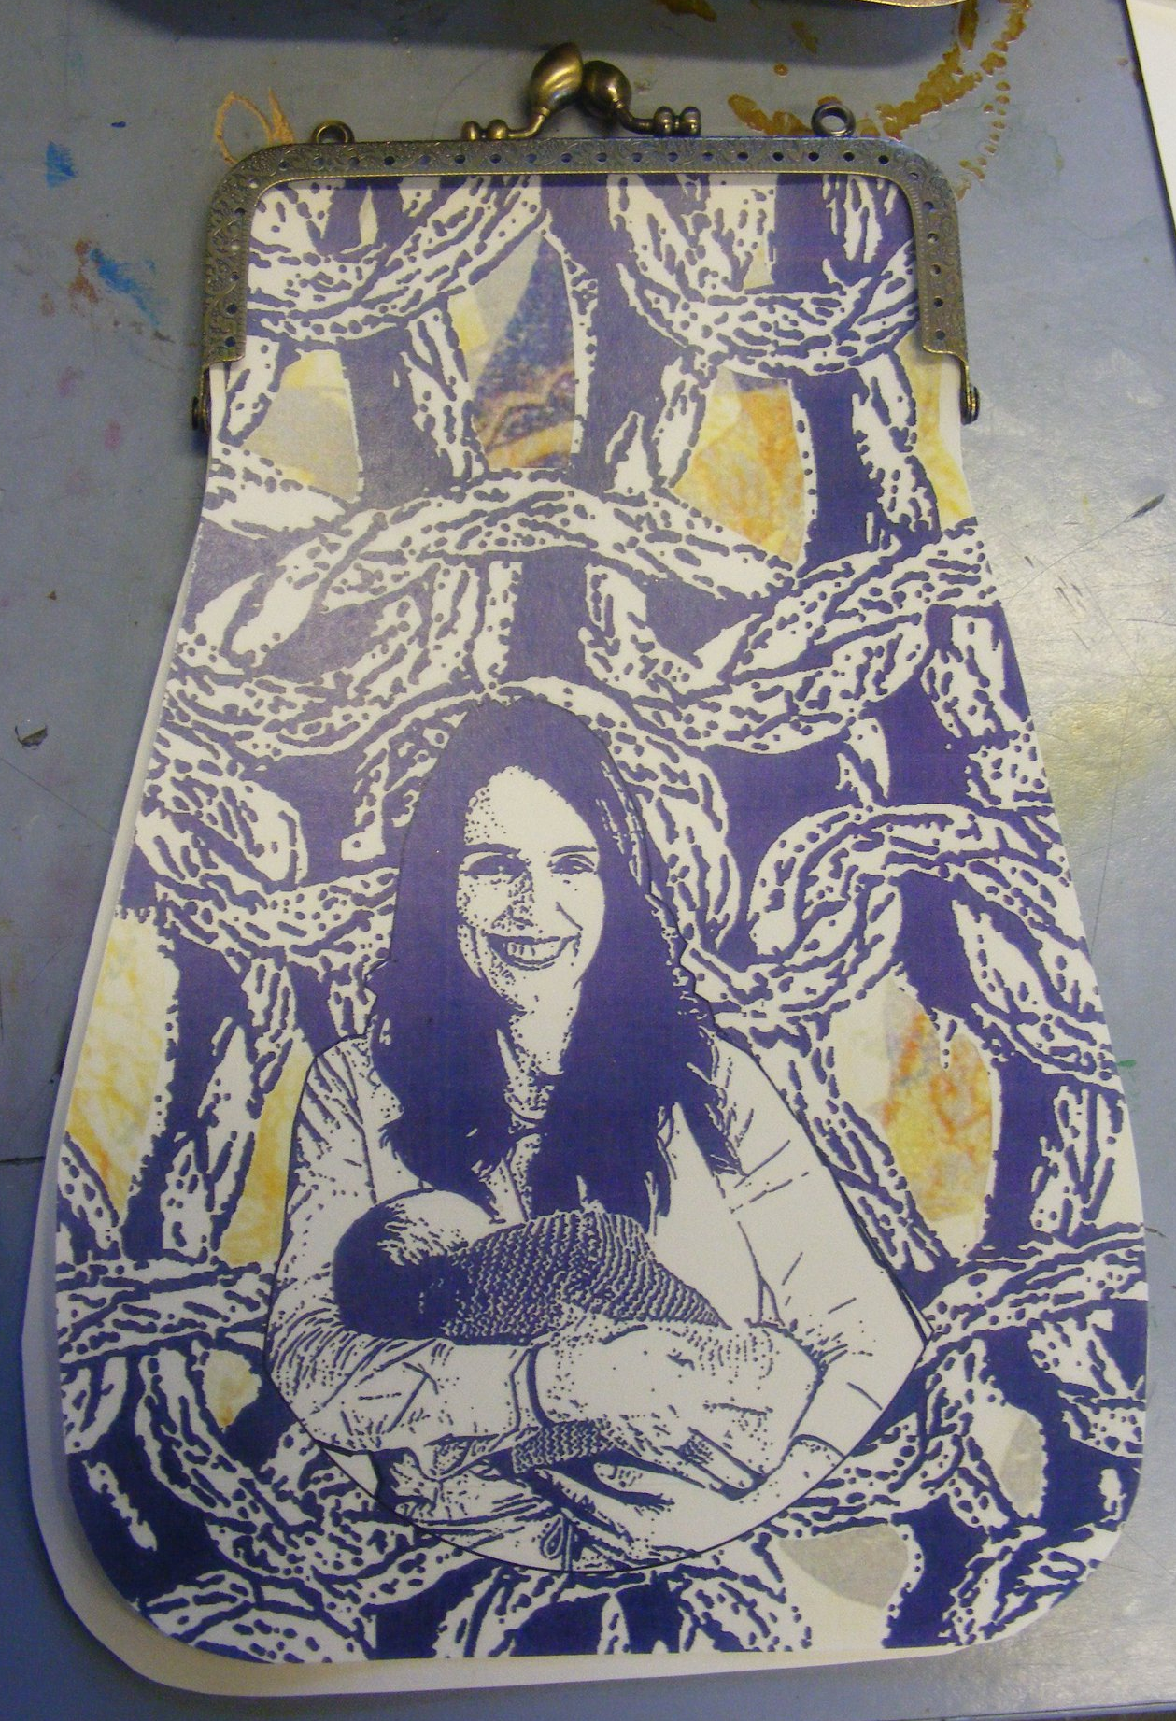

Slide 18
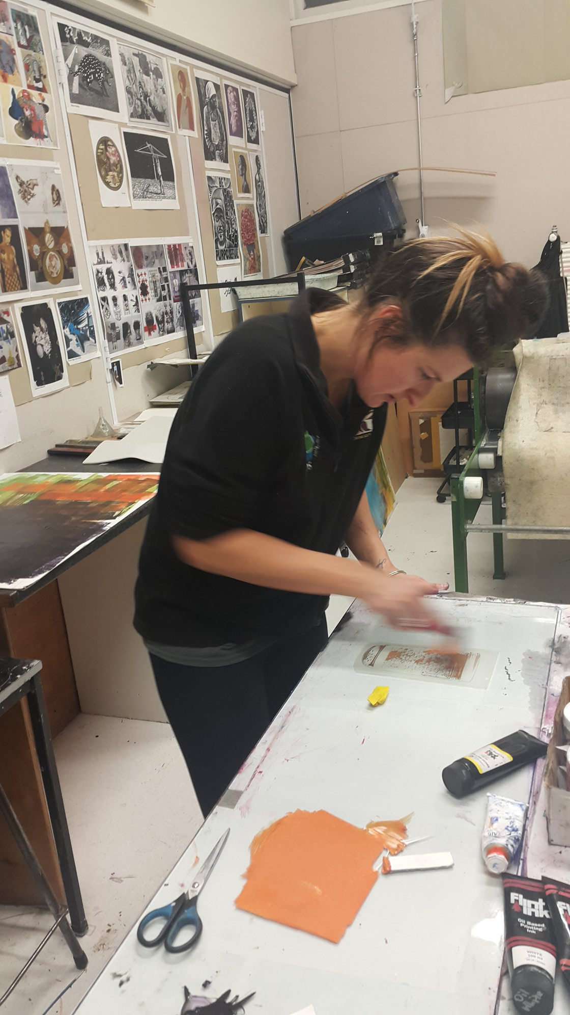
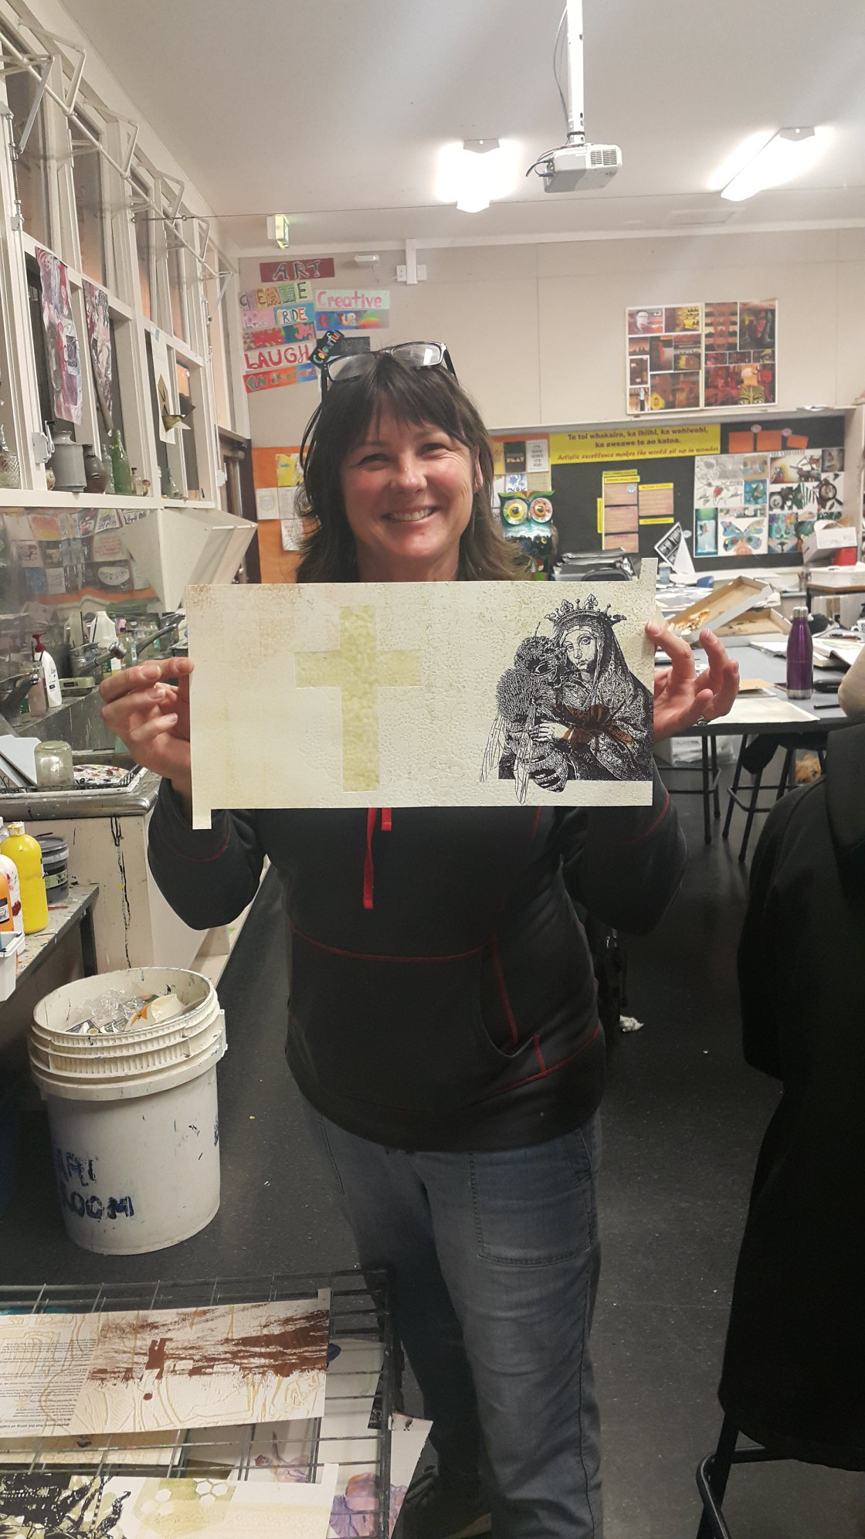
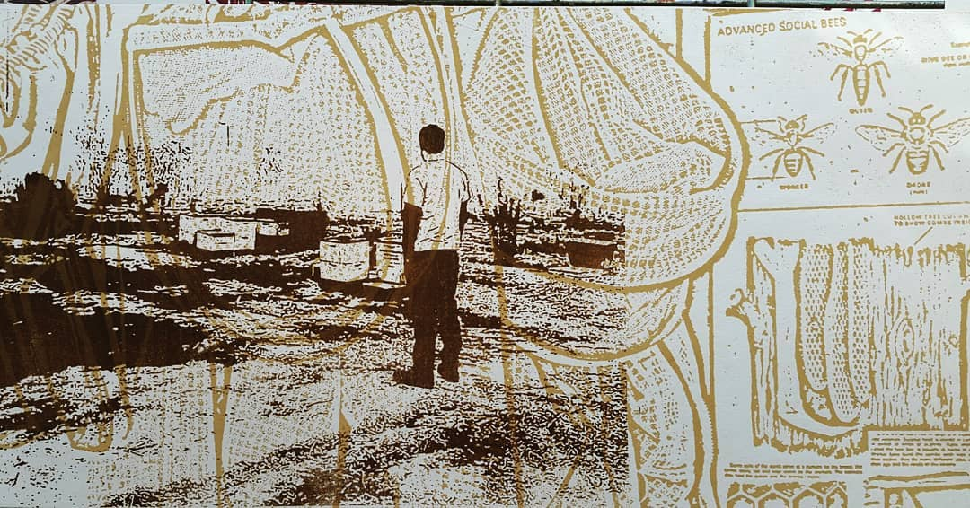
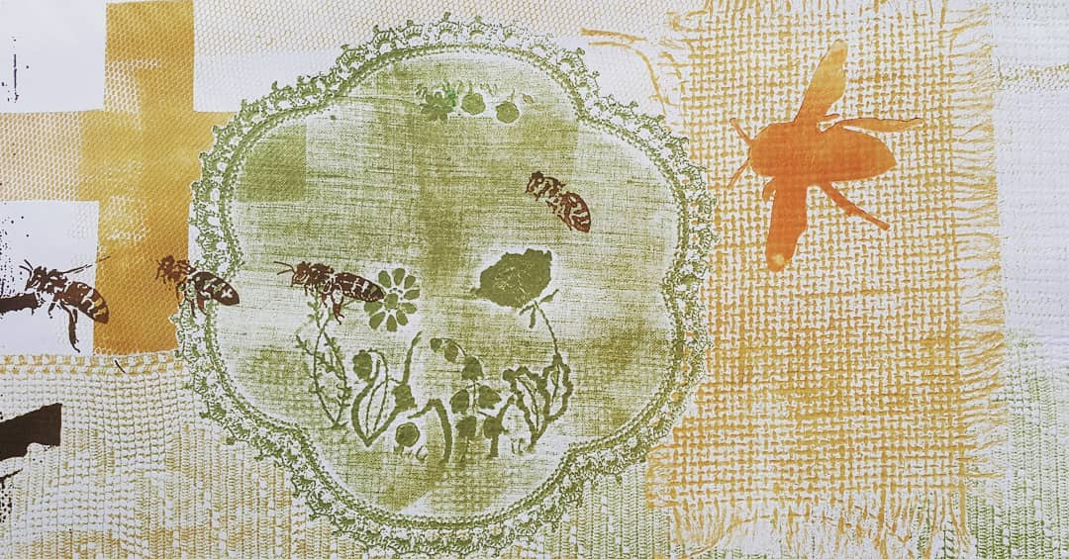
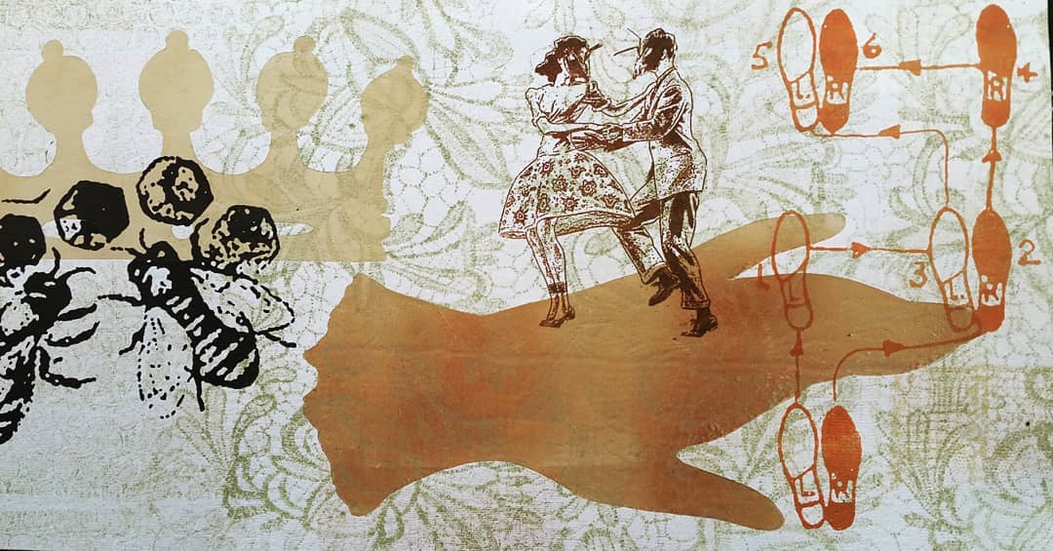

Slide 19
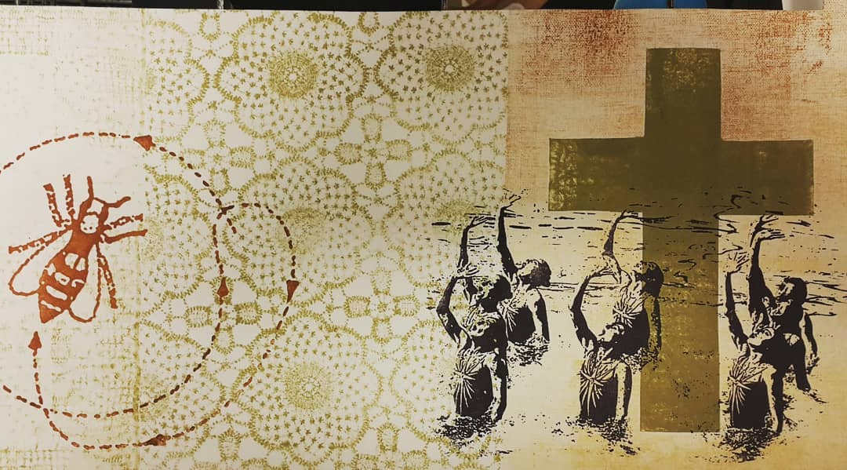
Detail from The Bee Box book project, Esther Hansen, 2019, monoprint, collograph, pronto plate. Printed with the assistance of #FranklinPrintGroup, Meg Wilson, Vicky Moore-Allen and Rebecca Bent. #printmaking #printmakers #PCANZ

Slide 20
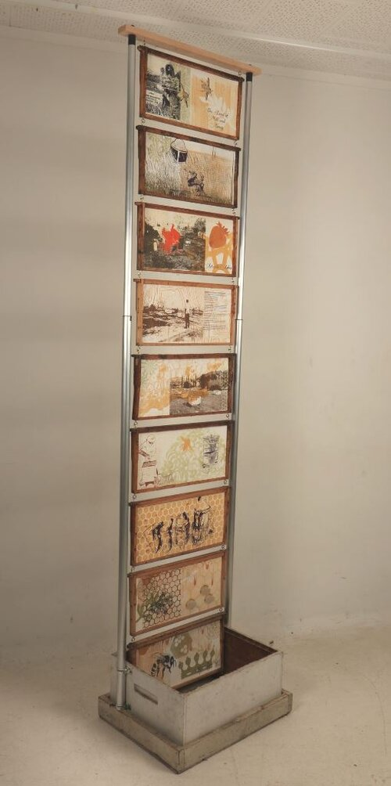
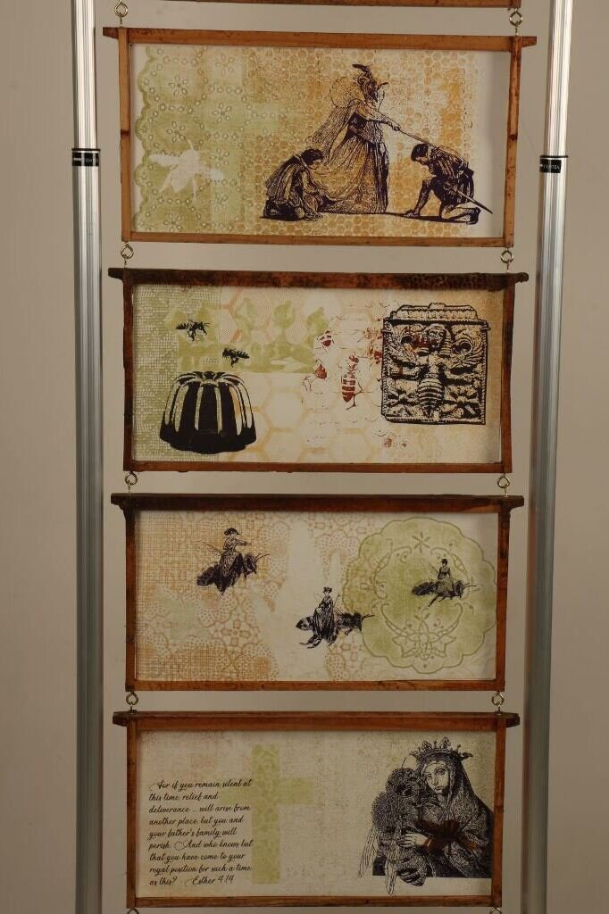
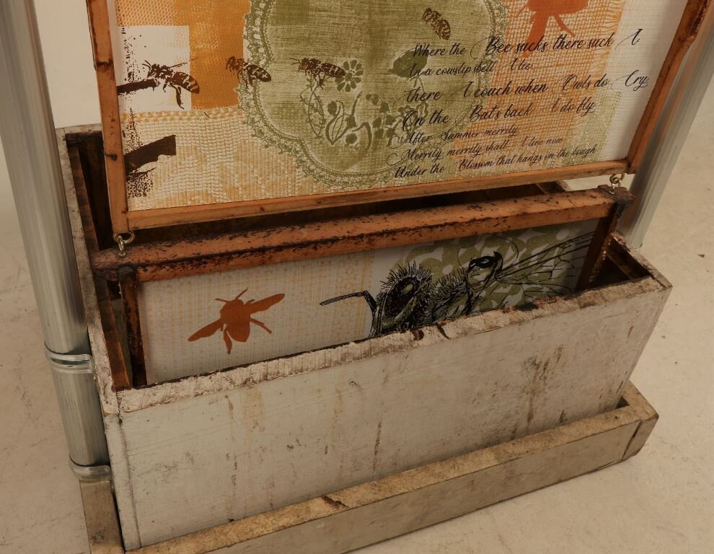
Esther Hansen (Pukekohe), Bee Box Book, 2019
Media/Materials used: Oil based monoprint, collograph, laser cut woodcut, pronto plate prints on Fabriano paper, bee hive frames, bee hive box, wood and aluminium supports.
Dimensions: 58 cm x 2.3 metres x 46 cm
Description: 9 used Langstroth beehive frames suspended above a hive box supported by wood and extendable aluminium supports. Prints on Fabriano paper on the front and back side of each hive frame.
Artist's Statement: “The roof, the roof, the roof is on fire” – The Bloodhound Gang “… I want you to act. I want you to act as you would in a crisis. I want you to act as if our house is on fire.” Greta Thunburg The Bee Box Book Project converts a Langstroth hive box into a “book”. Each side expressing an aspect of beekeeping and the artist’s own personal bee mythology. On one side, the factual story of Steve Nimmer, a California beekeeper who tried to rescue, but lost, most of his hives in the 2017 Thomas Wildfires. Global warming is increasing the risk of fires that destroy everything in their path, including whole ecosystems, homes and businesses. They also show the power of man working with nature to rebuild and restore. We are on the brink of ecological disaster. Bees are dying from the impact of human practices. The other pages are more fantastical, from ladies riding bees side-saddle to bees dancing jive. What if a Queen bee really did rule the world? Monoprint, laser-cut woodcuts and pronto lithography have been layered to create images that celebrate a pivotal moment in our species. Our house is on fire, will we just let it burn?
List of collaborators: Esther Hansen concept, design and printing; Rebecca Bent paper cuts, gluing and framing; Meg Wilson expert inking of pronto plates.
Gained Merit award $150

Slide 21
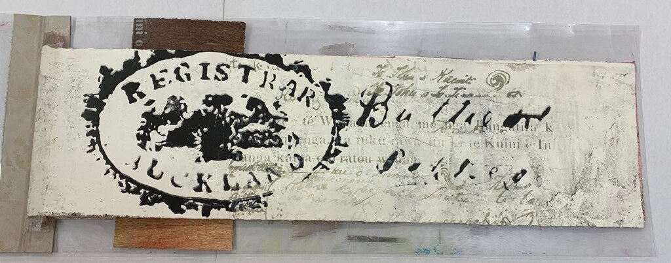
Jodi-Ann Tautari (Hamilton), Mohinui A424, 2019
Media/Materials used: Moulin de gu 230gsm, stone lithography, mono print, collagraph (sand), plexiplate, leather
Dimensions: Closed 760mm x 300mm x 5mm. Open 1500mm x 300mm x 5 mm
Description: For Maori, their historic traditions and connections were passed on through whakairo(carving in wood) and ornamentation on material culture. The connection to Tane(God of the Forrest) and his offspring (paper) are used to explore the difference between maori and pakeha understanding. Maori place a great amount of importance on spoken word (korero) where as for pakeha unless it is written down as in on a contract is not considered as equally valid. Oral histories as opposed to written histories. So oral for maori is greater than written.
Artist's Statement: This book is titled Mohinui 4A2A and is the name of a Maori land block in Waiomio, Northland. The original land deed was given to my mother in-law by a kuia who was born there. The deed which includes the crown stamp, map lines and faded imagery inspired a series of lithographic prints in 1999. The deed hung in my husband’s family homestead (an unlined kauri villa at Waiomio) and was a source of fascination and interest for whanau and manuhiri alike. My mother in-law has been actively involved with Te Tiriti o Waitangi claims since the early 1970s. I have heard many accounts of historical incidents and the social impact of colonization on Maori. Her dedication to exploring the grievances of the Tiriti was one of the reasons the deed was given to her. The book celebrates the phenomenology that only occurs when you are involved in the making, touching and unfolding. It is a sensory response to my unique experience of living close to the whenua on a Maori land block that has such a rich and engaging history.
Heather Bramwell, assisted in some collagraph work and the binding of the book

Slide 22
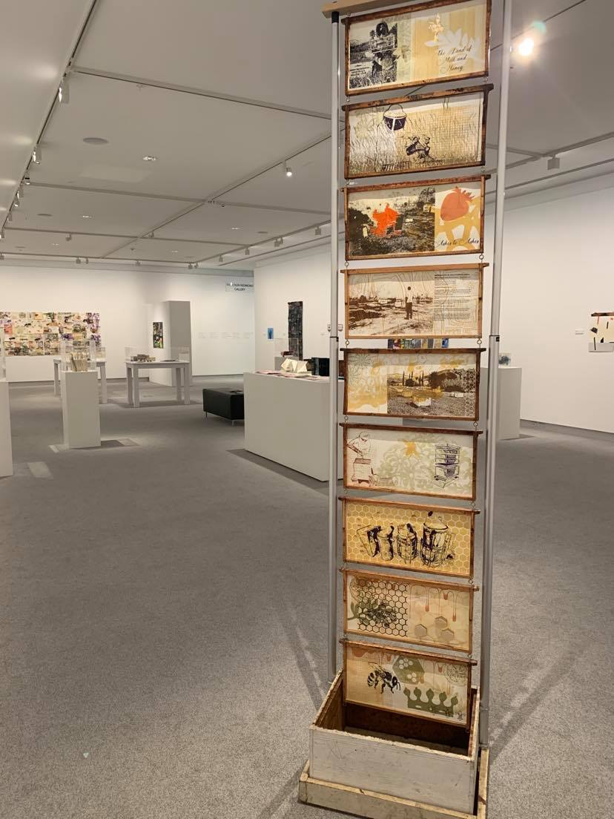
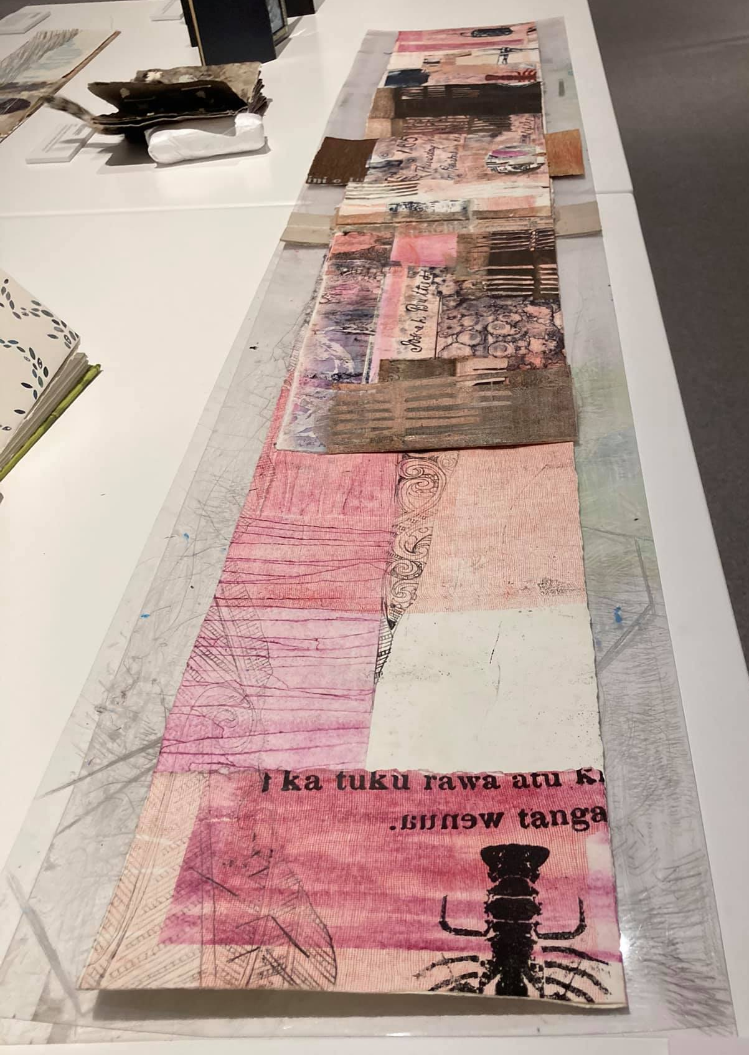

Slide 23
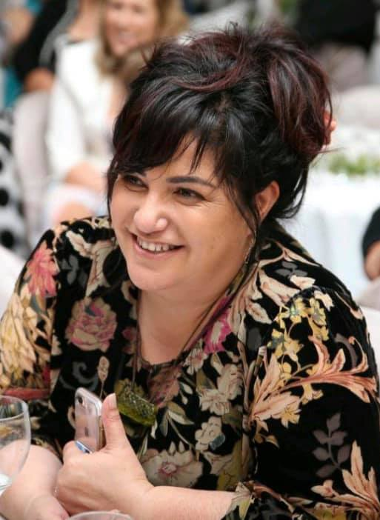
Jodi-Ann Tautari 1970 - 2020

Slide 24
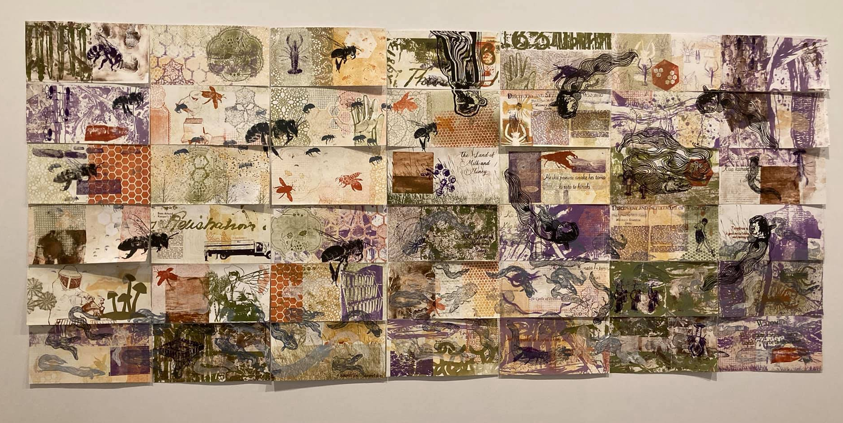
Jodi-Ann Tautari and Esther Hansen "Mohinui Block and the Bee Box Testaments" 2020. This collaborative project between artists: Jodi-Ann Tautari and Esther Hansen. Shows Tuna (Maori word for Eel) and the Bees are brought together. The wall work is made of monotype, laser cut woodcut, pronto plate prints, (7 rows of 6 works, 42 works in total, each work is 40cm x 20 cm)

Slide 29
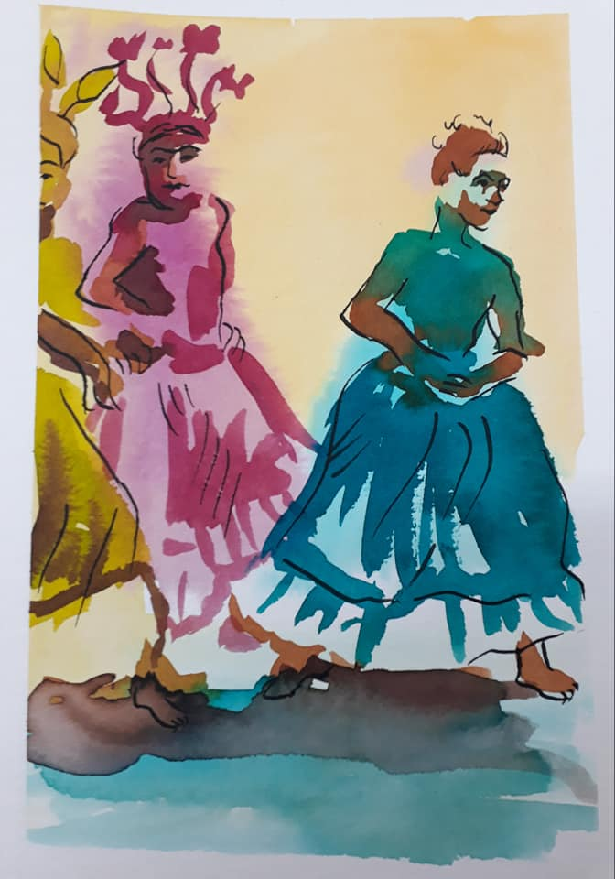
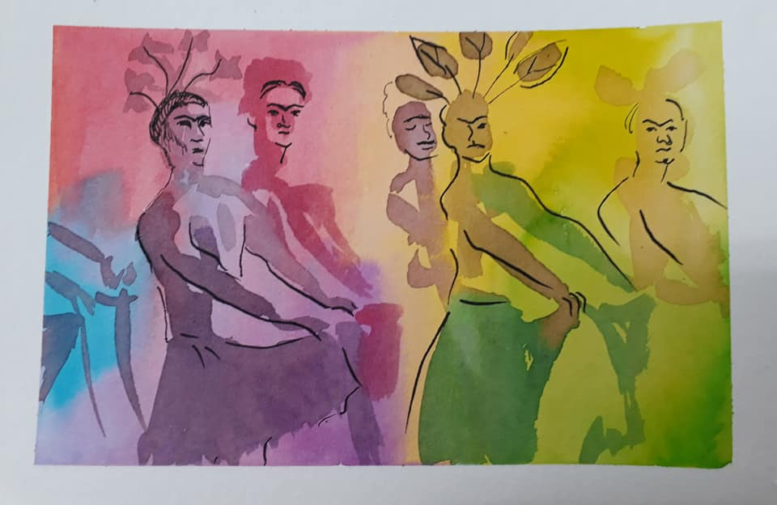
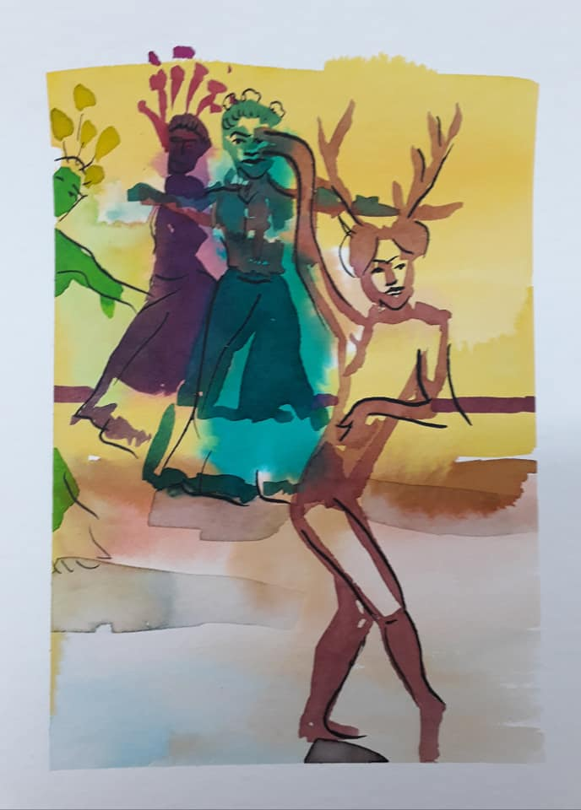
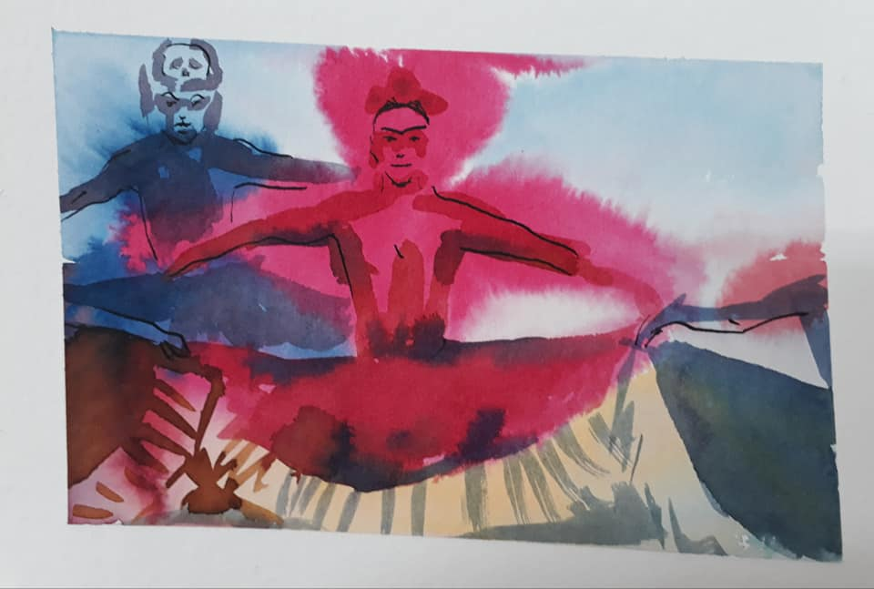
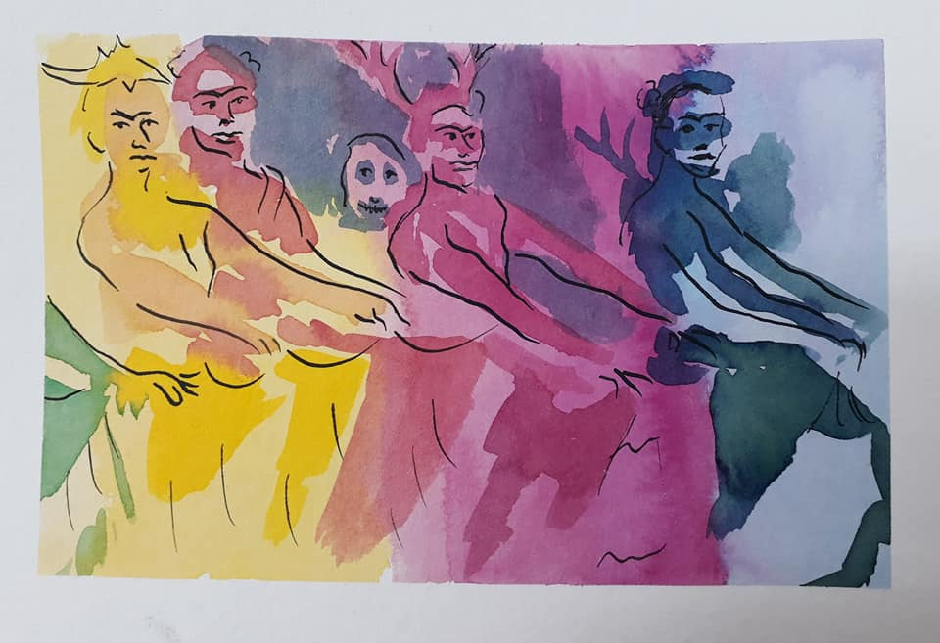
2020 watercolour studies

Slide 30
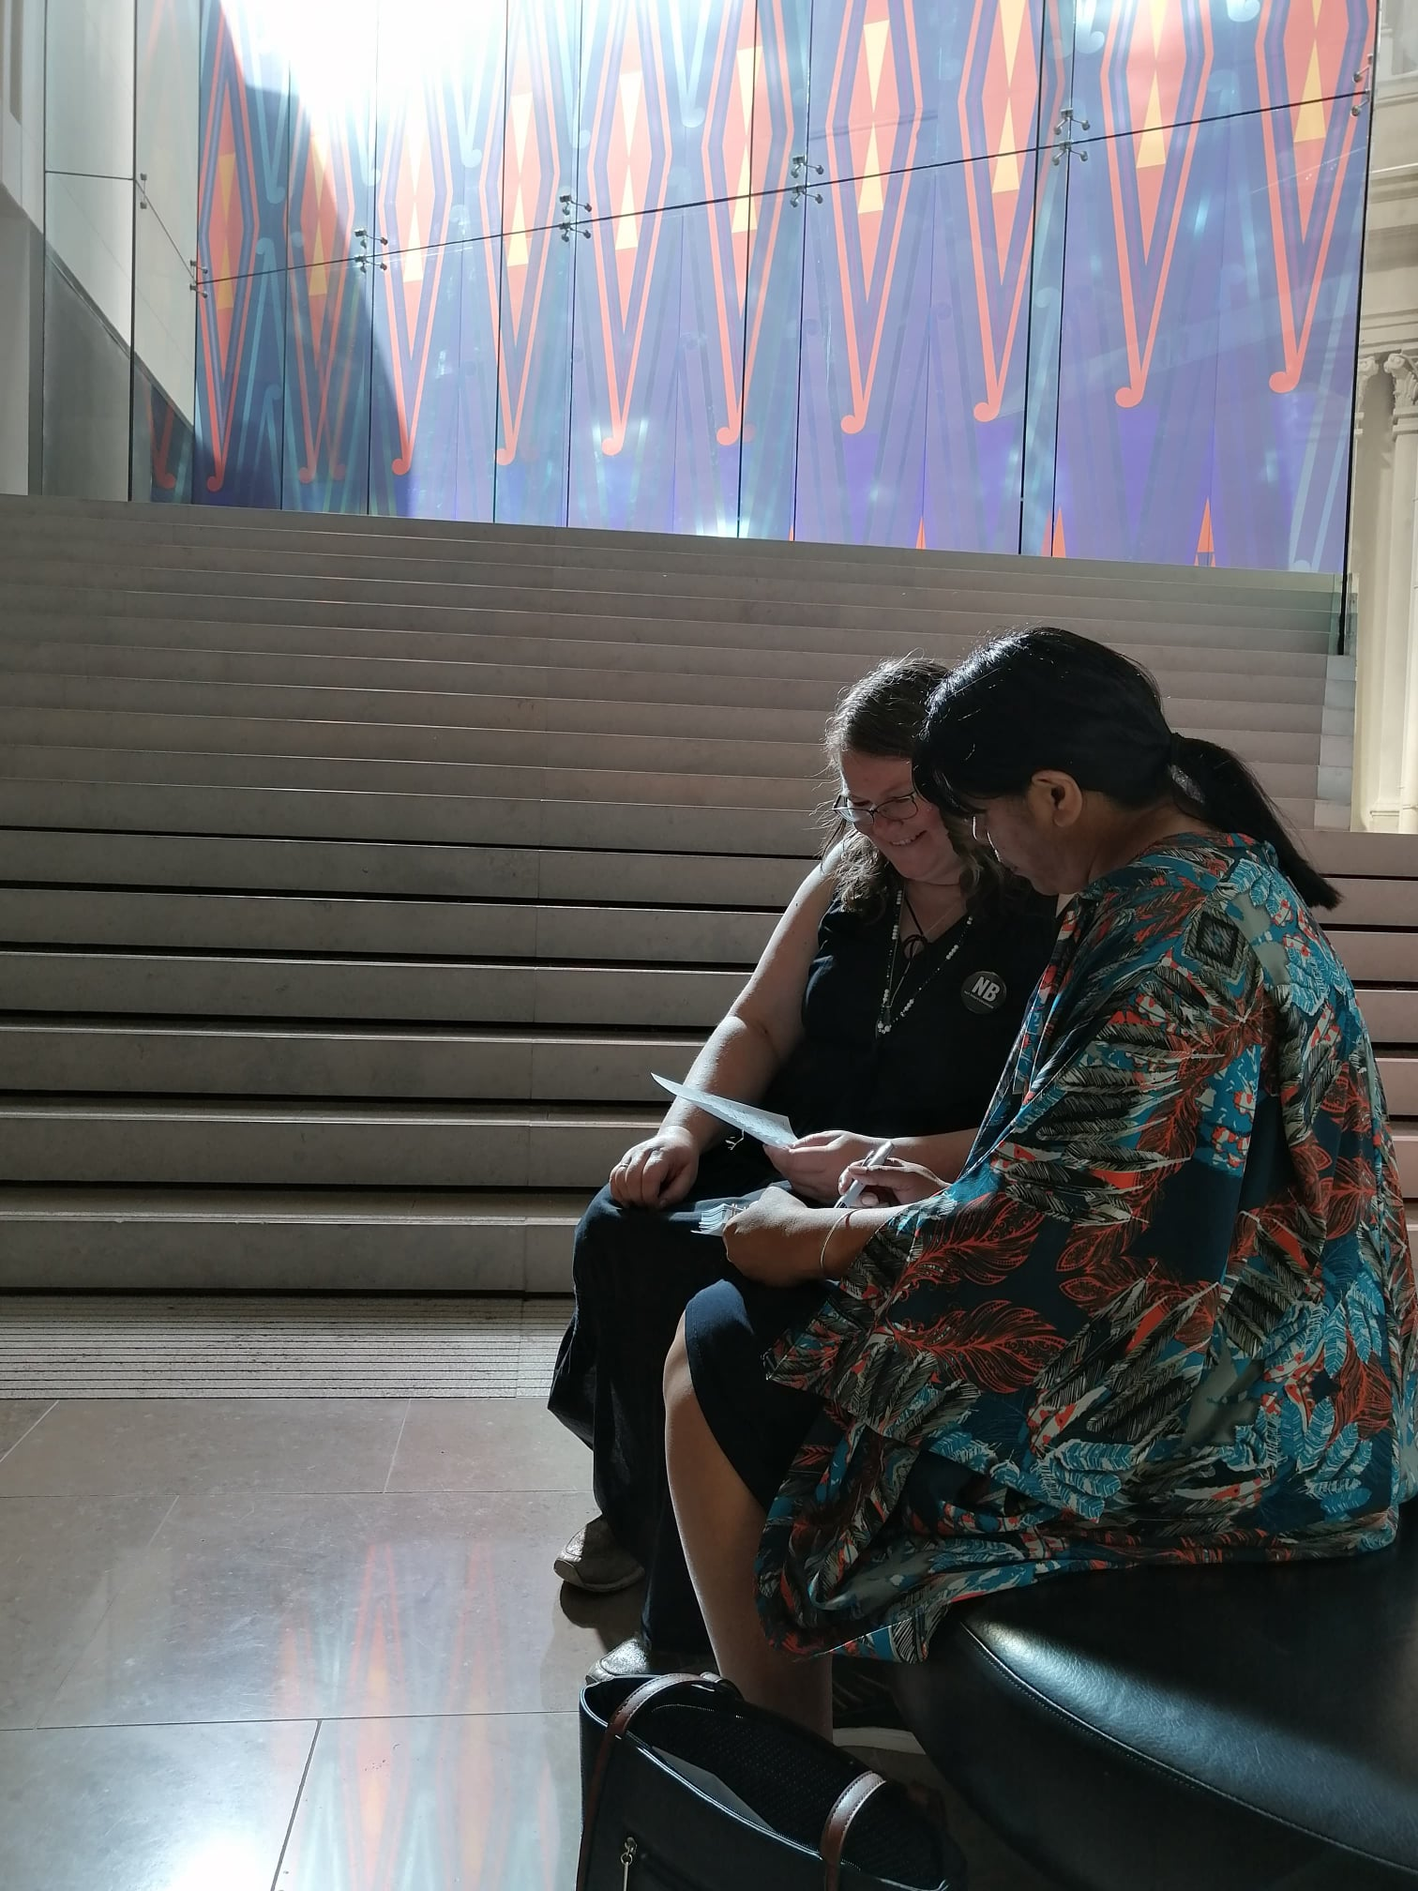
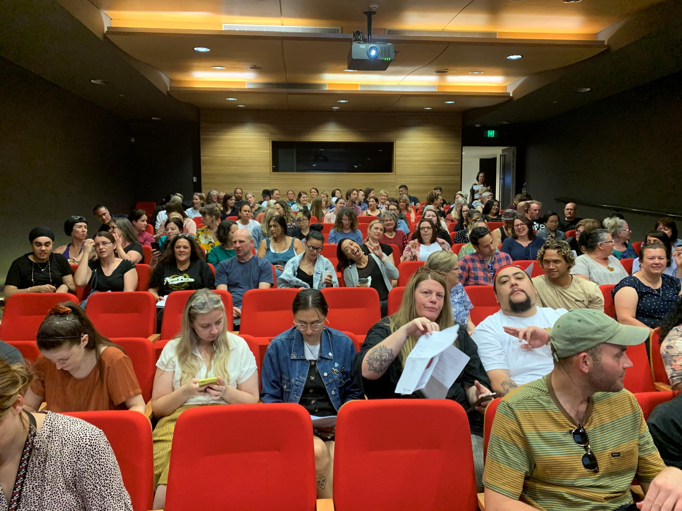
ANZAAE (Aotearoa New Zealand Association of Art Educators)
Toi Tū Toi Ora: Contemporary Māori Art Teacher PD
Donna Tupaea–Petero and curator Nigel Borrell

Slide 31
Eco Printing

Slide 32
Drawing sequence PHS Student Aleisha Neary 2018
Native plants- pressed onto paper-natural colours-pressed into nature
Tree trunk pencil rubbing on Totara Tree –pressed/rubbed against nature
Realistic South Island Robin pencil drawing

Slide 33
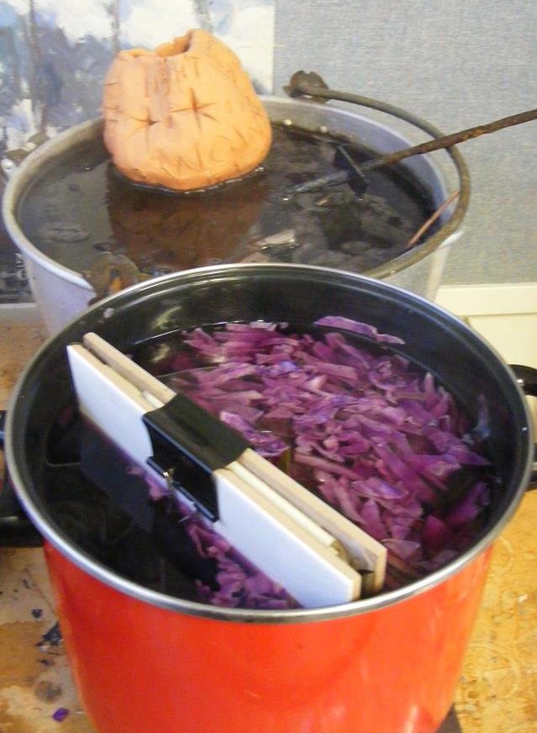
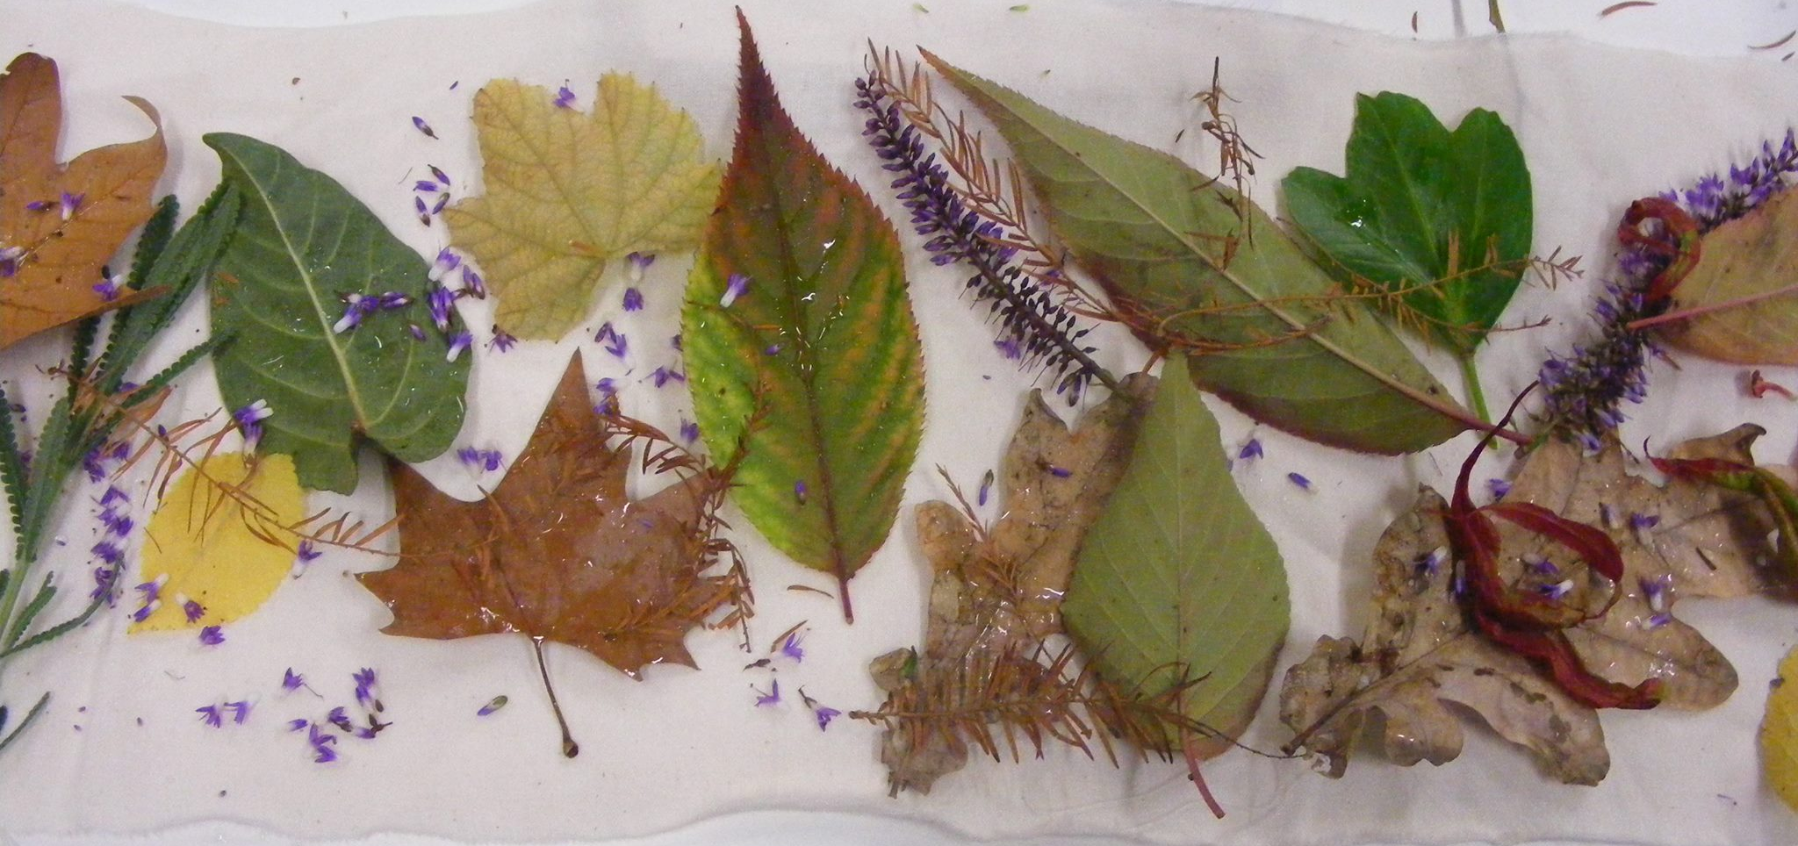
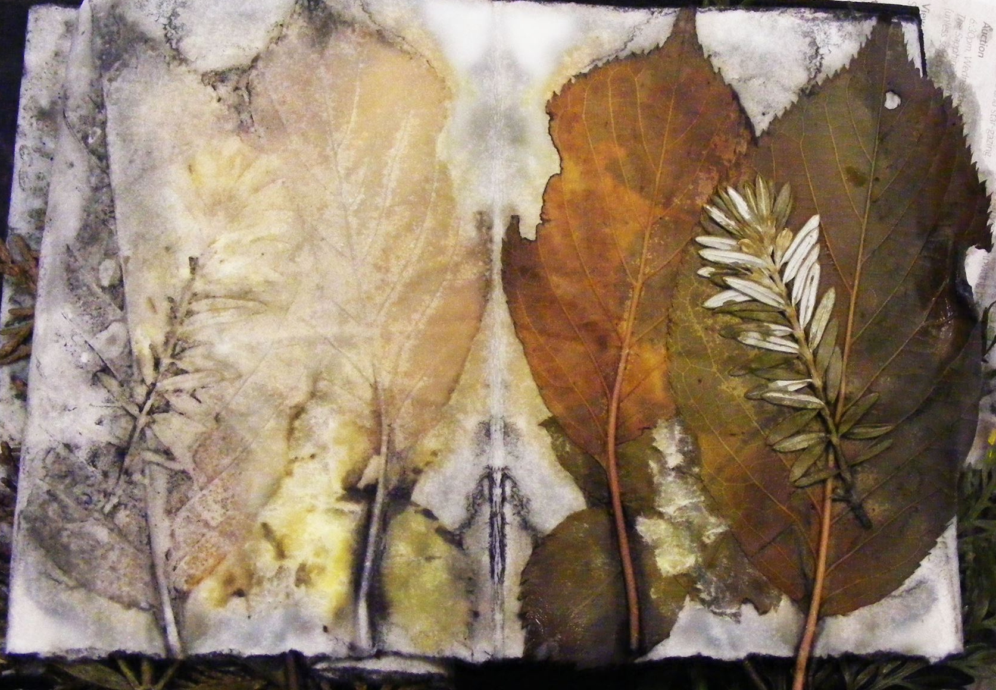
Eco printing

Slide 34
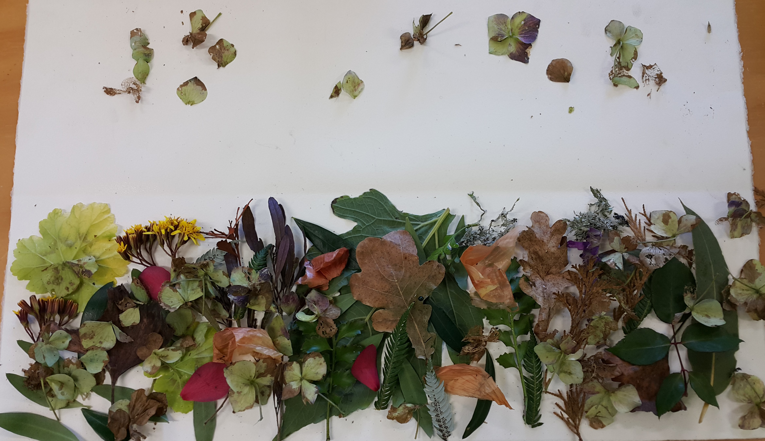
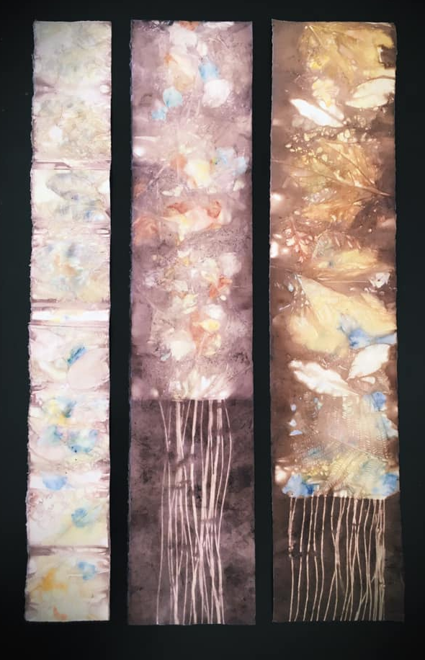
Erinna Law-Szalay

Slide 35
Eco-printing on paper tutorial: how to eco-print with a rusty can
https://www.youtube.com/watch?v=Gyc3stbuSlI
Eco-printing on paper tutorial
https://www.youtube.com/watch?v=h2GCTfySJtA
Eco Printing
Https://www.youtube.com/watch?v=gNmt5_PlTSc
Eco Printing on Watercolour Paper
https://www.youtube.com/watch?v=DyXnnnh0SuU
Any collected leaves or plant material you might like to try (eucalyptus, silver dollar, olive, rose leaf, tanikaha (celery pine), rimu, onion skins, lichen, oak leaves, etc). Petals from flowers may add colour into the background of your leaf prints (Iris, dark pansy etc). Lightly press or put between pages of a book for travelling. Best picked on the day.
(you will pool these to share in the group)
2 x 20cm approx. lengths of copper pipe and/or iron pipe and/or wood dowel and/ or PVC pipe to wrap paper around
8 large bulldog clips or similar
4 x A5 plywood piece or flat ceramic tiles to for the outer flat bundles for contact printing
String, scissors, ruler
Disposable gloves
Craft knife
smallish bits of rusty steel, washers, bolts, old hinges or any interesting steel shapes
An Old large pot/ spare hot plate
Rust water
2 or 3 pots with various coloured baths for eco dying effects, tongs, weights
One sheet of 300gsm or close - 100% cotton rag paper or equivalent, un-sized will be provided – you will be able to purchase more if you use this up.
Recipe
In a large Pot WATER APPOX. 20 LITRES, +1 CUP WHITE VINEGAR + 1 litre of Iron Water + 2 TABLESPOONS CHESTNUT TANNIN POWDER (brown tones) (or red cabbage (purple tones) or turmeric (yellow tones))
= ROLLING SIMMER 1 ½ HOURS

Slide 36
Elke Campforts drawing into eco prints

Slide 37
Sharon McCartney, Significant Signs of Safety and Lookout, Mixed Media
Textile Construction mounted on wood canvas21.00" h x 14.50" w x 1.50" d
https://www.artspan.com/art/2945157-15090/Textiles-and-Fiber-Arts/Artquilt/Wildlife/significant-signs-of-safetysold.html
Dragonfly, Samantha Boulanger, Etching on Eco-printed Paper 2019
http://samanthaboulanger.com/blog/

Slide 38
Kate Gorringe-Smith
The Godwit, the Grass Frog and the Golden Sun Moth, Linocut on eco-print, Altona foreshore, Melbourne's west
Altona Stint, Linocut on eco-print, Altona foreshore, Melbourne's west

Slide 39
Aleisha Neary 2018 eco print and dry-point print

Slide 40
Silk Mezzotint

Slide 41
Silk Mezzotint
Enrique Leal - Enrique Leal printing silk mezzotint plate
https://www.youtube.com/watch?v=gJDLQ_7reqE&feature=emb_logo

Slide 42
Jude Gordon
https://www.facebook.com/profile.php?id=676988708&sk=photos_all

Slide 43
Lo Fi print processes

Slide 44
flower hammering/pounding technique https://rebeccadesnos.com/blogs/journal/a-botanical-mandala-on-fabric
I prewashed the fabric (I used a cotton bag and extra piece of fabric on top. You choose what you want to use)
I pretreated the fabric in soya milk (or alum - your choice). Make a very diluted bucket of soya milk and soak the cloth in there for 12 hours, then squeeze out as much liquid as possible and hang to dry. Then do two more dips in the same bucket of milk and dry in between. Wait a few days before hammering plants into the fabric. This will give the milk time to cure and bond with the fibres.
Making the mandala
You can create incredible results with just a small handful of plants.
Here I collected violas, dyer's knotweed (Persicaria tinctoria/Japanese indigo), lemonbalm, coreopsis, sage and oregano. You can try any plant as long as it's not poisonous.
two pieces of fabric
soya milk* or other way to pretreat/mordant fabric (you choose)
plants (check that none are poisonous)
hammer
smooth hard surface (I used a wooden chopping board)
iron
*soya milk is a binder, not a mordant, but still helps plant dyes attach to the fibres. Technically soya milk is a binder, and the chemistry involved is different to traditional mordants like alum. The end result is similar - you have dyes that last longer on fibres.

Slide 45
Cyanotype
Students need:
Packet of precoated paper from the teacher
OHT negatives or Negative sharpie drawings or cardboard silhouettes
Found objects - flat and 3D
Glass or perspects sheet
Clip board or wooden base and bulldog clips
Home essentials Hydrogen Peroxide 3% solution from chemist ( one cap full in a bucket of water makes the Blue prints more intense
3 buckets – first bucket with running water, peroxide bucket, final wash
Extend with:
Over drawing
Over printing – etchings, mono prints, woodcuts, etc….
Double exposures – move items
Different times of day – shadows created by objects
Stitching
Combining with rust prints
The process uses two chemicals:
Ammonium iron(III) citrate
Potassium ferricyanide
Teacher Prep:
Science department to mix the chemicals solutions
Store in dark
Mix two part solution in equal amounts
Coat paper in safe lighting
Store in black plastic, light proof envelopes
Use within a few days

Slide 46
Expose the sensitized paper within a few hours of coating, if possible. It makes no difference whether the paper is heat-dried in warm air for a few minutes, or dried at room temperature for at least half an hour. Its storage life depends on the purity of the paper base, but it will keep longer in a desiccated enclosure. The coated side should remain yellow or yellow-green; if it has turned blue the highlights will be chemically fogged, so it must be rejected, and a better paper found.

Slide 47
Tasks
Make at least 3 cyanotypes.
You can explore the following ideas:
Double exposure,
layering transparent and solid objects,
create a repeated pattern or mandala of leaves and flower petals
Make a cyanotype frame for another kind of drawing
Make your own negative from your bush photos and draw back into it with sharpie, chinagraph pencil and a craft knife
Make paper masks/ silhouette shapes
Use what you have around you
A record of botanical specimens like Anna Atkins
Create your own silhouette negative in photoshop

Slide 48
Jody Hanson, 'Cyanotype Mandala', 2015
https://www.dishwishes.ru/ru/content/25-cynotype

Slide 50
Christie Taylor
Lemons by Anna Atkins

Slide 51
Einat Imber

Slide 52
inkjet prints and cyanotypes
http://stevenwillblog.blogspot.co.uk/

Slide 53
Whispers of the Positive by Wen Redmond - hand pulled print, collaged, and sewn on watercolour paper and cloth, painted with acrylics, layered with digital images, and monoprinted using inkjet prints, cyanotype, silk organza, cheesecloth, watercolour paper, ink drawings and mediums

Slide 54
KristaMcCurdyArt

Slide 55
Melissa Panter, “Death and Sainthood“, cyanotype and mixed media.

Slide 56
Tasha Lewis

Slide 57
Hollis Moore – with mono print and woodcut

Slide 58
Marilee Salvator collaboration with Kristina Arnold
Erupt, etching, screen-printing, cyanotype, sewing, ink, rhinestones, 2017, 27 x 32

Slide 59
MAX STADNIK
Cyanotype and rust print

Slide 60
Jonpaul Smith

Slide 61
Anna Watts photography

Slide 62
Louise Jackson saved to Stitched
Partridge. Cyanotype, gouache, ink, metallic pen, thread, varnish. The start of a Blue Series.

Slide 63
L Jackson, Paint and pen on Cyanotype background with hand embroidery. Buy it at Two & Six, Brixton Village

Slide 64
Rust prints
You Need:
Paper or cotton fabric (old 100% cotton bed sheet or pillow case)
Iron objects/ rusty objects (no galvanized nails, they won’t rust, ask permission before you make something rusty, I don’t want parents complaining
Vinegar and water Half and half in an old spray and wipe bottle
Plastic sheet (can be a shopping bag or rubbish bag)
Try to make a sequence of 5 A5 prints with rust.
Spray paper with vinegar solution
Place iron/ steel objects to create interesting patterns, if they are already rusty that that is great (screws, nuts bolts nails, bulldog clips, old keys, safety pins, washers, sewing pins, safety pins, horse shoes, steel wool, hinges……)
Sprayed everything with vinegar water solution and covered with plastic. Leave for 2 or 3 days. Respray to keep the objects moist.
Leave in a warm place to ‘cook’ like in front of a window, or on a shelf in the hot cupboard or on sunny deck. The heat and moisture make the rust form faster.
Rust print will make an excellent background for printing on to with etching or woodcut when you return to school

Slide 65
Doroth Mayer, rust and cyanotype
https://www.dandelionunlimited.com/mixed-media-textiles

Slide 66
Jill Saxton-Smith – rust print backgrounds with drypoint, stamping and woodcut

Slide 67
Jennifer Coyne Qudeen

Slide 68
Julienne Francis and Celia Walker

Slide 69
Kelly McKaig
Kelly McKaig

Slide 70
Maeve Coulter
These are some rust prints from my Reparation series. I refer to themes of family and identity, grief and regret, disintegration and repair. I screenprint using family photos that are personal yet universal. My approach is haptic. I print but replace the use of ink with flocked iron filings. The image then rusts like evanescent memories and fading family dramas. A tarnished shadow creeps across the cloth and threatens to obliterate. A simple darning stitch alludes to the notion of repair, like an incantation to restore and recall. It is my way of warding off the inevitable decline of memory, to conjure and preserve.
Rust print. Flocked iron filings-rusted & stitched. www.maevecoulter.com
https://www.maevecoulter.com/work/reparation/

