Slide 1
Woodcuts/ Lino Cuts

Slide 2
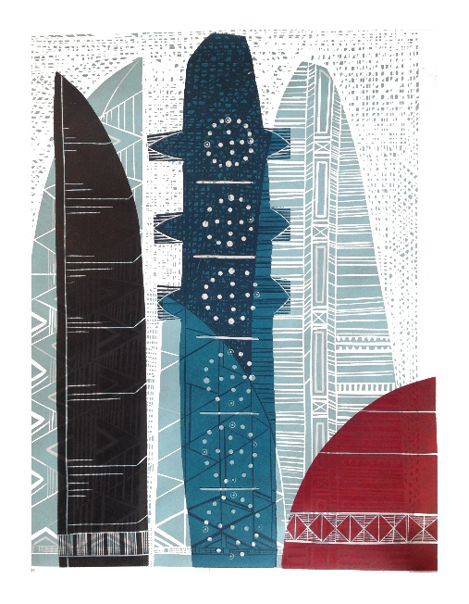
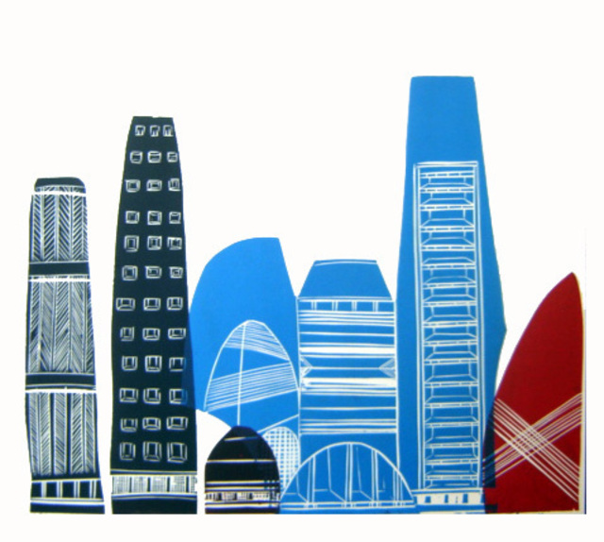
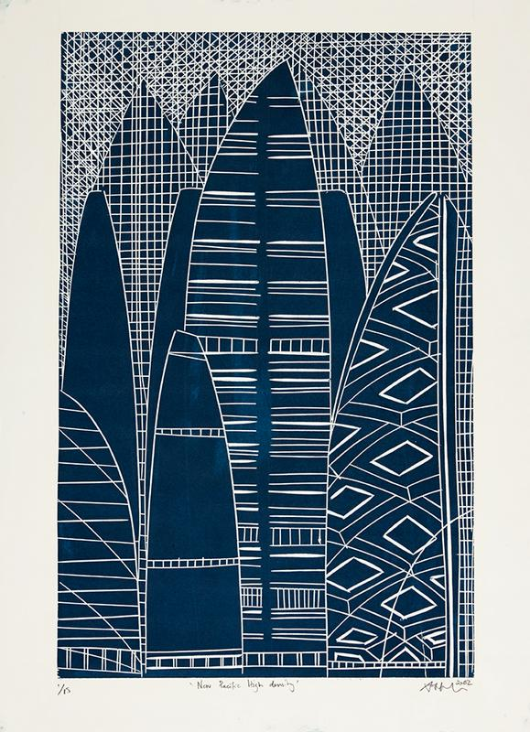
Sheyne Tuffery
https://www.sheynetuffery.com/
https://www.parnellgallery.co.nz/artists/sheyne-tuffery/

Slide 3
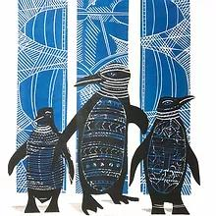
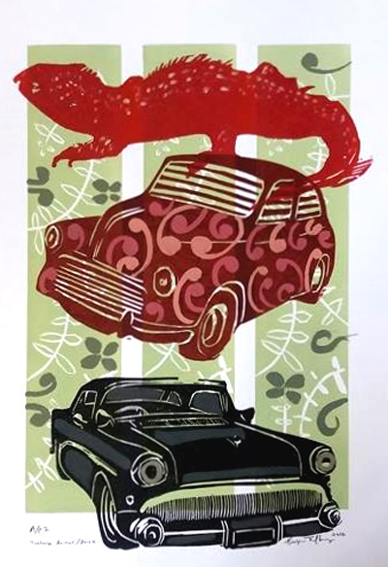
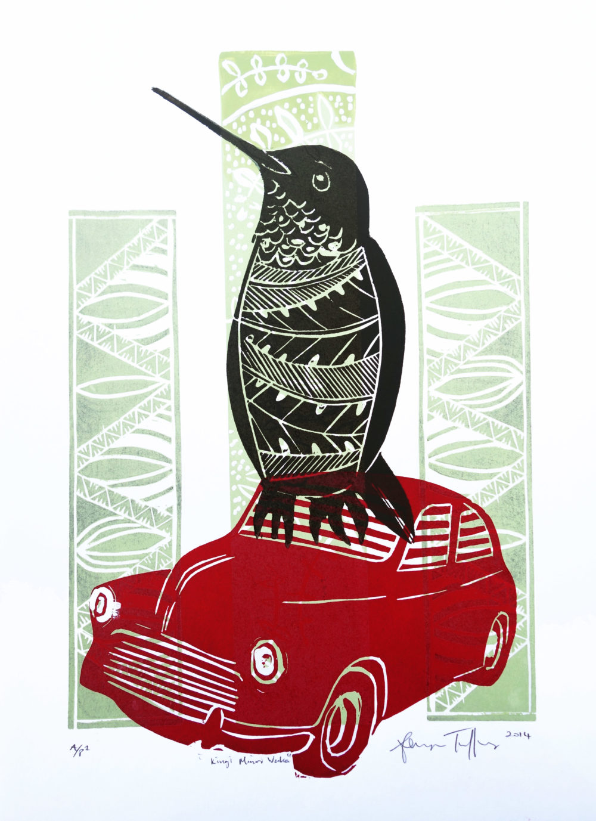
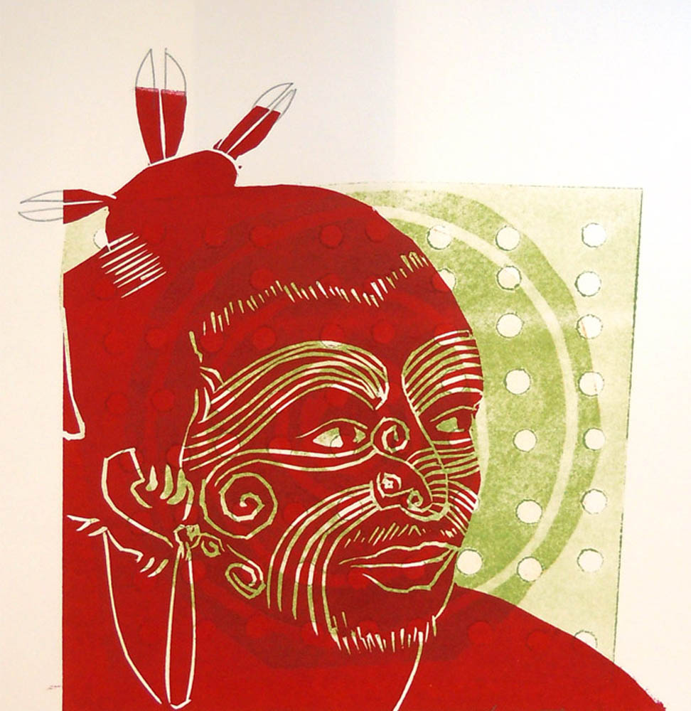
Sheyne Tuffery

Slide 4
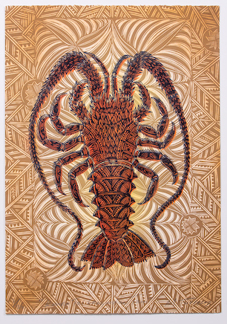
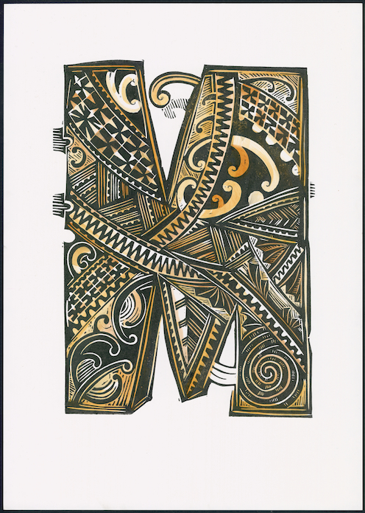
Michel Tuffery

Slide 5
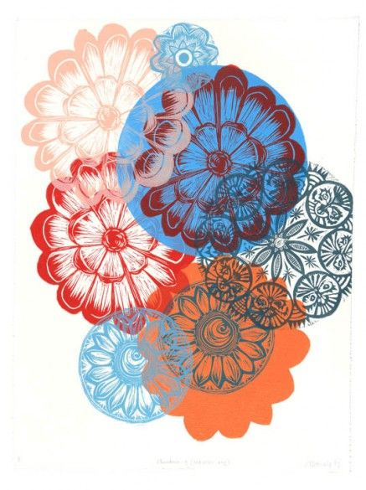
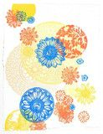
Clair Makwana
http://www.missprint.co.nz
https://www.facebook.com/clare.makwana/

Slide 6
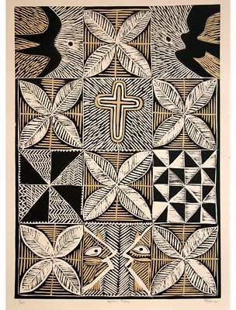
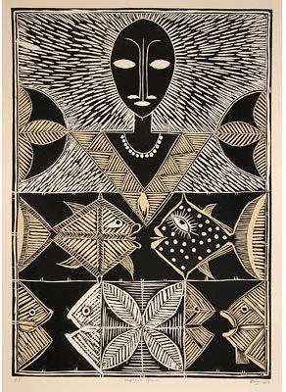
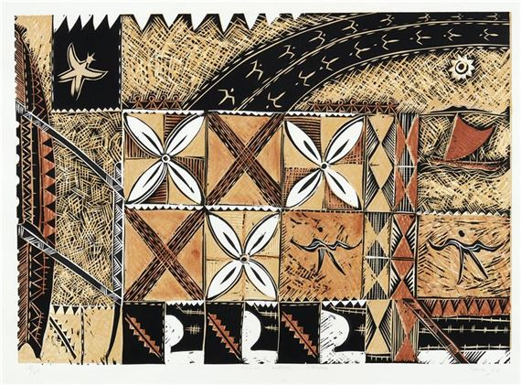
Fatu Feu’u
https://www.pggallery192.co.nz/products-page/fatu-feuu/

Slide 7
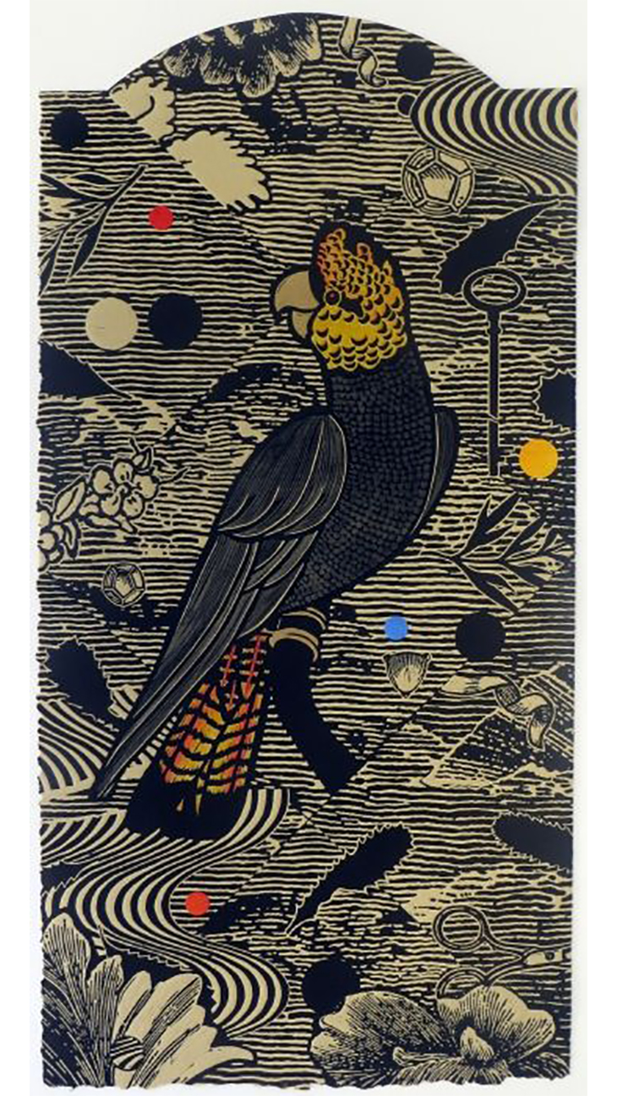
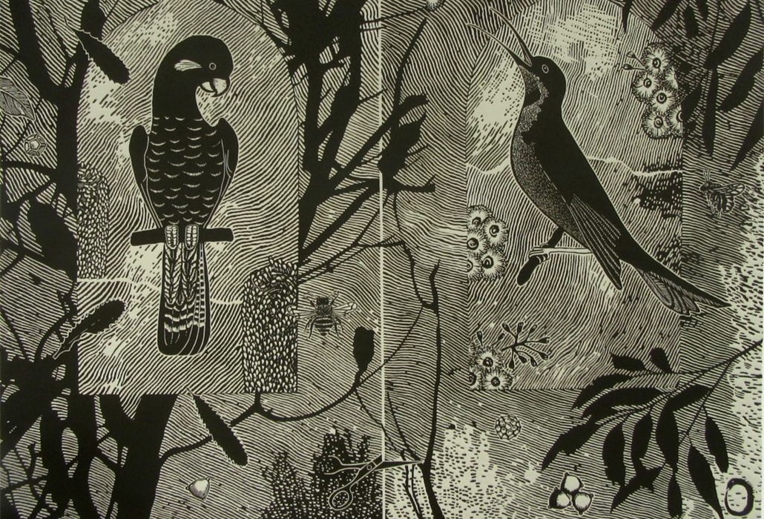
Jenny Kitchener https://www.printmakergallery.com.au/artists-2/jenny-kitchener/

Slide 8
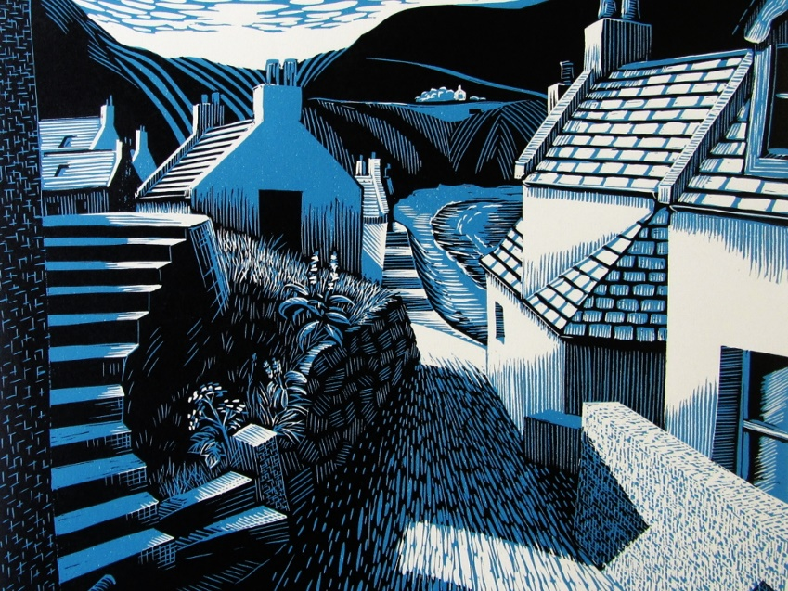
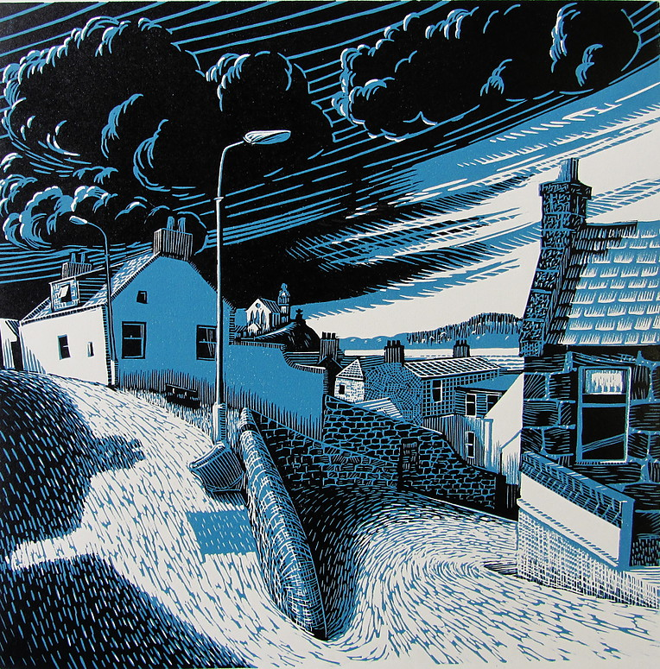
Brian Angus https://www.bryanangusart.com/lino-prints

Slide 9
KAREN NEAL https://www.gallery247.com.au/karen-neal https://www.facebook.com/karennealartandprint/

Slide 10
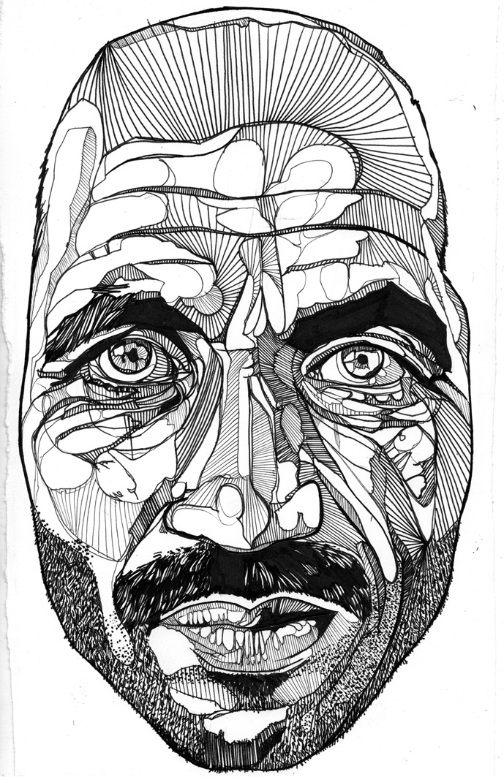
Drawing artist model: Luke Dixon Linear shading to create planar form https://www.thebearhug.com/luke-dixon-m2

Slide 11
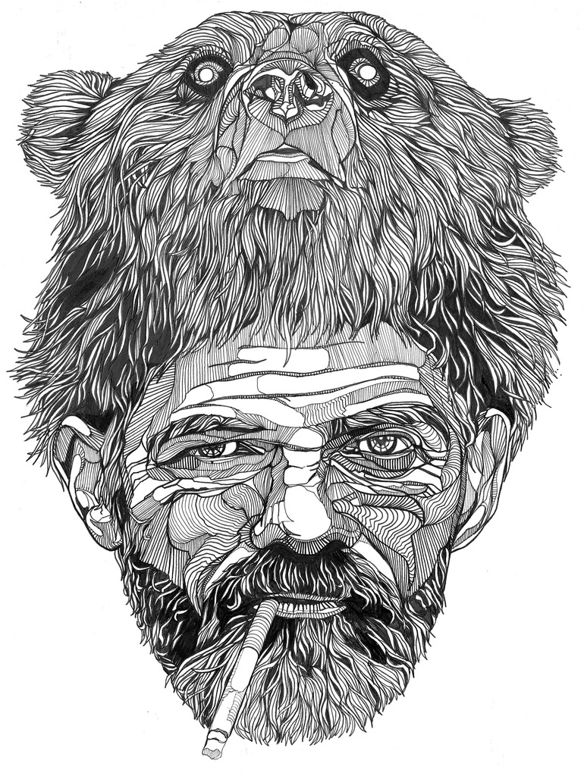
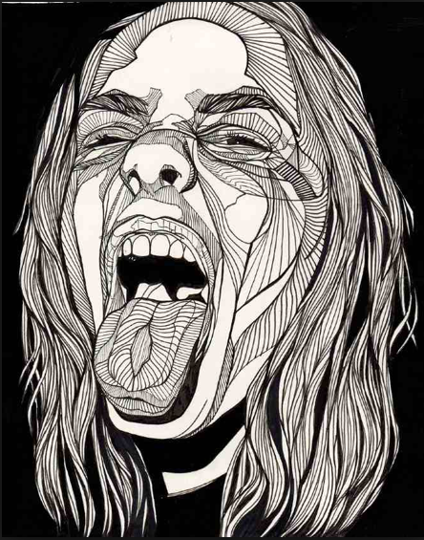
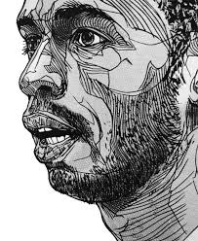
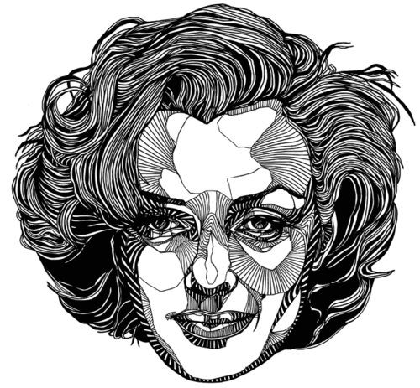
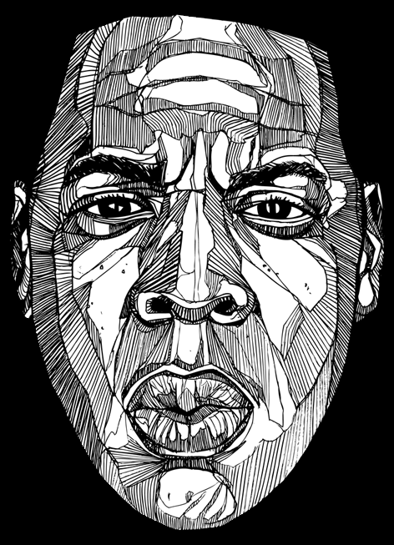
https://www.thebearhug.com/luke-dixon-m2
Luke Dixon

Slide 12
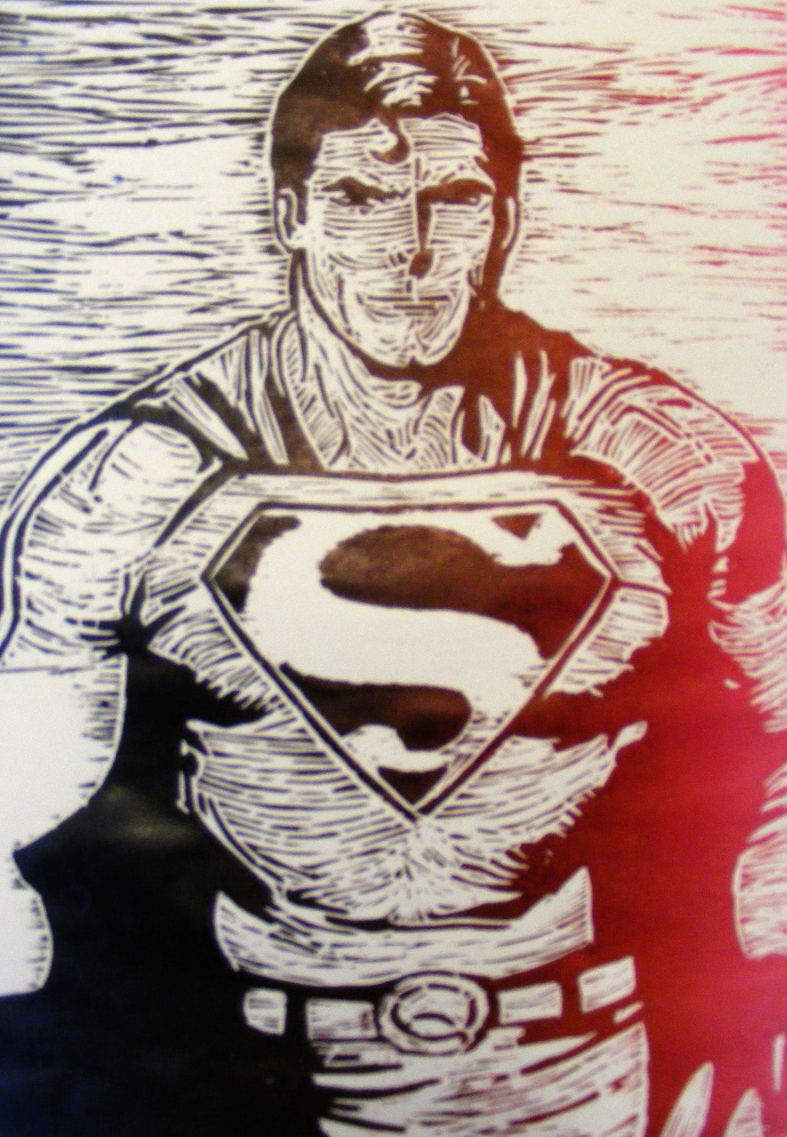
Concentrate on creating form (3D roundness with your cutting lines
Pukekohe High Student - Sam Lataipangai
Year 10<
Year 11>

Slide 13
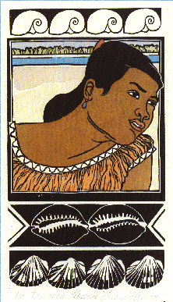
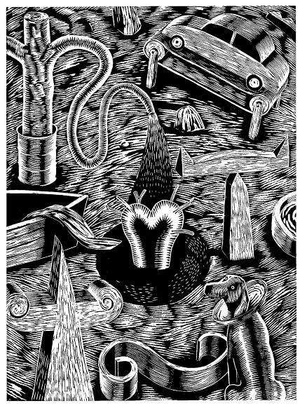
Look at the form Campbell creates with his cutting style – 3d, tonal, detailed – this is your goal!!!!
Robin White , from 28 days in Kiribati, Hand coloured woodcut^
https://collections.tepapa.govt.nz/object/39342
>Brian Campbell –The people who can’t stop making things, 1996
http://www.brianpcampbell.com/woodcuts

Slide 14
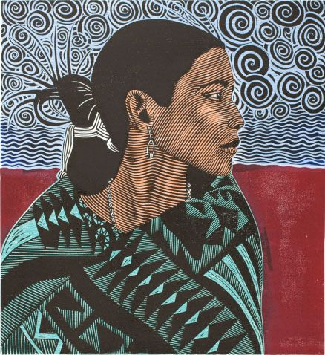
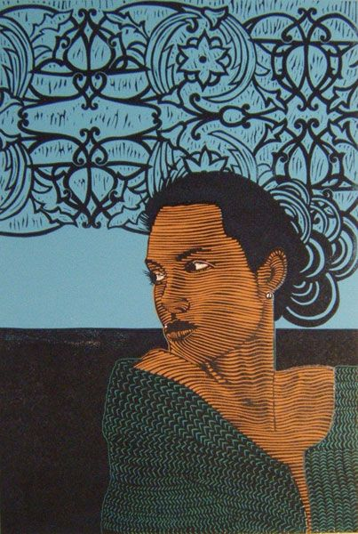
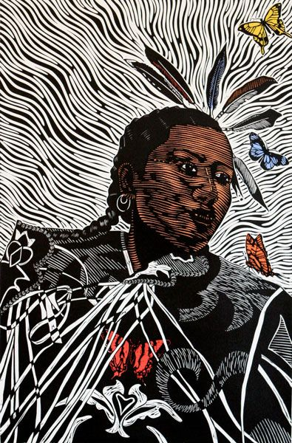
Juan R Fuentes The strength of these portraits and the curving lines in them helped inspire a series of reduction woodcut portraits. The use of strong background with clean line work was also a major inspiration. https://juanrfuentes.com/
Look at the contour cutting on the face!!!!!

Slide 15
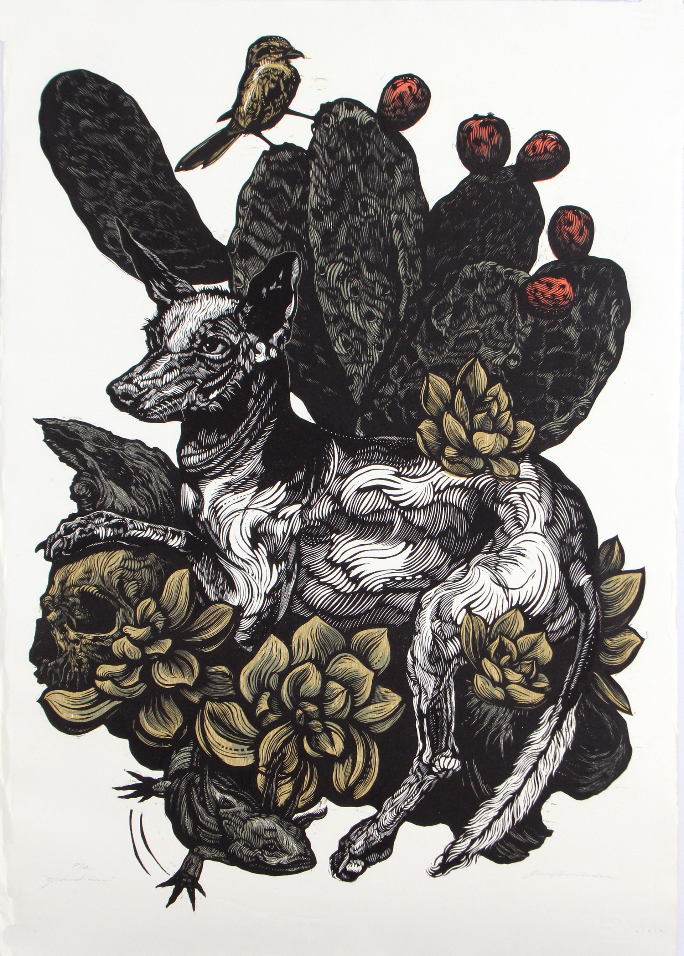
Daniel Hernández
https://hechoamano.org/artist/daniel-hernandez
https://www.instagram.com/danielhernandez.pintor/

Slide 16
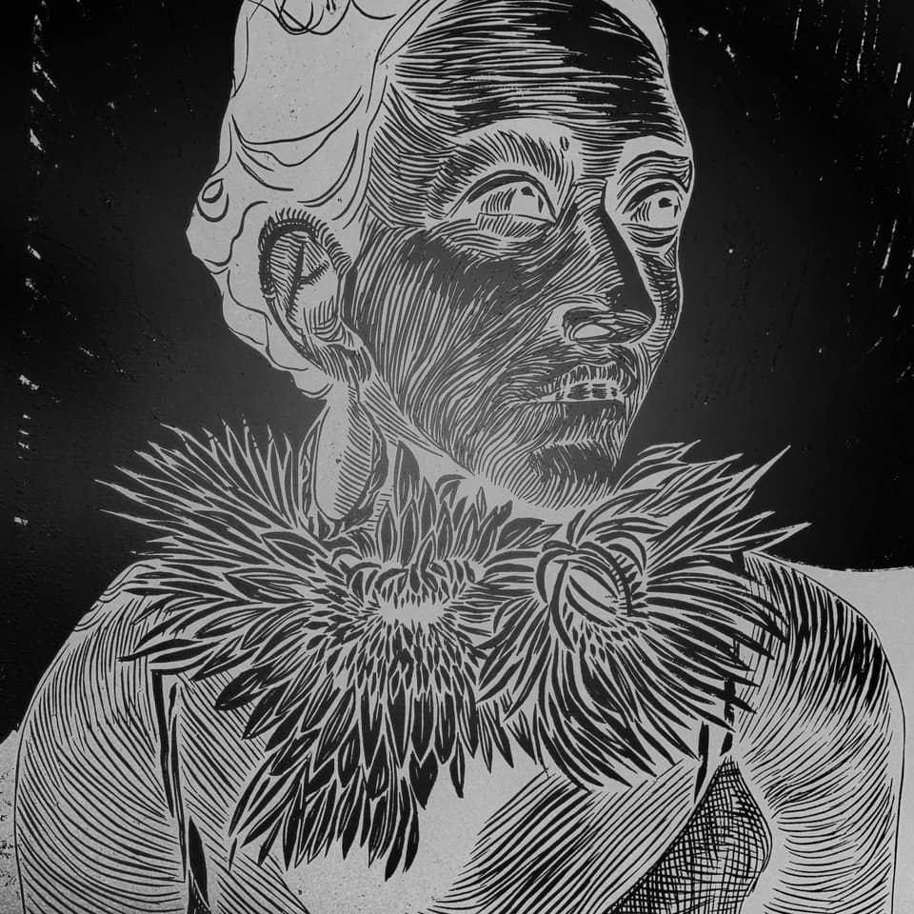
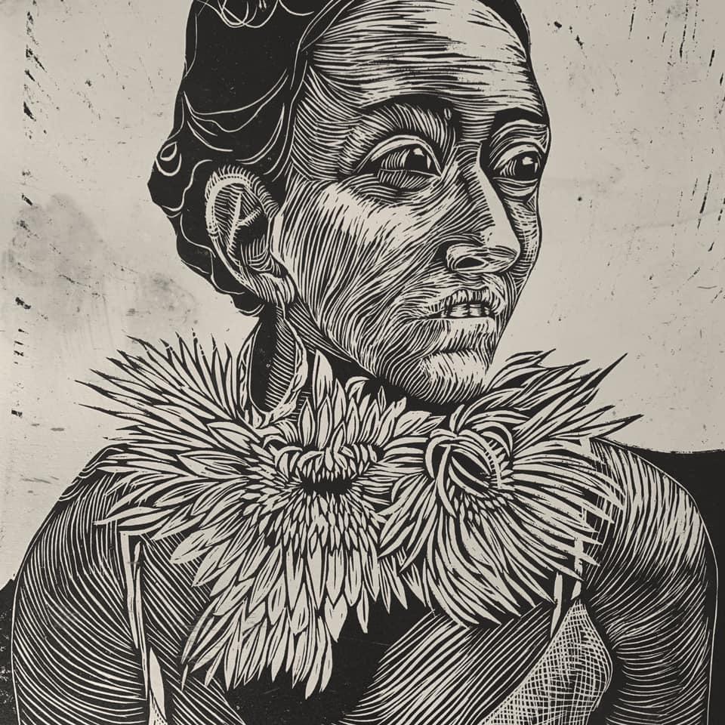
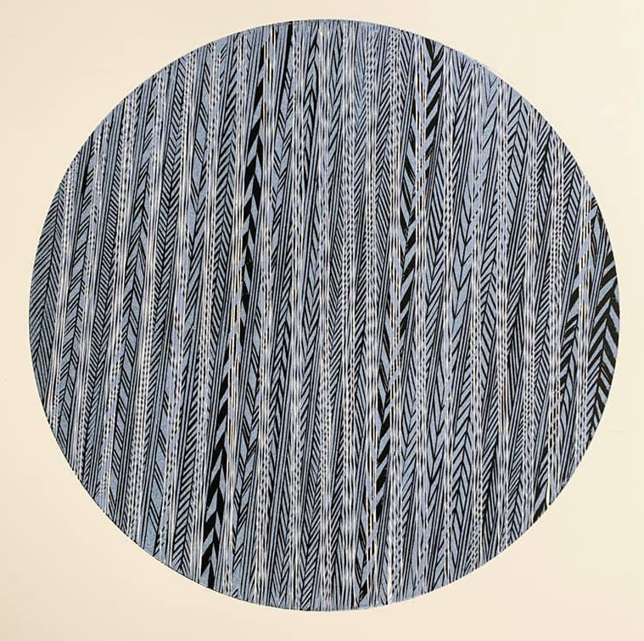
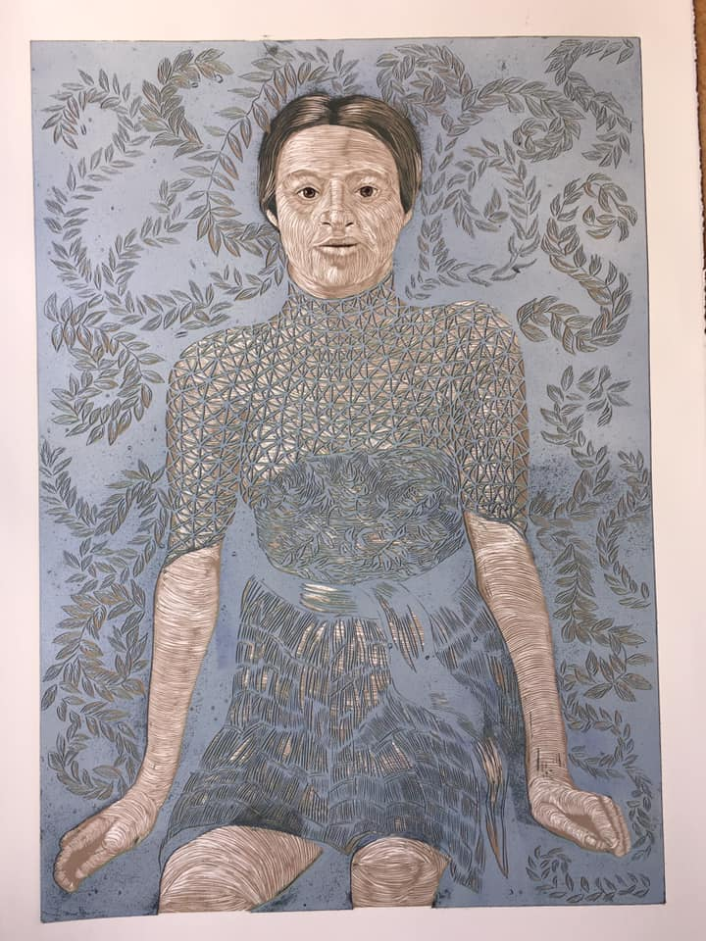
Suzette van Dorsser
https://www.facebook.com/SuzettevanDorsserArtist/

Slide 17
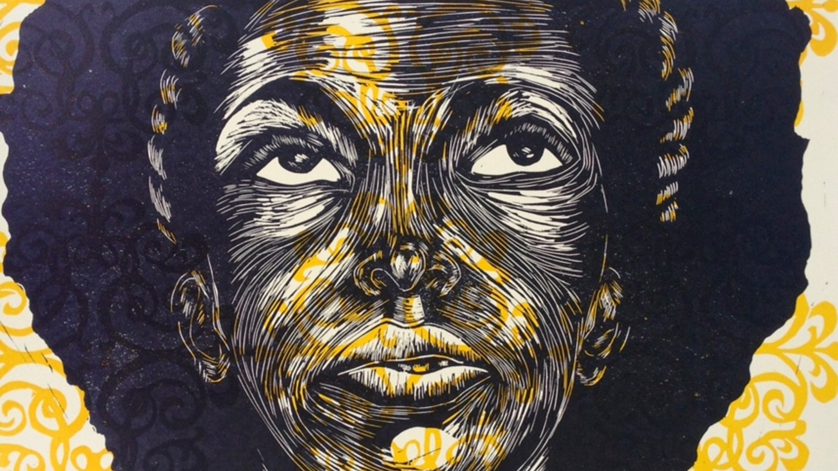
Delita Martin https://blackboxpressstudio.com/printmaking

Slide 18
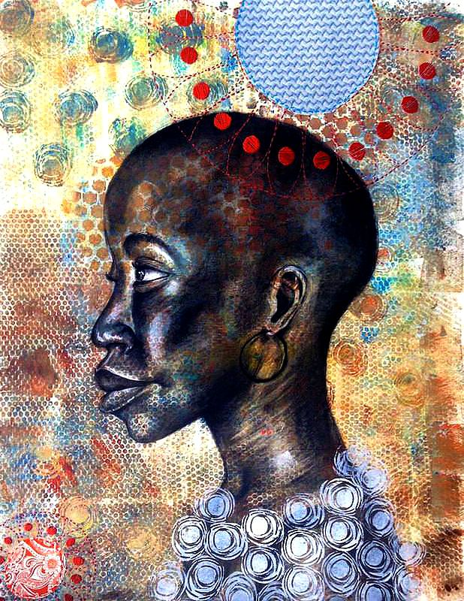
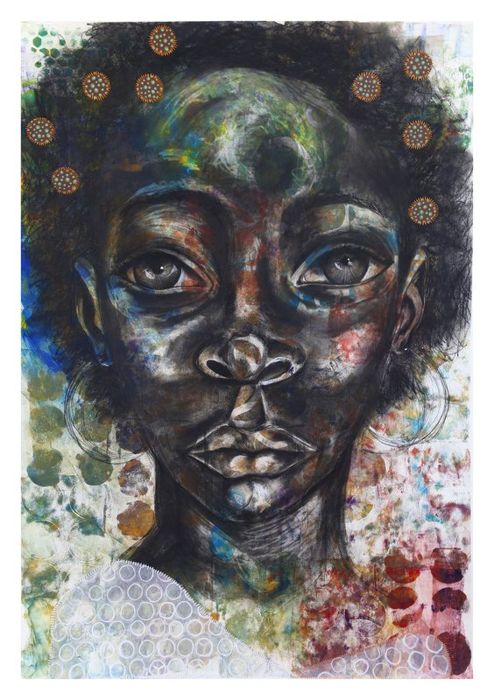
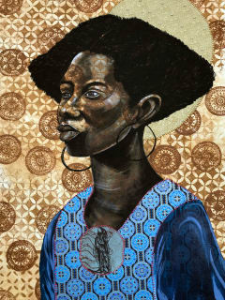
Delita Martin https://blackboxpressstudio.com/printmaking

Slide 19
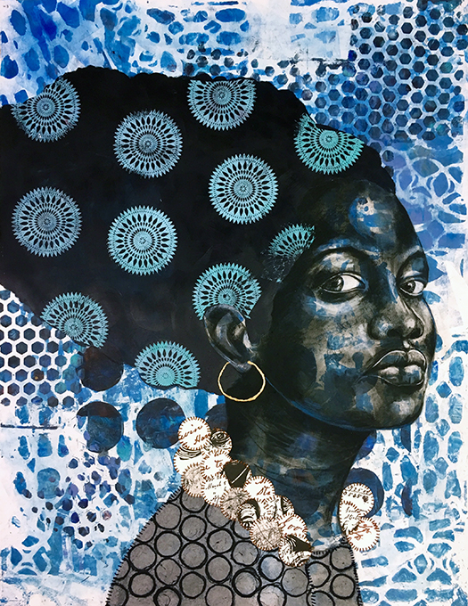
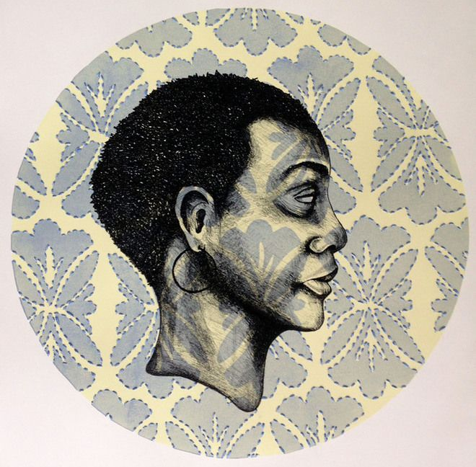
https://blackboxpressstudio.com/printmaking

Slide 20
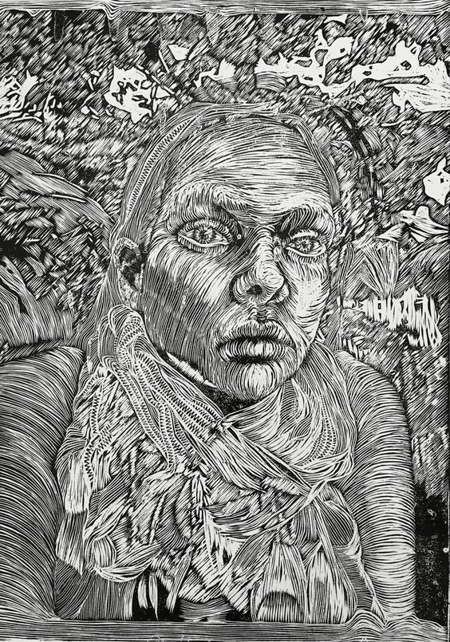
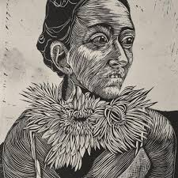
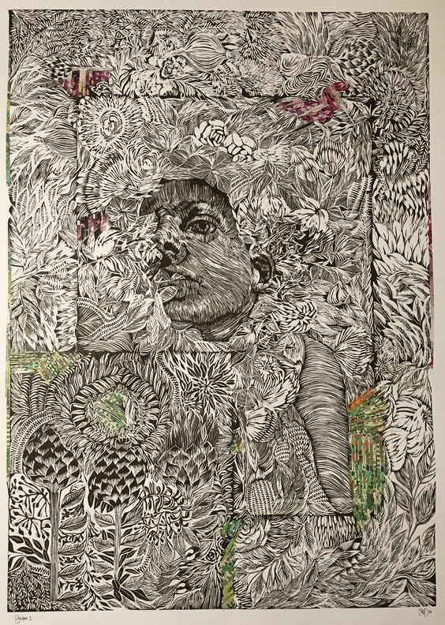
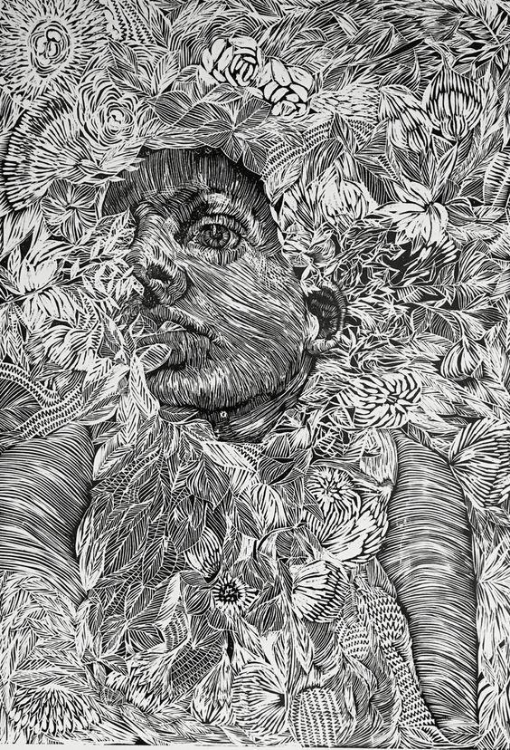
Suzette Van Dorsser

Slide 21
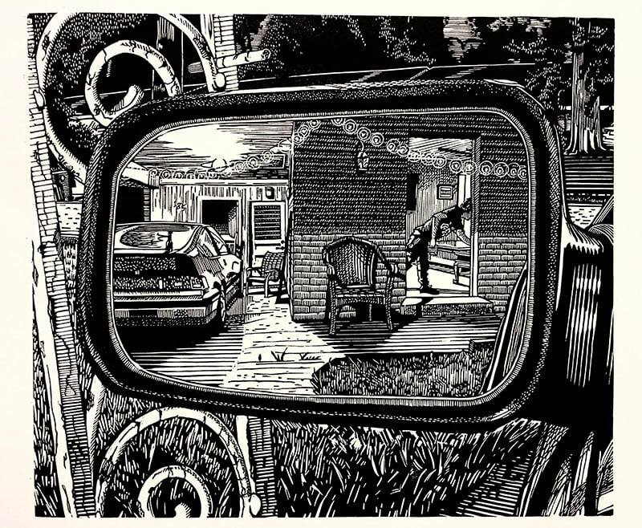
Michael G Miller

Slide 22
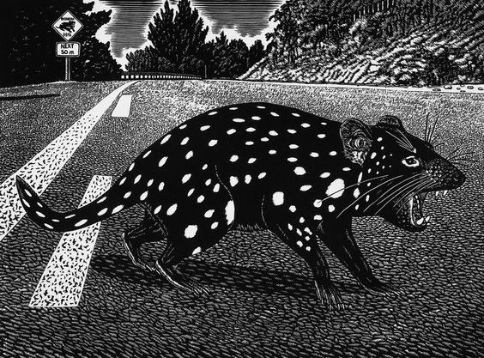
Rew Hanks

Slide 23
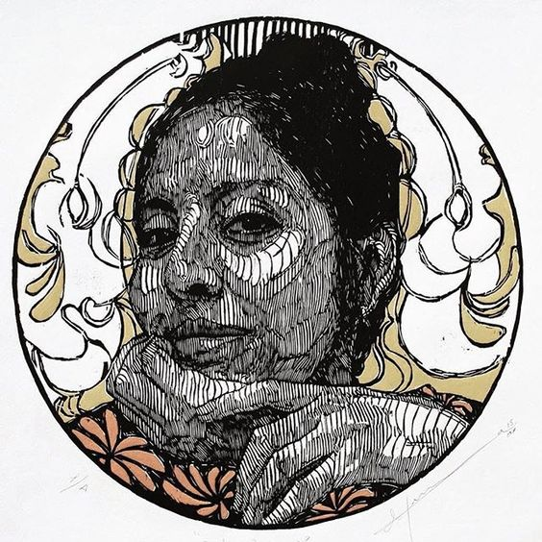
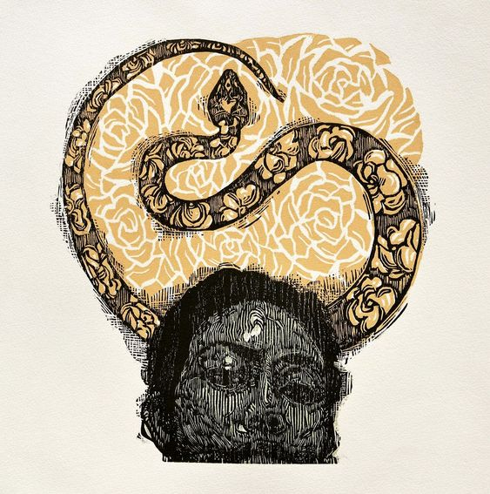
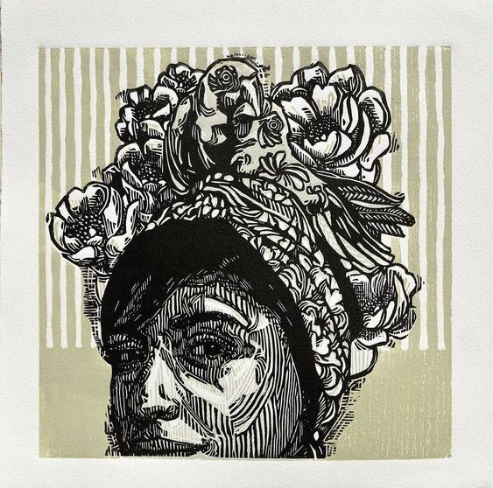
Irving Herrera

Slide 24
Gabrielle Belz

Slide 25
Osmeivy Ortega

Slide 26
E Mervyn Taylor

Slide 27
Part 1

Slide 28
Starting tasks designed to be novice friendly
Small textured woodcut
Pattern woodcut
Collograph pattern or imagery
6 prints with minimum of 6 layers each (showing opaque and transparent layers)
Theme selected

Slide 29
Select a range of pieces of wood (including at least one A5)
Choose a range of textures or patterns from dark and dense to very light
Mechanical and hand made marks
Think about soft/ fuzzy lines versus hard edge lines
Create wood blocks that can be layered to create interesting layered surfaces (These can be shared/ abstract patterns/ tones/ textures or relate directly to your theme)
Conrad Botes

Slide 30
Ilona Lasminas http://www.fps.org.au/ Fire station Print studio Melbourne

Slide 31
Ilona Lasminas http://www.fps.org.au/ Fire station Print studio Melbourne

Slide 32
Ilona Lasminas http://www.fps.org.au/ Fire station Print studio Melbourne

Slide 33
PCANZ Summer school workshop with Jo Ogier - Shellac texture, embossed wallpaper or plastic lace glued on wood to create background textures in print

Slide 34
Lucinda Tanner https://www.lucindatanner.ch/ https://qgallery.com.au/portfolio-item/lucinda-tanner/

Slide 35
Lucinda Tanner
https://www.lucindatanner.ch/ https://qgallery.com.au/portfolio-item/lucinda-tanner/

Slide 36
Lucinda Tanner
https://www.lucindatanner.ch/ https://qgallery.com.au/portfolio-item/lucinda-tanner/

Slide 37
Elizabeth Banfield
http://www.elizabethbanfield.com.au/

Slide 38
VIRGINIA HUNGATE-HAWK
https://www.davidsongalleries.com/collections/virginia-hungate-hawk
https://vhhprints.webflow.io/project-gathering

Slide 39
Joyce Silverstone
https://vimeo.com/59275068
Peach, 2013, relief and monotype, 15" x 15“
Follow through, 2014, relief and monotype, 15" x 15“
https://www.joycesilverstone.com/archives/relief/1

Slide 40
https://www.joycesilverstone.com/archives/relief/1
red relief, 2013, relief print with monotype additions, 15" x 24“
City, 2013, relief print with monotype additions, 15" x 15“
Joyce Silverstone

Slide 41
Charles Shearer
https://www.stjudesprints.co.uk/collections/charles-shearer
https://www.twenty-twenty.co.uk/artists/shearer-charles/

Slide 42
Luke Dixon
https://www.thebearhug.com/luke-dixon-m2

Slide 43
Planar drawing
Planar Drawing Video
https://www.youtube.com/watch?v=xLXCnyzNNcQ
How to Use Cross-Contour Lines | Improve your cross-hatching & Ink drawing
https://www.youtube.com/watch?v=qMo1C58KYqU&t=895s

Slide 44
Graham Hall 4 layer grey prints
http://www.nzprintmakers.com/2014/09/studio-visit-graham-hall.html

Slide 45
Wash a piece of wood with Indian ink or acrylic paint then create a grid using white pencil. Use different tools (chisels, hammer and nails, dremil, etc.) and mark making techniques
https://hughhadfield.com/assignment-2-first-relief-prints/
https://pamwright66.wordpress.com/2013/02/12/project-5-linocuts-the-sampler/

Slide 46
Joyce Silverstone linocut layers with mono-print drawings, paper masks https://www.joycesilverstone.com/ https://www.youtube.com/watch?v=RSGbllptgiU

Slide 47
Joyce Silverstone http://vimeo.com/59275068

Slide 48
Pine Feroda https://www.youtube.com/watch?v=ju4kW_2unv8
Pine Feroda. The group formed in November 2013 during an experimental workshop in collaborative printmaking in Hartland, North Devon. In four years the group have developed into a unique artistic collaboration with a recognisable style and intricate processes. They have been selected for the Royal Academy Summer show in 2015 and 2017 and exhibited widely. Three quarters of Pine have just returned from an Arts Council England funded trip to study water woodcut at the Purple Bamboo studio in Hangzhou, China.
From November 2013 until the start of 2017, Pine Feroda consisted of five professional print makers, Merlyn Chesterman, Julia Manning, Rod Nelson, Ian Phillips and Judith Westcott, who all worked together to create the woodcut prints on this website up to, and including, 'Lake'. In February this year Rod Nelson moved on from the group and Pine Feroda is now the four print makers shown here. Pine Feroda are currently working on three new woodcuts of Devon, Eton College and the coast at Staithes.

Slide 49
Part 2

Slide 50
Delita Martin
https://blackboxpressstudio.com/printmaking

Slide 51
Delita Martin
https://blackboxpressstudio.com/printmaking

Slide 52
https://blackboxpressstudio.com/printmaking

Slide 53
Vanessa Wairata Edwards Make 2 Lino cuts that use line to describe the form of a face or an object related to your theme.

Slide 54
Monthian Yangthong

Slide 55
Monthian Yangthong

Slide 56
Delita Martin

Slide 57
Marc Leitzel
Scratch board

Slide 58
Suzette Van Dorsser

Slide 59
Rew Hanks

Slide 61
Rew Hanks

Slide 62
Irving Herrera

Slide 63
Brian Campbell –The people who can’t stop making things, 1996

Slide 64
Gabrielle Belz

