Slide 1
Waka huia & Papahou
“RAW” teacher research

Slide 2
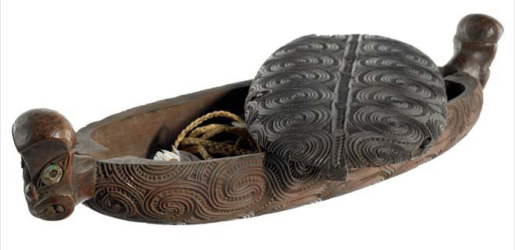
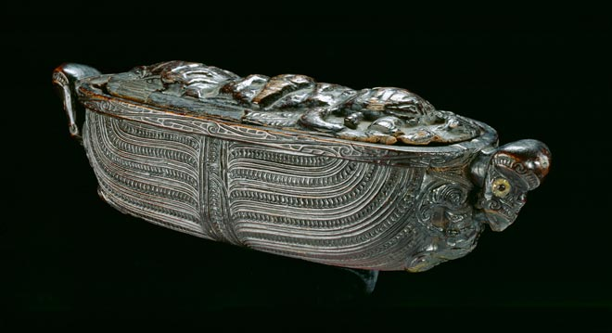
Waka huia and Papa hou – Maori treasure containers
Store a person's most prized personal possessions. Traditionally; hei-tiki (pendants), huia tail feathers), heru (hair combs) and other items of personal adornment.
Historically designed to be suspended from the ceiling of whare where their beautifully carved and decorated undersides could be appreciated.
Highly prized taonga - gifted between generations, hapu (sub-tribes), whanau (families), and individuals to acknowledge relationships and friendships.
Te Papa overview including the mana and tapu of these vessels
Notes:
Explain Huia in relation to name waka huia and translate Maori words

Slide 3
Te Papa Museum
Could a museum be considered a treasure box?

Slide 4
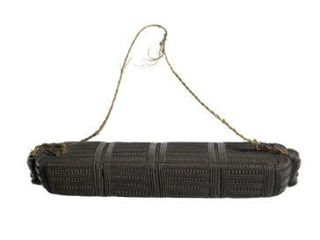
Did you know the meaning of ‘Te Papa Tongarewa’
The Māori name literally means ‘container of treasures'.
The name is made up of two classical Maori expressions with more than one meaning:
Papa:
Papatūānuku (Earth Mother) – including New Zealand, where the Museum is l
a papahou (carved Māori treasure box)
the beloved homeland – te papa kāinga.
Tongarewa:
a type of greenstone, such as the mauri (life force) stone on The Marae
any other kind of treasure, such as a well-loved chiefly person.
Papahou (treasure box) 1800-1850, Maker unknown, Northland. Oldman Collection. Gift of the New Zealand Government, 1992. Te Papa
A fuller interpretation of the name Te Papa Tongarewa is therefore:
‘our container of treasured things and people that spring from Mother Earth here in New Zealand’.
Notes:
https://www.tepapa.govt.nz/about/what-we-do/our-history#The%20meaning%20of%20Te%20Papa%20Tongarewa

Slide 5
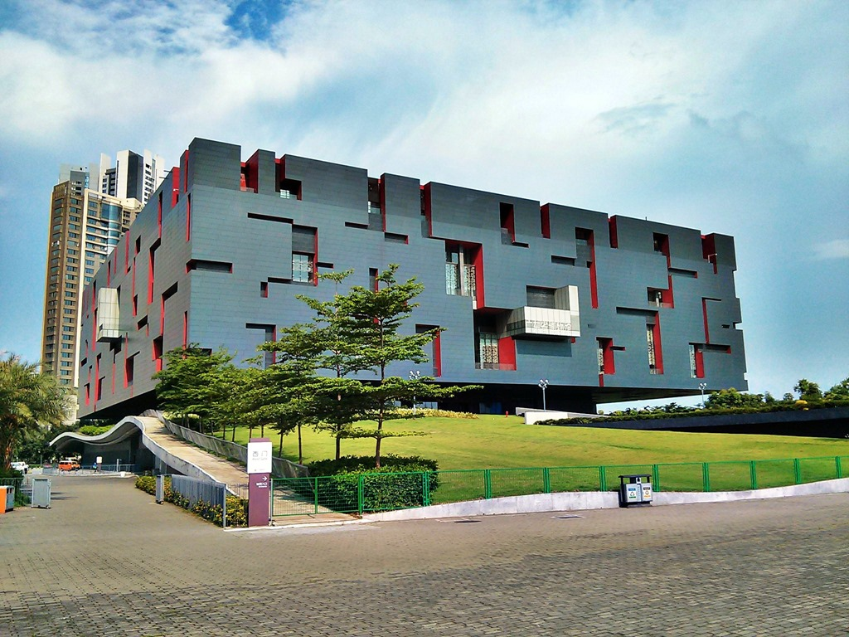
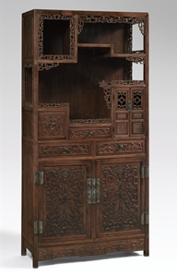
Guangdong Museum in China
– is designed to look like a treasure box

Slide 6
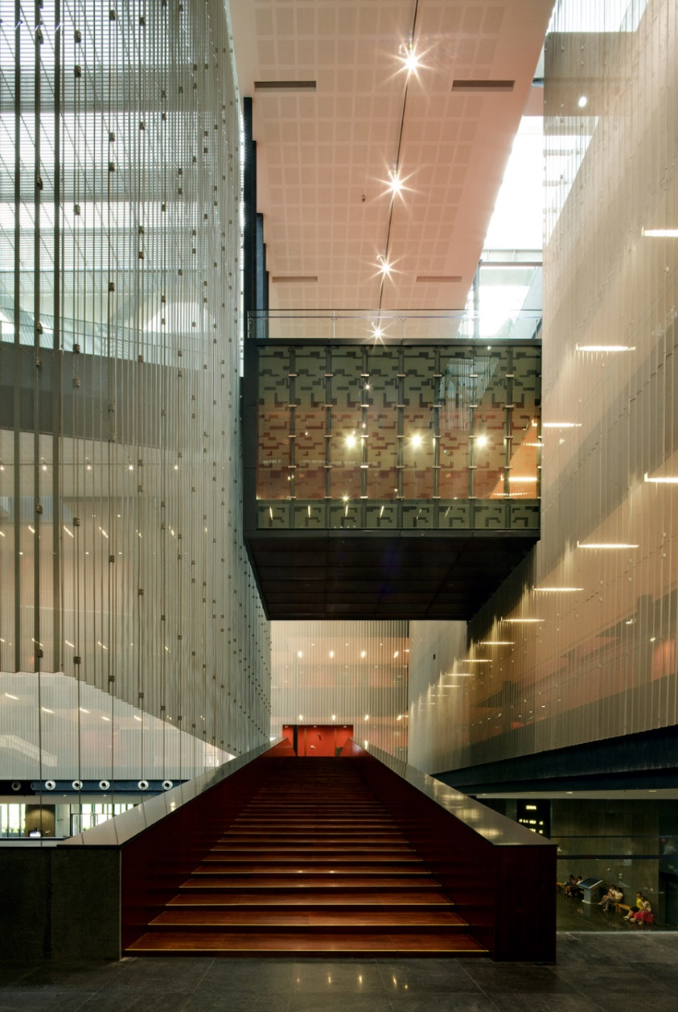
Aerial view of the museum from a nearby hotel and the interior…

Slide 7
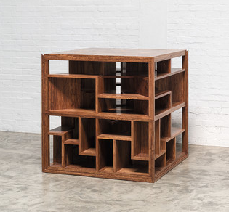
Ai Wei Wei
Treasure Box 2014
Contemporary art made to look like traditional treasure box or display.

Slide 8
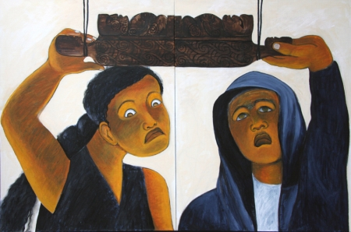
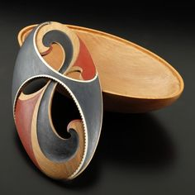
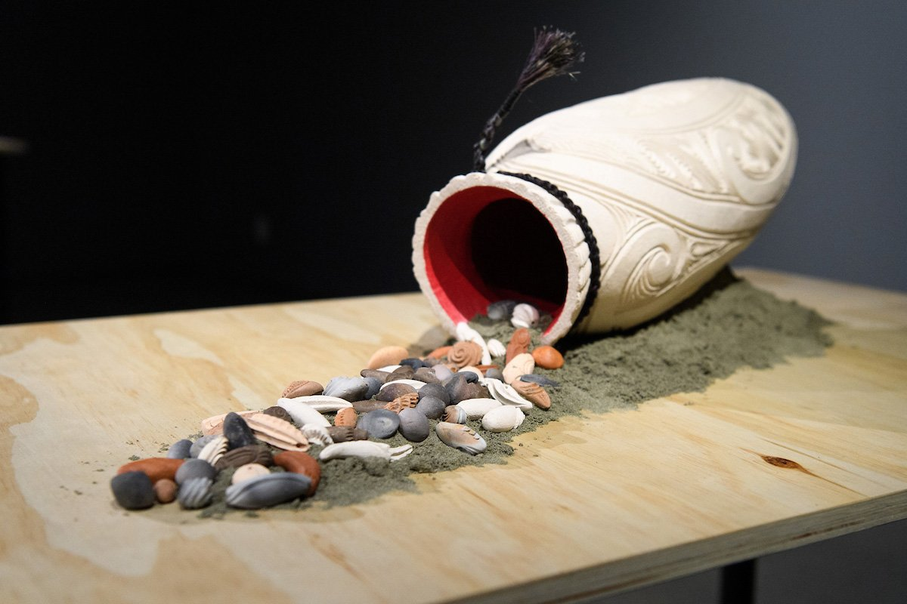
Contemporary Waka Huia ideas and examples…
‘Te Waka Huia (diptych)’ by Robyn Kahukiwa
Stevei Houkamau (Ngāti Porou, Te Whānau a Apanui, Scotland)
A korero with Todd Couper

Slide 9
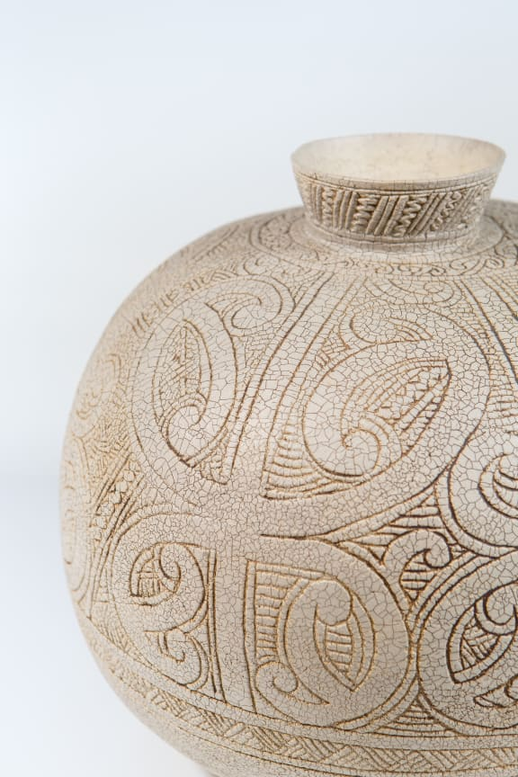
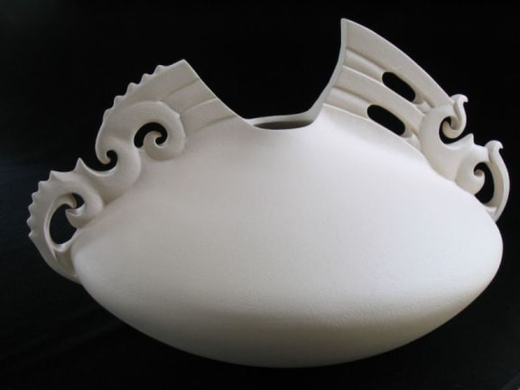
Wi Taepa
Manos Nathan interview on RNZ

Slide 10
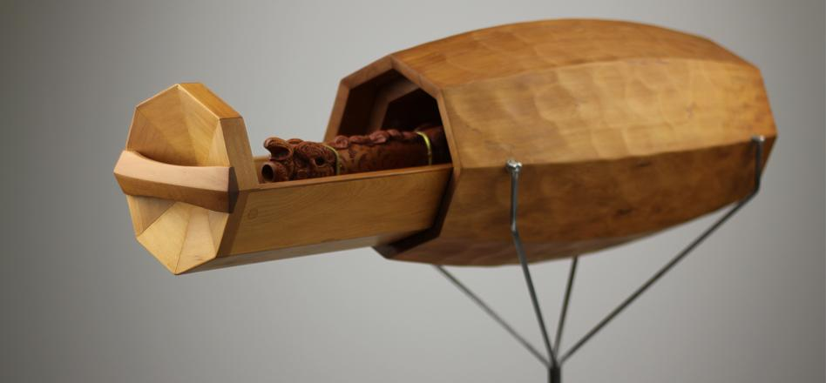
https://cargocollective.com/jeff-bartlett/filter/Maori/WAKA-HUIA-Sculpted-Cartography
https://christchurchartgallery.org.nz/media/uploads/2020_04/Worksheet-Waka_huia-FINAL.pdf
Tim Wigmore Precious cargo

Slide 11
Random links for discussions:
Treasure box mystery has people baffled
Special Vessels for new mothers
Cool waka huia mystery

