Slide 1
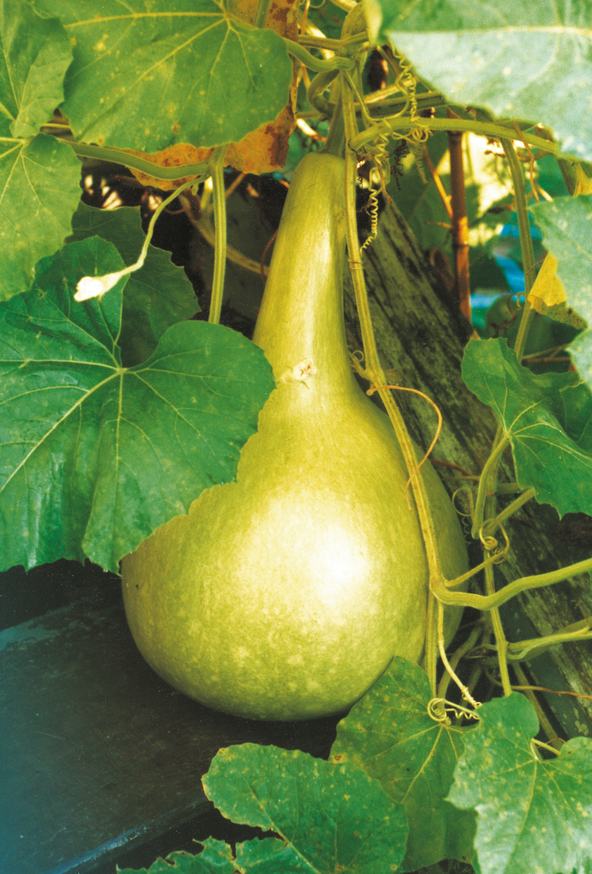
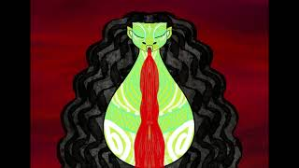
HUE - gourd
HE TAOKA O TE RĀ - OBJECT OF THE DAY
In Māori mythology, hue are personified by the deity Hinepūtēhue, the youngest daughter of Tāne and Hinerauāmoa. After the separation of Ranginui and Papatuanuku there was terrific fighting amongst their children and the story goes that Hinepūtēhue intervened and captured the anger of the gods in her gourd.s
Posted 09 Jul 16 by Jamie Metzger - https://otagomuseum.nz/blog/he-taoka-o-te-ra-object-of-the-day-4

Slide 2
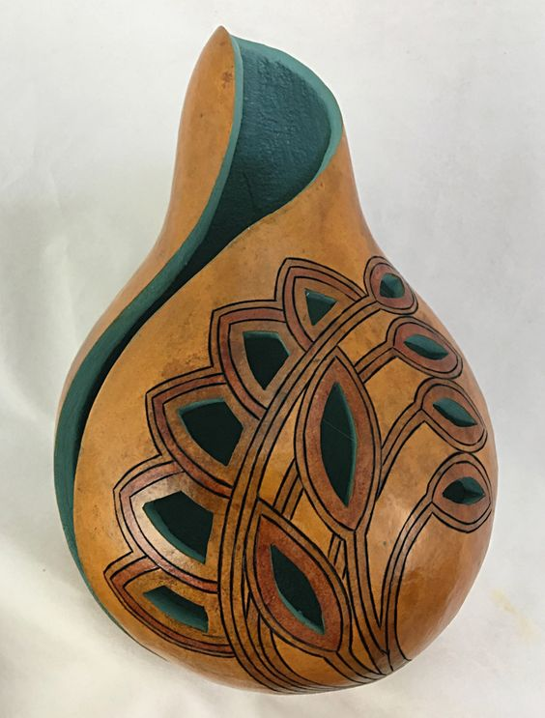
Hue have had many uses here & globally…
First cultivated by humans at least 10,000 years ago. Along with kumara, they were introduced to New Zealand by Polynesian settlers. When small, their spongy flesh was eaten. Larger ones were left to mature for a variety of uses
While traditionally hue were used as storage containers, bowls and water bottles they were also made into taonga puoro, traditional Māori musical instruments.
https://www.bickerton.co.nz/worksheets/ (images sound files and flash cards
There are a number of different types of hue instruments in the family of Hinepūtēhue, ranging in size and musical sound.
Hue were also a flotation device before the invention of the modern day pool noodle or ‘floties’.
Decoration
Hue are often elaborately decorated around the world. Māori beautifully ornamented their gourds with carved, incised or painted designs. A gourd that was the personal property of a chief would have part of the moko of that chief carved into it and thus the tapu of the chief transferred onto the object.
Musical bird sounds
Notes:
Posted 09 Jul 16 by Jamie Metzger - https://otagomuseum.nz/blog/he-taoka-o-te-ra-object-of-the-day-4/

Slide 3
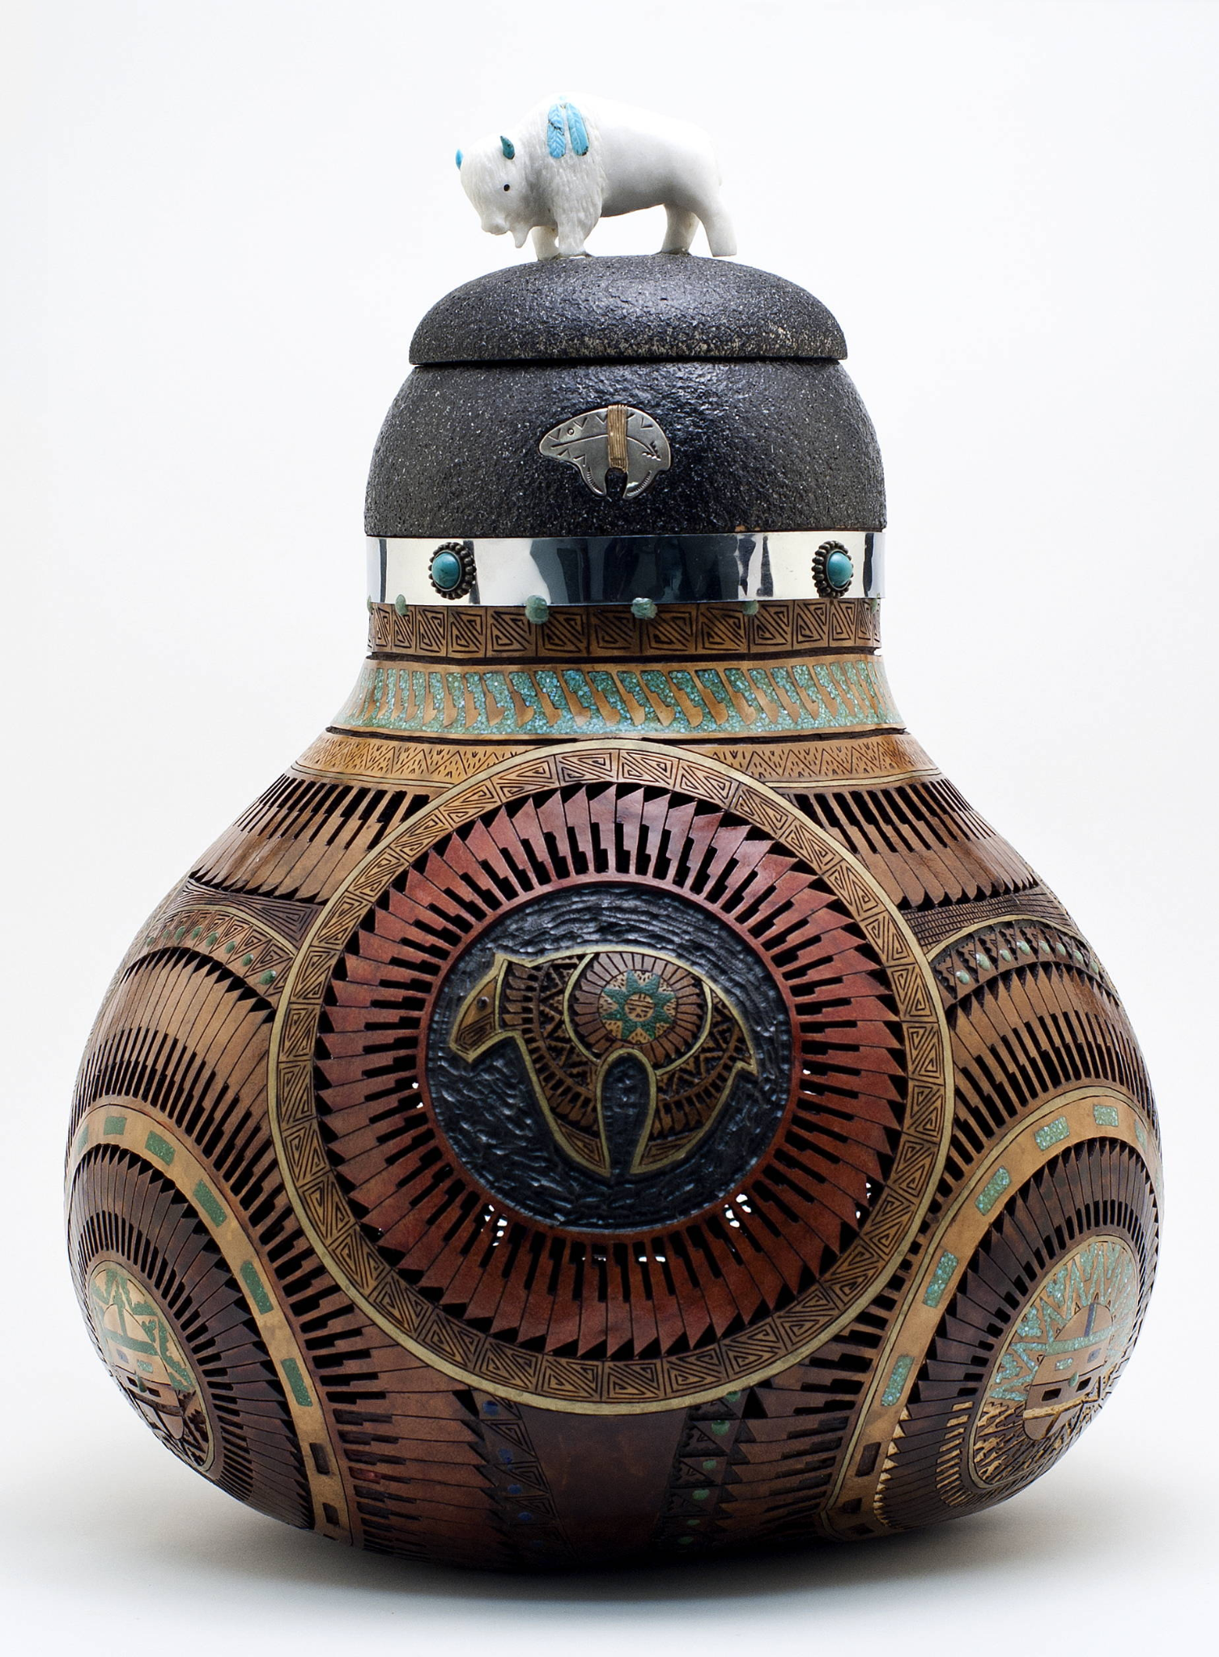
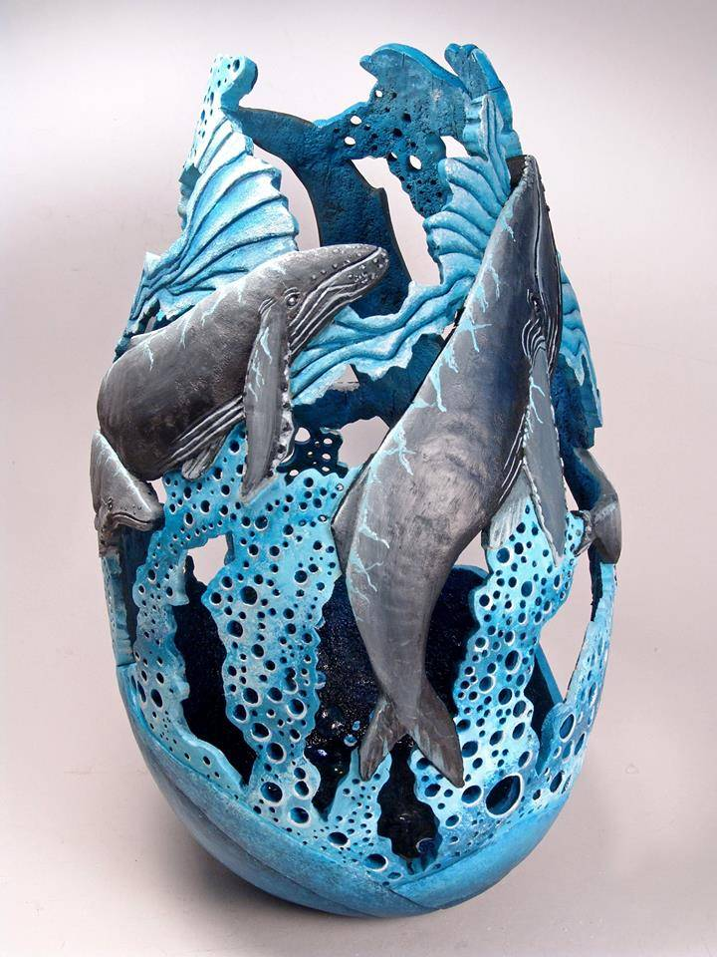
Contemporary gourd decorative
Denny Wainscott
Phyllis Sickles

Slide 4
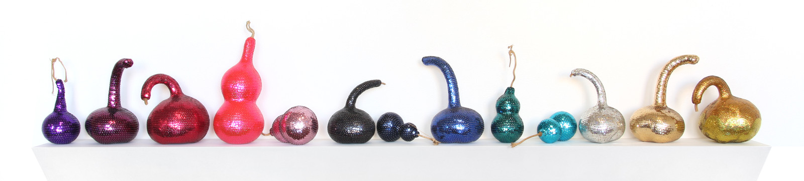
Contemporary Maori Art
Reuben Paterson (of Ngāti Rangitihi hapū of Te Arawa and Tūhoe, Scottish and Pakeha descent) while he was living in Greece (2005-2006). He identified correlations between the Greek and Māori uses of the gourd as a cultural object.
Add links or videos about this artwor and others….

Slide 5
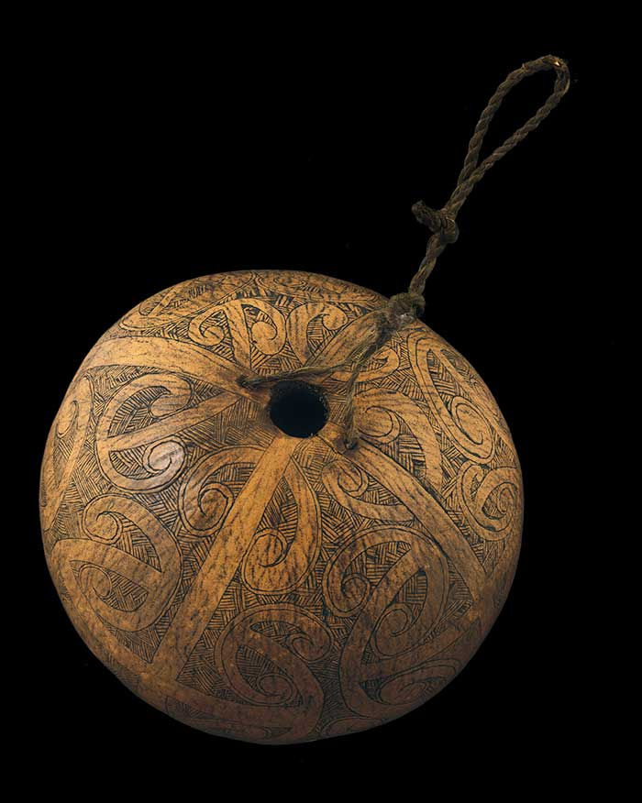
Hue at Te Papa
Dried and hollowed gourds were used as containers for water and preserved food. Smaller ones were used as containers for perfume. Taonga pūoro were also made from hue, including the hue puruhau (pictured), kōauau pongaihu, poi āwhiowhio or ‘whistling gourd’, and hue puruwai.

Slide 6
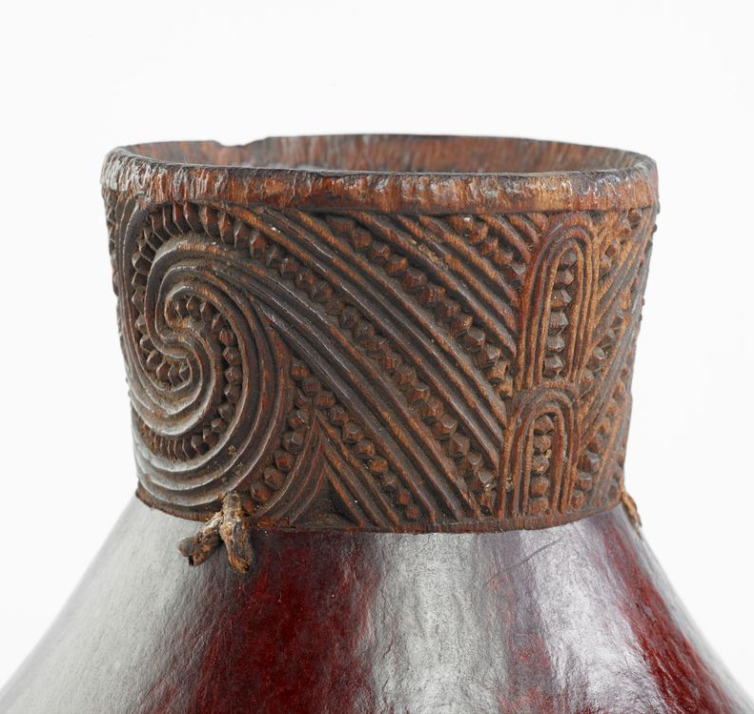
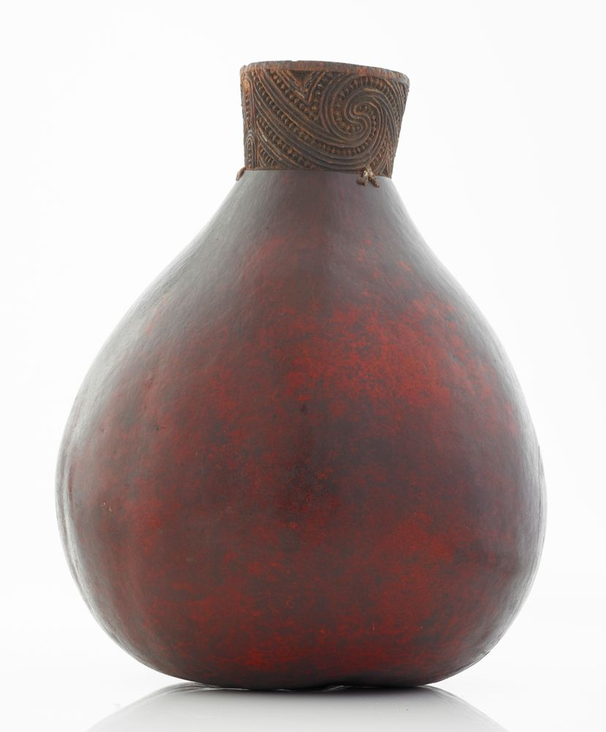
Taha huahua were fashioned from dried hollowed hue - gourds (Lagenaria Siceraria), and used to hold preserved foods. They were highly prized, decorated and used as presentation vessels at important feasts or for important guests.
This taha still has a beautifully carved and intact tuki, or carved mouthpiece, attached to the hue with muka binding (extracted fibre from the leaf of the harakeke - New Zealand flax). However, at some stage of its life, the supporting waewae taha (carved supports) and woven supporting frame have become separated from the container.
This taha huahua was collected by the museum in 1968, donated by Mrs WH Robieson. Her
husband had collected it in 1902, purchasing it
from Te Whiti Pa in the Wairarapa.

Slide 7
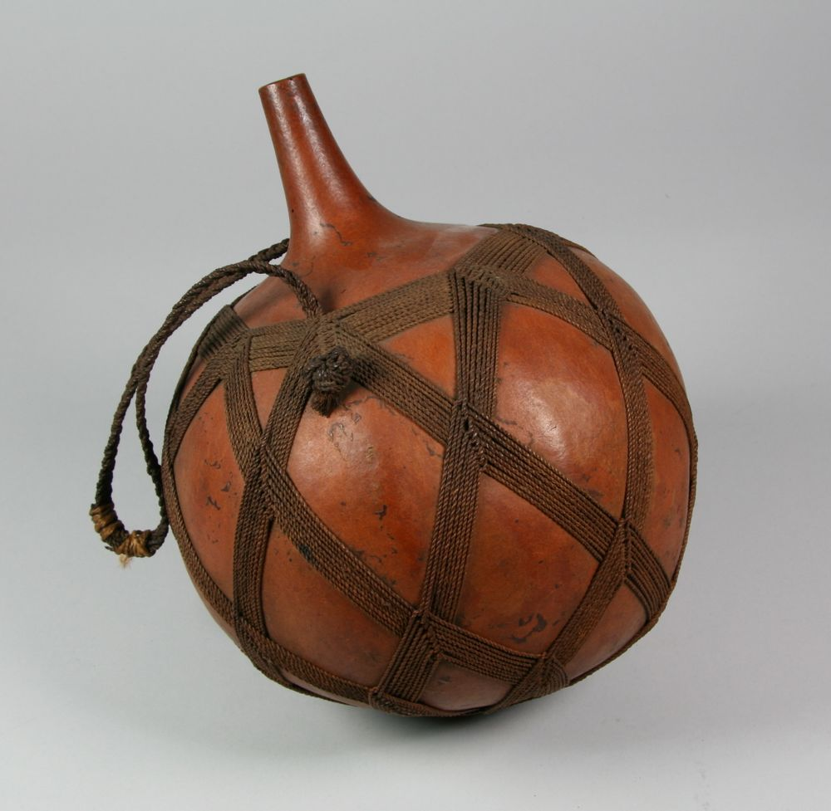
Gourd container
This is in the Pacific Cultures Collection at Te Papa
Notes:
Name
Gourd Container
Production
New Caledonia
Classification
containers
Materials
gourd
Dimensions
270mm, 220mm
Registration Number
OL000099.S/3
Credit line
Oldman Collection. Gift of the New Zealand Government, 1992

Slide 8
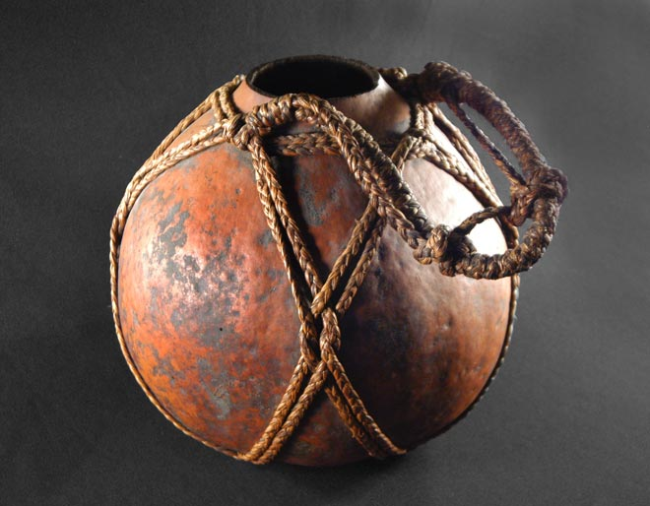
About Ipu - Ipu is the general term to describe a container or vessel. Traditional containers were used for holding water, preserved food, serving dishes, pigments and dyes. The feathers of a bird preserved inside the container were attached as a label marker. The outer surface was sometimes decorated with etched kōwhaiwhai patterns. Other types of ipu are kumete (carved wooden bowls) and pātua, made from the inner bark of the tōtara or mānuka tree. Hinepūtēhue is the female deity of hue, and the most common types of container used in the past were the hue/tahā or gourd, grown from seed. They were also used as a buoyancy device and as musical instruments. Gourds can be cultivated by skilled gardeners to create long, thin or widened forms. A gourd’s outer surface when dried is hard and durable, so once the inside seeds are removed and the top cut off they make excellent storage containers. Today hue are mostly kept as ornamental objects.

Slide 9
Ceremonial drinking vessels from other contexts - rough teacher research…
Scottish Quaiche and carving a quaich
Irish Mether mead distillery with book of leinster and National Museum of Ireland
Taiwanese Linak - Bowers museum - Linak from Paiwan culture - and Transforming Taiwan Aboriginal Cultural Features into Modern Product Design:
Mexican Pox - There’s a belief that pox reveals bonds between all individuals, and instead of saying Cheers, the traditional toast is In Lak'Ech', which means "I’m another you," to which the reply is Hala Ken, which means "You are another me,” Sanchez says. Pox is used in major ceremonies such as births, baptisms, weddings and funerals.
Beyond the rim a comparative study of kava bowls -
E na batini tanoa (Around the kava bowl)
Talanoa about all things kava
‘The great elevation’, chalice and host - Te Papa - Chalice - Neil Dawson
Kylix (Drinking Cup) and a second example
Japanese tea ceremony - Haisen- sake cup washing bowl, second example
Shared communion cup - and another example, pre-filled communion cups in response to Covid - what is communion and why is it important to Christians

Slide 10
How to grow and decorate gourds
When preparing fruiting plants to serve a functional purpose where and how they grow are important to the final shape and function - check out this article from stuff
Find 2 or 3 examples of other plants that are trained into specific shapes for a post harvesting function.

Slide 11
Teacher links
https://teara.govt.nz/en/video/46578/decorating-gourds
https://natlib.govt.nz/librarians/nga-upoko-tukutuku

