Slide 1
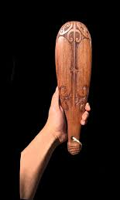
Patu
Traditional and Contemporary
Maori Art
William Colenso College
Onekawa Napier

Slide 2
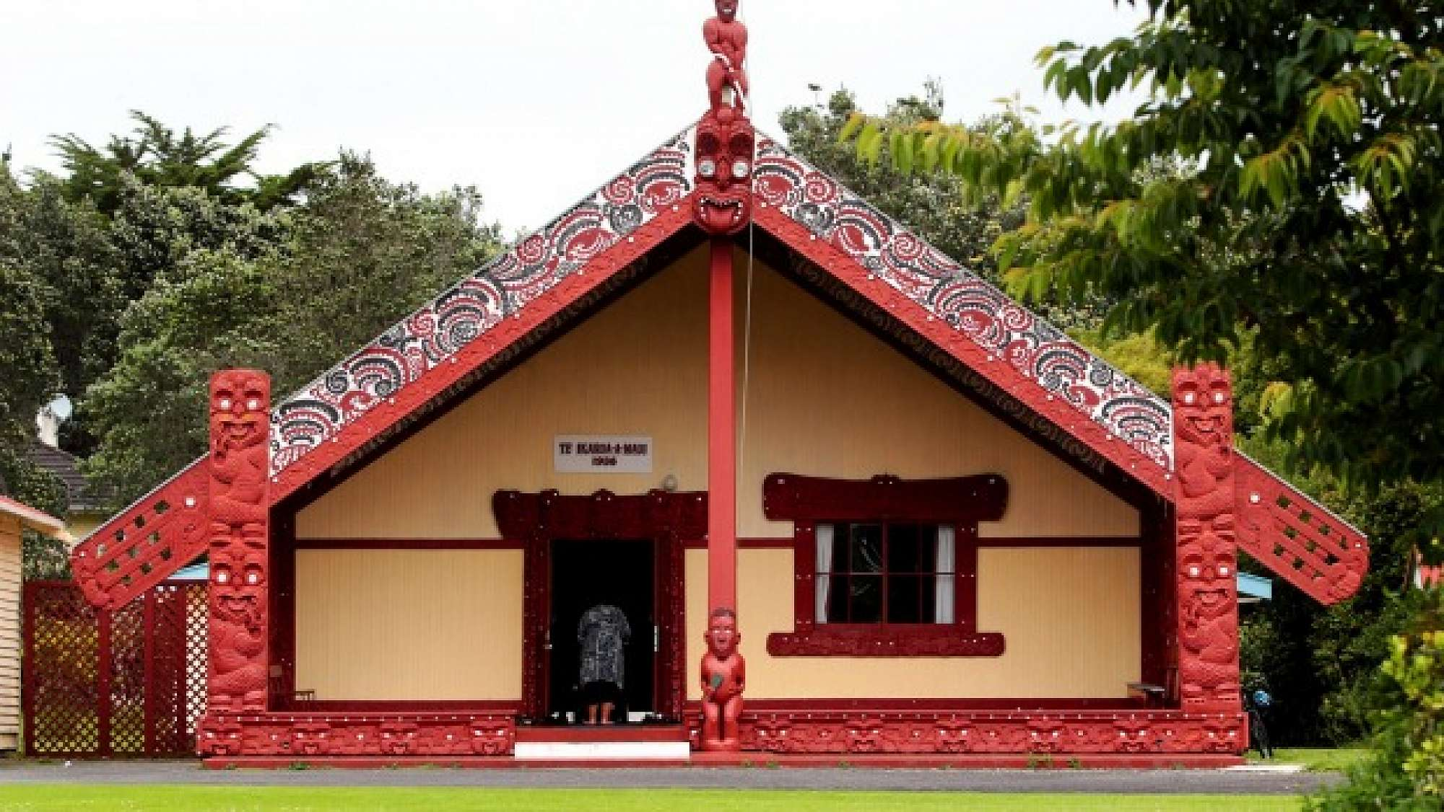
Traditional Marae

Slide 3
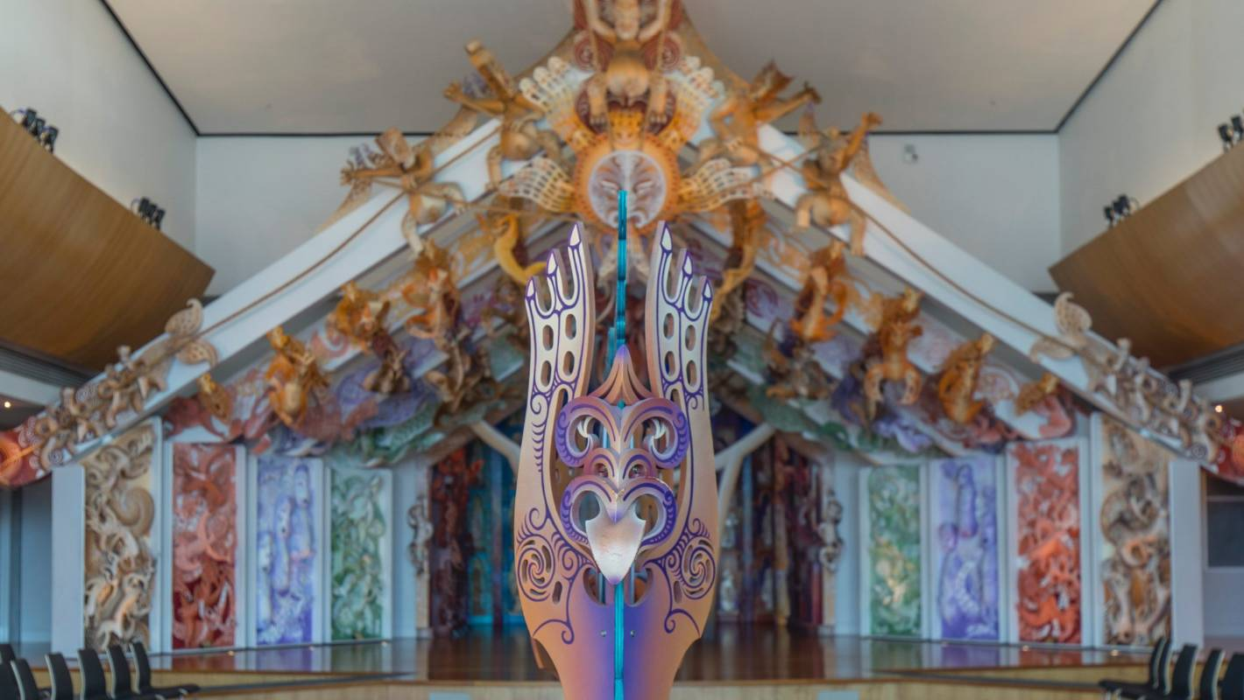
Contemporary Marae - Cliff Whiting Marae at Te Papa

Slide 4
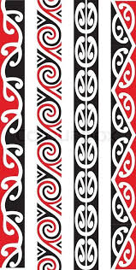
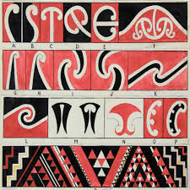
Traditional Kowhaiwhai

Slide 5
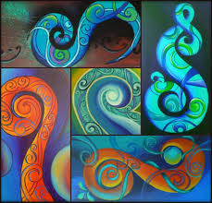
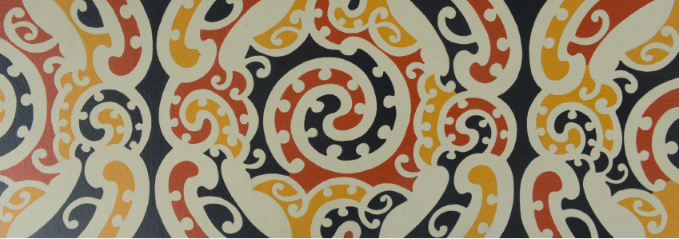
Contemporary Kowhaiwhai
Reina Cotter
Ra Gossage

Slide 6
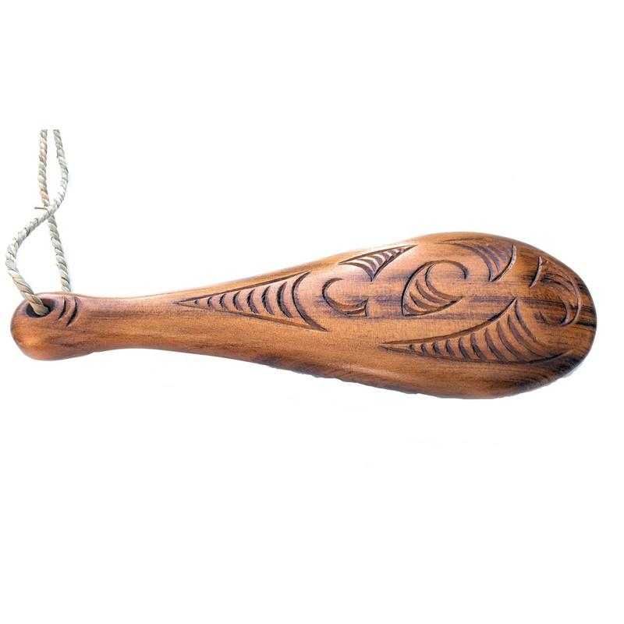
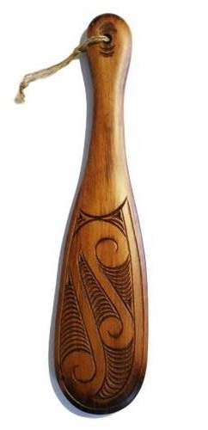
Traditional Patu
Patu - and other weaponry were symbols of chieftainship and regarded as valuable heirlooms and sometimes used on ceremonial occasions. Some patu were adorned with carvings that may have represented; a deity or protector (poukaiora) for the user; or a deity or protector to help the user overcome his opponent.

Slide 7
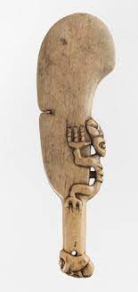
Other ways that patu were adorned depended on who the owner was - where they came from - what this particular patu was used for i.e. battle or ceremony.

Slide 8
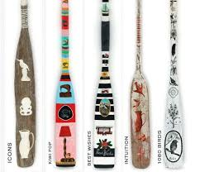
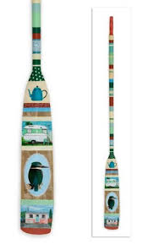
Leanne Culy Oars

Slide 9
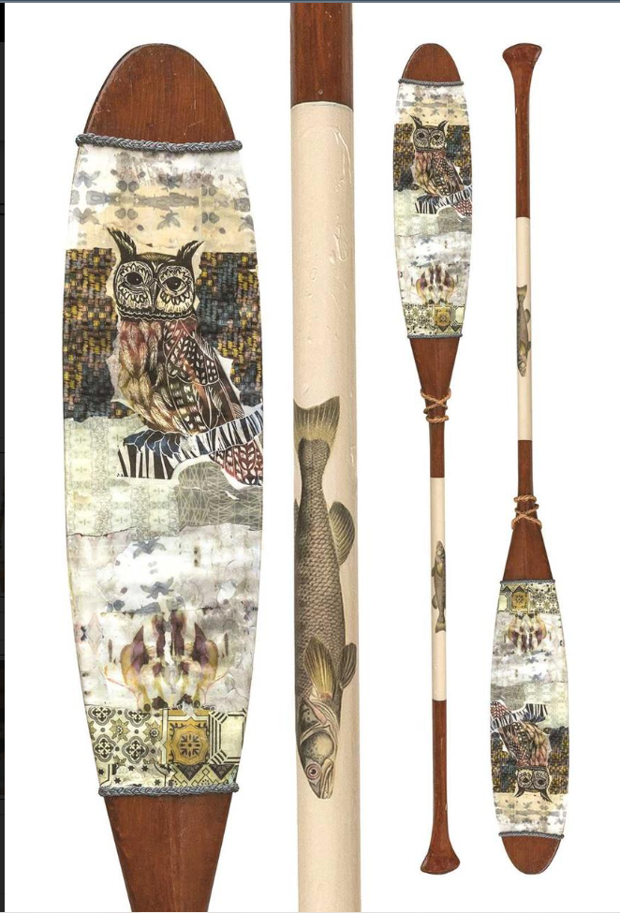
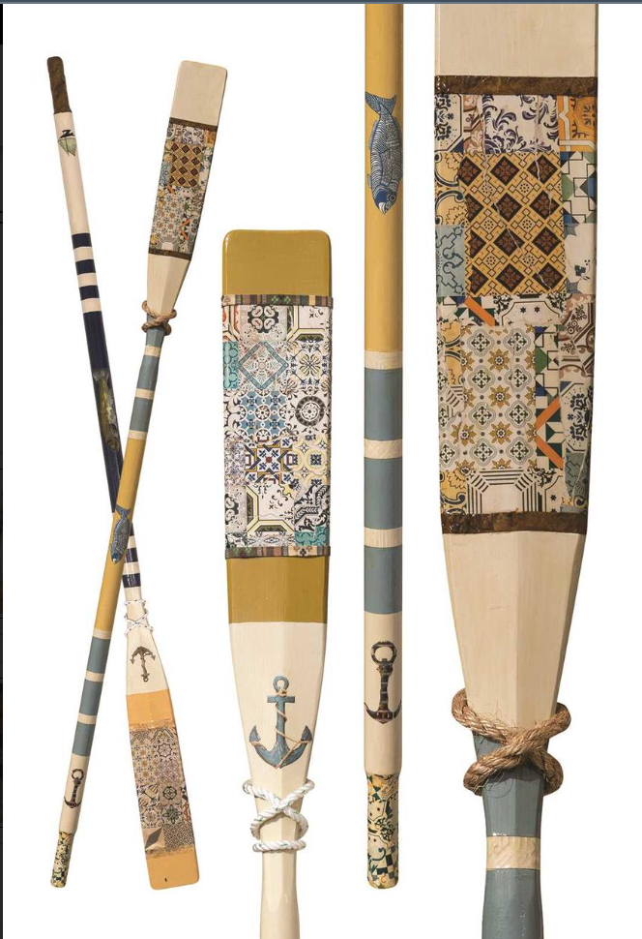
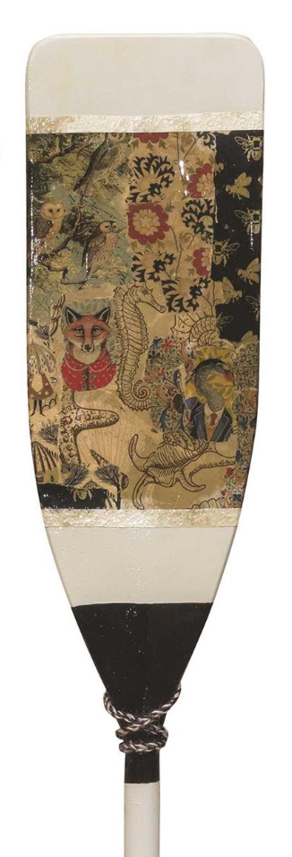
Anna Jacobi

Slide 10
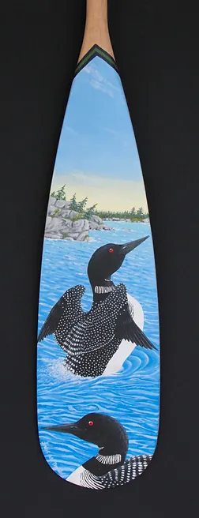
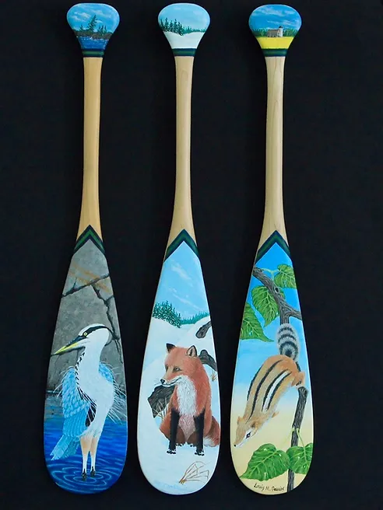
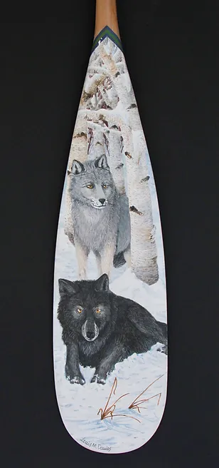
Louis Davies

Slide 11
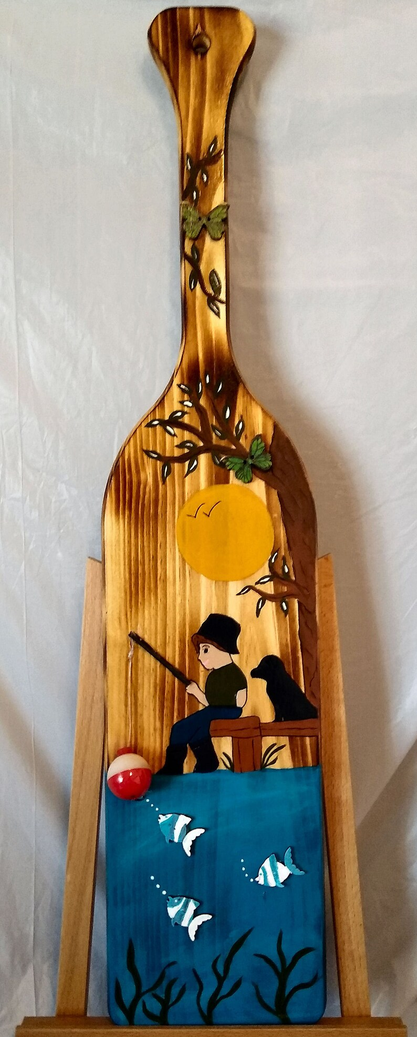
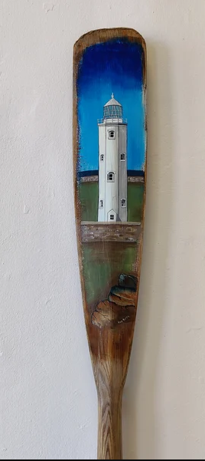
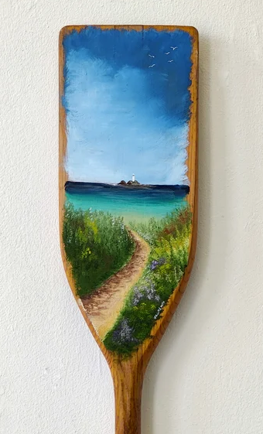
Crafty
Gnomes
Designs
Kim Potter
Kim Potter

Slide 12
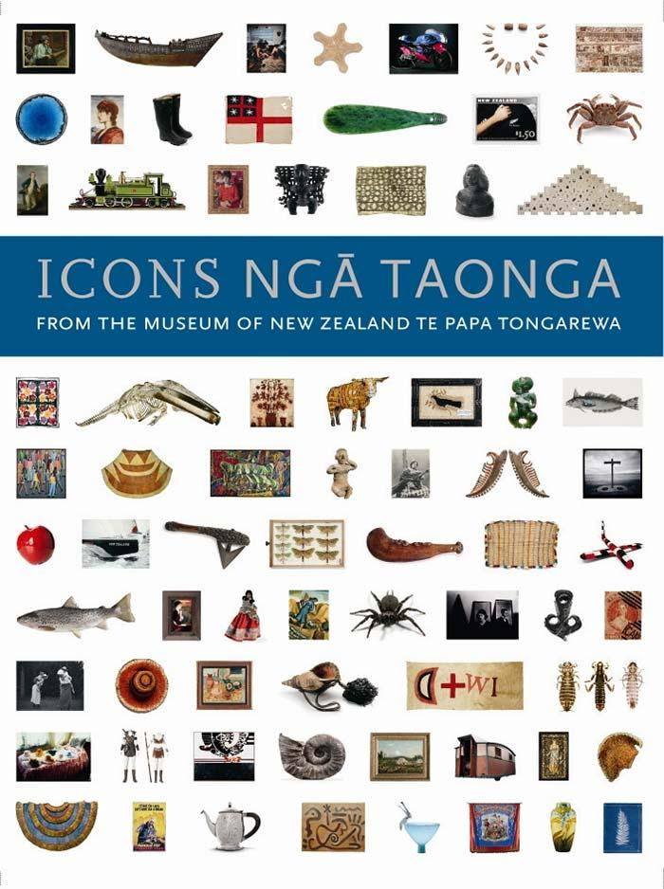
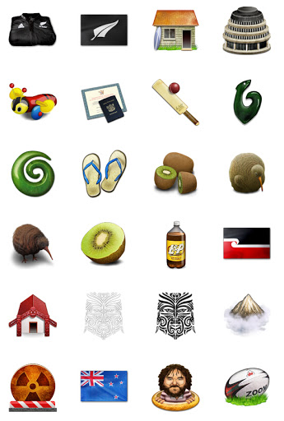
New
Zealand
Icons.
Ngaa
Taonga

Slide 13
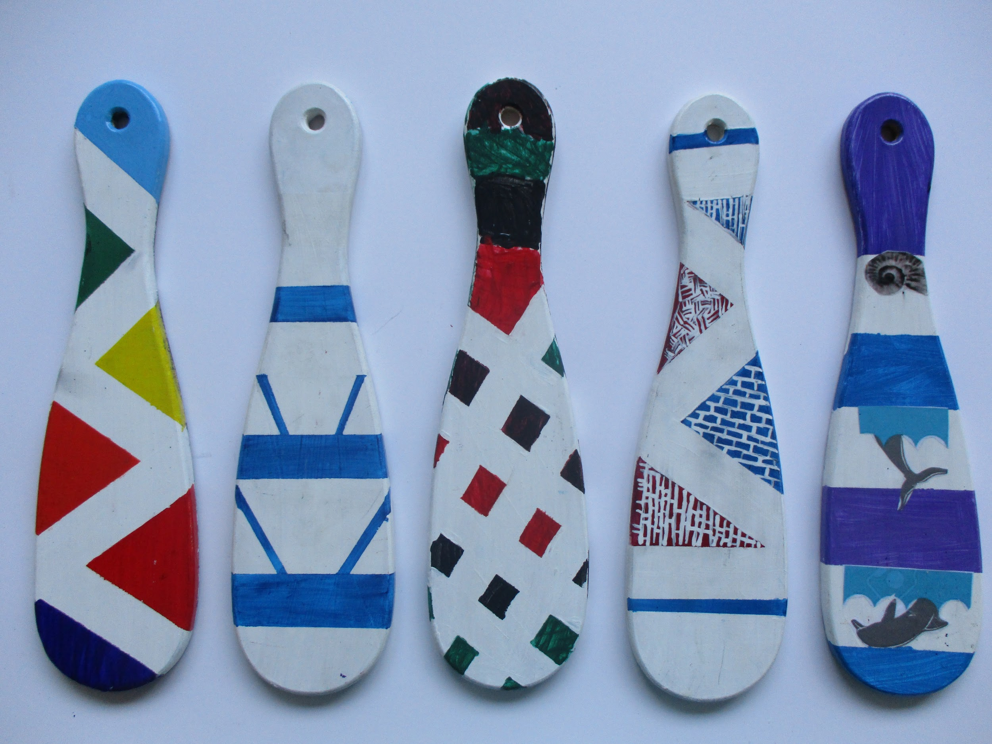

Slide 14
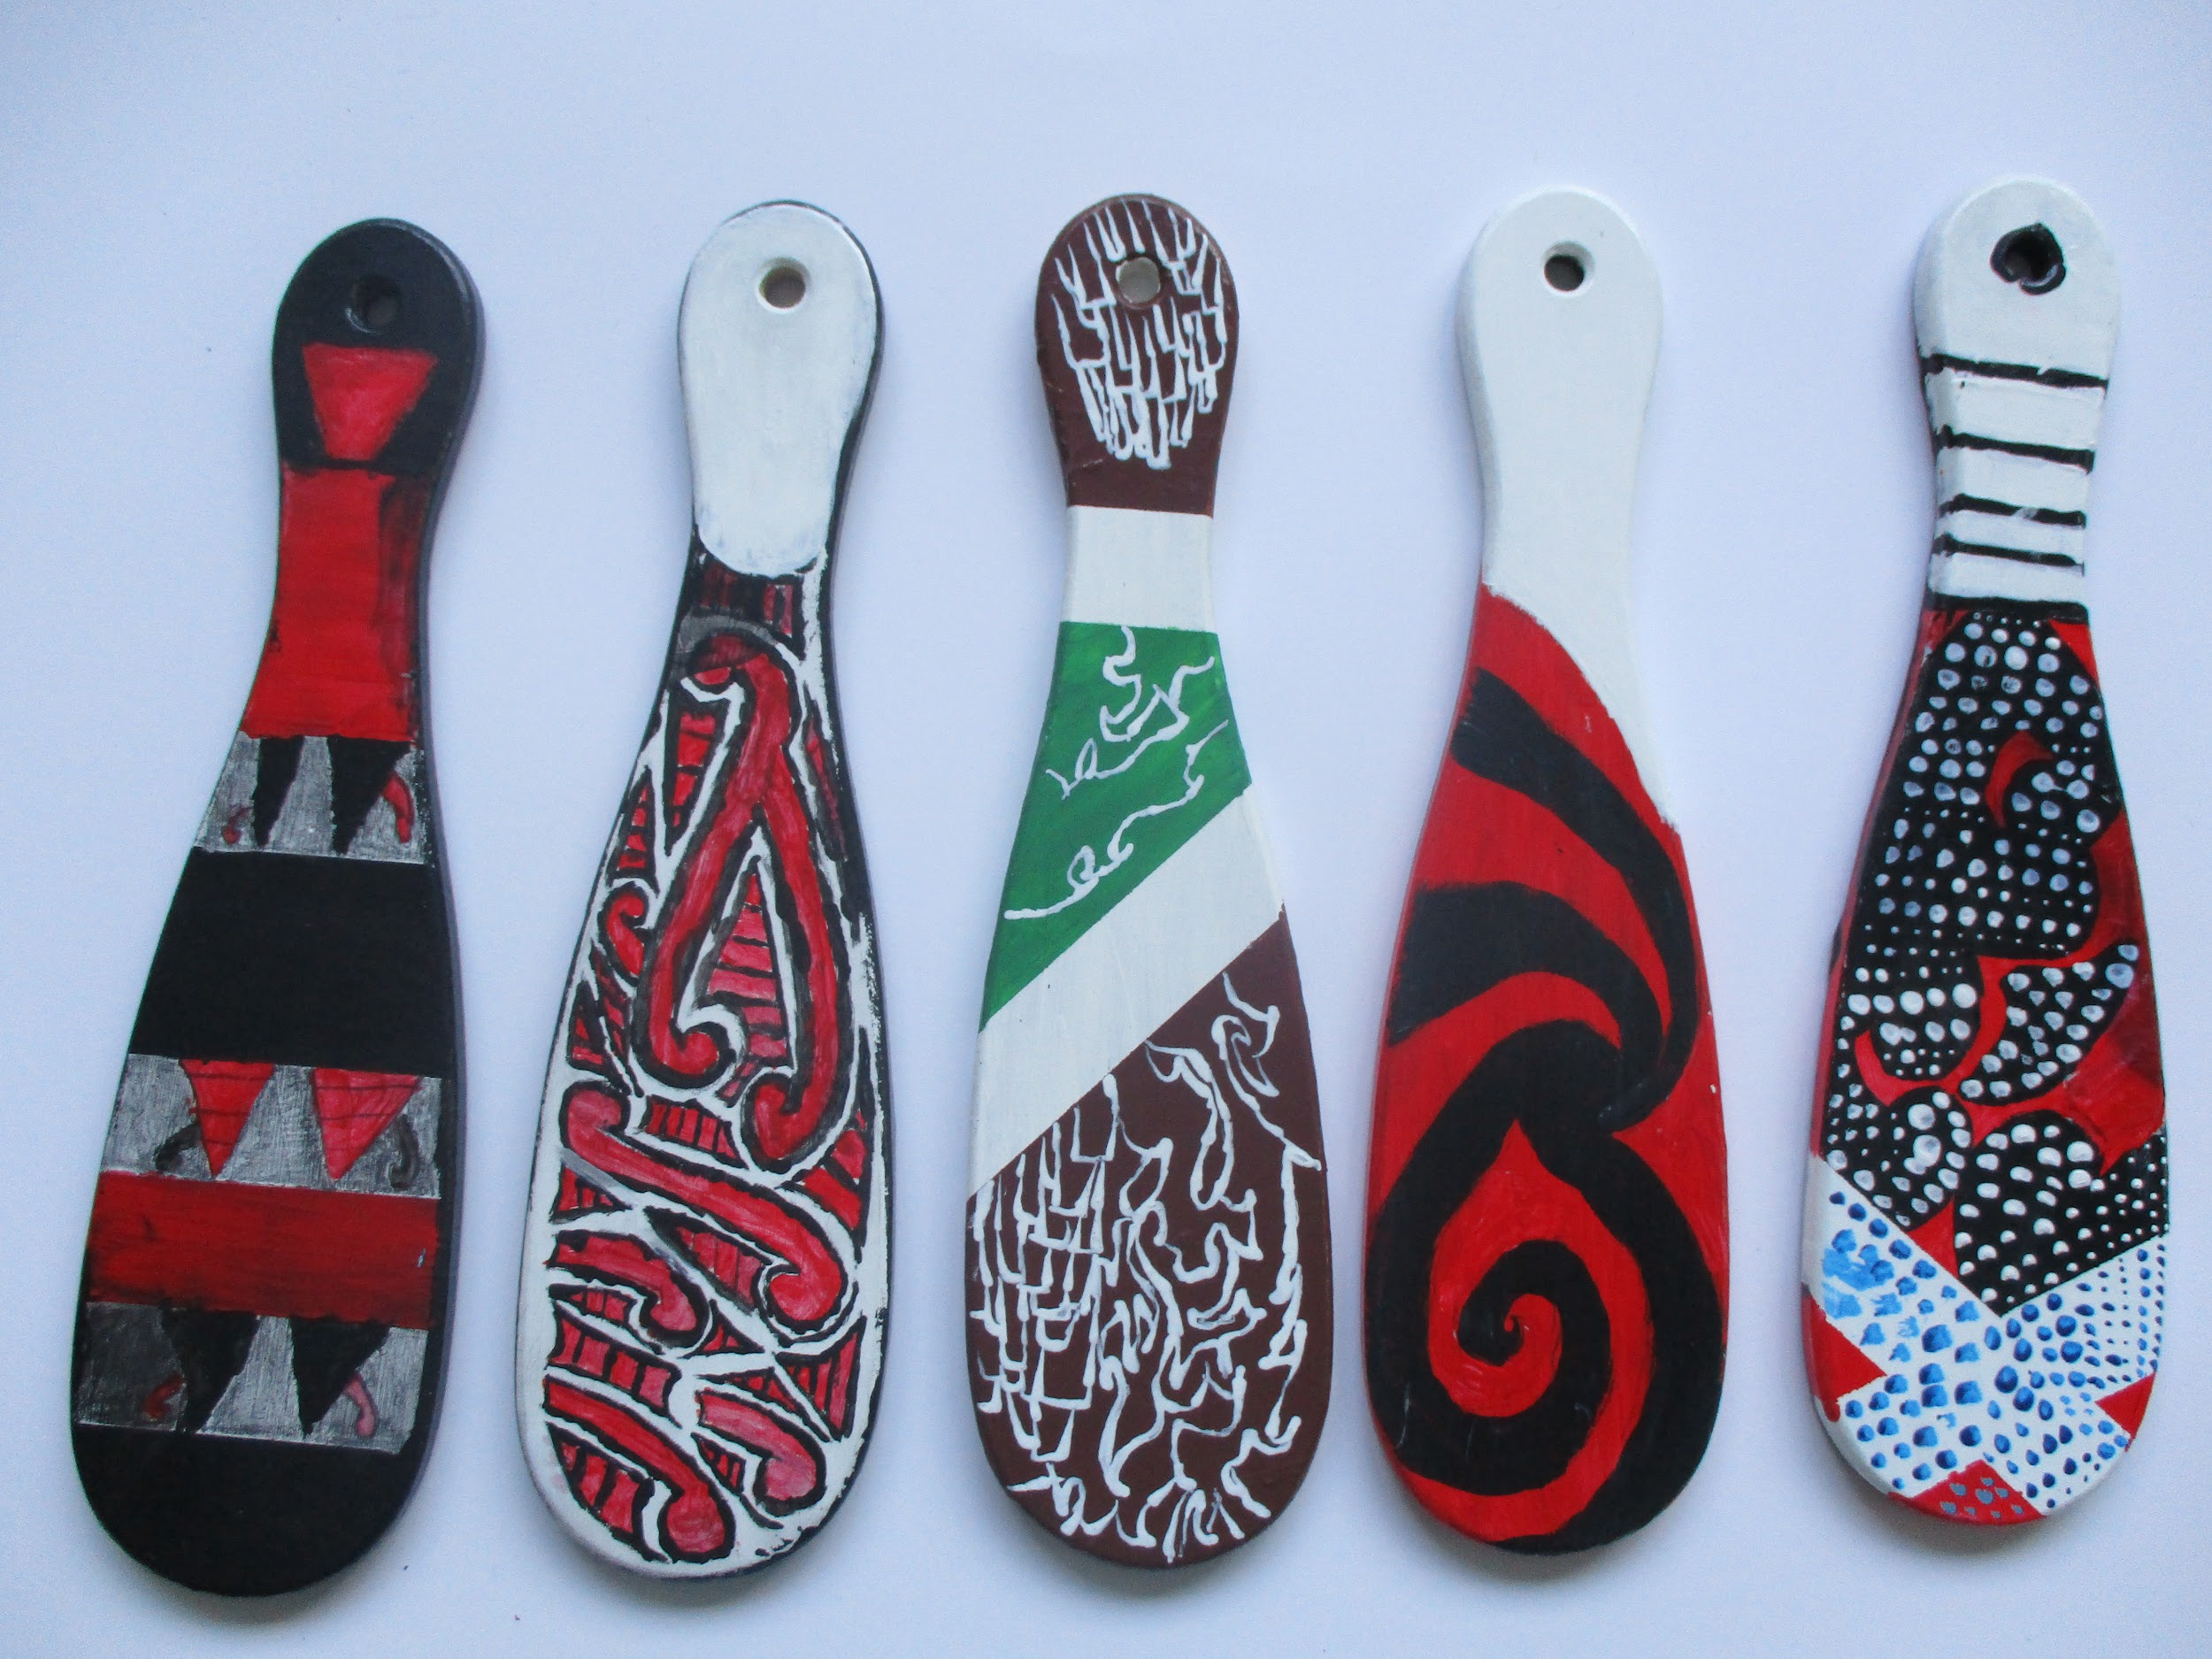

Slide 15
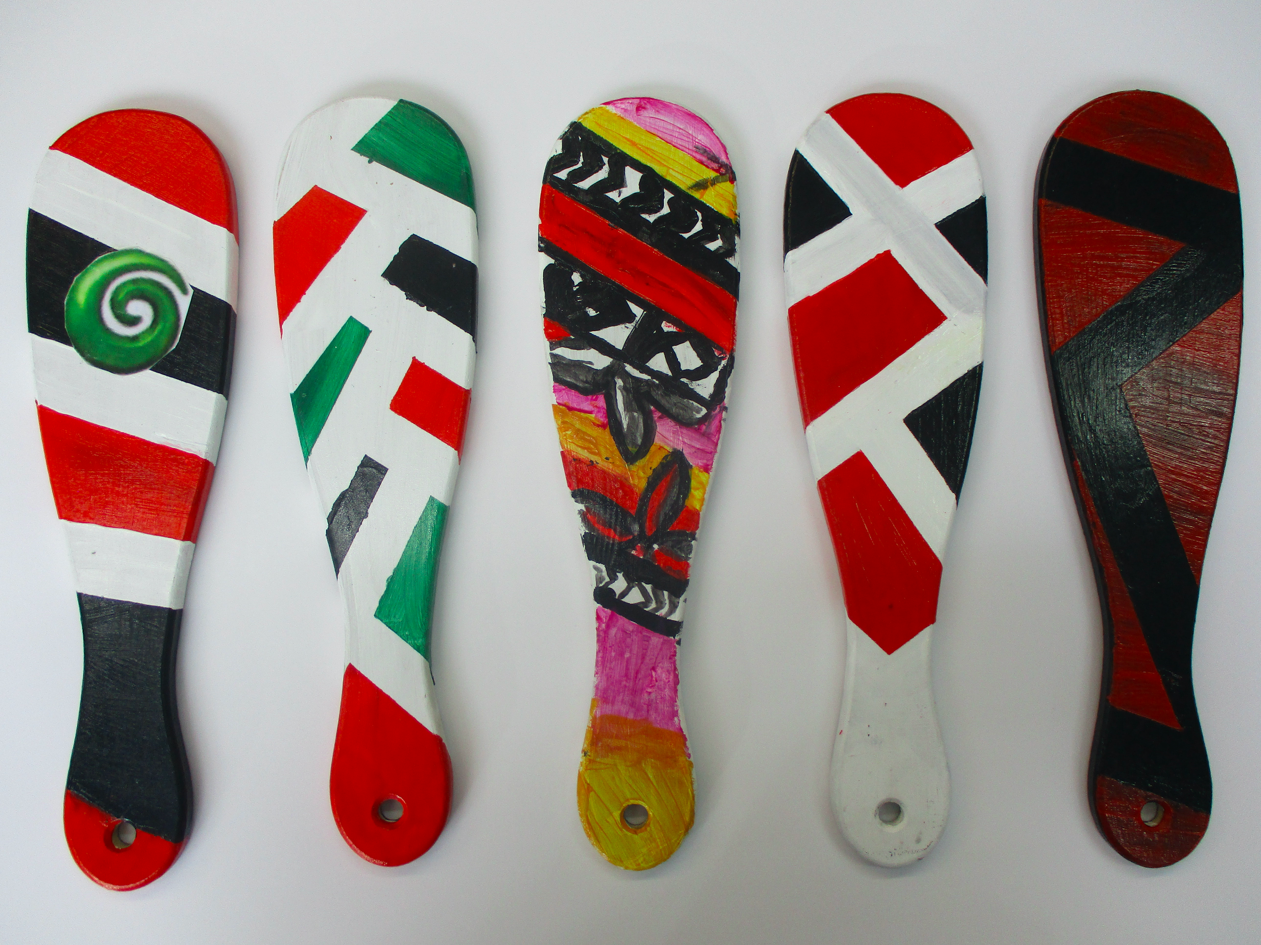

Slide 16
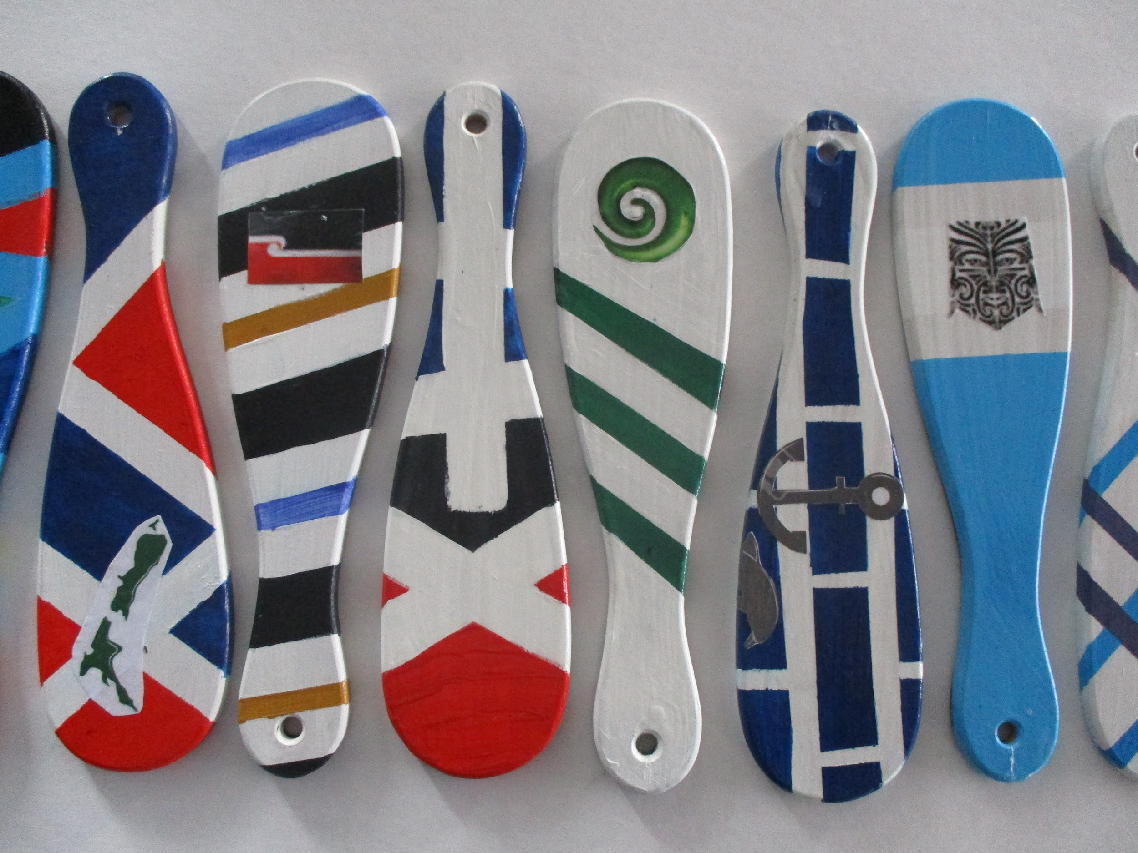

Slide 17
