Slide 1
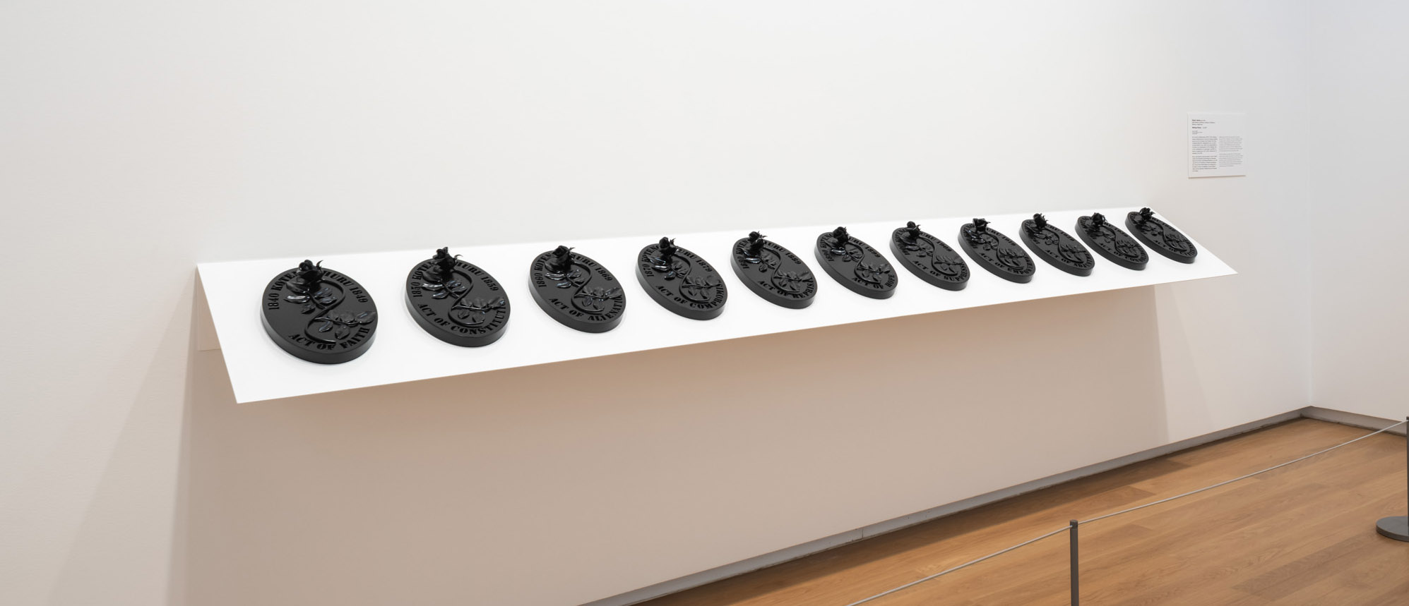
Waitangi Rosary Botanical Plaster Casting
Inspired by Robert Jahnke

Slide 2
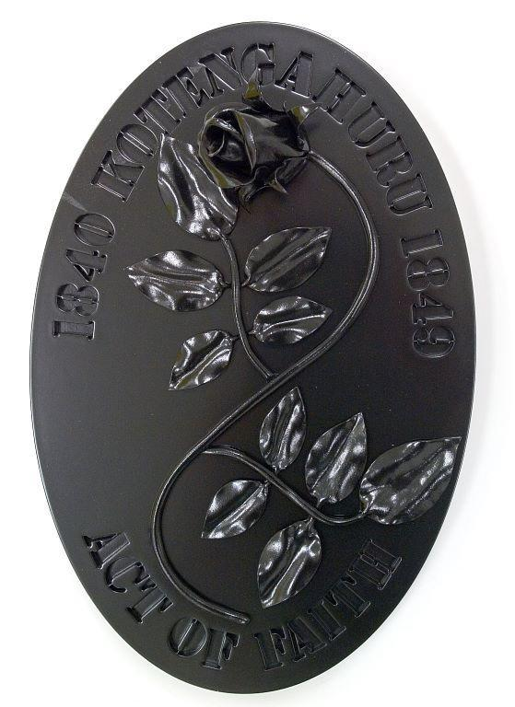
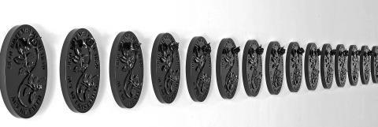
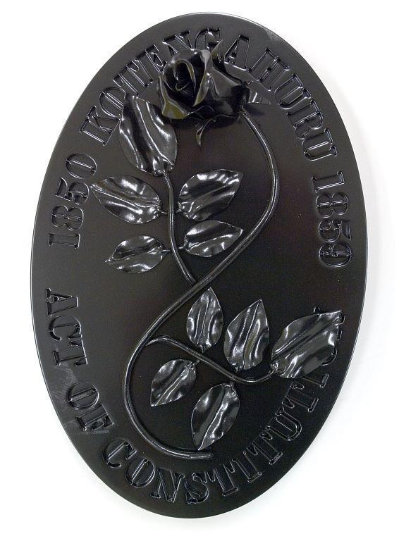

Slide 3
Waitangi Rosary, Robert Jahnke, Oct 2007
Kei te hoki atu te Waitangi Rosary, 2007 ki Te Tiriti o Waitangi. I hangaia te Waitangi Rosary hei urupare ki te kaupapa whakatutū puehu, arā ki te Ture Principles of the Principles of the Treaty of Waitangi Deletion Bill i whakatakotoria ki mua i te aroaro o te komiti whiriwhiri i te tau o 2006, ā, kei te tāpaetia tētahi ara hei huritao i te nui whakaharahara o te Tiriti o Waitangi i tēnei rā; kei te whakarōpūhia e ai ki ngā kaupapa o ngā ‘Mahi a te Karauna’ e putaputa mai ai i roto i te hītori o Aotearoa mai i te hainatanga i te tau 1840.
Kitea ai ngā kuputuhi me ngā kupu angarua, i ngā toi a Robert Jahnke. Kei te whakamahia ngā āhuahanga reo, āhuahanga ataata hoki, hei tūhura i ngā āhuatanga tīkokikoki a te reo. Pērā i ngā rōhi rino nei, he taumaha, he māngohe ngā āhuatanga tohu. He tohu tēnei mō Maria Takakau, mō te hekenga toto o Ihu Karaiti, o te aroha, o te kīngitanga, o te Kuini Irihapeti o nāianei. Kua āta whakaritea te Waitangi Rosary hei huritaonga mā te tangata.
Waitangi Rosary, 2007 revisits New Zealand’s founding document Te Tiriti o Waitangi – the Treaty of Waitangi. Created in response to the contentious Principles of the Principles of the Treaty of Waitangi Deletion Bill that went before a select committee in 2006, Waitangi Rosary offers a pathway to contemplate the importance of Te Tiriti o Waitangi today by recasting ‘Crown Acts’ into underlying themes that have played out in New Zealand history since its signing in 1840.
Text and wordplay are regular features of Robert Jahnke’s works. He uses linguistic and visual forms to reveal the unstable nature of language. Like the lead these roses are cast in, their symbolism is heavy and malleable. Symbolic of the Virgin Mary, the spilling of Christ’s blood, human love, kingly power and in the present day, Queen Elizabeth. Waitangi Rosary is purposefully paced to invite reflection.

Slide 4
Text and wordplay are regular features of Robert Jahnke’s works. He uses linguistic and visual forms to reveal the unstable nature of language. Like the lead these roses are cast in, their symbolism is heavy and malleable. Symbolic of the Virgin Mary, the spilling of Christ’s blood, human love, kingly power and in the present day, Queen Elizabeth. Waitangi Rosary is purposefully paced to invite reflection
Act of Faith
Act of Constitution
Act of Alienation
Act of Compromises
Act of Reprisals
Act of Hope
Act of Suppression
Act of Empowerment
Act of Adjustment
Act of Consolidation
Act of Citizenship
Act of Assimilation
Act of Development
Act of Redress
Act of Entitlement
Act of Restitution
Act of Charity

Slide 5
The power of Words
International Artist that Utilise Text:
Jasper Johns
Barbara Kruger
Jenny Holzer
Ed Ruscha
Christopher Wool
Bruce Nauman
Mel Bochner
Steve Powers
Ben Eine
Sean Landers
Adam Pendleton
Kay Rosen
Erica Baum
Guerilla Girls
Xu Bing
Petter Preffington
John Baldessari
Tracey Emin
Glenn Ligon
Robert Jahnke and a significant number of NZ artists have created artworks that explore the power of words and text.
“Language is a powerful tool. And no one understands that better than artists who thoughtfully utilise text to make a statement and draw out emotion. By using text as the central communication vehicle in their artistic expression, these artists push forth letters, numbers, and words as their primary means to get out their message.
Of course, text and art have been intertwined for centuries—think of medieval illuminated manuscripts, with their elaborate illustrations. But things really took off in the 20th century. When Surrealist artist Magritte famously wrote “Ceci n’est pas une pipe.” (“This pipe isn’t a pipe.”) across his painting, he moved text to a central role in understanding the work. Cubists, such as Georges Braque, were also known for incorporating text into their artwork, often highlighting its graphic quality.
From the 1960s onward, a group of artists increasingly focused on text in their art. From projections to canvases, sculptures to public murals, the versatility—and power—of the written word forces the viewer to reflect. Clever word play, political activism, subversion of advertising, and appropriation of form are just some common characteristics of powerful text art. ” https://mymodernmet.com/text-art-masters/
In Jahnke’s work there is another layer to the text that can be explored from a Te Tiriti perspective. “The Treaty of Waitangi has two texts. The Māori version is not an exact translation of the English. There has been much debate over the differences – how they came to be and what they mean. Some people argue that there are two treaties: te Tiriti, the Māori version, and the Treaty, the English version.
Legally there is just one Treaty, despite the differences between the two texts. The Waitangi Tribunal has exclusive authority to determine the meaning of the Treaty in the two texts and to decide issues raised by the differences between them. References to the Treaty in law try to bridge the differences by referring to the 'principles' of the Treaty, or the core concepts or spirit that underpin both texts. As is often noted now, it is the spirit of the Treaty that matters most.” https://nzhistory.govt.nz/politics/treaty/read-the-Treaty/differences-between-the-texts
Jahnke is exploring the consequences of the interpretations of the Treaty principles in his choice of words describing the actions these interpretations have lead to: an Act of Faith, Constitution, Alienation, Compromises, Reprisals, Hope, Suppression, Empowerment, Adjustment, Consolidation, Citizenship, Assimilation, Development, Redress, Entitlement, Restitution, Charity. Each of these words becomes loaded with meaning. It is our job to unpick these meanings. Further examination of postcolonial theory would be appropriate for students to engage in.
Further reading of Linda Tuhiwai Smith’s writing on “Decolonisation” and Epeli Hau'ofa “reconceptualisation of the Pacific” may be appropriate.

Slide 6
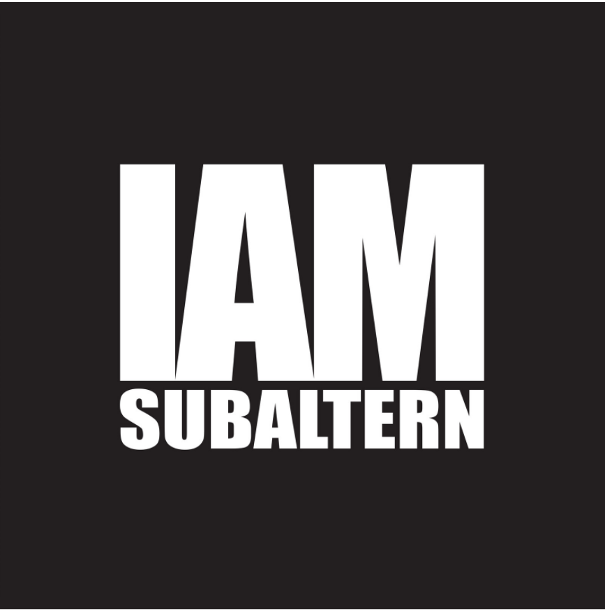
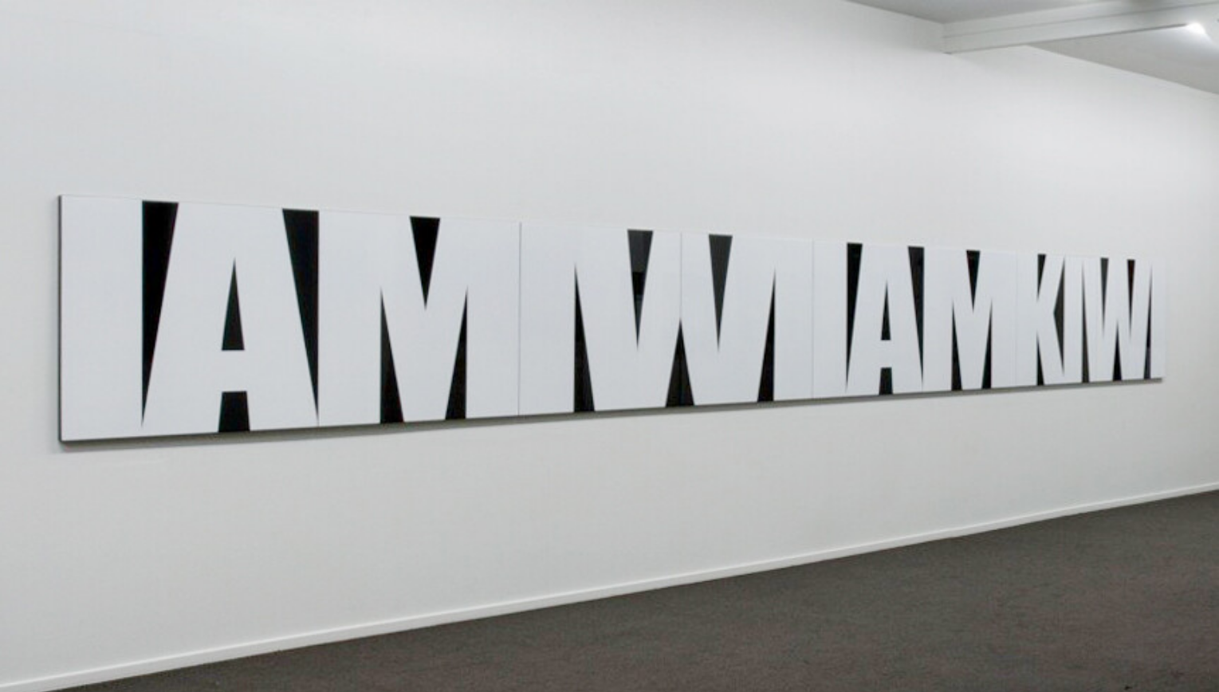
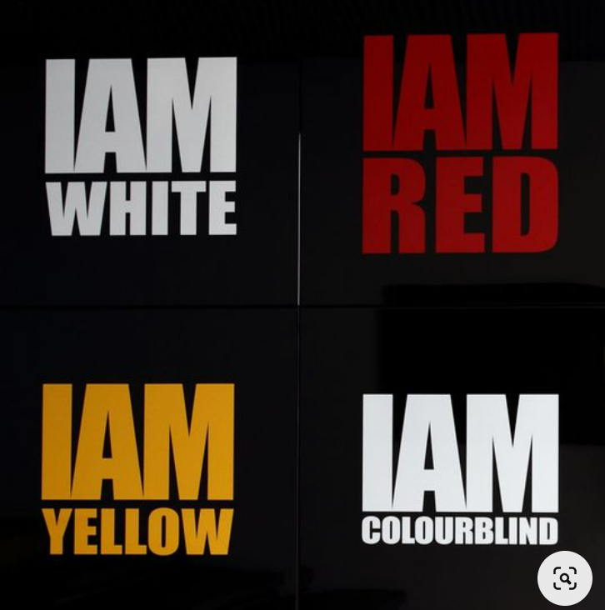
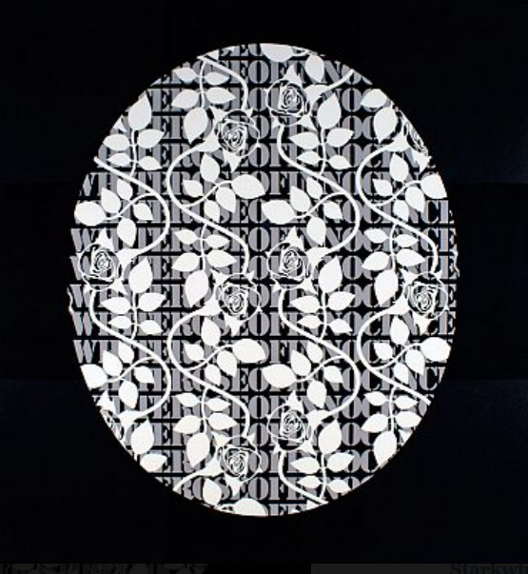
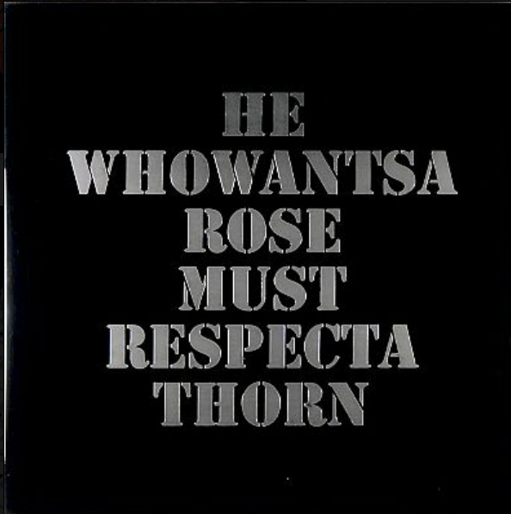
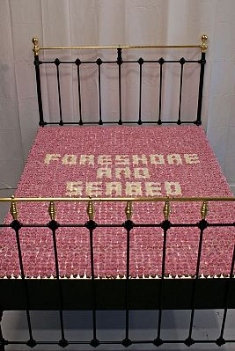
Other Jahnke works that deal with text….
Robert Jahnke iam subaltern (2012) stainless steel, lacquer,
Robert Jahnke iam diaspora (2012) stainless steel, lacquer,
Robert Jahnke this land was made for you and me (2011) 8 panels; stainless steel, lacquer,
Robert Jahnke 'Some of my best friends are coloured too' - Bath Street Gallery

Slide 7
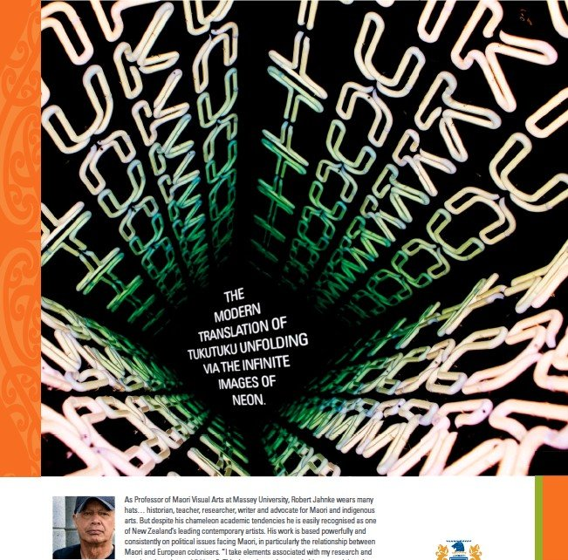
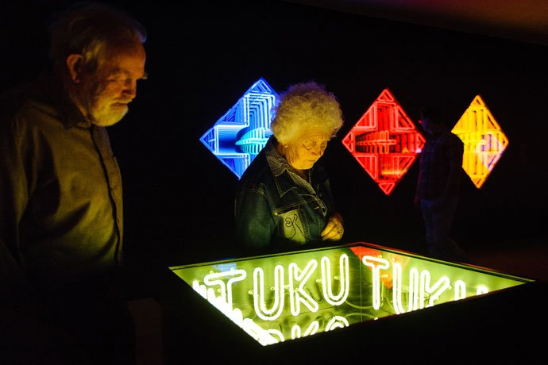
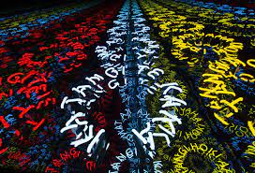
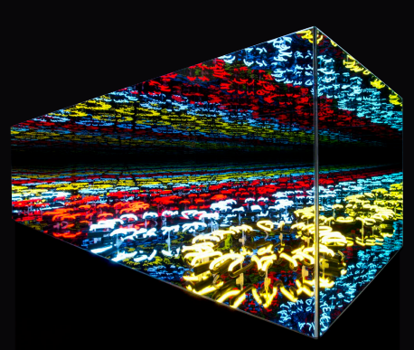
Ka tangi hoki ahau, 2019

Slide 8
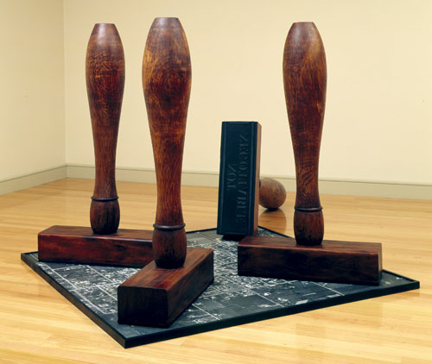
Robert Jahnke, ‘Ta te whenua’, 1995
This artwork, ‘Ta te whenua’, is Robert Jahnke’s response to conflicting Māori and Pākehā attitudes to land, money and power. At the time the work was created, in 1995, the New Zealand government was attempting to settle Māori land grievances through a one-off cash settlement known as the ‘fiscal envelope’. In Jahnke’s work, huge rubber stamps bearing the message ‘not negotiable’ stand on an aerial photograph of Martinborough, a small town in the Wairarapa. The streets of Martinborough were laid out in a grid representing the Union Jack, the flag of the United Kingdom.
https://teara.govt.nz/en/artwork/1811/maori-perspectives

Slide 9
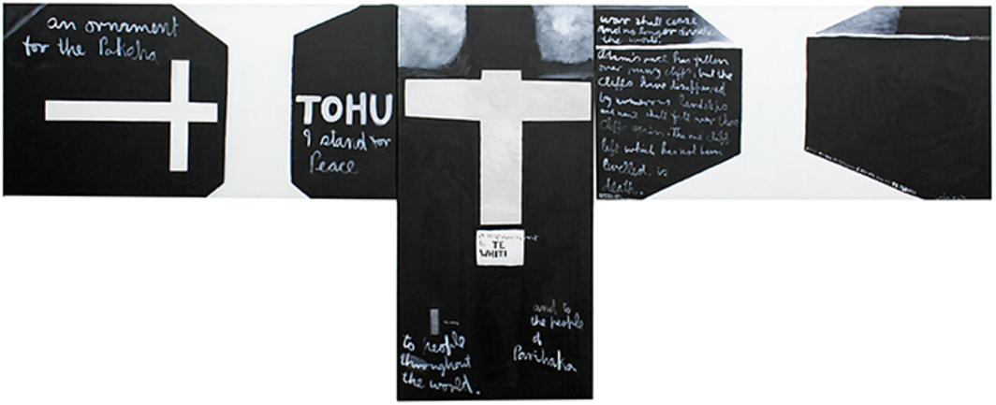
Colin McCahon, Parihaka Triptych, 1972, acrylic on canvas, 5' 9“ × 12' 4”.

Slide 10
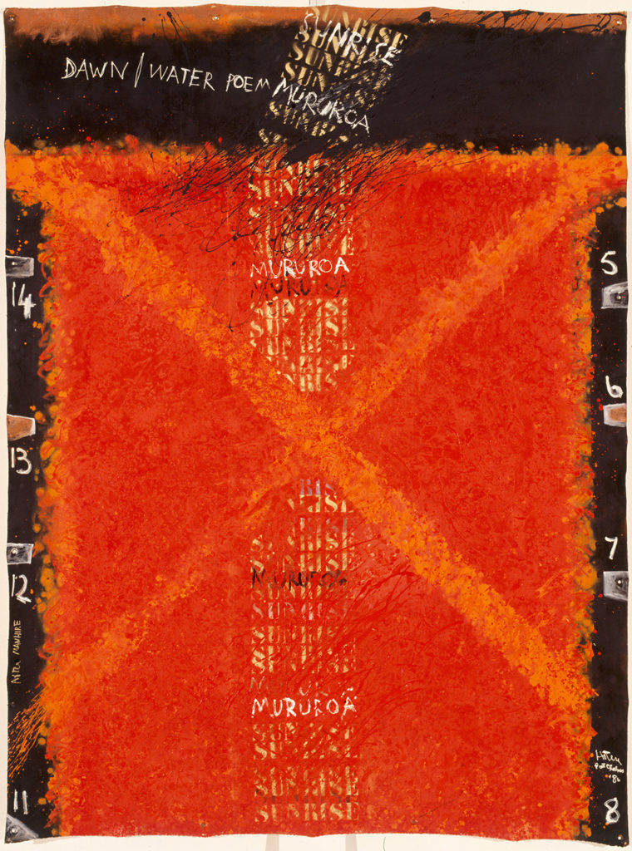
Ralph Hotere Dawn/Water Poem 1986

Slide 11
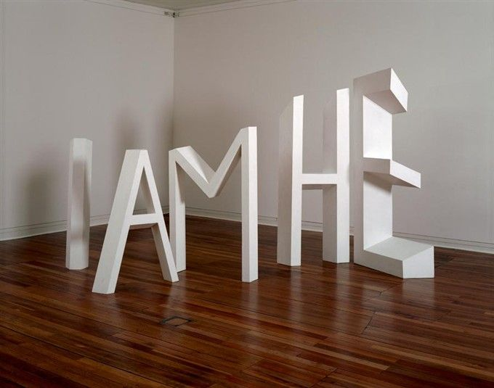
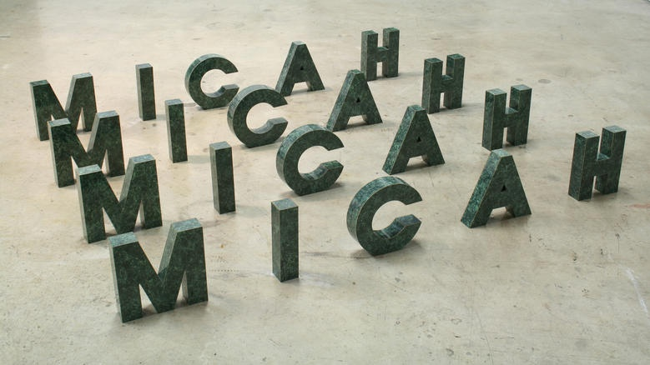
Michael Parekowhai, The Indefinite Article, 1990, collection of Jim and Mary Barr, Wellington
Michael Parekowhai, "Everyone will live quietly" Micah 4.4, 1990, 255 x 2200 x 1500mm, Wood and laminates

Slide 12
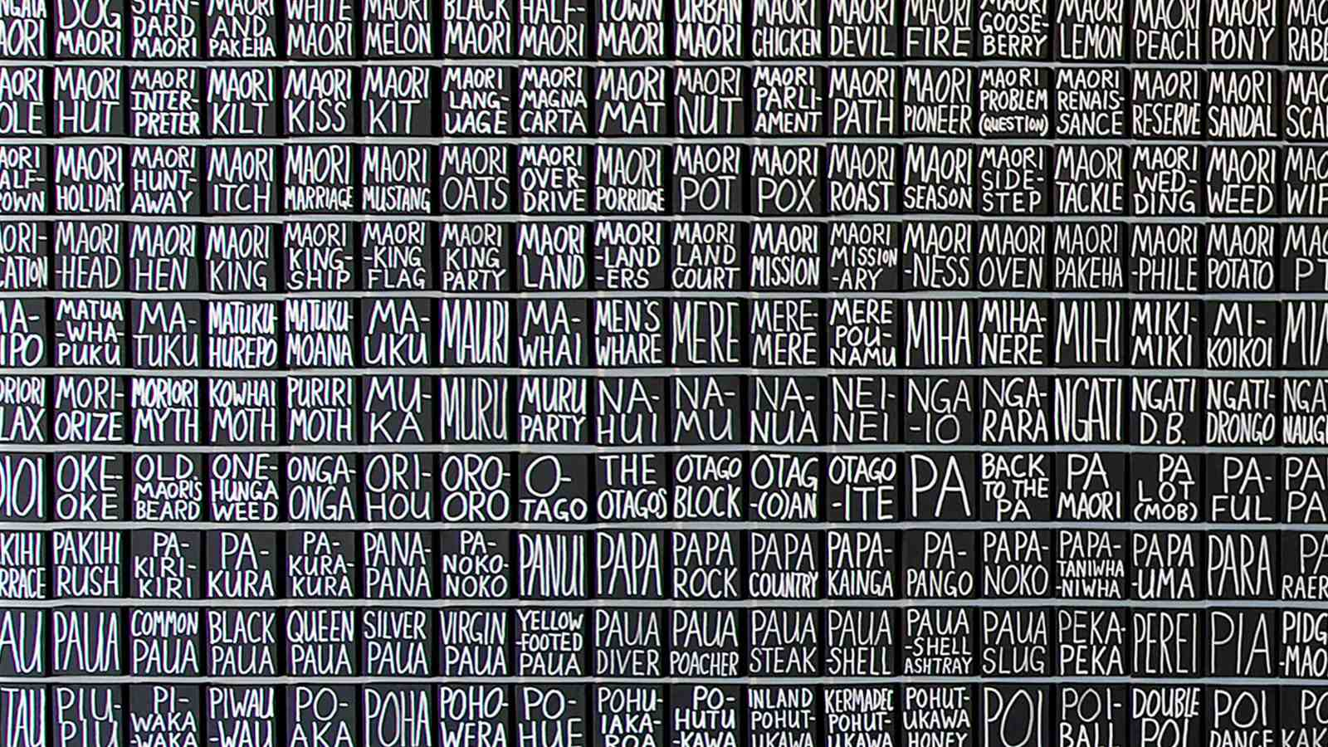
John Reynolds' 'Looking west, late afternoon, low water' (2007), Victoria University of Wellington Art Collection.

Slide 13
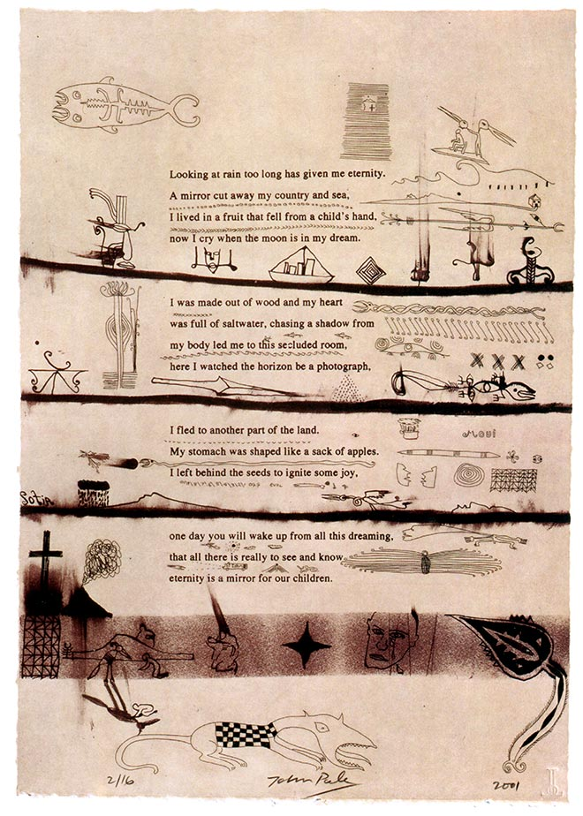
John Pule, 100 love poems.
John Puhiatau Pule, Niuean New Zealand novelist, poet and artist, has often used his poetry within artworks. This lithograph, 'looking at rain too long has given me eternity', is from his series '100 love poems'. While Pule’s art expresses contemporary experience and understanding of history, it is also deeply based in Niuean traditions. In his work, he has translated the layout, forms and colours of hiapo (Niuean tapa), and commented on the history of colonisation and Christianity in the Pacific, and on 20th- and 21st-century experiences of migration.
Reference: Nicholas Thomas, ed., Hauaga: the art of John Pule. Dunedin: Otago University Press, 2010, Plate 50 Lithograph by John Pule
This item has been provided for private study purposes (such as school projects, family and local history research) and any published reproduction (print or electronic) may infringe copyright law. It is the responsibility of the user of any material to obtain clearance from the copyright holder.

Slide 14
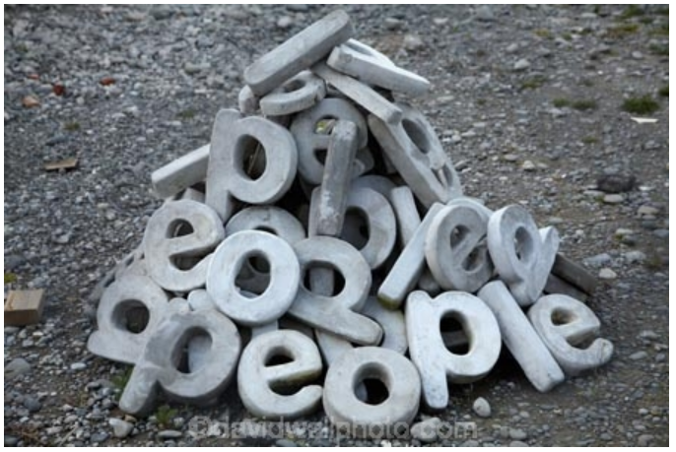
People’s people, Lucy Matthews, Christchurch

Slide 15
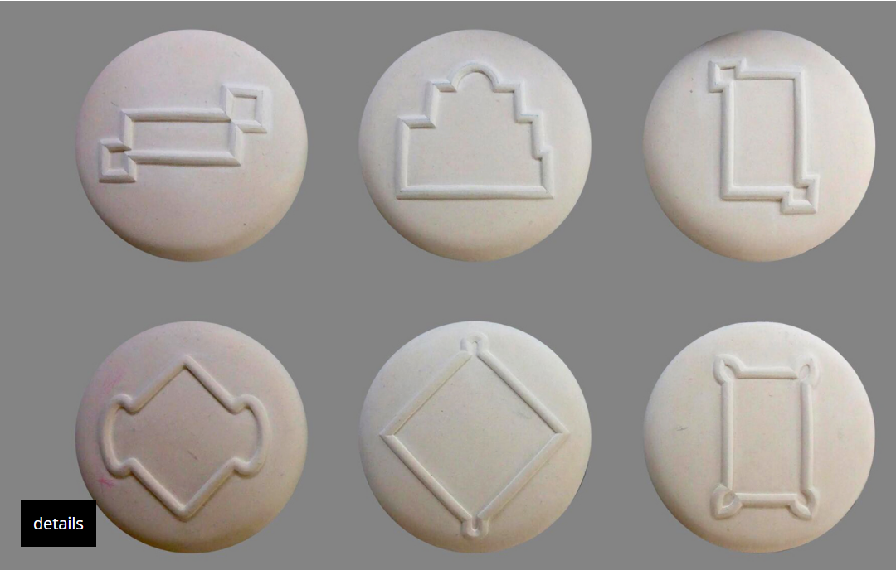
"Plot 150 reproduce(s) the outlines of six of the scores of redoubts raised along or near the Great South Road before, during, and just after the Waikato War. Together, they trace the path of the British Army and its local allies from the southern outskirts of Auckland, across the aukati, or border, that King Tāwhiao had proclaimed near present-day Mercer, through the coveted plains of the Waikato to Pirongia, at the mountainous southern edge of the region.
Graham's show has coincided with the one hundred and fiftieth anniversary of the conquest of the Waikato, and it says as much about the meaning of that event as a table-load of wordy documents and weighty artefacts.
When Brett Graham sculpts our redoubts, he is depicting much more than a few temporary military fortifications. Empires expand by dividing smaller societies into pieces, and consuming each piece in turn. As they marched south from their Auckland citadel a century and a half ago, Britain's imperialists established islands of control and familiarity amidst an alien, autochthonous landscape of forests and swamps and thatched kāinga."
Extracted from Scott Hamilton's review of the Plot 150 exhibition
Brett Graham, LOT 150, 2014, St Hubert limestone,400 x 400 x 90 mm each, Waikato Museum of Art and History, Hamilton, New Zealand http://www.brettgraham.co.nz/brett-graham-plot150.html

Slide 16
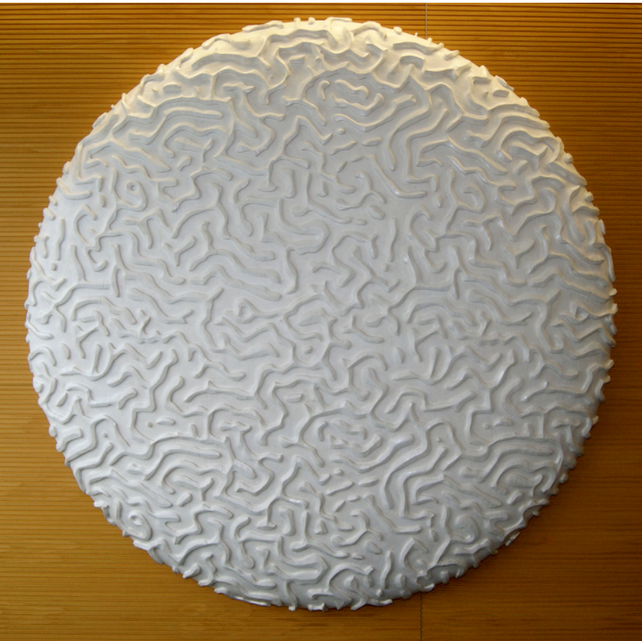
Brett Graham, TE AU MARINO, 2012, wood.
"This work was commissioned by Ernst & Young as a memorial to Simon Moore (1972–2011). Coral is a central theme to acknowledge our locality within the Pacific and to reflect some of the essential qualities Simon shared with those around him. In the natural world coral serves as an organic hub, attracting, sustaining an protecting all manner of life, qualities Simon demonstrated throughout his life. The coral motif emphasizes the fragile nature of life and its latticed character speaks of Simon's ability to build and maintain lasting relationships." (Kiwa Whatarau)
http://www.brettgraham.co.nz/brett-graham-te-au-marino.html

Slide 17
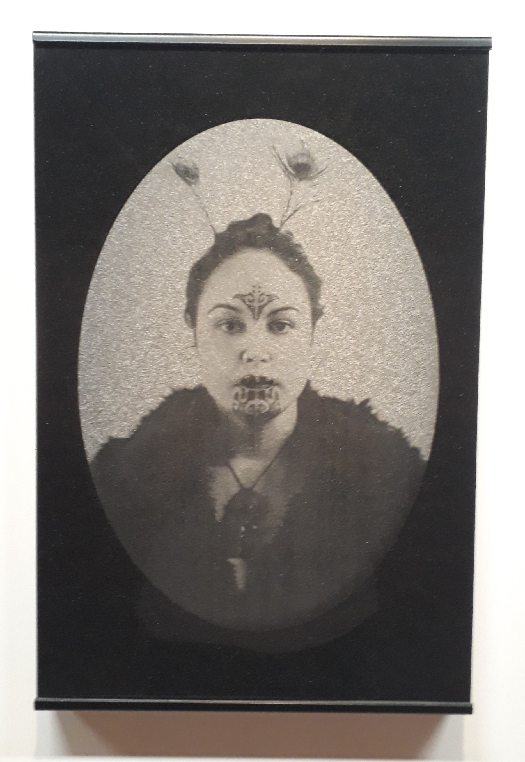
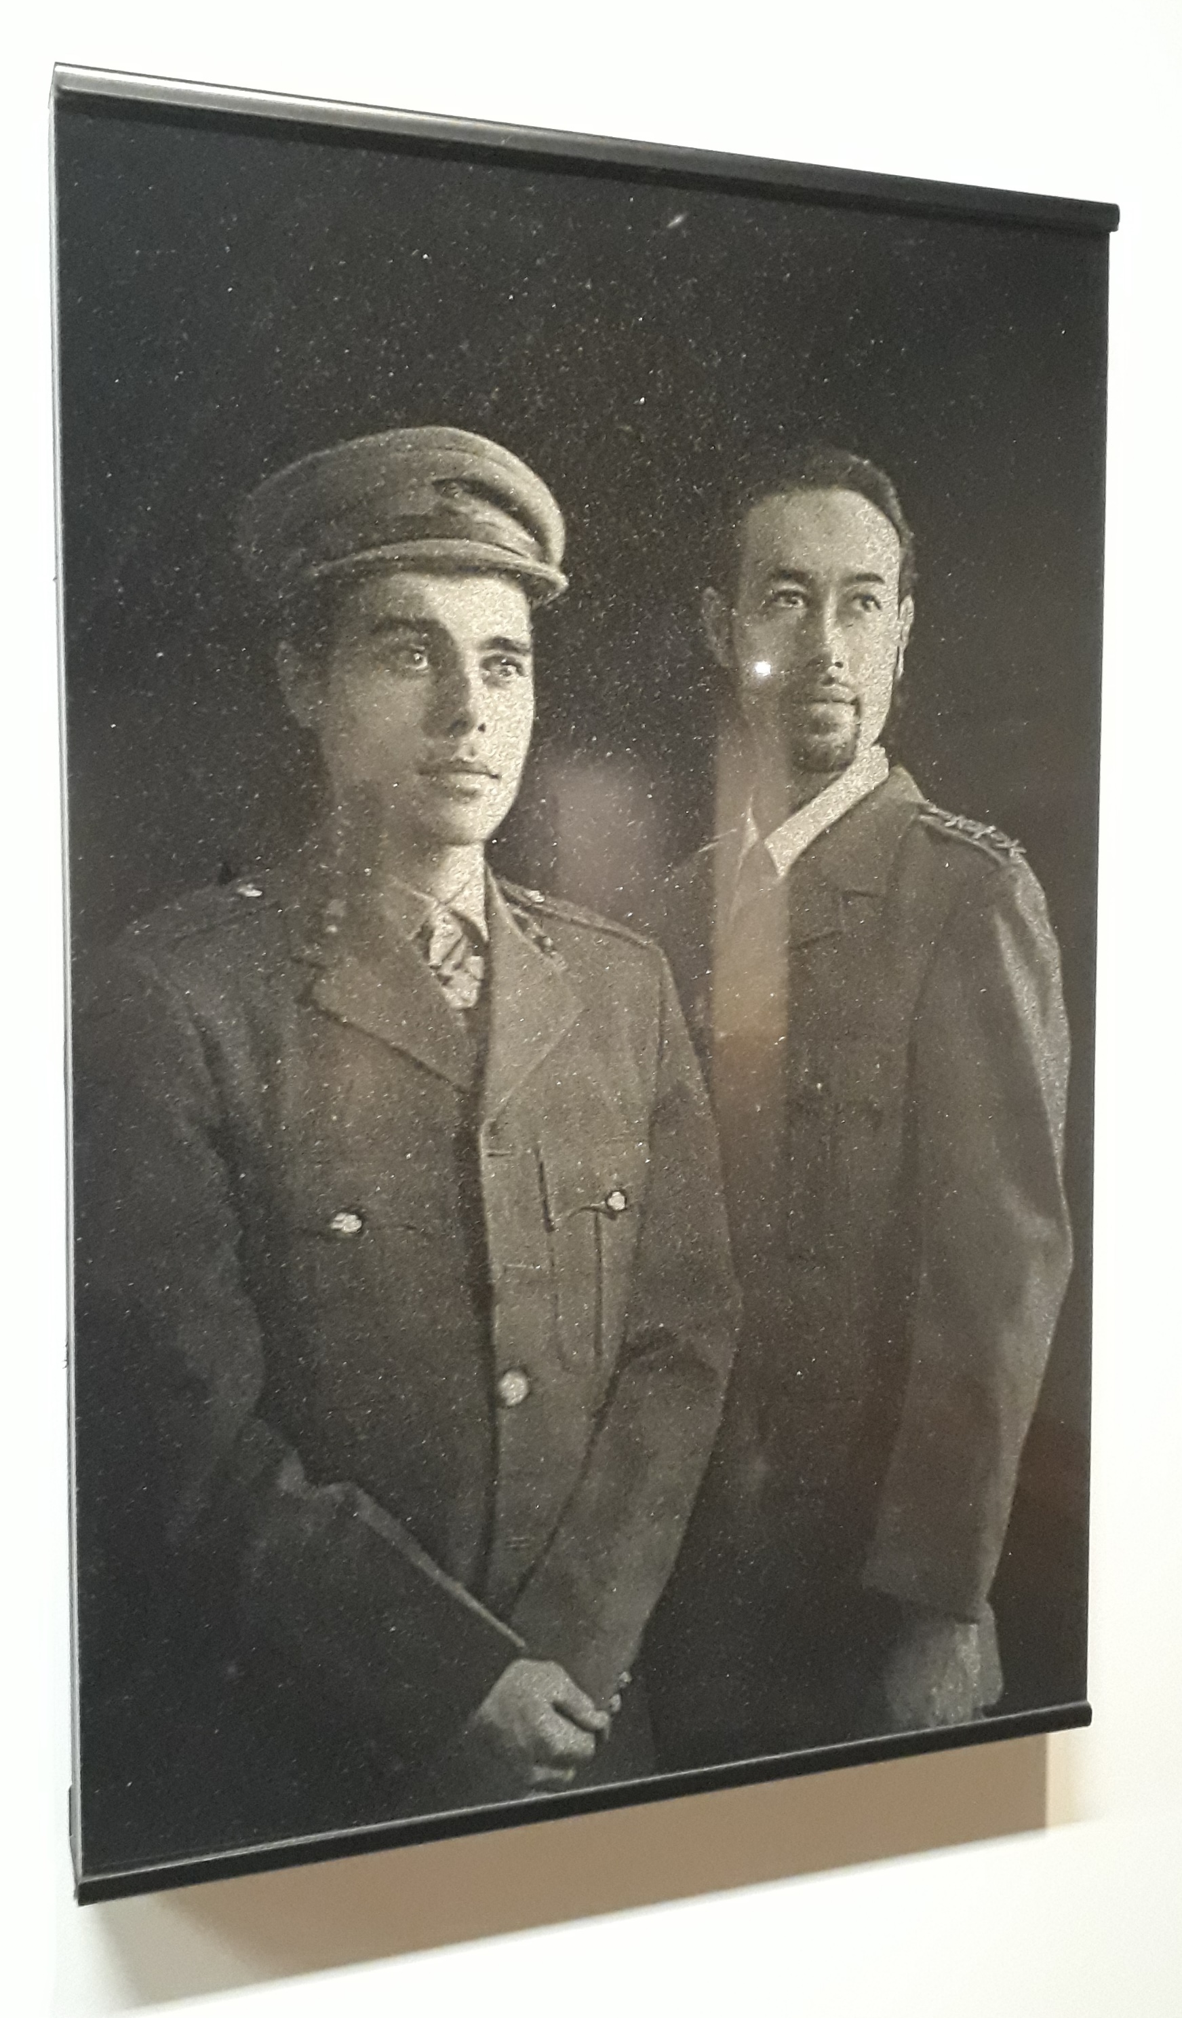

Slide 18
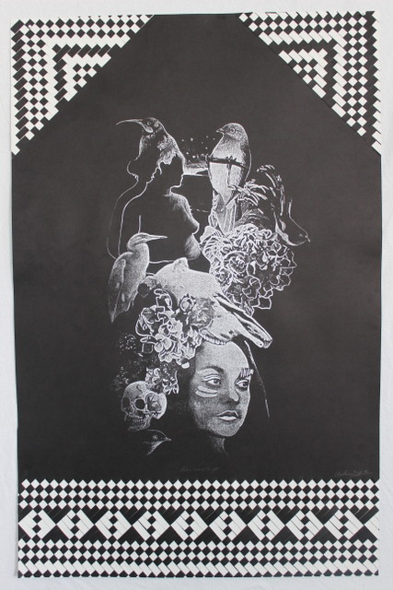
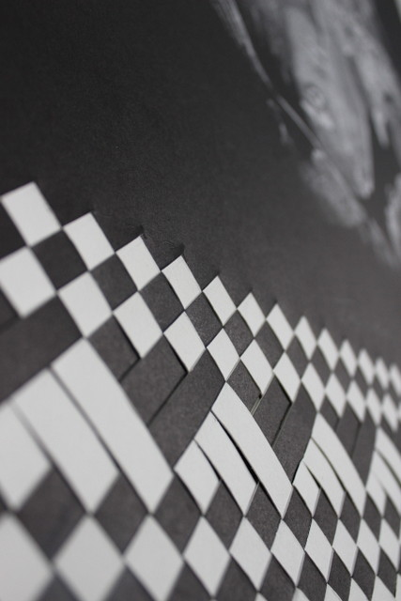
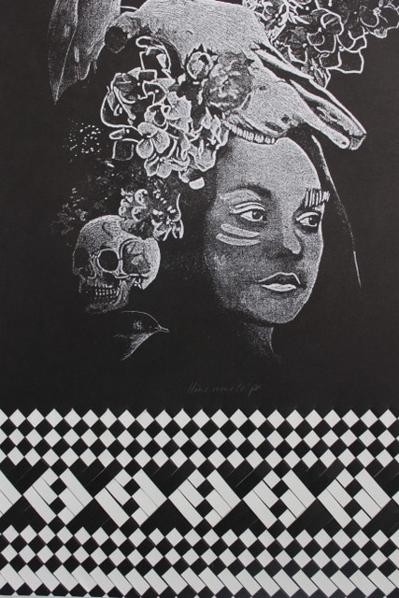
Vanessa Wairata Edwards

Slide 19
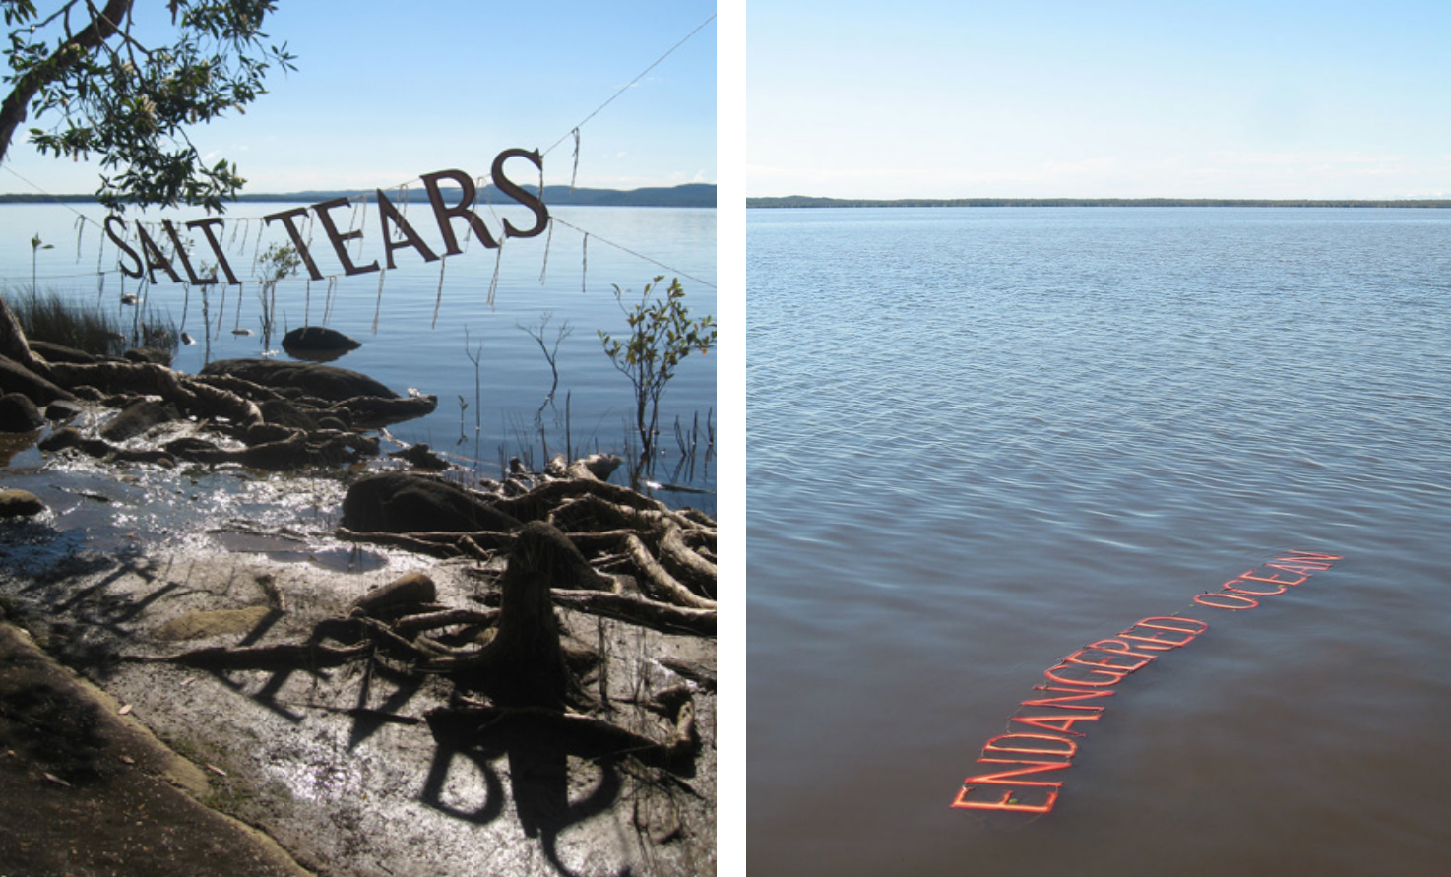
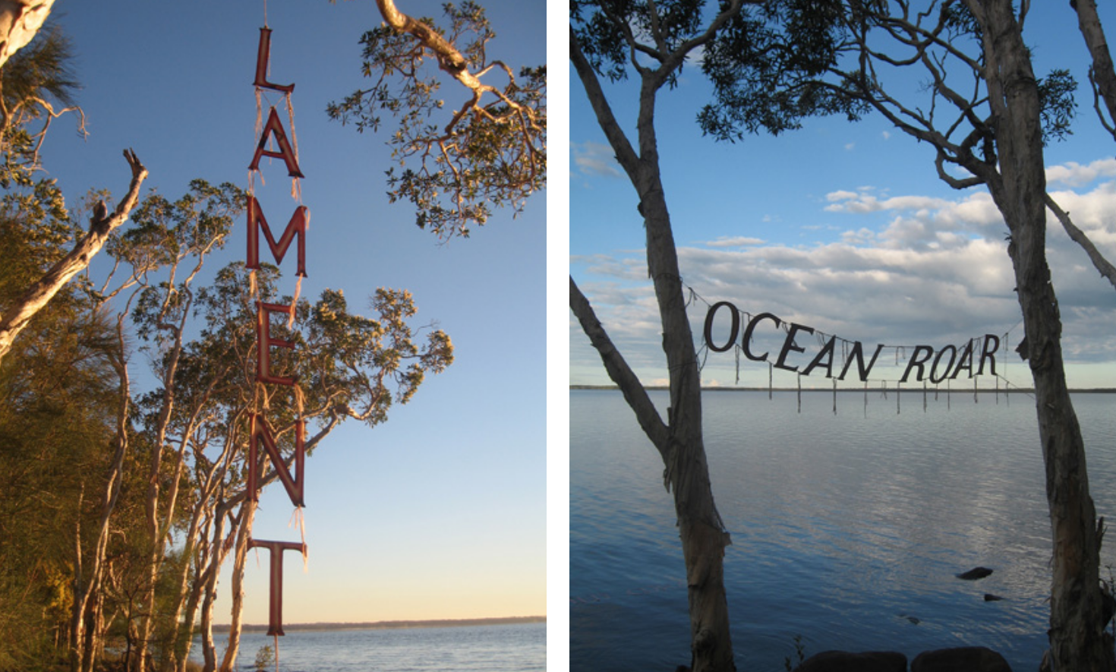
Virginia King – Word strings
2009
Floating land - Rising Seas.
Created during the Artist and Writer's Symposium, Lake Cootharaba, Boreen Point, Noosa.
The twelve hand cut word-strings were floated in the lake, across the land and in the air. They allude to and re-float past histories of Lake Cootharaba; Aboriginal and Colonial.
My concept was to create strings of words, referring to our written culture. To assemble phrases that suggest past and present loss, combined with references about environmental neglect, global warming, the plunder of the oceans, rising seas, endangered coral reefs and storm wreckage. Before leaving New Zealand I had made a complete alphabet of plywood templates that we used for cutting the 200 or more characters needed to write the words.

Slide 20
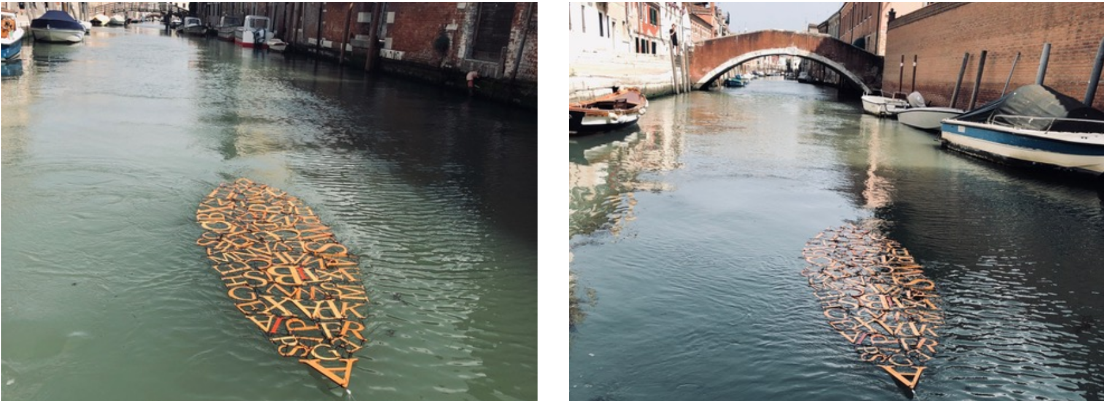
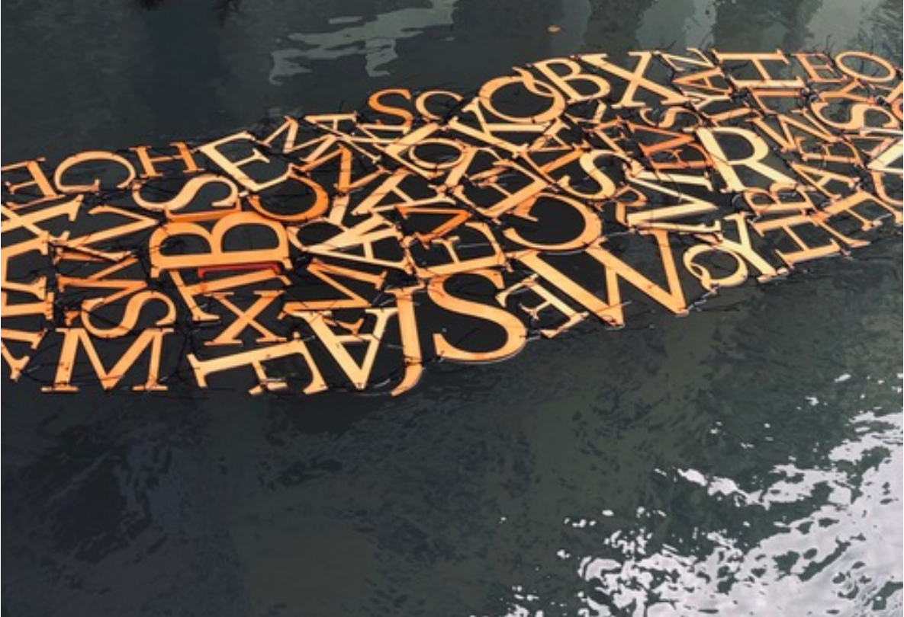
Virginia King, FLOATING ALPHABET, 2019
The assemblage of floating letters celebrates Venice as the heart of printing in the fifteenth century, when the Republic of Venice became the centre of the printing industry in Europe. The assemblage of floating letters alludes to the migration of language. The classical Roman characters are combined with and echo the characters in the Latin quotation PAX TIBI MARCE ENVANGELISTA MEVS, carved on the marble tablet beneath the paw of the Lion of Venice. This performance work was floated in the Canal di Sant’Alvise in June where it was photographed and videoed. Dimensions: Hoop pine plywood, natural and artificial fibres, acrylic and oil based stains.
Materials: Hoop pine plywood, natural and artificial fibres, acrylic and oil based stains.Dimensions: Lettere da Venezia. Length 3.200mm

Slide 21
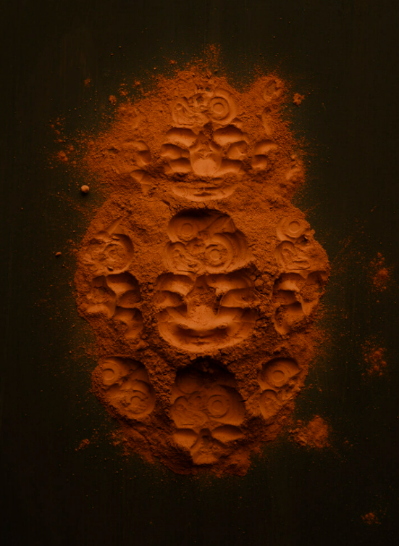
Tessa Williams, #It’sNotAboutATie, 2021, (merit award in the The Kiingi Tuheitia Portraiture Award 2021)
Tessa Williams on #ItsNotAboutATie
https://www.youtube.com/watch?v=PJPSurYUaSw

Slide 22
Theme of your artwork
Super Heroes
Villains
Nuclear testing in the Pacific
Protecting NZ fisheries
Kauri dieback
Kaitiakitanga
Mana
The Gods
Maui
Māori Rongoã - medicinal plants
Cultural appropriation
Select a theme from the following list:
Tiriti o te Waitangi
Treaty claims
Treaty protests
Treaty settlements
Parihaka
Land wars
Te Reo
Matariki
Tūrangawaewae
Colonisation

Slide 23
Research your chosen theme
Create a list of words in Māori and English related to your theme.
Think of 10 objects that you can push into the clay to make an impression related to these words
Collect what you need to make an impression in the clay
E.g. Māori Rongoã - medicine plants theme – I could use a toy stethoscope, a syringe, Kawakawa leaves, and lettering to spell the word “Hauora”

Slide 24
Technique

Slide 25
Collecting
Using the plants, flowers, seeds and leaves, 3D letters from the $2 shop and other objects, Lego, toys, dolls, plastic tikis etc….
You can use gladwrap as a barrier between your object and the clay, most items will need to be washed and soft objects like leaves might be destroyed in the process.
Remember to follow tikanga when harvesting native plants. Māori usually say a karakia (prayer) when harvesting leaves for use. In the karakia, thanks is given for the plant as well as asking that no harm come to the plant, to the harvester or to whoever will work with the cut material or the finished article. The karakia focuses the mind on the task at hand and acknowledges that plants are a taonga.
The discarded leaves can be returned to the ground to compost. Cut the scraps into small pieces as composting takes a long time. Traditionally plant scraps were returned to the ground by the bush they were cut from. A more recent trend is to compost the scraps in a place away from the original plant to avoid the spread of pests and diseases.

Slide 26
Watch the Demo in class and these Videos to get your head around the process
How to make imprints of plants/ KLEVER plaster cast plant fossils
https://www.youtube.com/watch?v=36xqDwp24wU
Fields of Gold / home art decor tutorial by KLEVER 11 min
https://www.youtube.com/watch?v=gBmdTVqcbNA&feature=youtu.be
Botanical Plaster Casting with Erica Devine 30 minutes good detail
https://www.youtube.com/watch?v=63F8gvuAB6w
DIY | Casting Flowers In Plaster | Clay Moulds |CRAFT IDEAS
https://www.youtube.com/watch?v=7fTxwIBuDSs

Slide 27
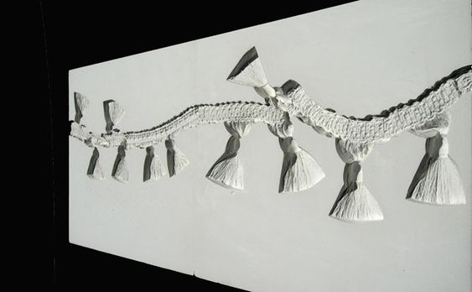
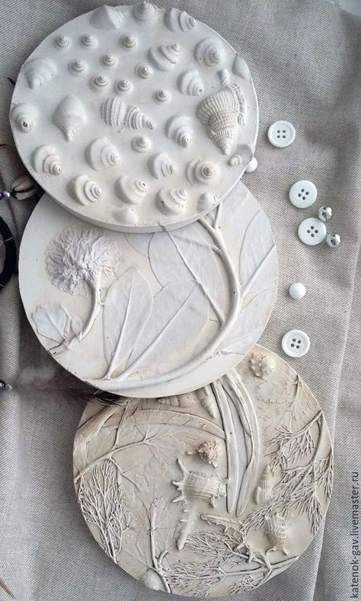
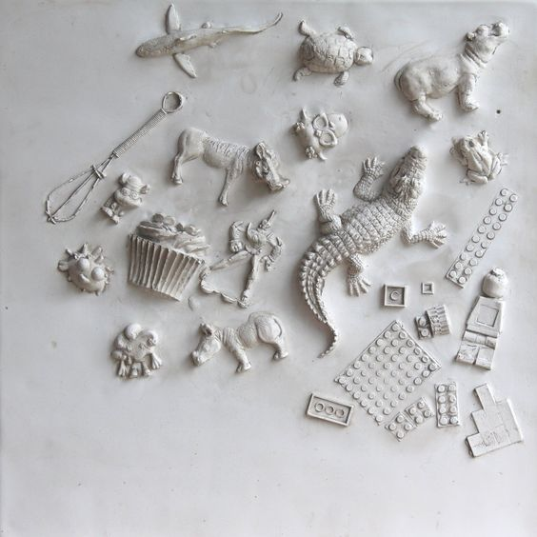

Slide 28
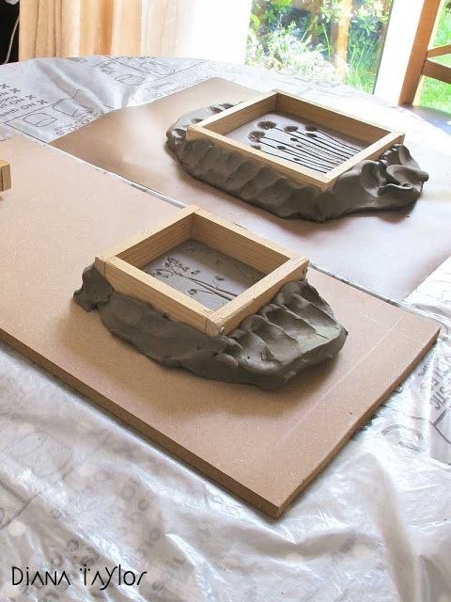
Impressing and Framing
Roll out a piece of clay insuring that it has a flat surface. Cut clay to the size of your desired tile, you will use these off cuts of clay to create a margin to hold the plaster later.
Remember to work backwards so your plaster cast comes out the right way.
Lightly impress your frame so you can see where to place your objects.
Organise your object into your composition.
Place a piece of baking parchment on top of your clay tile and a glossy lifestyle magazine on top of that. Apply firm but gentle pressure with the rolling pin, remove magazine and parchment straight away and check the indentations. At this stage you can carefully press any objects that haven’t gone in evenly but be gentle about this and try not to touch the clay.
Carefully remove the objects without damaging the impression. (for leaves and fine seedheads you can use a pair of tweezers, soft brush or sharpened ice cream stick to remove left over bits, flicking seems to work well). Again, be careful not to touch the clay as this could alter the smoothness of the surface.
Find existing frames or create a class set of frames – this creates a barrier to keep the plaster in place once it is poured, using your fingers to adhere these edging pieces to the tile so that it is proofed from possible leaks.
Arrange the objects and text backwards so it transfers the right way
Push the frame into the clay so it forms a tight seal
You can add clay to the outside
Mix your plaster according to instructions - ratio 2:1 of plaster to water. The success of plaster of Paris is all in the mixing. Add the powder slowly and evenly as you would decorating a cake. Tap the bottom of your container to distribute the plaster, mixing with a spoon for the last third of the mix, but do this gently, the chief aim of mixing plaster of Paris is to avoid air bubbles.
https://velvetmothstudio.blogspot.com/2020/05/plaster-cast-flowers.html

Slide 29
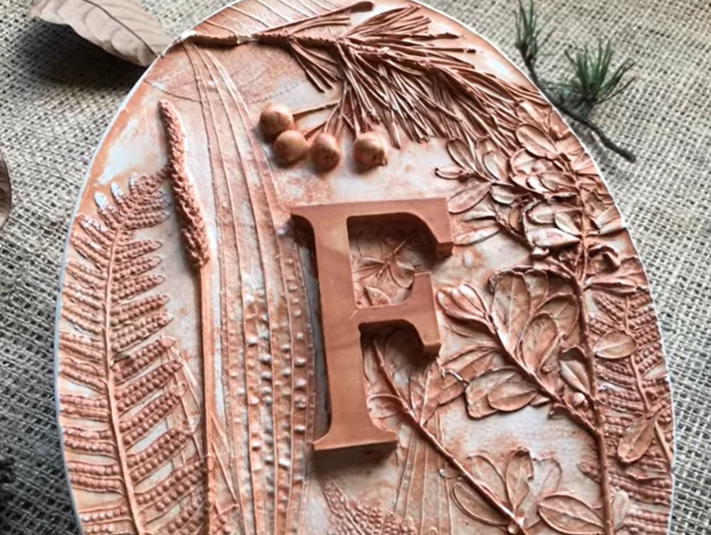
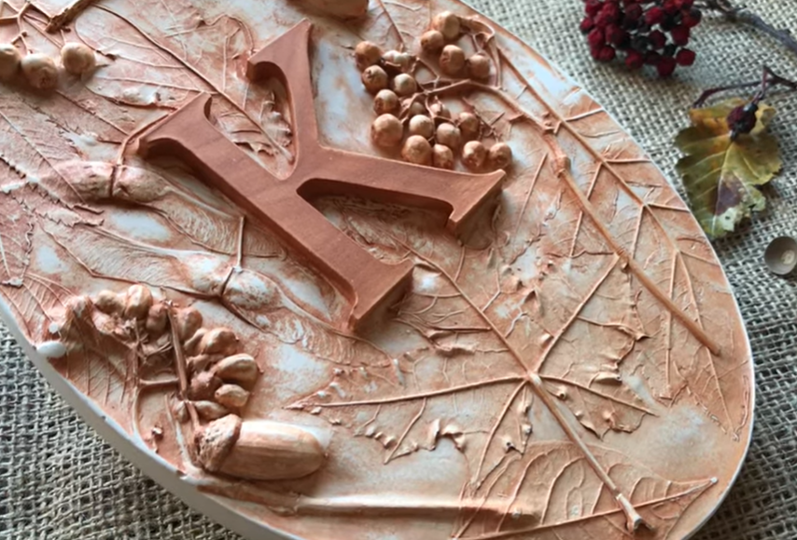
Pour the plaster of Paris mixture over your clay tile and leave to dry. This should take about 40 minutes at room temperature. When it feels set, gently lift away one of the side guards to check, when everything is set remove all clay from tile. When the plaster is dry, flip and peel the clay away from the plaster cast
With some water in a bowl and a dish cloth gently remove any remnants of clay from your plaster tile, remembering that a light touch is optimal as you don’t want to dull any of your flower details.
Leave to fully dry for a week, you can now sand around the edges for a straight tile,
You can leave the clay effect, or try cleaning it back to white or add paint to colour.
You can add a acrylic medium seal the final design

Slide 30
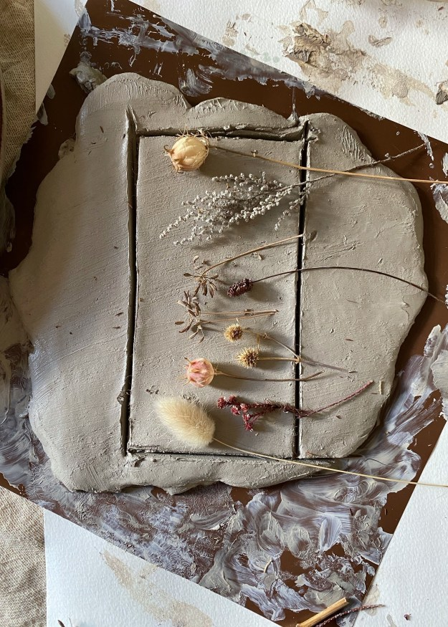
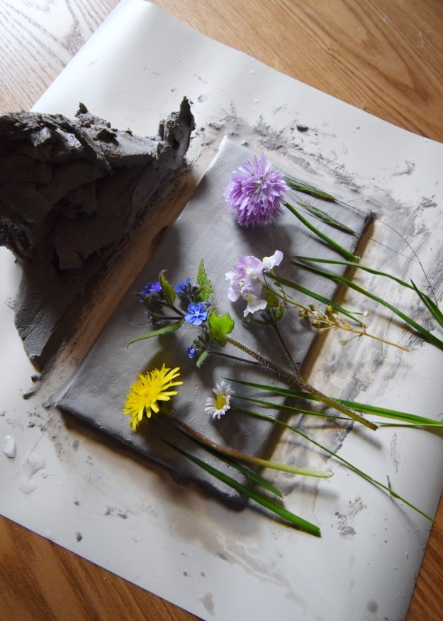
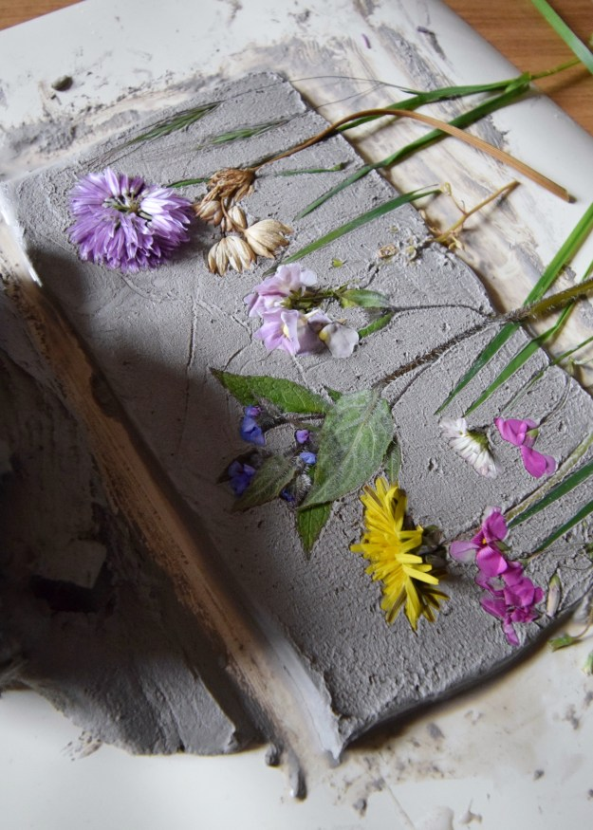
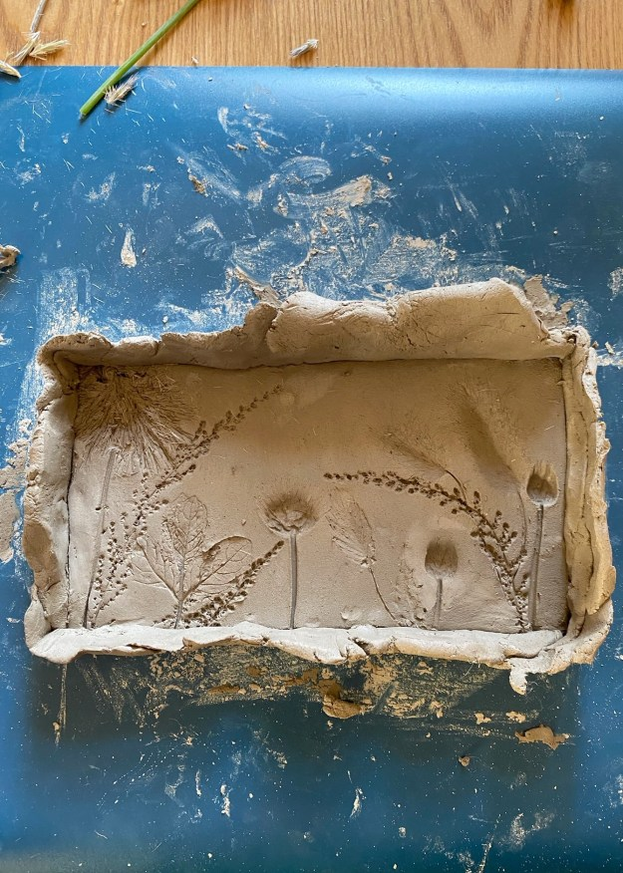
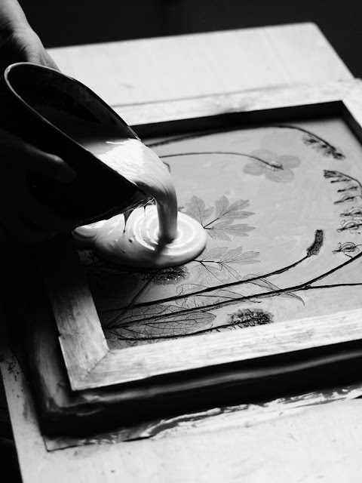
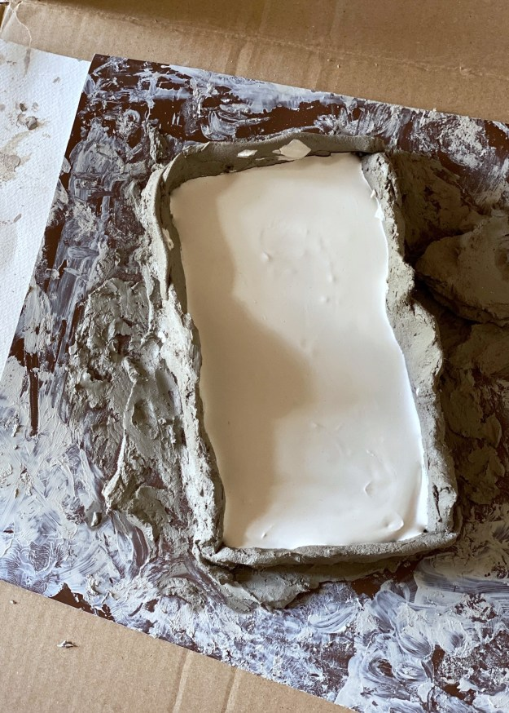
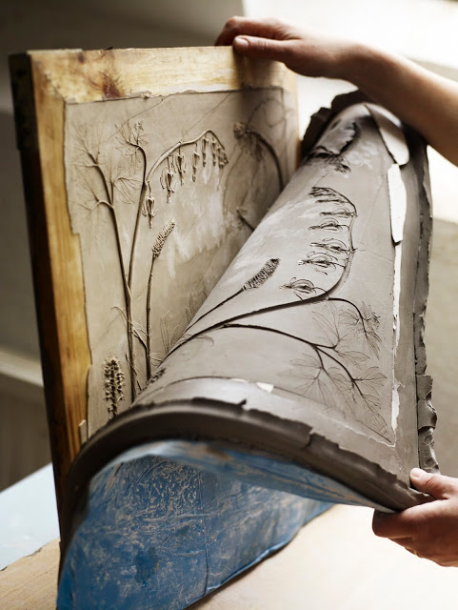
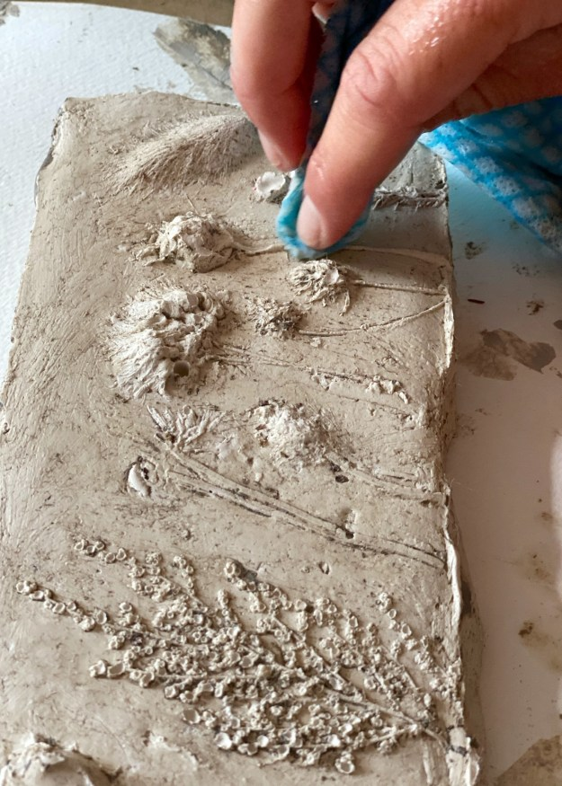
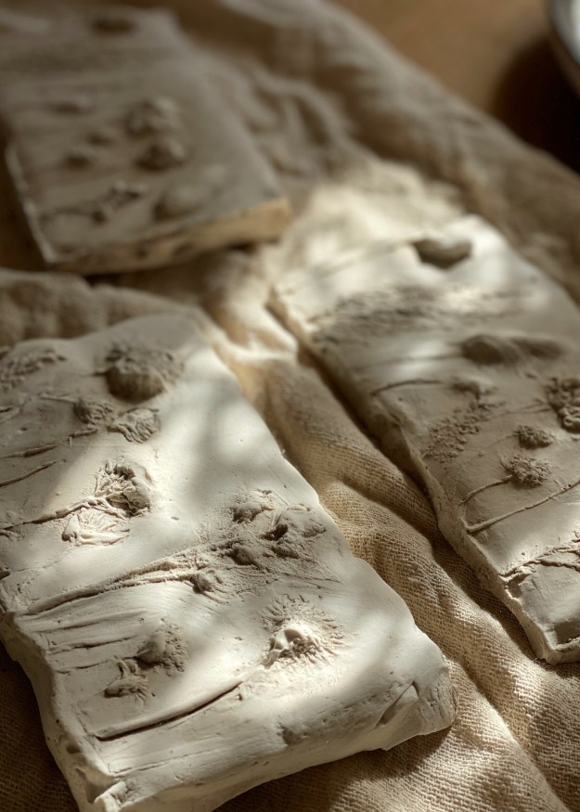
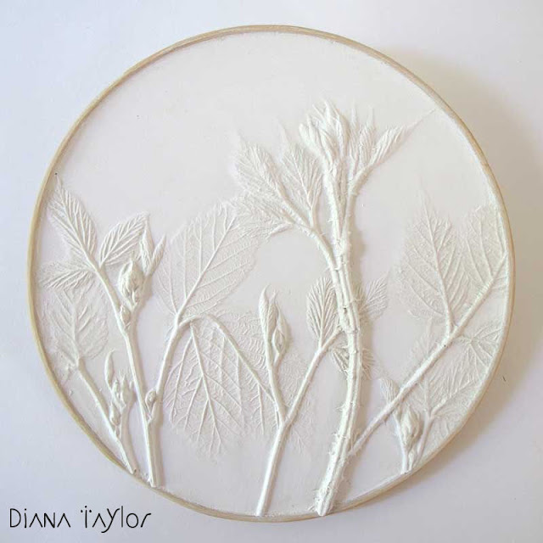
https://www.pinterest.nz/triffidgirl72/botanical-plaster-casting/

Slide 32
Natural versions

Slide 33
Cleaned versions

Slide 34
Painted Versions
https://www.pinterest.nz/triffidgirl72/botanical-plaster-casting/

