Slide 1
Whakapapa Portraits
Robin Kahukiwa - Personal heritage unit

Slide 2
Whakapapa
The Māori story of creation gives us some sense of our beginnings, and while each culture has different versions of this – and even variations within cultures – there are also commonalities which bind us.
In the beginning was Te Kore (the void, the nothingness), from which came Ranginui, the skyfather, and Papatūānuku, the earth mother. Ranginui and Papatūānuku held each other in an eternal embrace, which meant, for their numerous children, it was eternally dark, forever night (Te Pō).
They were surrounded by their children, namely:
Tūmatauenga – Atua of ‘man’ and war
Tawhirimatea – Atua of the elements (e.g.: wind etc)
Haumiatiketike - Atua of uncultivated or natural foods
Rongo-mā-Tane – Atua of peace, balance and cultivated foods
Rūaumoko – Atua of the unborn child (e.g.: in the womb, underground, God of volcanoes and earthly movements)
Tangaroa - Atua of the sea and its creatures
Tāne Mahuta - Atua of man and forests, and all which inhabits the forests.
https://www.otago.ac.nz/maori/world/tikanga/whakapapa/

Slide 3
Tāne Mahuta
Tāne was responsible for pushing his parents apart and letting in the light; thus from Te Pō came Te Ao Mārama (the world of light and dwelling place of humans). Tāne is also regarded by many as the starting point of our whakapapa, our genealogy, for it was Tāne who took earth from his mother, Papatūānuku, and shaped it, breathing life into it (hence the phrase, “Tihei Mauri Ora”), thus creating the first woman from which all humans were born; Hine-ahu-one. We are, therefore, descendants of Tāne, and ultimately, Papatūānuku.
Whakapapa is derived from these beginnings. It is about our recitation of genealogy, our link to the land, which is the core of Māori identity, fixing people as part of an extended family. It is how Māori identify themselves within the constructs of iwi (tribe), hapū (subtribe) and whānau (family), describing our familial structures and relationships with others. Whakapapa is at the heart of who Māori are as a collective.
https://www.otago.ac.nz/maori/world/tikanga/whakapapa/

Slide 4
Māori society and structures
The spiritual connection derived from whakapapa through our links with the various Atua (i.e. Gods, deities), lays the foundation for our physical connections, including our familial and social structures. The similarities between the words which describe these familial structures and the words relating to birthing or being born are no coincidence.
https://www.otago.ac.nz/maori/world/tikanga/whakapapa/

Slide 5
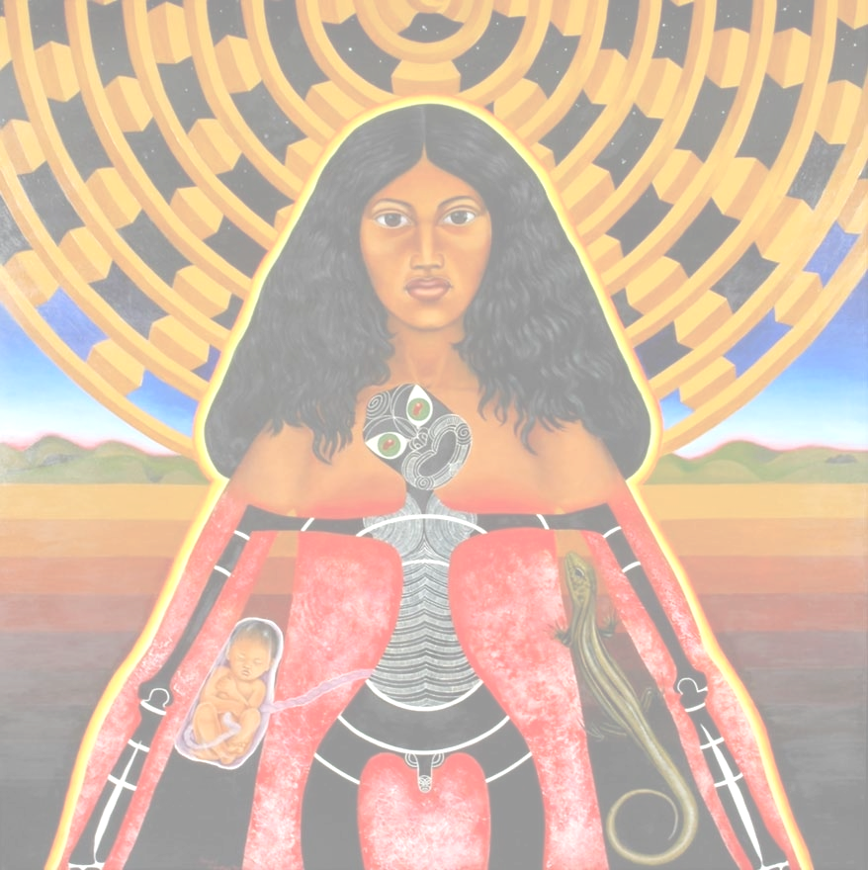
Ko Hinetītama, te whaea o te tangata, te wahine o te ata hāpara tērā, e mura mai ana i te mata o te whakaahua. Ko te peita tuatahi o te raupapatanga whai mana a Wahine Toa nā Robyn Kahukiwa e whakaū ai, e whakanui ai i te whakahirahiratanga o te mana wahine i ngā kōrero Māori tuku iho, kei te tōiriirihia te mana o te atua a Hinetītama, 1980 hei kaihanga o te ao mārama, o te tauoranga, o te orokohanga o te tangata. E ai ki ngā kōrero mō te hanganga o te ao, ka wehe a Hine-tītama i tēnei ao nā te putanga mai o te mōhiotanga ko tōna hoa moe a Tāne, ko ia tōna pāpā. Ko tāna ki a Tāne, ‘Ka haere au ki Rarohenga ki reira pōhiri ai, tiaki ai i ā tāua tamariki i ō rātou matenga. Ko Hine-nui-te-pō kē ahau ināianei.’
Kei waenganui e kongange ana, e whetē mai ana, ko ia te ihi e honohono ana i ngā apaapa 10 o tēnei ao me te ao o Rarohenga, me te taiao e kapakapa ana i waenganui. Ko Tāne, ko tōna pāpā me tāna hoa moe, he tiki pango; ko Māui te mokomoko nā tāna whakamokomoko i a ia anō i tāna ngana ki te tinihanga i tēnei mea te mate. Kei te noho ā-apaapa te atahanga me te tohutanga kia whakarauorahia ai e Kahukiwa i roto i tēnei peita whai mana, tēnei peita wā mutunga kore.
Hinetītama, mother of mankind, dawn maiden radiates out of the picture plane. The first painting from Robyn Kahukiwa’s powerful Wahine Toa series, which reinstates and celebrates the centrality of mana wahine (female power and authority) in Māori cultural narratives, Hinetītama, 1980 reverberates with the deity’s influence and significance as a creator of light and life, and the originator of mankind. Māori creation narratives tell us that Hine-tītama’s departure from the world of light was prompted by her discovery that Tāne, her husband, was also her father. She tells Tāne, ‘I will go to the underworld of Rarohenga where I will welcome our children when their earthly life is ended and care for them in death. I will be known from now on as Hine-nui-te-pō.’
Emblazoned in the centre and staring steadfastly at us, she is the interconnecting and generating force for the 10 layers of the overworld and underworld and the landscape pulsating in between. Tāne is represented in the black tiki figure, while Maui appears as a lizard – the disguise he adopted when he tried to triumph over death. These narratives sit layered in imagery and symbolism that Kahukiwa brings to life in this iconic and timeless painting.
View this work at https://nzhistory.govt.nz/media/photo/hinetitama-robyn-kahukiwa
Hinetītama, Robyn Kahukiwa, 1980, oil on board, 1315 x 1320 x 50 mm

Slide 6
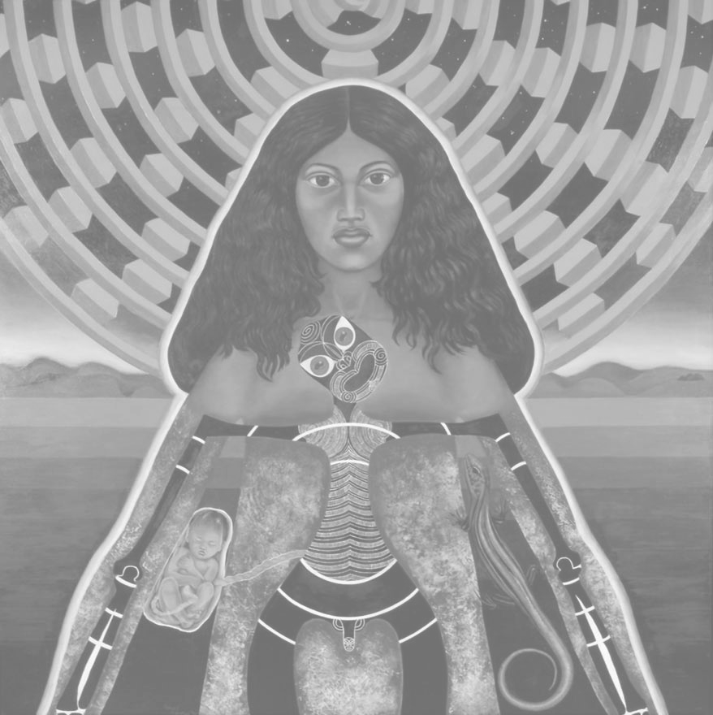
Analyse the painting and identify the symbolic and stylistic features (at least 5 for each)
Identify symbolic features
Lizard (meaning…..
Identify stylistic features
Hinetītama is facing us front on, directly meeting our gaze, she is the subject of the painting
Colours are natural in the background
View this work at https://nzhistory.govt.nz/media/photo/hinetitama-robyn-kahukiwa

Slide 7
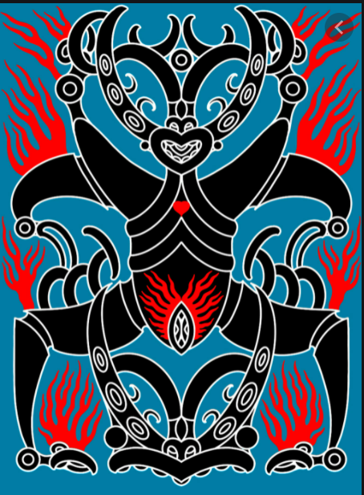
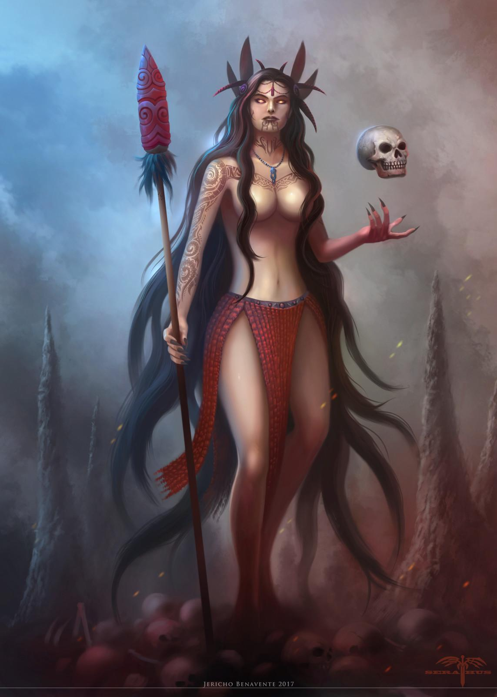
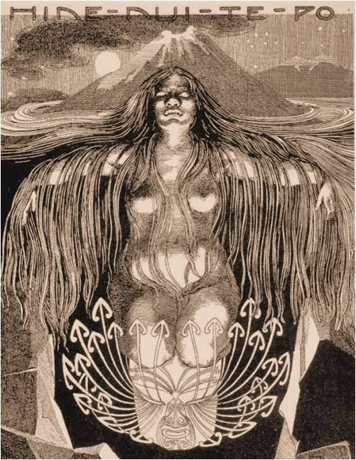
Hine-nui-te-pō
Wilhelm Dittmer
Tristan Marler
Jericho Benavente

Slide 8
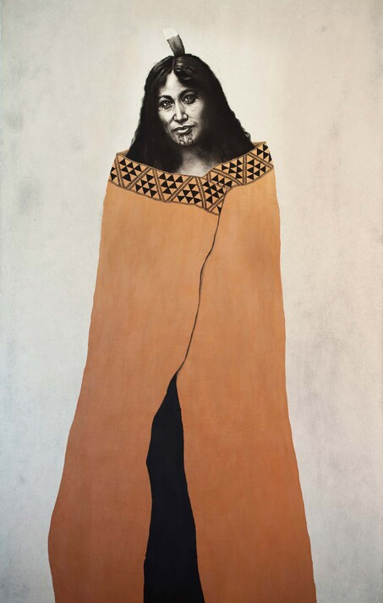
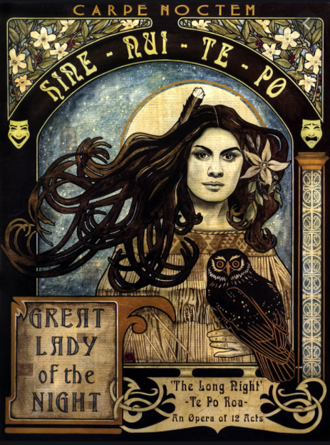
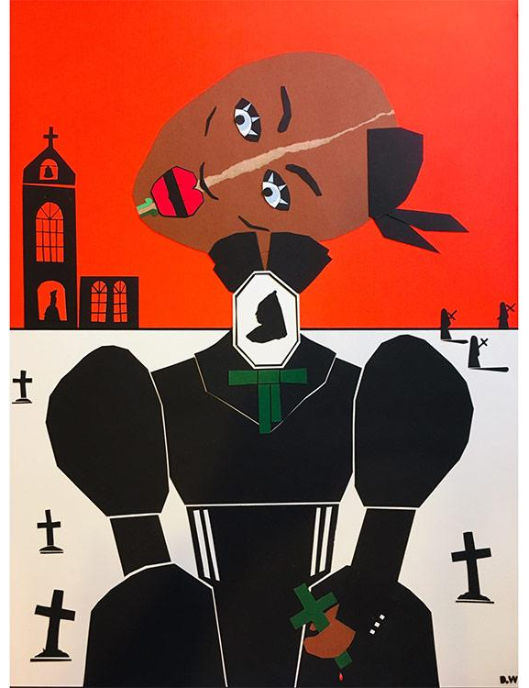
Sofia Minson
Sandy Rodgers
Hine-nui-te-po in Scarlet Ohara’s mourning dress
Dean Whittaker

Slide 9
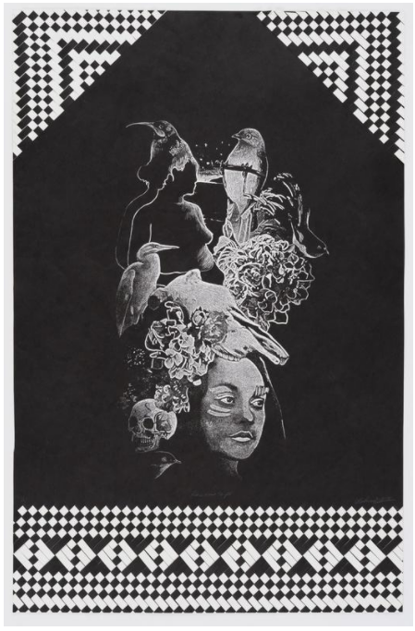
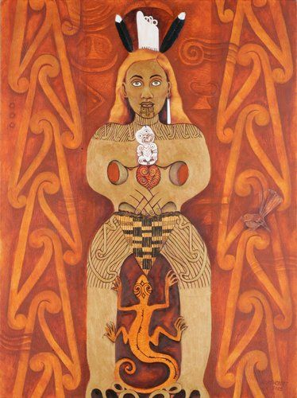
Hine-nui-te-pō
Vanessa Wairata Edwards
This series represents the female essence of Hine as expressed by the lineage of tīpuna wāhine (female ancestors): Hine-ahu-one, Hine-tītama, Hine-nui-te-pō. The artist’s titling of the series, Hine Kua Oho – Woke Wahine refers to the awakening of consciousness in body, mind and spirit within the respective stories of these atua wāhine (goddesses).
Vanessa Wairata Edwards is a printmaker and founding member of Toi Whakataa – Māori Print Collective. In these works, she has combined laser-cut technology and customary weaving techniques. By slicing and weaving into the black space that surrounds the central cameo, Edwards pays tribute to Hine-te-iwaiwa, spiritual guardian of childbirth, weaving and the cycles of the moon. In keeping with this female lineage the artist incorporates images of herself in these depictions of tīpuna wāhine.
Hine-nui-te-pō, di © June Northcroft Grant

Slide 10
Iwi (Tribe)
‘Iwi’ is a tribal structure that incorporates multiple hapū and a multitude of different whānau. It also means ‘bones’ (koiwi), the structures that support and strengthen iwi Māori. Because one is defined by one’s whakapapa, belonging to an iwi requires commonality of descent from a single ancestor or literally ‘from their bones’.
Traditionally, iwi only congregated for special occasions, festivities and in times of strife. Since the signing of the Treaty of Waitangi, many iwi have come together to recover and manage land and assets lost to them either through confiscation, war or legislation.
Contemporarily, iwi are recognised tribal groups which come together to pursue economic, social, political and cultural goals and aspirations while adhering to cultural values according to tikanga.
See example explanations and information from Waikato Tainui and Ngāi Tahu
https://www.otago.ac.nz/maori/world/tikanga/whakapapa/

Slide 11
Hapū, Whānau, Whenua
Hapū (Sub tribe)
Hapū, which translates as sub-tribe, also means to be pregnant, to generate life. It expresses the idea of birth from common ancestors and incorporates the idea of growth. A hapū includes many whānau; indeed, membership to a hapū is based on familial ties and people may belong to a number of different hapū.
Traditionally, these extended family units formed closely for mutual benefit and familial allegiance. A lot of tribal resources were cared for by hapū who were given kaitiaki (caretaking) responsibilities for those resources; for example, mahinga kai (food gathering areas) and other resources such as pounamu (greenstone) may have been the responsibility of certain hapū.
Whānau (Family)
Whānau refers to one’s immediate or extended family, and also means to be born (i.e. the act of childbirth or being born into one's whānau). One is born into a whānau, which constitutes larger collectives known as hapū. Whānau also refers to descent from a common ancestor and it is within this smaller familial unit that certain responsibilities and obligations are both expected and upheld.
Membership to an iwi, hapū and whānau provide a sense of affiliation and belonging for Māori, as well as their tūrangawaewae (a place to stand). Given this, it is important to also note another dual meaning in the word 'whenua'.
Whenua (Land)
Whenua, the land that nourishes iwi, is also the name for the placenta, the organ that nourishes the unborn child. After childbirth, the placenta is often buried in a piece of tribal land, a process iwi Māori often refer to as, ‘whenua ki te whenua’, placenta returning to the land. This place has significance as the child grows, as it signifies a birthright, their tūrangawaewae.
All of these terms bind Māori as a group to the very structures which strengthen and sustain us, which ensure our survival, both spiritually and physically.
https://www.otago.ac.nz/maori/world/tikanga/whakapapa/

Slide 12
So, what does this mean for me?
Introducing ourselves in relation to our whakapapa
As you will now be aware, whakapapa is about our connections to people and our relationship with these people.
When we meet others, we listen out for clues about where they are from; a common land feature (e.g.: Ko Aoraki te mauka/Aoraki is my mountain – linking that person to the South Island, and most likely, the iwi of Ngāi Tahu) or a well-known name (e.g.: Ko Brooking te ingoa whānau/Brooking is my last name – linking that person to the East Coast of the North Island, and probably, the tribe of Ngāti Porou).
People, and therefore relationships, are the cornerstone to the essence of being Māori. When we stand to introduce ourselves, we tend to recite our pepeha (an introductory ‘speech’ – based on whakapapa – recited during mihimihi), which relays information about where we’ve come from and to whom we affiliate, using our affiliations to place and people.
Go to the Mihimihi/Pepeha part of the Te Reo Māori section for more information and to develop your own pepeha.
https://www.otago.ac.nz/maori/world/tikanga/whakapapa/

Slide 13
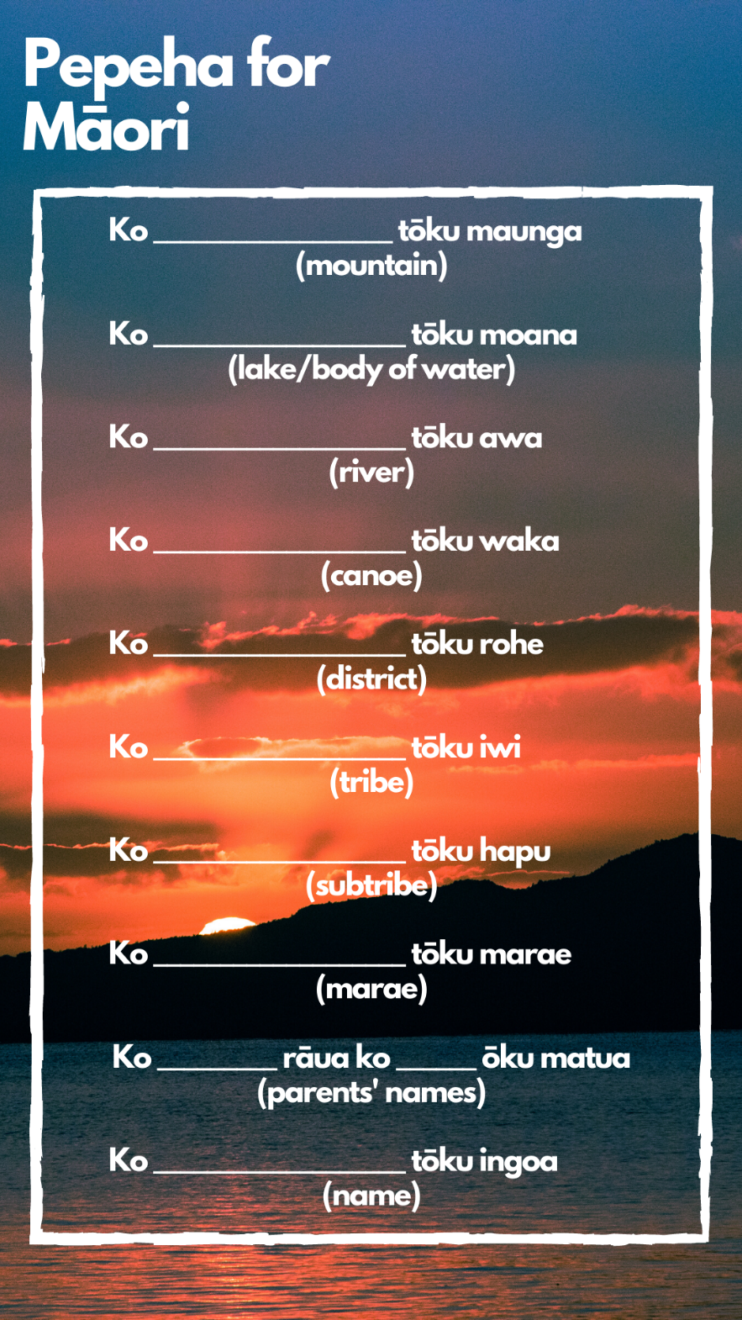

Slide 14
Planning your Whakapapa Painting
Create a slide show or an A3 word document in which you will collect between 20 and 40 images related to your ideas. This will be the imagery that you use to make your Whakapapa portrait composition.
My Atua - Search in books and on google and copy and paste imagery about my Atua to use as visual research when I am designing my artwork. Find at least 10 images (can include artworks, symbols, patterns, etc…..)
My Mountain, River, Beach, land that you feel connected to – this could also include a town, map, landmark, memorial, symbols from nature, flags,
Symbols of Place – nature, plants, Animals, insects, textures, objects
Relating to NZ/ International Art – Is there a significant art work or works that you want to make reference to in your Whakapapa portrait, an artwork on the wall of your home, or works related to your cultural heritage, cultural patterns, ancestry, an important location or time
Family pictures
Photos or carvings of your Ancestor/s that you want to focus on or images that represent your Ancestor
Symbols that represent your ancestor – objects that represent their work, life, interests, hobbies, passions, characteristics, culture, dress, fashion, background, time period, animal totem, DNA……..
See Miss Hansen’s slideshow example. Use your images to help develop your composition. Develop 3 to 5 thumbnails designs before sketching out your final design in pencil on A3 or larger paper or canvas.

Slide 15
See Miss Hansen’s example slideshow for visual research
When you have put together your own slideshow or word doc then use these images to help develop your composition for your painting. Develop 3 to 5 thumbnails designs before sketching out your final design in pencil on A3 paper. Look at how the following artist models have organised their compositions and select a compositional approach that will support your ideas

Slide 16
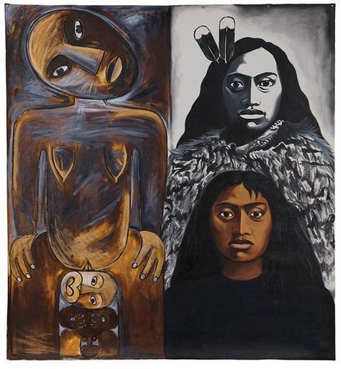
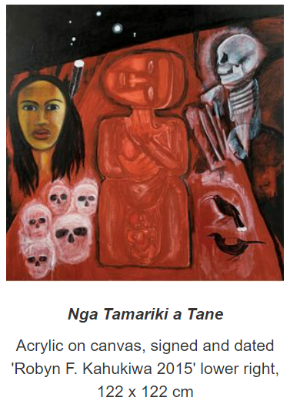
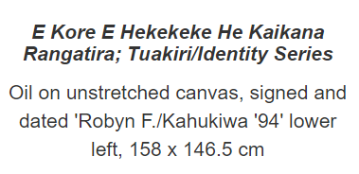
Compositional Ideas from Robyn Kahukiwa
2 or 3 Columns
Mix of real faces and carvings, symbolic elements used to frame or draw eye to focal points,
colours are harmonious / monochrome
B/W used to symbolise history or the underworld
https://www.aasd.com.au/index.cfm/list-all-works/?concat=kahukiwarobyn&direction=0&order=1&start=49&show=48

Slide 17
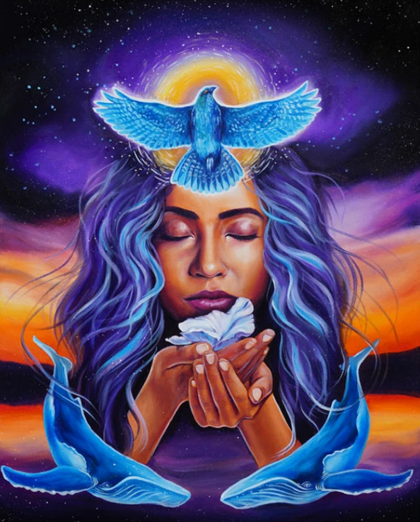
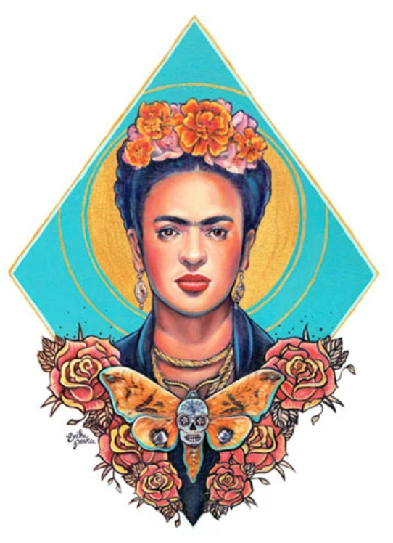
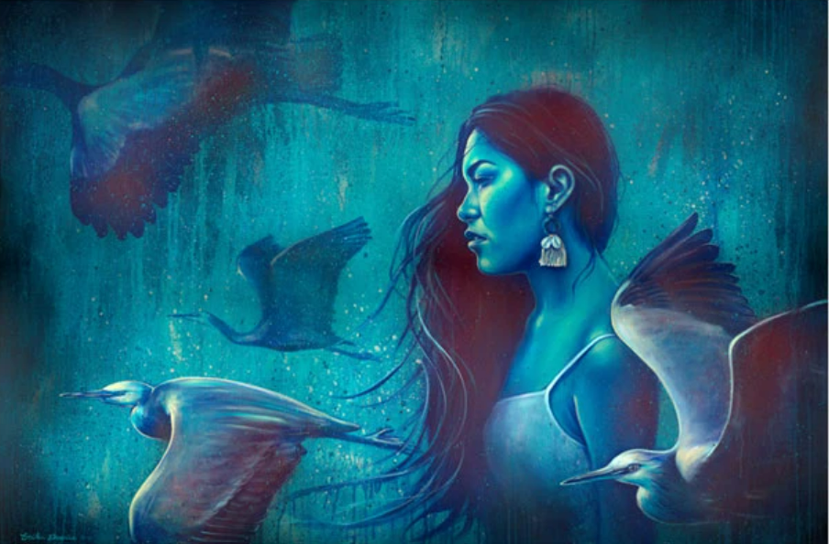
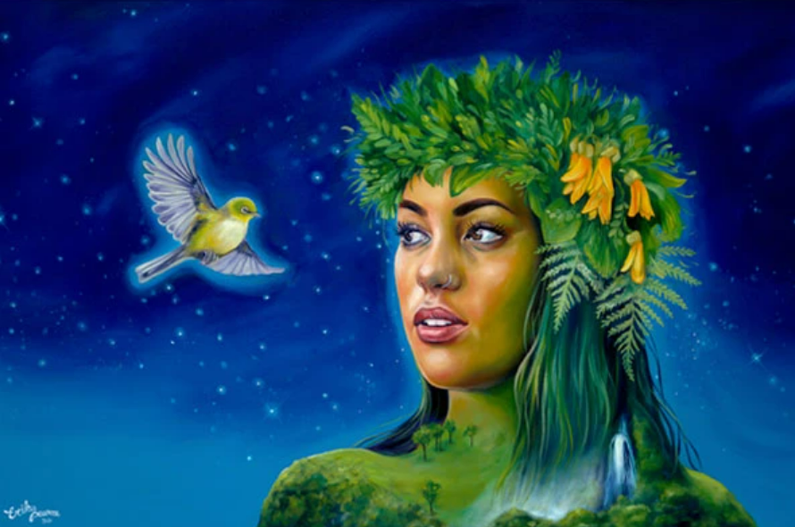
Erika Pearce
Landscape/ animal/ geometric background
Woman and nature symbols
Mirror imaging/ reflections in the foreground
https://erikapearce.co.nz/

Slide 18
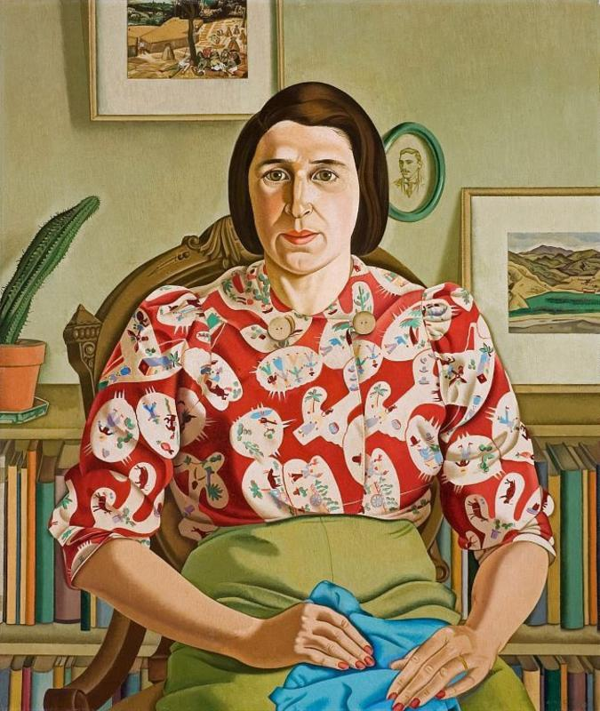
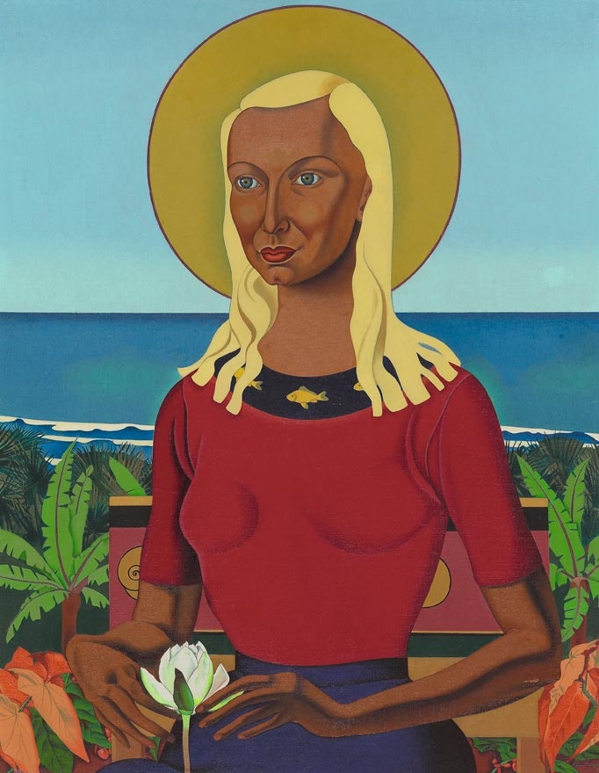
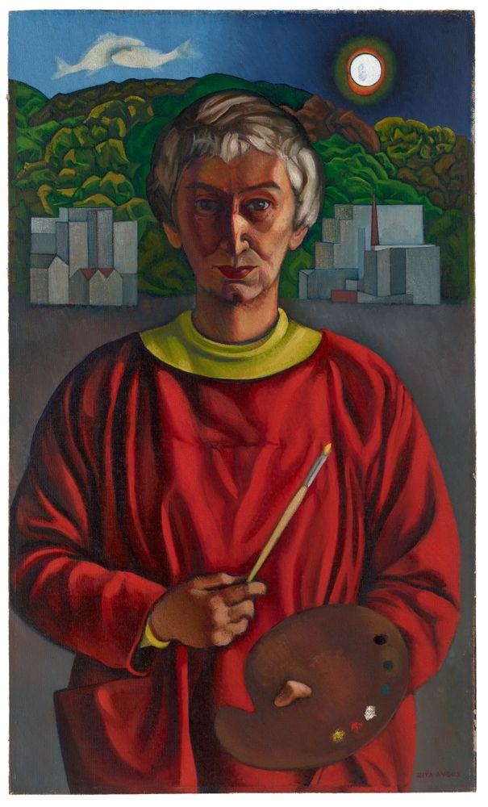
Rita Angus
https://teara.govt.nz/en/biographies/5a16/angus-rita
https://www.tepapa.govt.nz/visit/exhibitions/toi-art/rita-angus-new-zealand-modernist

Slide 19
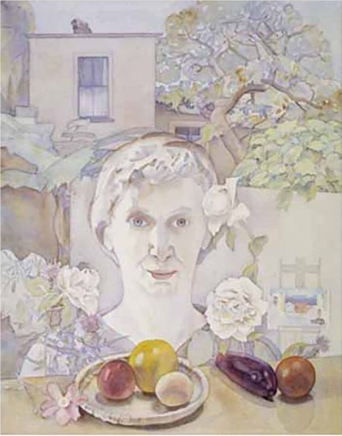
Rita Angus, Self-portrait with fruit, 1960-61, watercolour
https://collections.tepapa.govt.nz/object/330016

Slide 20
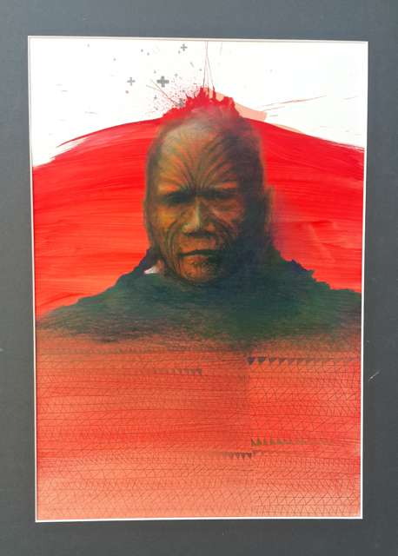
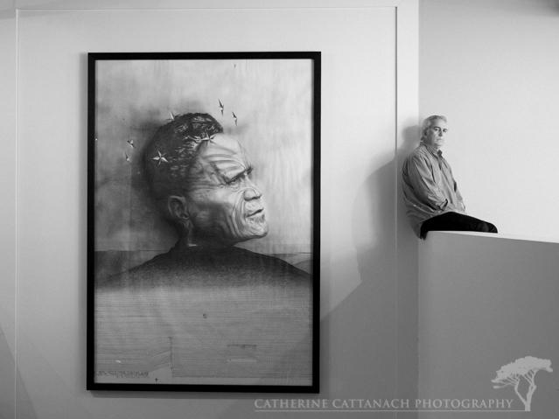
James Ormsby
https://www.whitespace.co.nz/artists/james-ormsby
https://www.aucklandartgallery.com/explore-art-and-ideas/artist/12006/james-ormsby?q=%2Fexplore-art-and-ideas%2Fartist%2F12006%2Fjames-ormsby

Slide 21
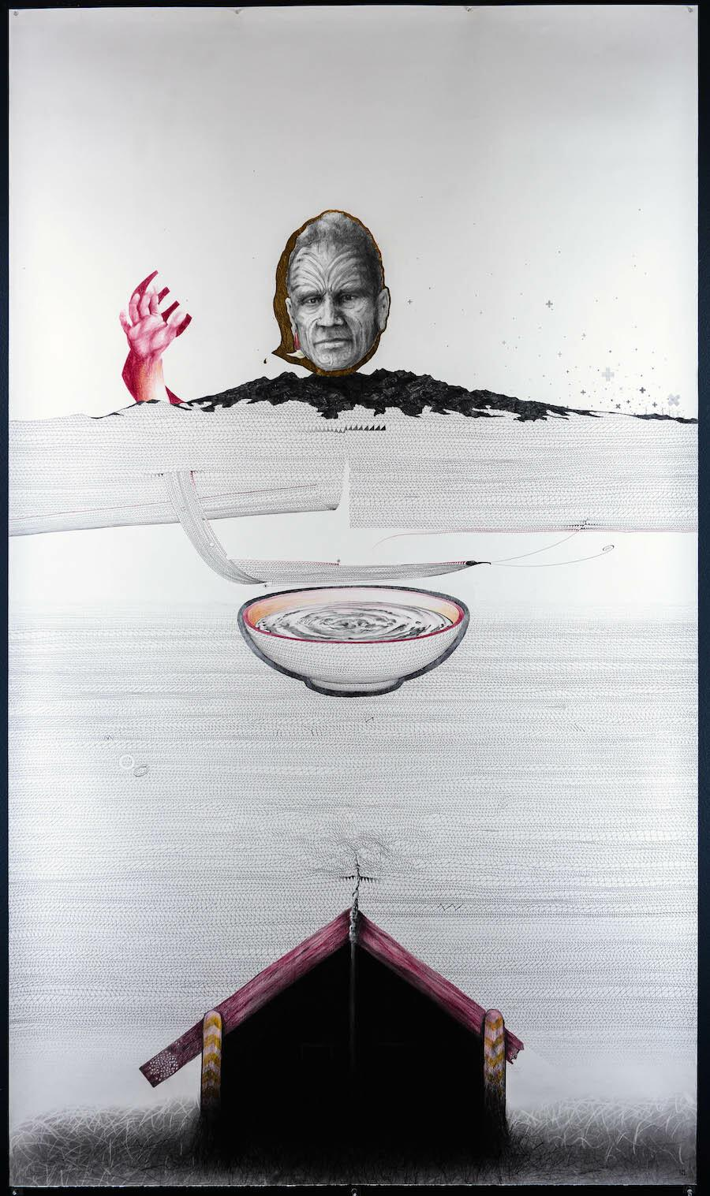
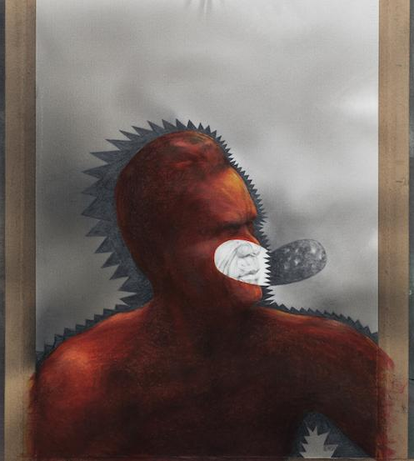
James Ormsby

Slide 22
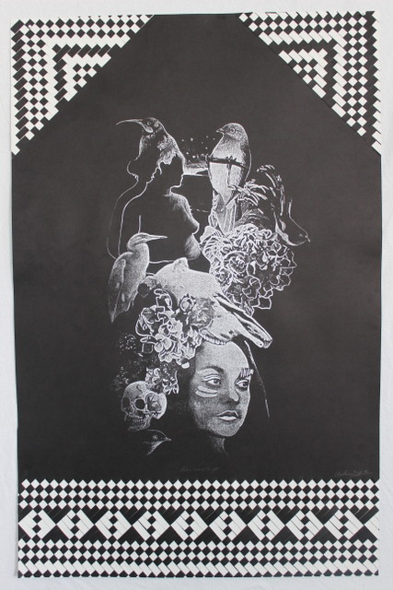
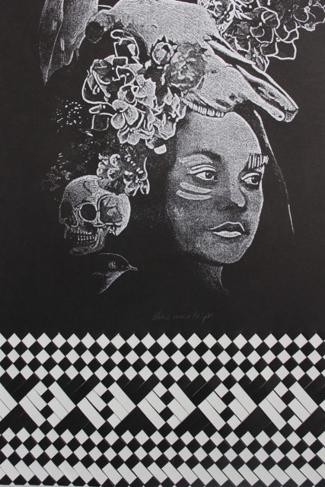
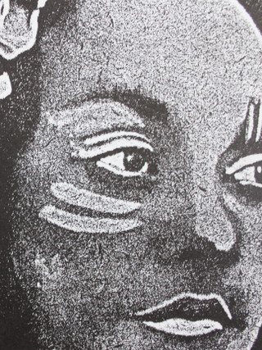
Vanessa Wairata Edwards
https://www.aucklandartgallery.com/explore-art-and-ideas/artist/11999/vanessa-wairata-edwards?q=/explore-art-and-ideas/artist/11999/vanessa-wairata-edwards
https://www.artformgallery.co.nz/blog/2019/6/21-vanessaedwards
https://www.thepoiroom.co.nz/collections/vanessa-wairata-edwards

Slide 23
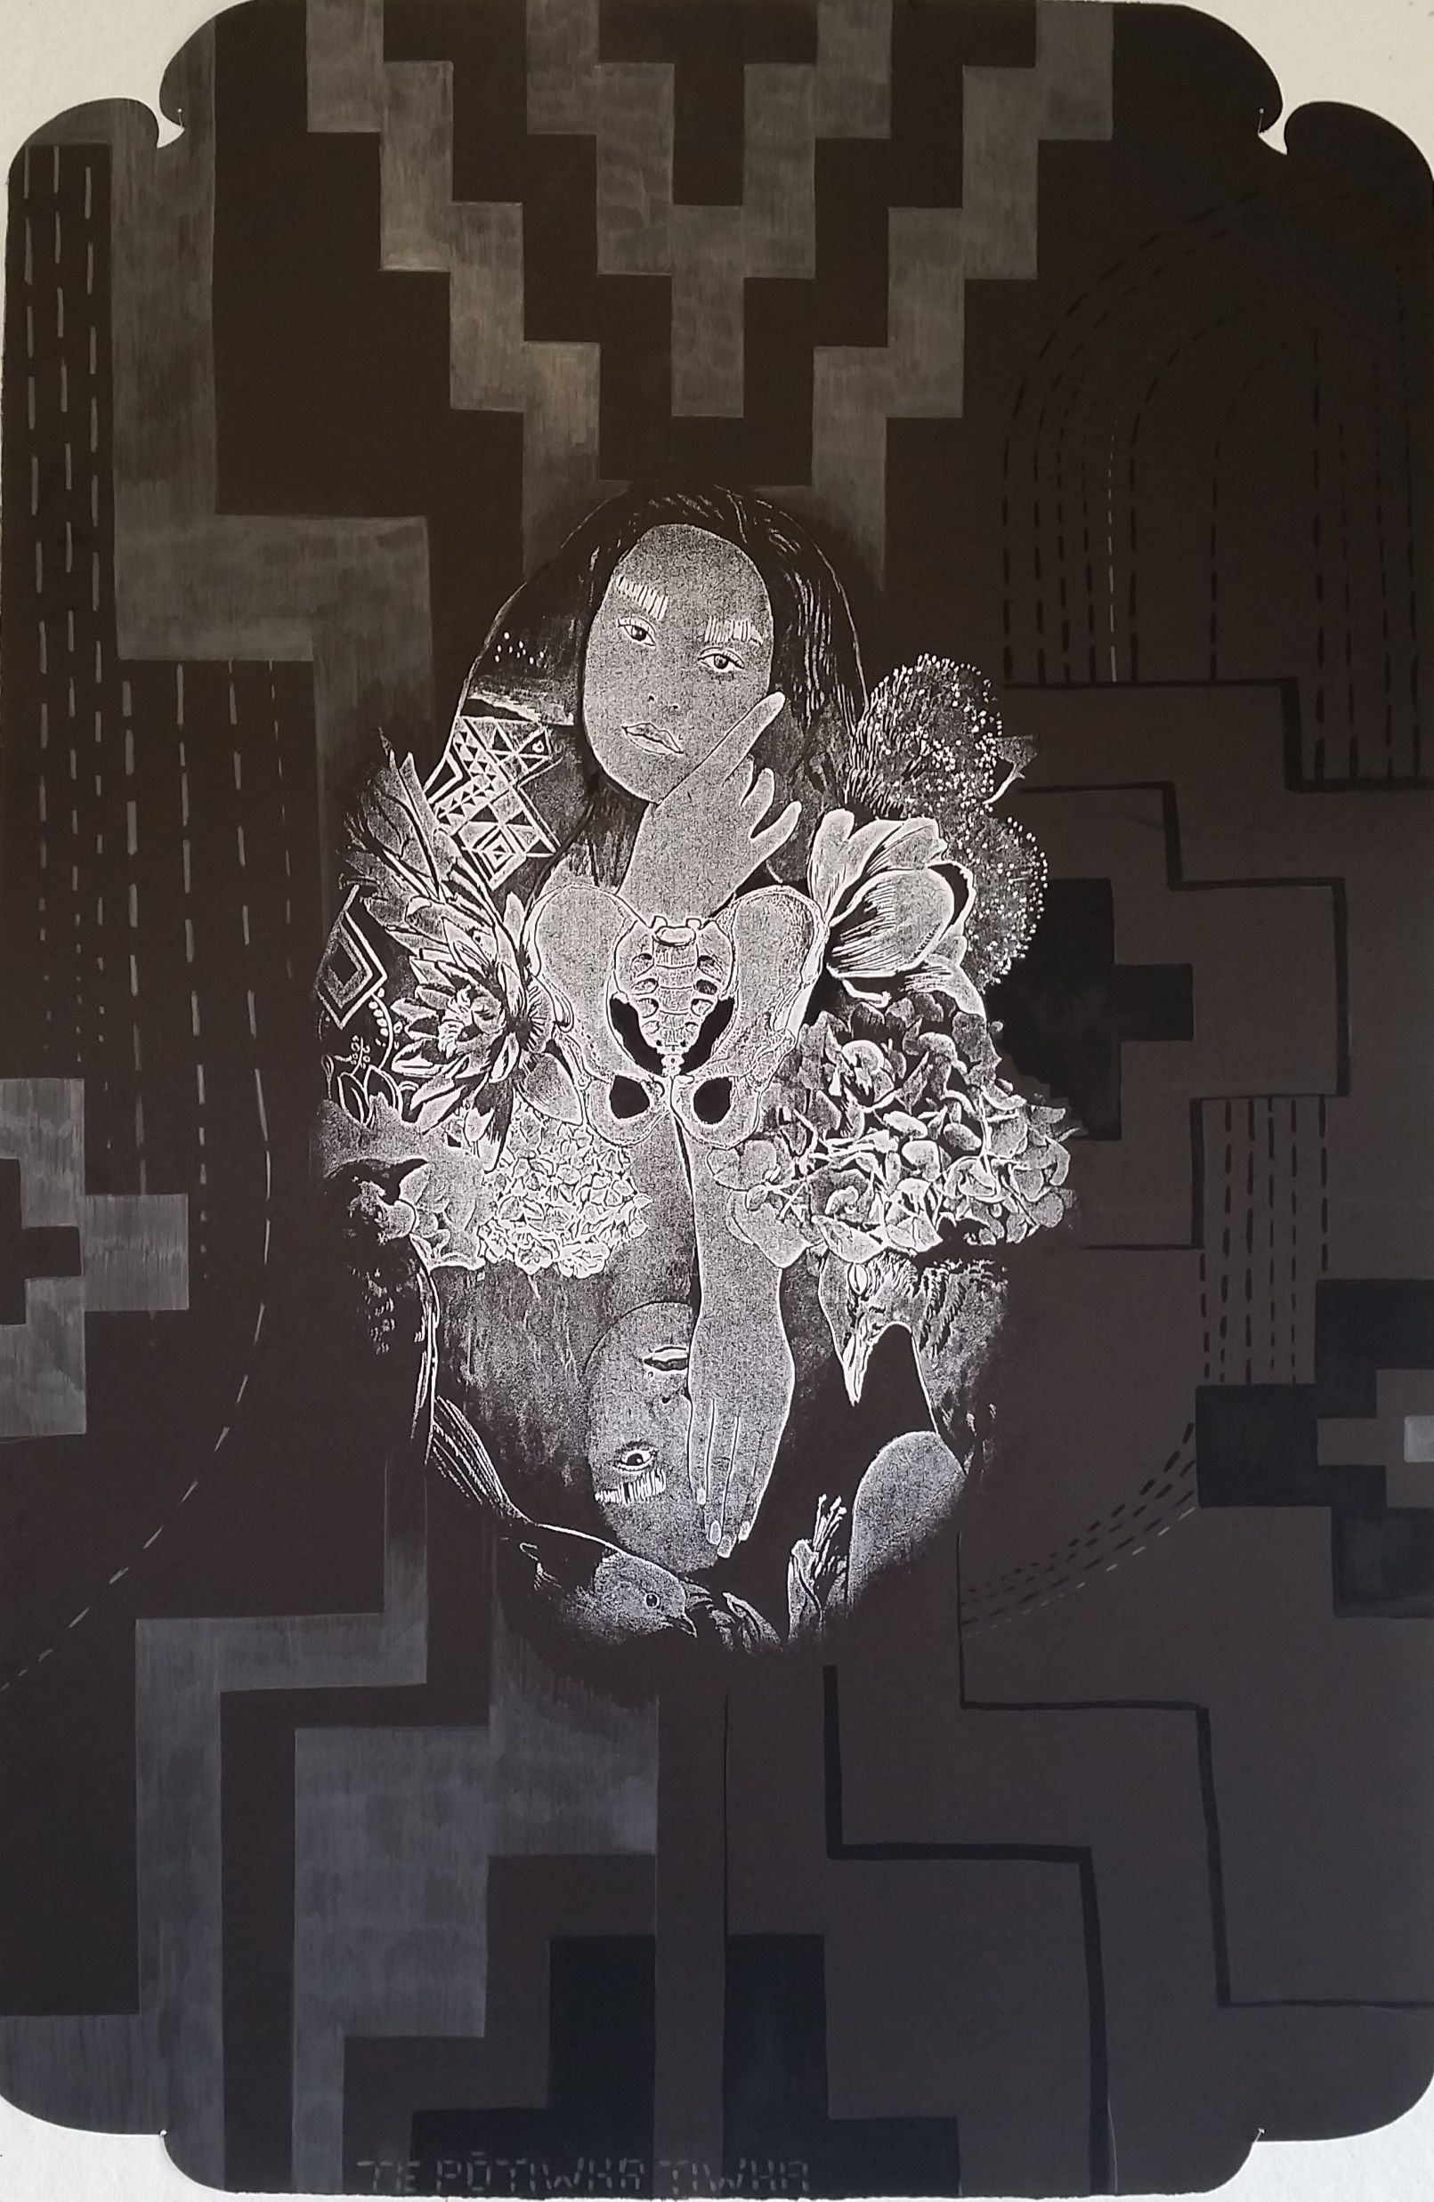
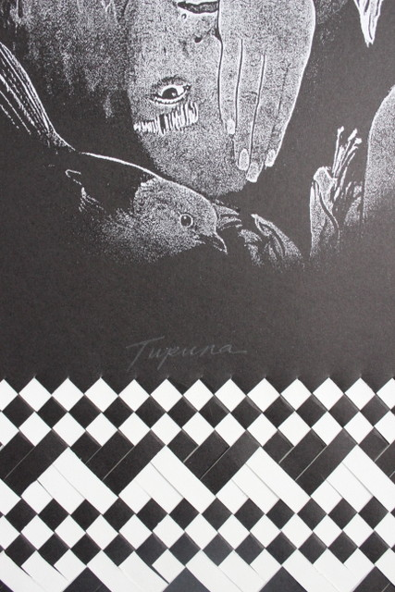

Slide 24
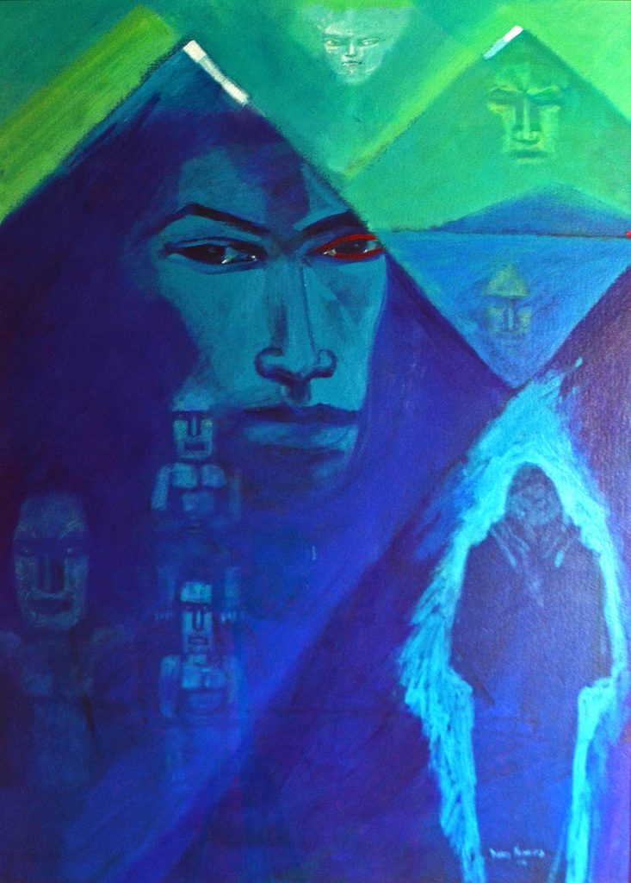
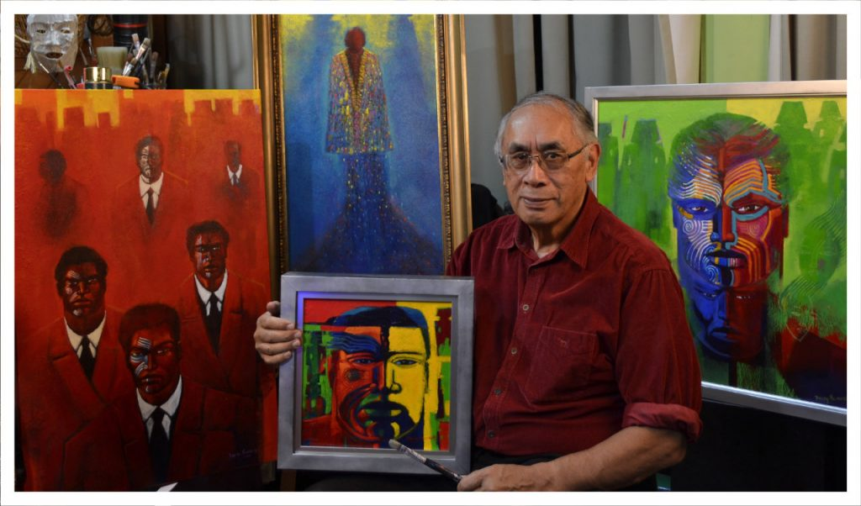
Darcy Nicolas
http://darcynicholas.co.nz/
https://www.kuragallery.co.nz/category/artists/darcy-nicholas

Slide 25
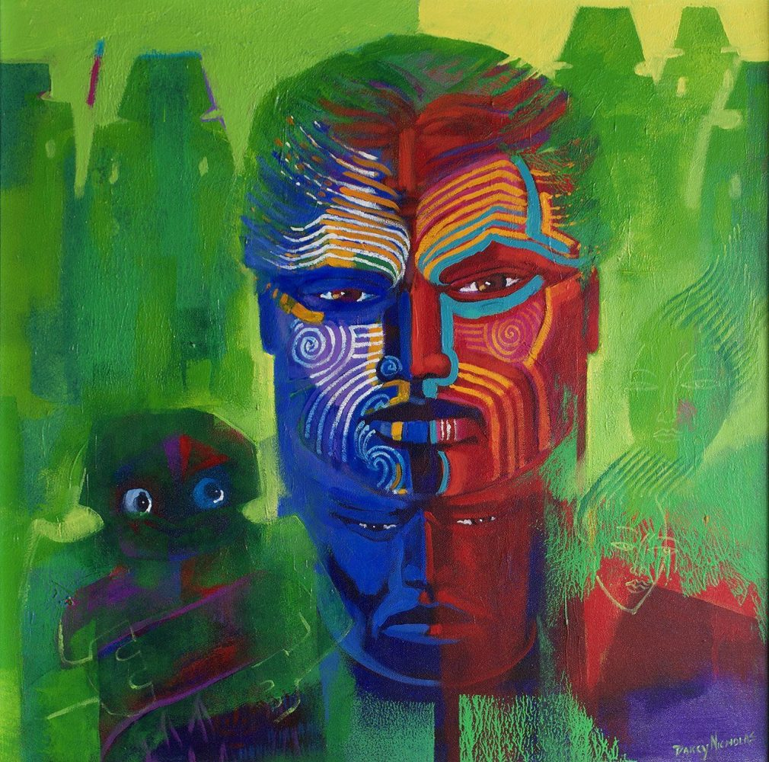
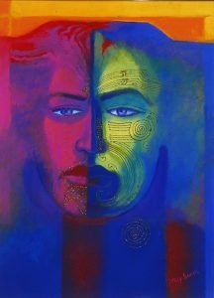
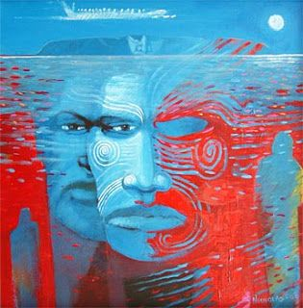
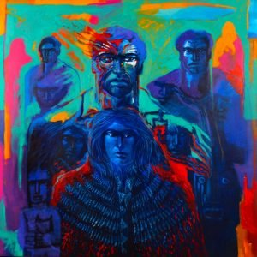
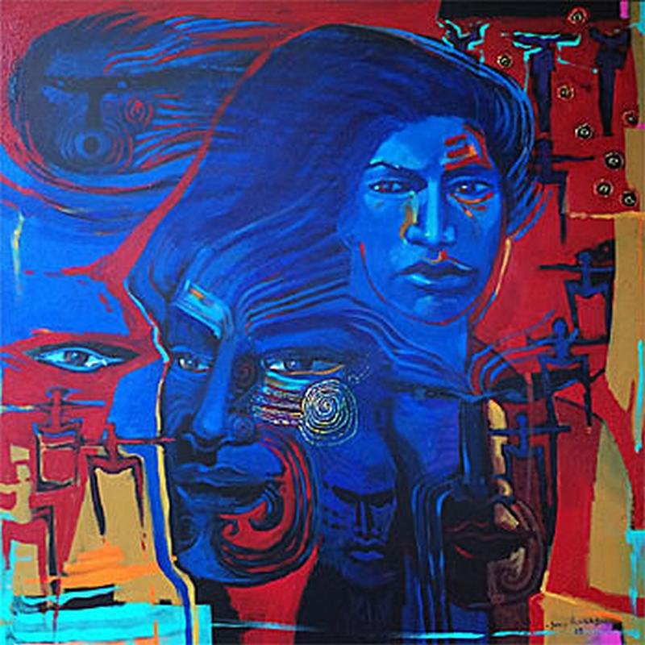

Slide 26
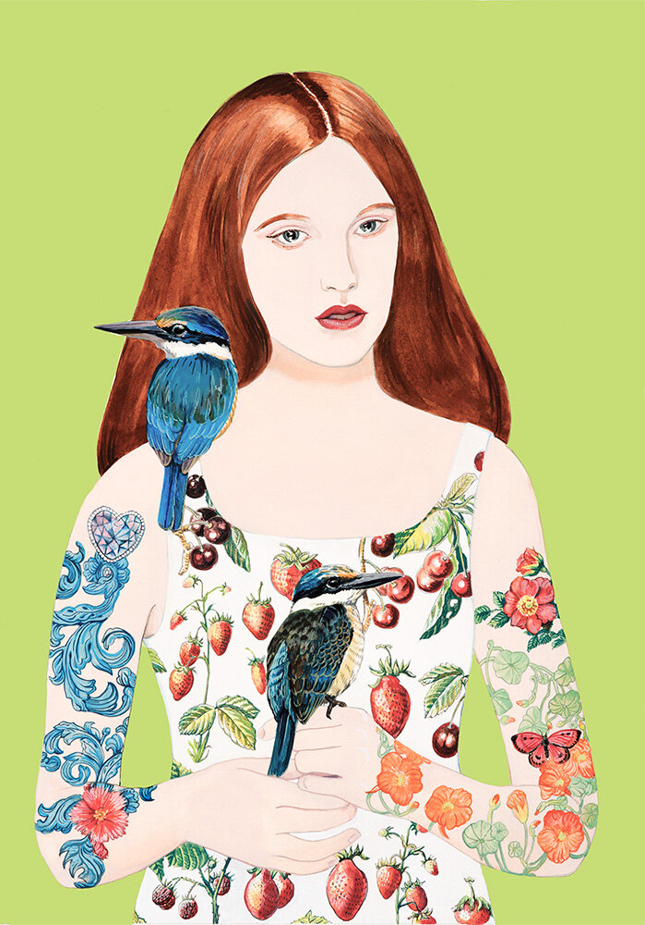
Jane Galloway
Friends ForeverGouache, image size 370 x 530mm, black frame, $1300. Available from studio
https://www.janegallowayartist.com/work#/new-gallery-2

Slide 27
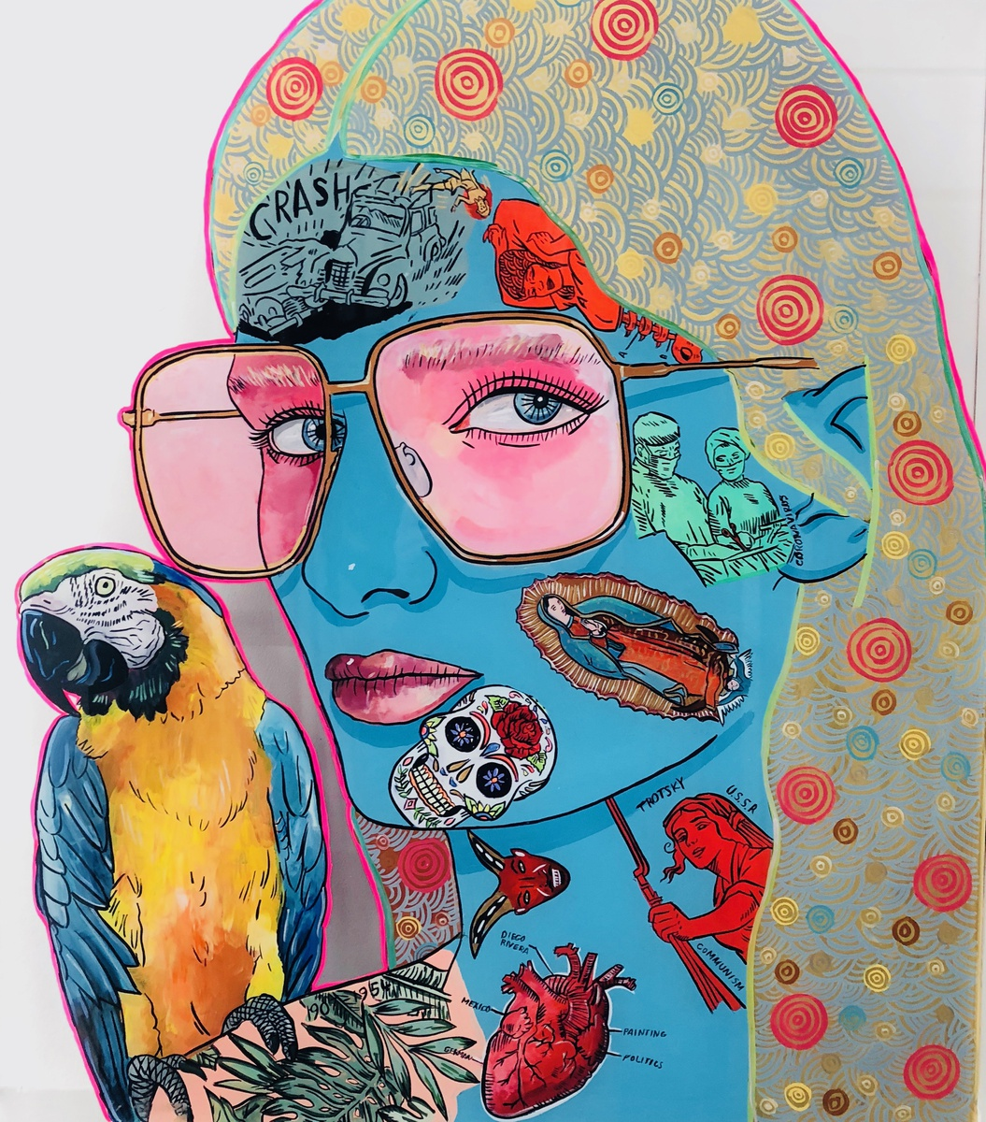
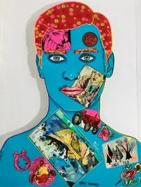
Sam Mitchell
https://melanierogergallery.com/stockroom/sam-mitchell/
https://ocula.com/artists/sam-mitchell/

Slide 28
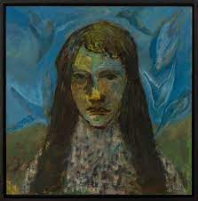
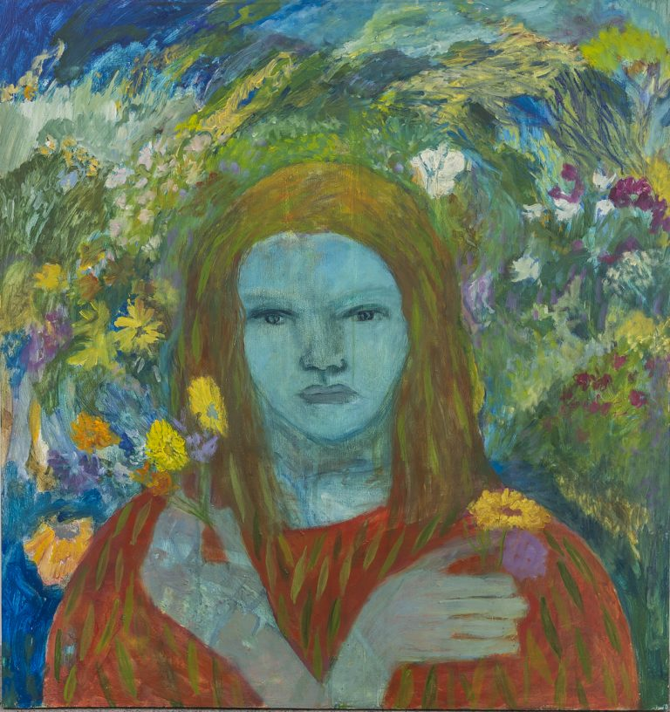
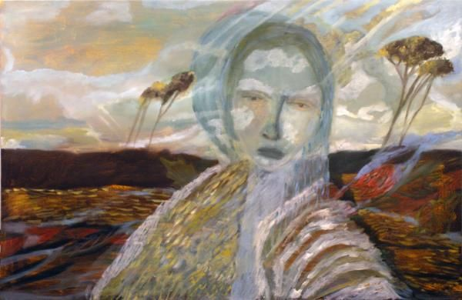
Star Gossage
https://www.timmelville.com/artist/star-gossage/
https://www.aucklandartgallery.com/explore-art-and-ideas/artist/6558/star-gossage?q=%2Fexplore-art-and-ideas%2Fartist%2F6558%2Fstar-gossage

Slide 29
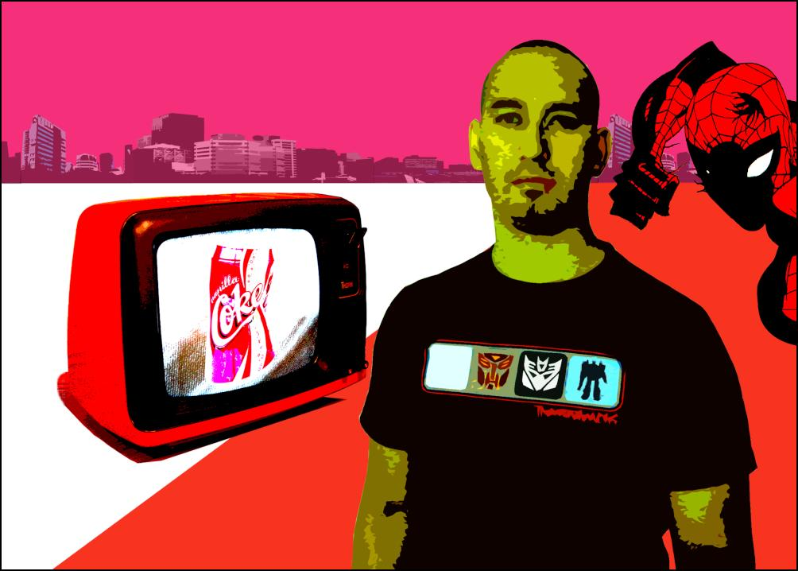
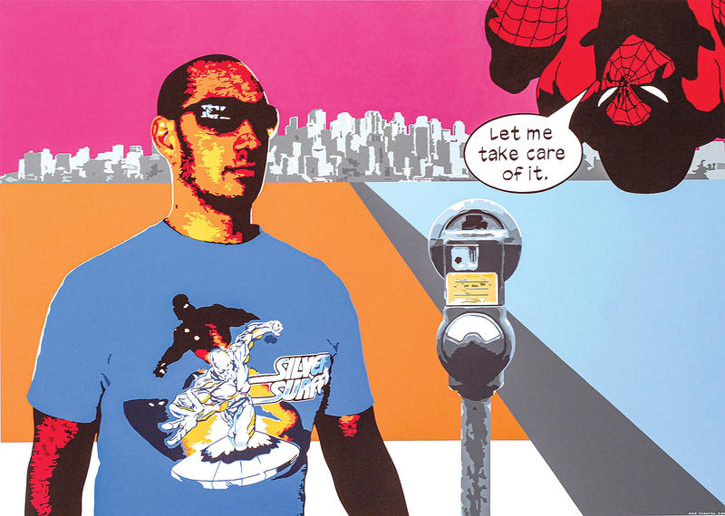
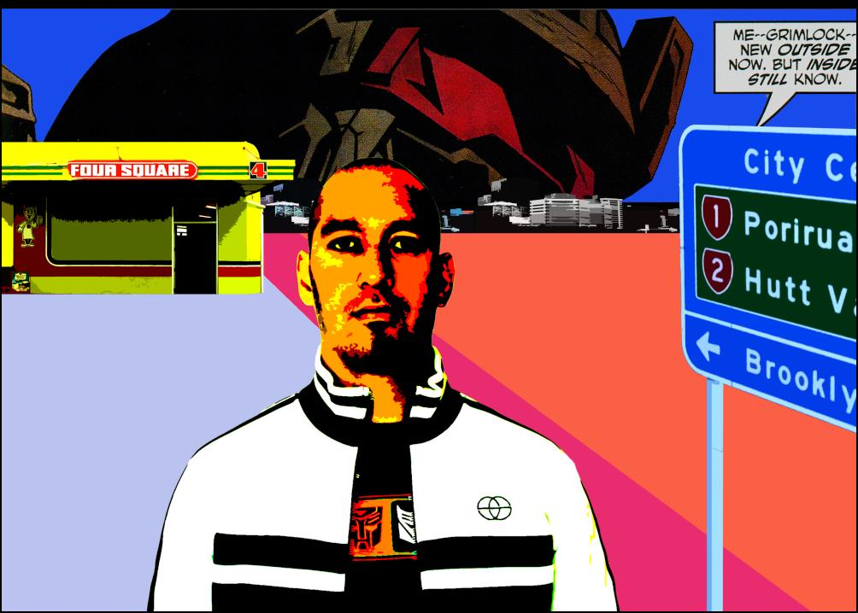
Kelcy Taratoa
https://ocula.com/artists/kelcy-taratoa/
https://www.toiohomai.ac.nz/about/our-people/kelcy-taratoa
https://kelcytaratoa.com/artworks/

