Slide 1
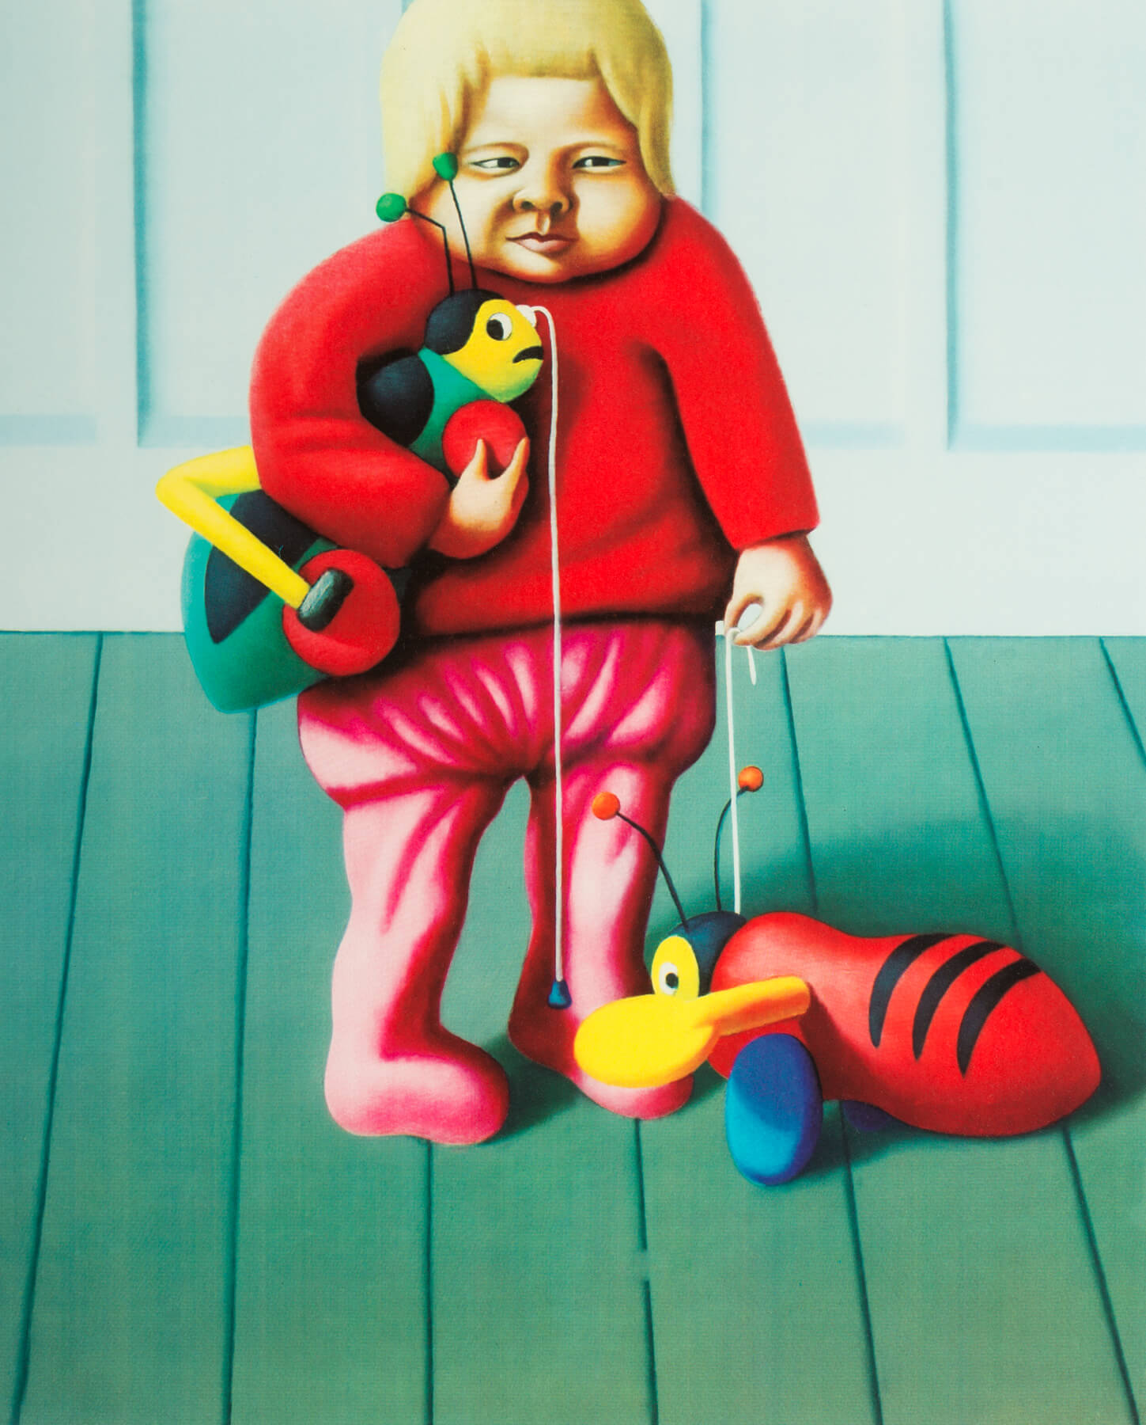
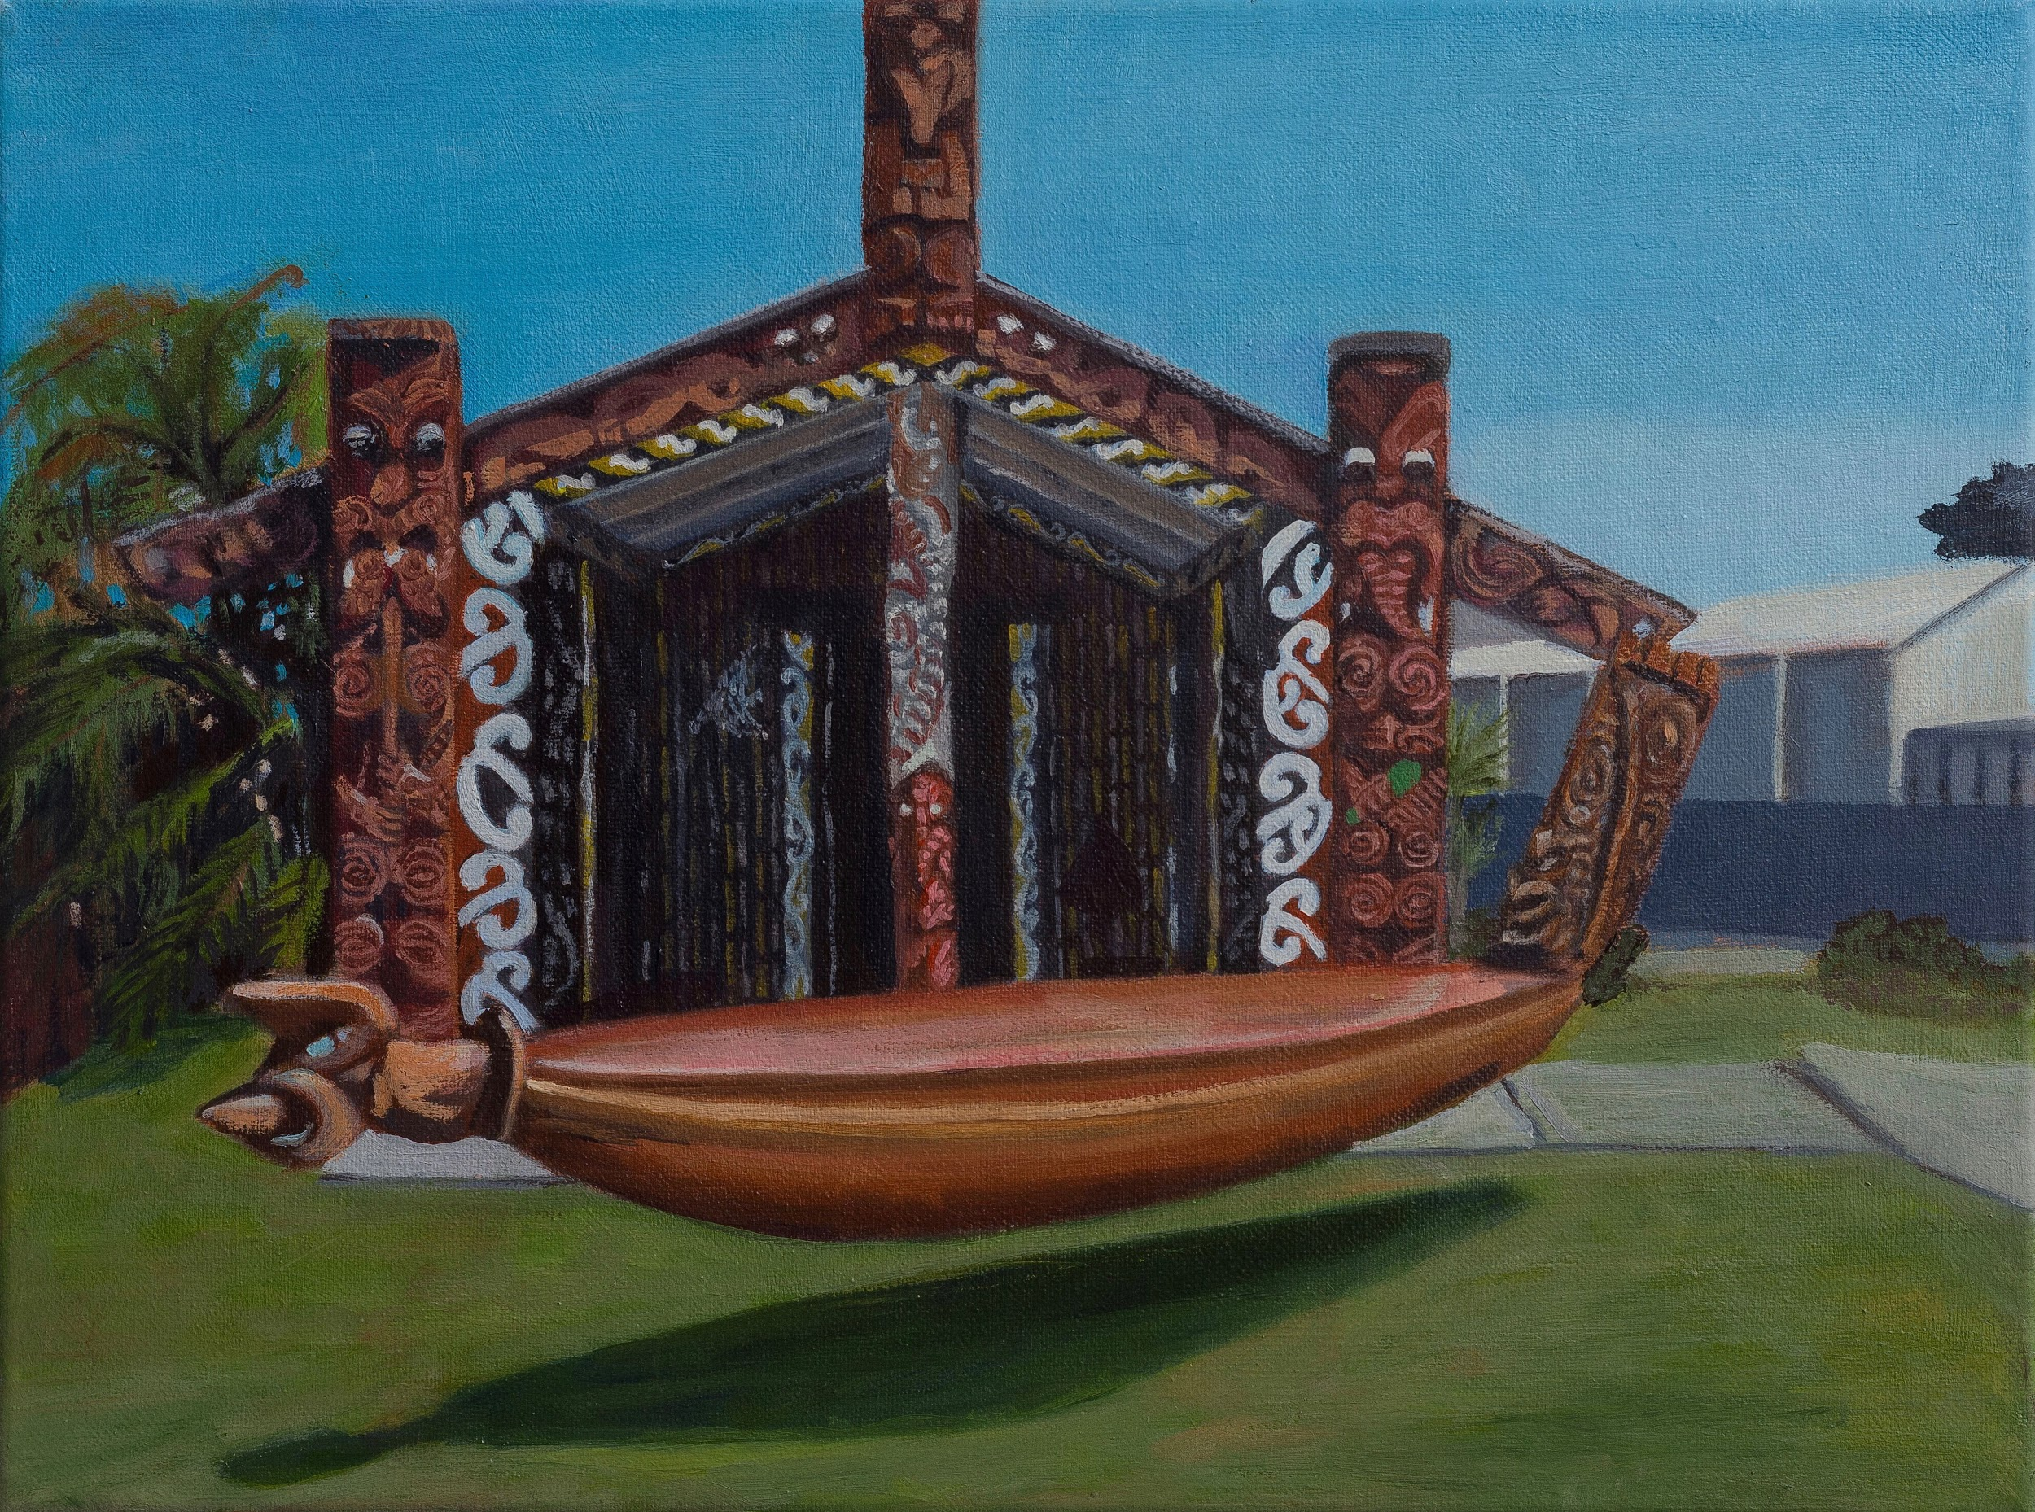
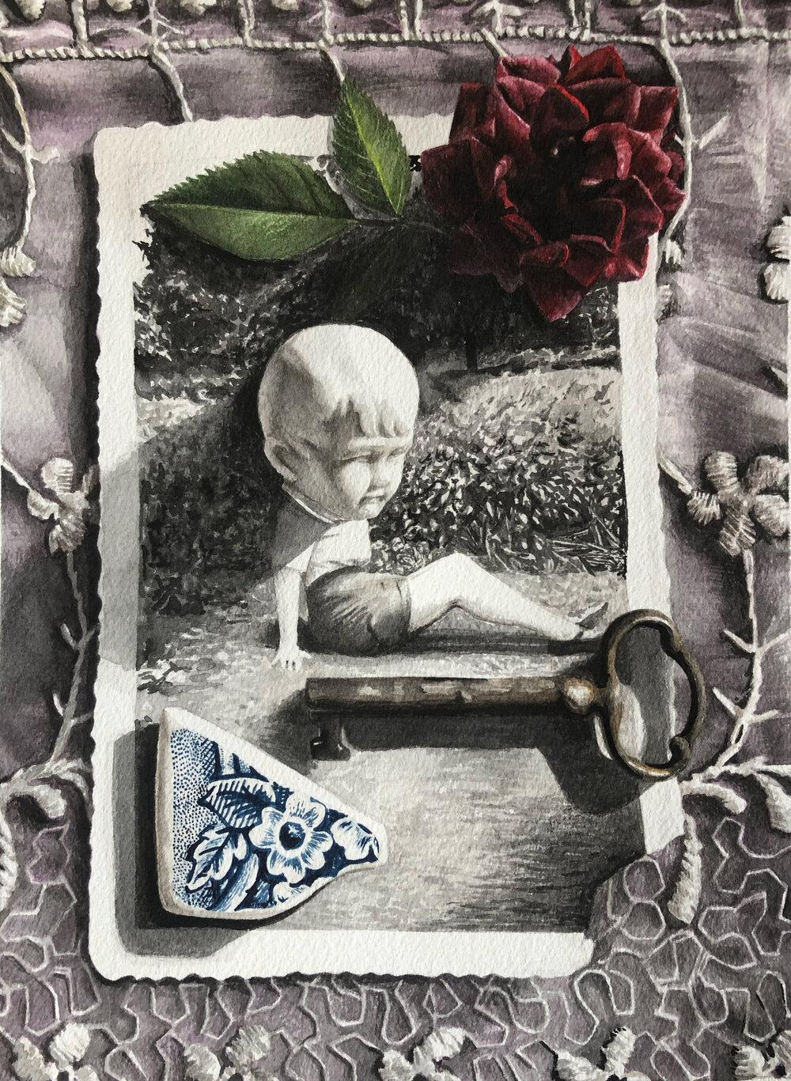
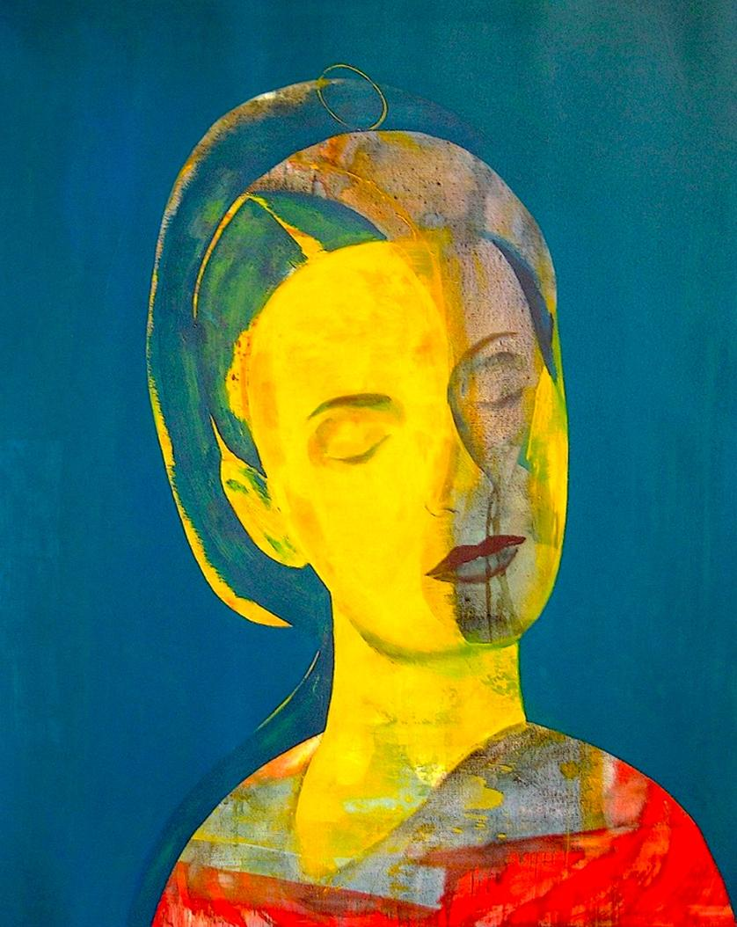
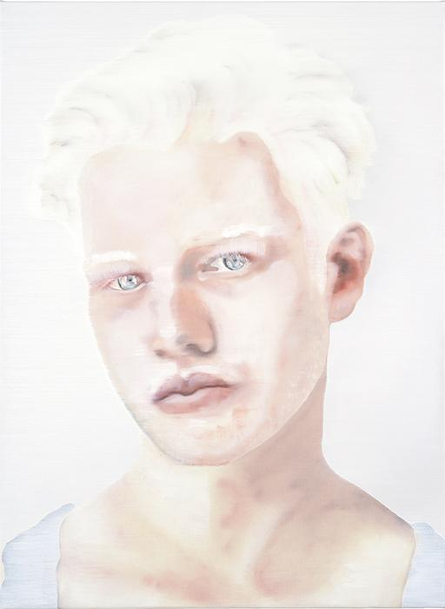
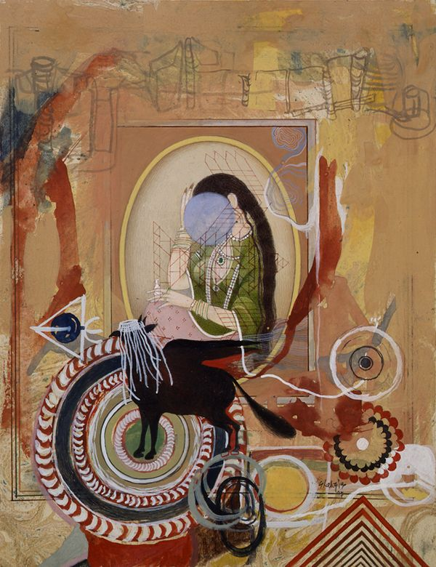
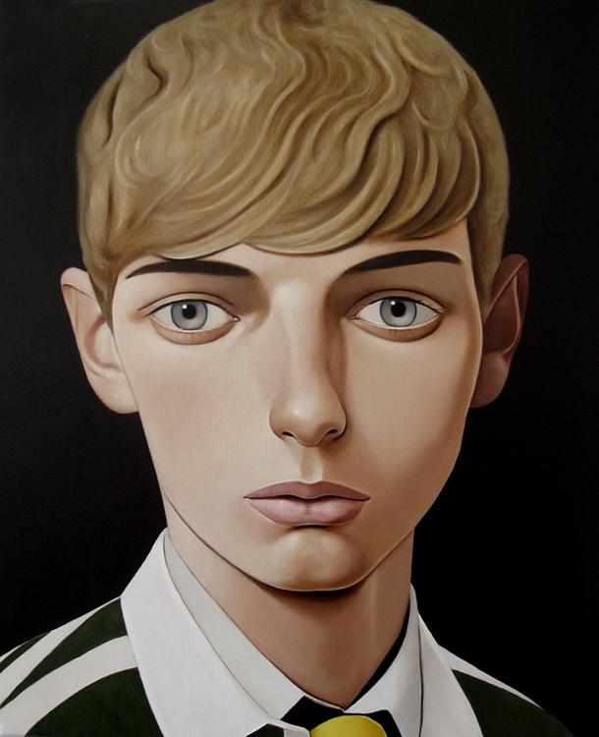
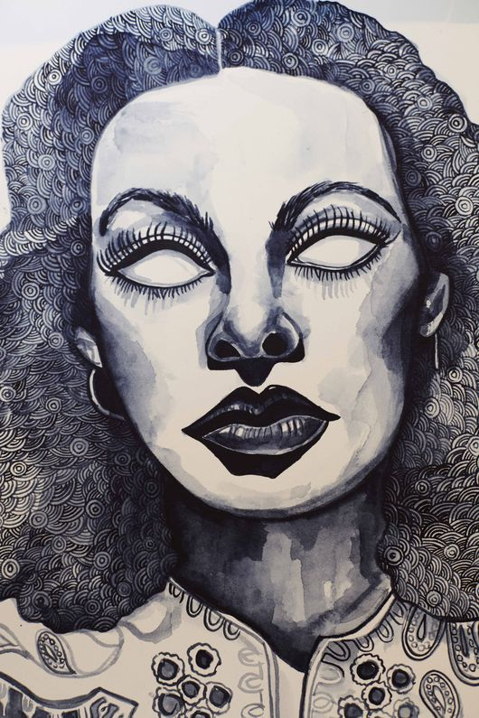
Identity
The fact of being who or what a person or thing is...
SUB-THEMES:
Feelings
Childhood
Religion
Memory
Well-Being
State of mind
Social Politics
Culture
Rituals
Habits
Routines
Organs
Physical States
Desire
Inequality
Gender
Transformation
Science
Anomalies
Personal attributes
Expressions
Body Language

Slide 2
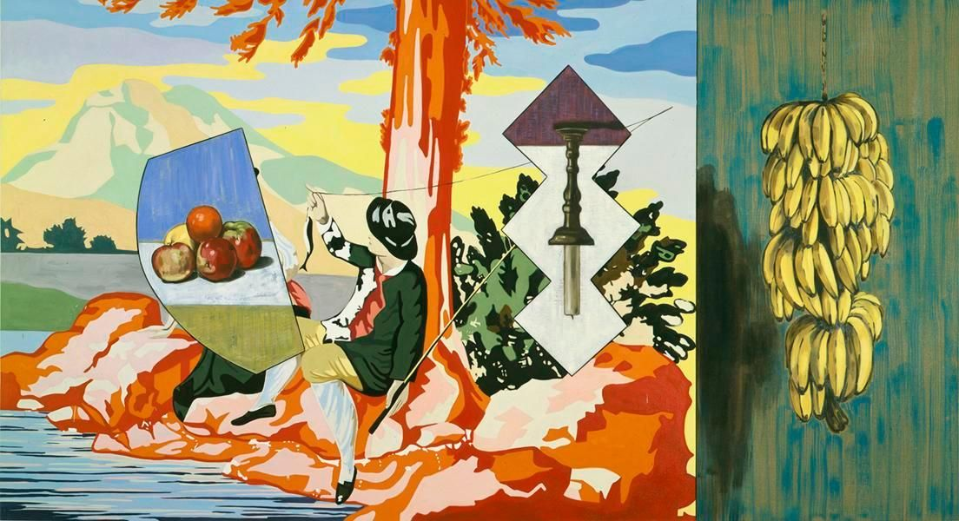
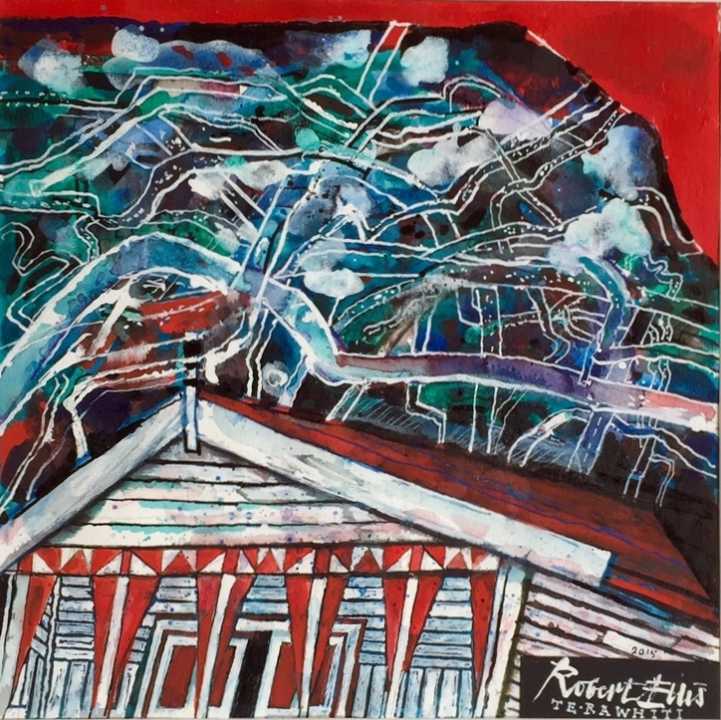
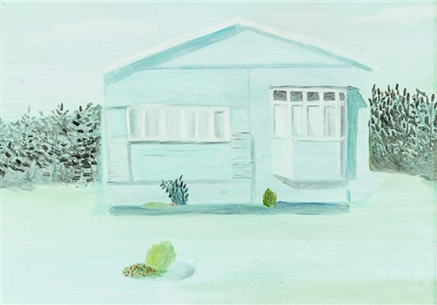
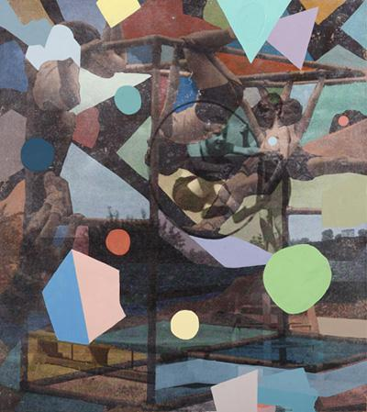
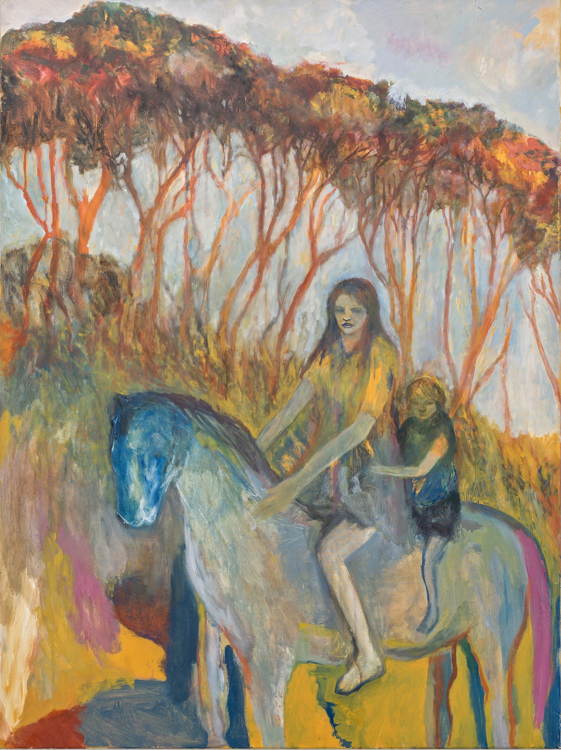
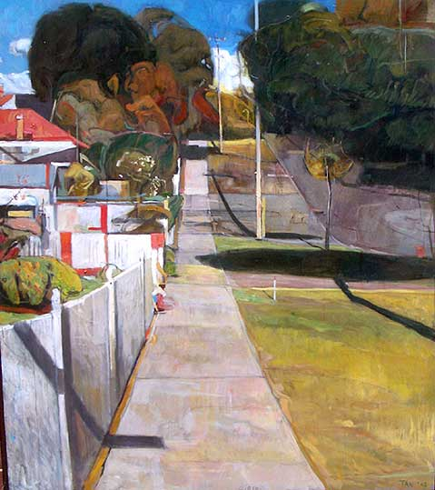
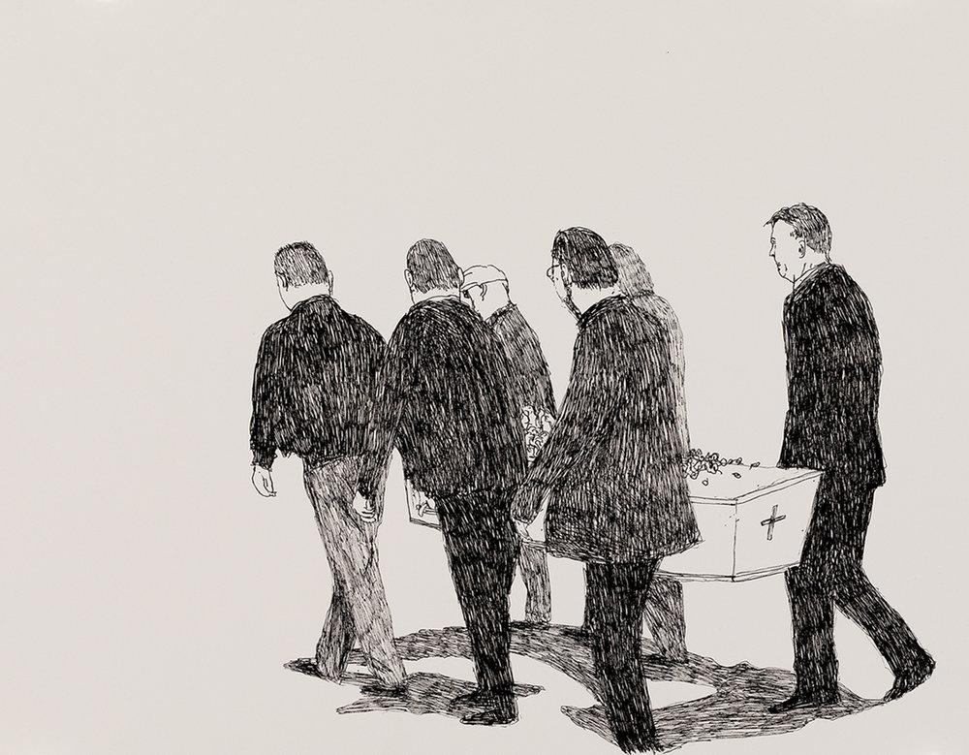
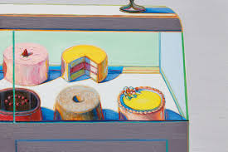
Time & Place
SUB-THEMES:
Memories
Family History
Dreams
History
Industry, Invention, Progress
Inequality
Transformation
Science
Fantasy
Dreams
The Past
The Future

Slide 3
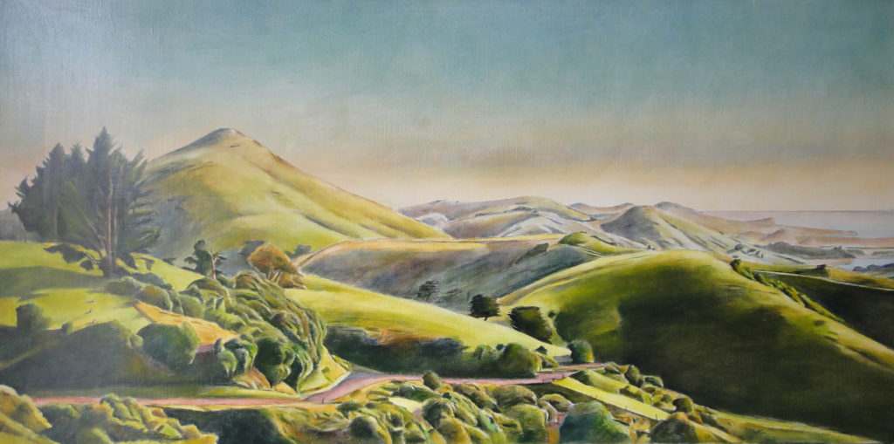
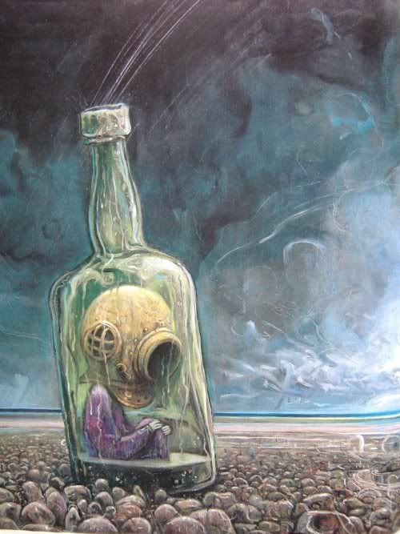
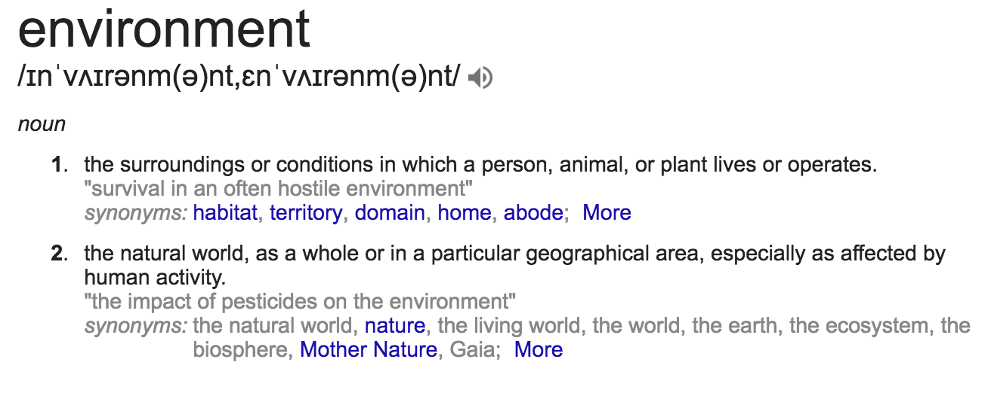
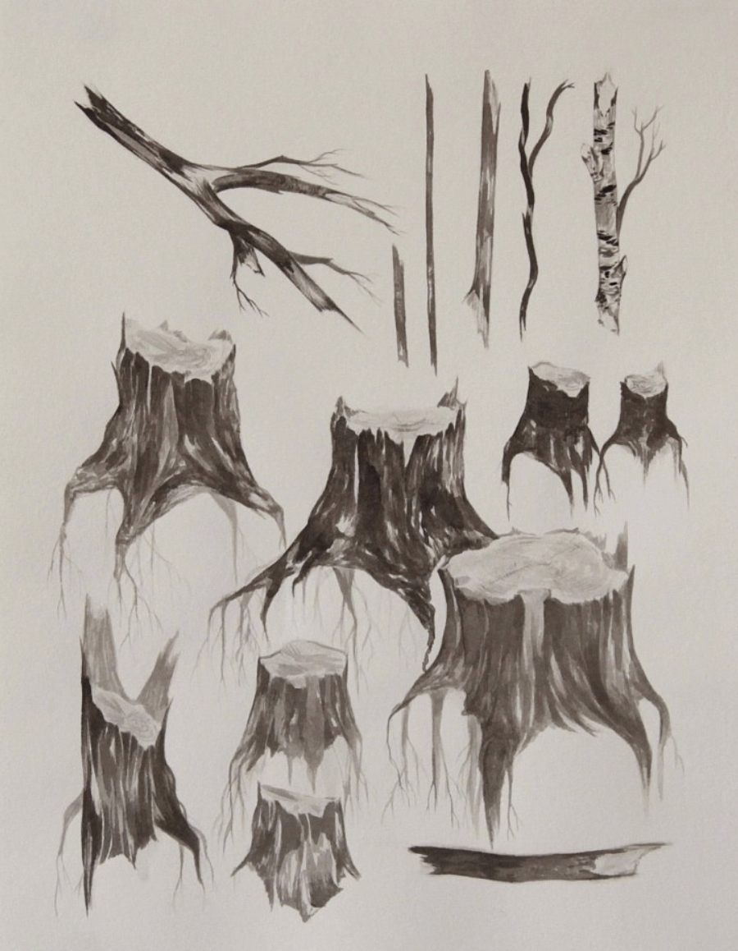
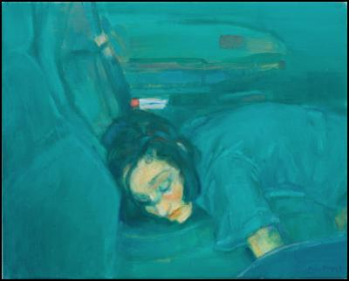
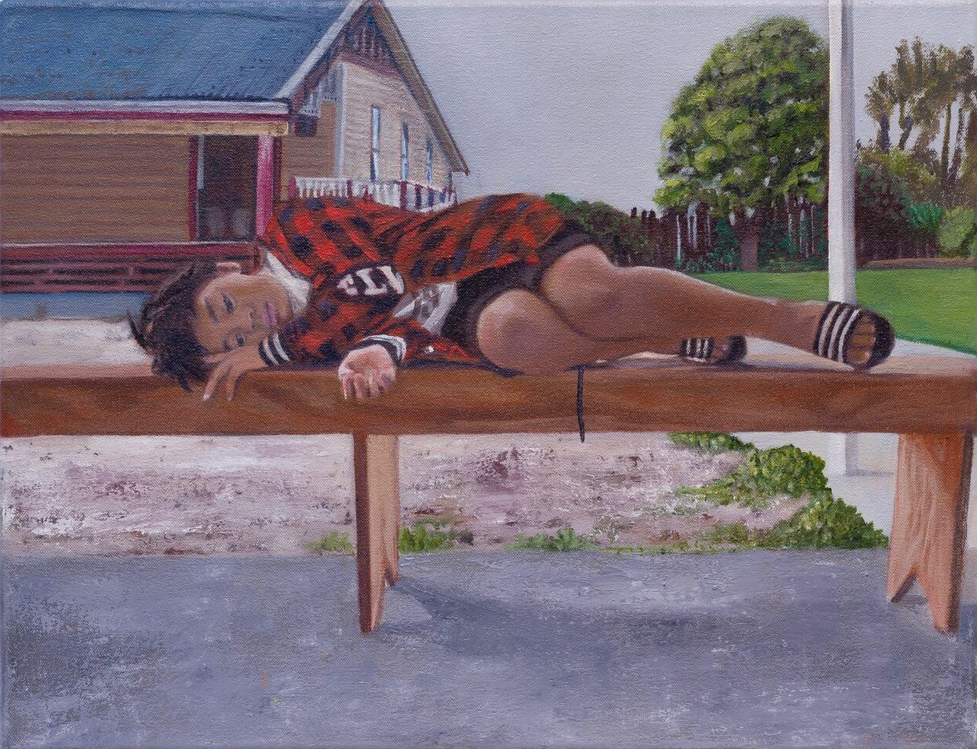
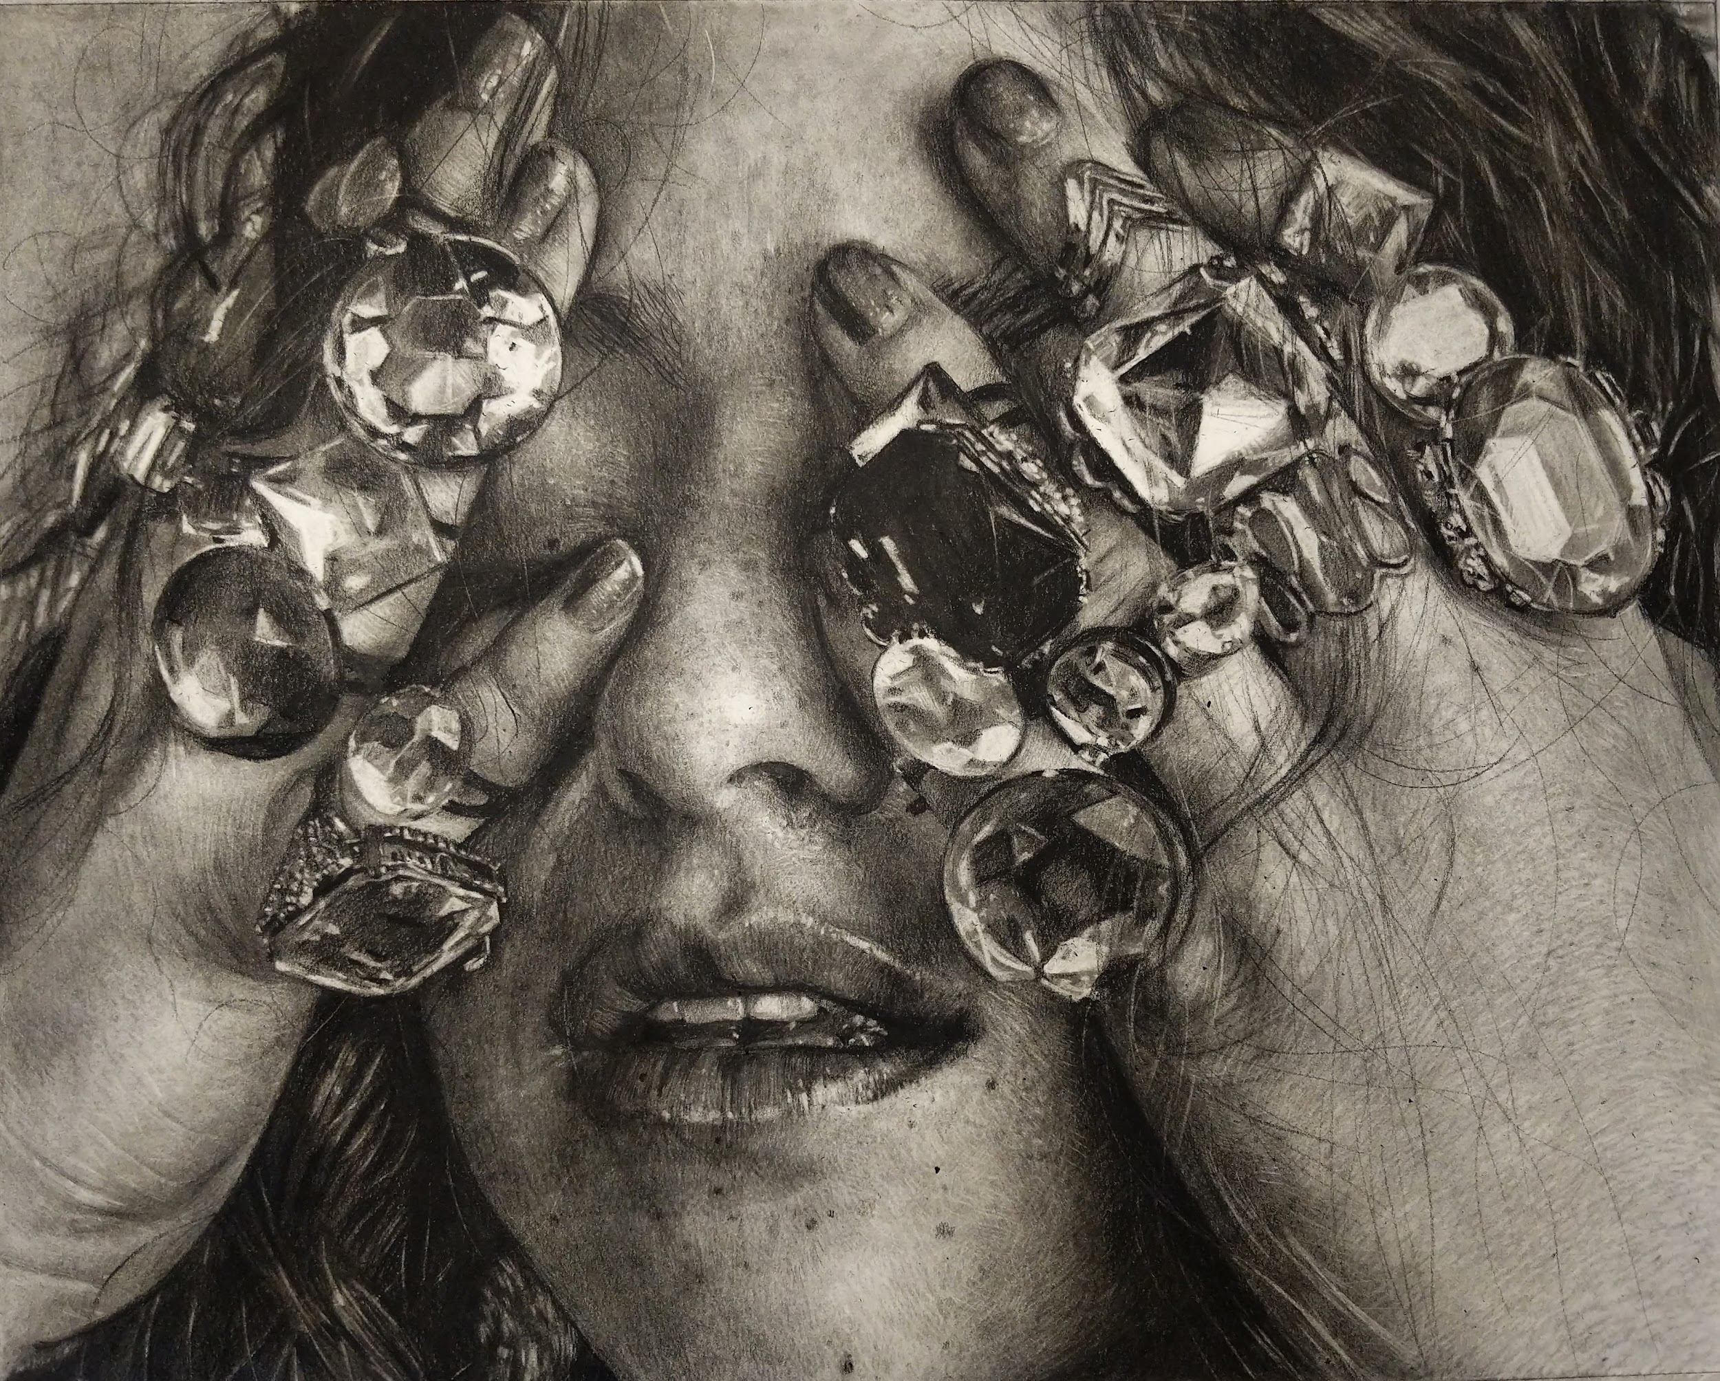
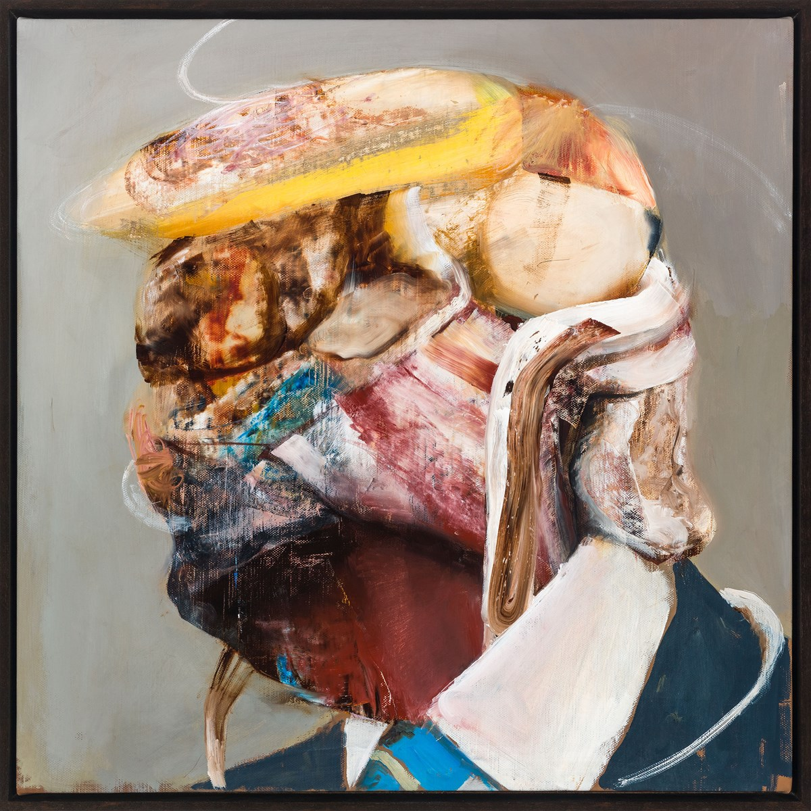
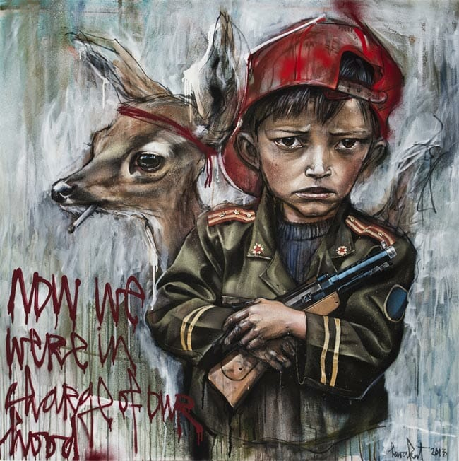
The Environment
SUB-THEMES:
Politics
Social Politics
Pollution
Global Warming
Nature
Whether
Ecology/Science
Domestic Space / Public Space / Private Space
Fiction
Animals
Insects
Plants
Food
Where you live
Culture
Urban
Rural
Physical forces
Change and transformation
Alternative
Light and Movement
Form, Function & Materiality

Slide 4
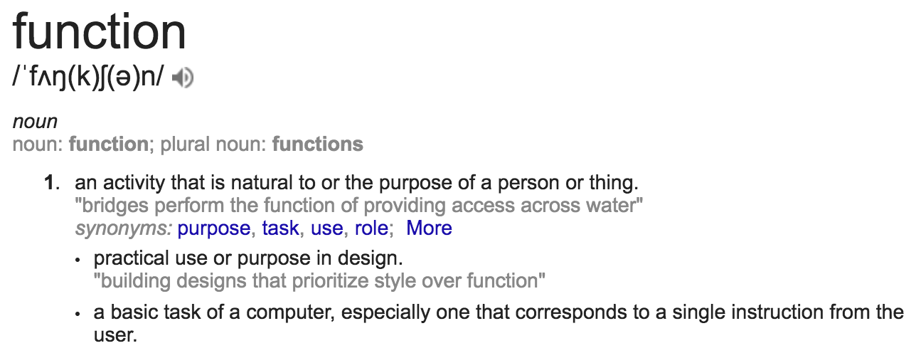
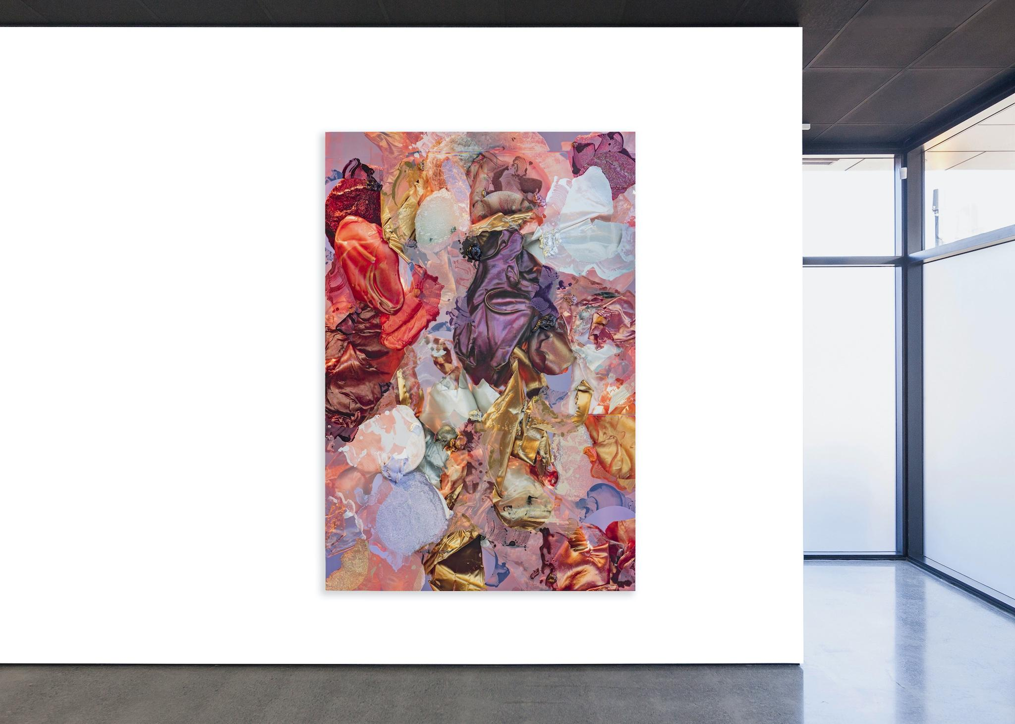
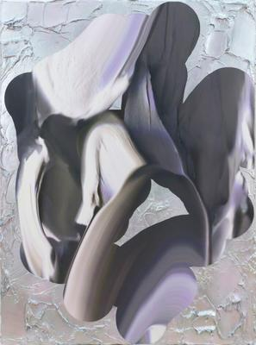
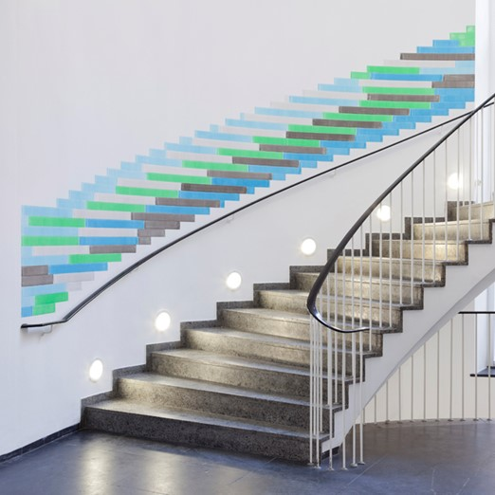
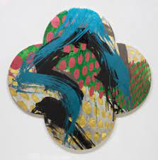
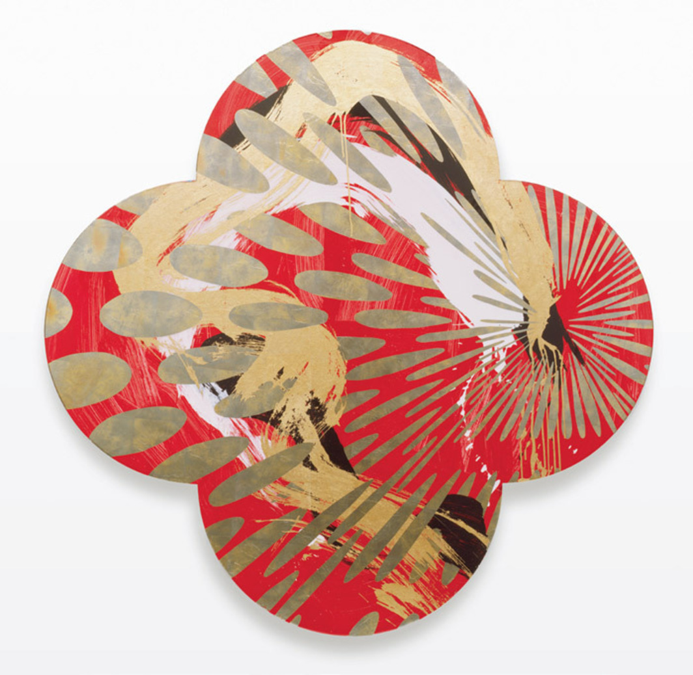

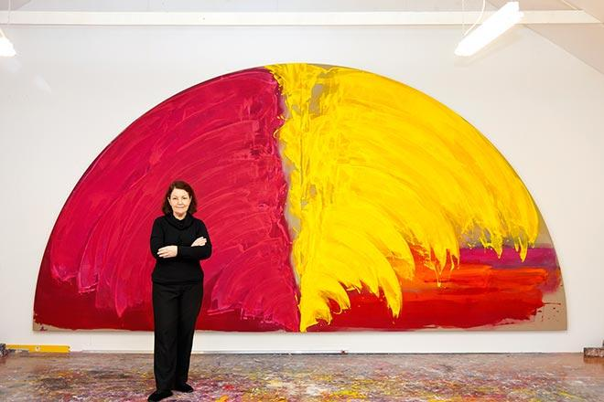
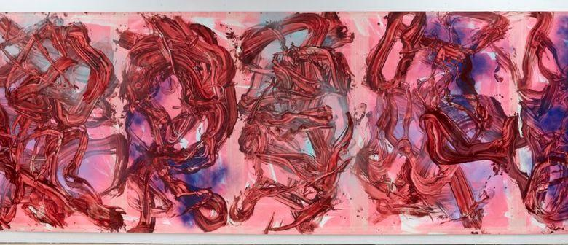
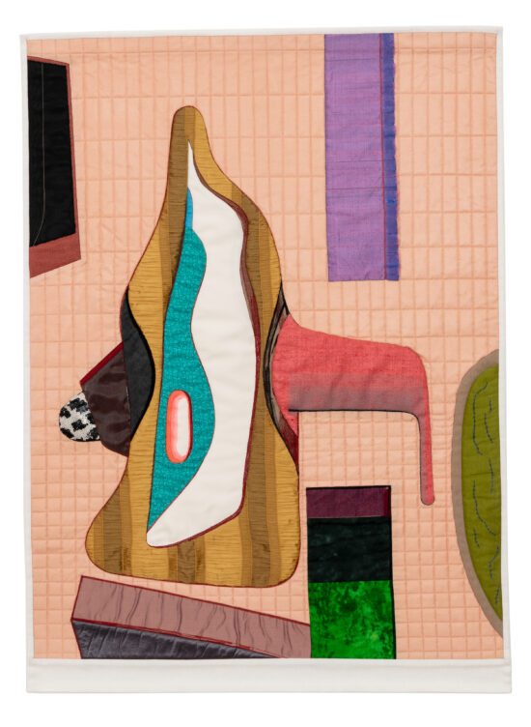
Formal Abstract
SUB-THEMES:
Feelings
Domestic objects
Purpose
Juxtaposition
Space
Interaction
Intervention
Colour
Shape
Line
Texture

Slide 5
Other resources…

Slide 6
Sentences to complete…
I am interested in inquiring about…?
An idea for my art is…?
A series of objects that could relate to my ideas are…
Physical spaces that I could represent in my work are…
I am curious about…
I would describe the style of work I want to apply this year as…
Through my practice I hope to use the following art mediums…
The following words represent how I want my work to feel…
My inquiry will be unique because…
My inquiry connects with me on a personal level because…
How might I generate subject matter to fuel my ideas? (Ie. how might I be able to find/source/make or capture subject matter that is unique to me only??).

Slide 7
